Slide 1
Pointer Analysis
G. Ramalingam
Microsoft Research, India
&
K. V. Raghavan

Slide 2
Goals
Points-to Analysis: Determine the set of possible values of a pointer-variable (at different points in a program)
what locations can a pointer point-to?
Alias Analysis: Determine if two pointer-variables may point to the same location
Compute conservative approximation
A fundamental analysis, required by most other static analyses

Slide 3
A Constant Propagation Example
x = 3;
y = 4;
z = x + 5;
x is always 3 here
can replace x by 3
and replace x+5 by 8
and so on

Slide 4
A Constant Propagation Example With Pointers
x = 3;
*p = 4;
z = x + 5;
Is x always 3 here?

Slide 5
A Constant Propagation Example With Pointers
p = &y;
x = 3;
*p = 4;
z = x + 5;
if (?)
p = &x;
else
p = &y;
x = 3;
*p = 4;
z = x + 5;
p = &x;
x = 3;
*p = 4;
z = x + 5;
x is always 3
pointers affect
most program analyses
x is always 4
x may be 3 or 4
(i.e., x is unknown in our lattice)

Slide 6
A Constant Propagation Example With Pointers
p = &y;
x = 3;
*p = 4;
z = x + 5;
if (?)
p = &x;
else
p = &y;
x = 3;
*p = 4;
z = x + 5;
p = &x;
x = 3;
*p = 4;
z = x + 5;
p always
points-to y
p always
points-to x
p may point-to x or y

Slide 7
Points-to Analysis
Determine the set of targets a pointer variable could point-to (at different points in the program)
“p points-to x”
“p stores the value &x”
“*p denotes the location x”
targets could be variables or locations in the heap (dynamic memory allocation)
p = &x;
p = new Foo(); or p = malloc (…);

Slide 8
Algorithm A (may points-to analysis) A Simple Example
p = &x;
q = &y;
if (?) {
q = p;
}
x = &a;
y = &b;
z = *q;

Slide 9
Algorithm A (may points-to analysis) A Simple Example
p | q | x | y | z
null | null | null | null | null
x | null | null | null | null
x | y | null | null | null
x | y | null | null | null
x | x | null | null | null
x | {x,y} | null | null | null
x | {x,y} | a | null | null
x | {x,y} | a | b | null
x | {x,y} | a | b | {a,b}
p | q | x | y | z
null | null | null | null | null
x | null | null | null | null
x | y | null | null | null
x | y | null | null | null
x | x | null | null | null
x | {x,y} | null | null | null
x | {x,y} | a | null | null
x | {x,y} | a | b | null
p | q | x | y | z
null | null | null | null | null
x | null | null | null | null
x | y | null | null | null
x | y | null | null | null
x | x | null | null | null
x | {x,y} | null | null | null
x | {x,y} | a | null | null
p | q | x | y | z
null | null | null | null | null
x | null | null | null | null
x | y | null | null | null
x | y | null | null | null
x | x | null | null | null
x | {x,y} | null | null | null
p | q | x | y | z
null | null | null | null | null
x | null | null | null | null
x | y | null | null | null
x | y | null | null | null
x | x | null | null | null
p | q | x | y | z
null | null | null | null | null
x | null | null | null | null
x | y | null | null | null
x | y | null | null | null
p | q | x | y | z
null | null | null | null | null
x | null | null | null | null
x | y | null | null | null
p | q | x | y | z
null | null | null | null | null
x | null | null | null | null
p | q | x | y | z
null | null | null | null | null
p | q | x | y | z
p = &x;
q = &y;
if (?) {
q = p;
}
x = &a;
y = &b;
z = *q;

Slide 10
Algorithm A (may points-to analysis) A Simple Example
x = &a;
y = &b;
if (?) {
p = &x;
} else {
p = &y;
}
*x = &c;
*p = &c;
How should we handle
this statement? (Try it!)
Weak update
Weak update
Strong update
x: a
y: b
p: {x,y}
a: null
x: a
y: b
p: {x,y}
a: c
x: {a,c}
y: {b,c}
p: {x,y}
a: c

Slide 11
Questions
When is it correct to use a strong update? A weak update?
Is this points-to analysis precise?
We must formally define what we want to compute before we can answer many such questions

Slide 12
Points-To Analysis: An Informal Definition
Let u denote a program-point
Define IdealMayPT (u) to be a function
\p. {x | p points-to x in some state at u in some run }
Algorithm should compute a function MayPT(u) that over-approximates above function

Slide 13
Static Program Analysis
A static program analysis computes approximate information about the runtime behavior of a given program
The set of valid programs is defined by the programming language syntax
The runtime behavior of a given program is defined by the programming language semantics
The analysis problem defines what information is desired
The analysis algorithm determines what approximation to make

Slide 14
Programming Language: Syntax
A program consists of
a set of variables Var
a directed graph (V,E,entry) with a distinguished entry vertex, with every edge labelled by a primitive statement
A primitive statement is of the form
x = null
x = y
x = *y
x = &y;
*x = y
skip
(where x and y are variables in Var)
Omitted (for now)
Dynamic memory allocation
Pointer arithmetic
Structures and fields
Procedures

Slide 15
Example Program
x = &a;
y = &b;
if (?) {
p = &x;
} else {
p = &y;
}
*x = &c;
*p = &c;
Vars = {x,y,p,a,b,c}
1
x = &a
2
y = &b
3
p = &x
p = &y
4
5
skip
skip
6
*x = &c
7
*p = &c
8

Slide 16
Programming Language: Operational Semantics
Operational semantics == an interpreter (defined mathematically)
State
DataState ::= Var -> (Var U {null})
Initial-state:
\x. null

Slide 17
Example States
Vars = {x,y,p,a,b,c}
Initial data-state
1
x: N, y:N, p:N, a:N, b:N, c:N
x = &a
2
Initial program-state
y = &b
x: N, y:N, p:N, a:N, b:N, c:N
<1, >
3
p = &x
p = &y
Next program-state
4
5
x: a, y:N, p:N, a:N, b:N, c:N
<2, >
skip
skip
6
*x = &c
7
*p = &c
8

Slide 18
Programming Language: Operational Semantics
Meaning of primitive statements
CS[stmt] : DataState -> 2^{DataState}
CS[ x = null ] s = {s[x → null]}
CS[ x = &y ] s = {s[x → y]}
CS[ x = y ] s = {s[x → s(y)]}
CS[ x = *y ] s = …
…
…
CS[*x = y ] s = …
…
= …

Slide 19
Programming Language: Operational Semantics
Meaning of primitive statements
CS[stmt] : DataState -> 2^{DataState}
CS[ x = null ] s = {s[x → null]}
CS[ x = &y ] s = {s[x → y]}
CS[ x = y ] s = {s[x → s(y)]}
CS[ x = *y ] s = {s[x → s(s(y))]},
if s(y) is not null
= {}, otherwise
CS[*x = y ] s = …
…
…

Slide 20
Programming Language: Operational Semantics
Meaning of primitive statements
CS[stmt] : DataState -> 2^{DataState}
CS[ x = null ] s = {s[x → null]}
CS[ x = &y ] s = {s[x → y]}
CS[ x = y ] s = {s[x → s(y)]}
CS[ x = *y ] s = {s[x → s(s(y))]},
if s(y) is not null
= {}, otherwise
CS[*x = y ] s = {s[s(x) → s(y)]},
if s(x) is not null
= {}, otherwise

Slide 21
Programming Language: Operational Semantics
Let u denote a vertex in the CFG
Define RS(u) = { s | s is a DataState that can arise at point u in some execution }
It is the collecting semantics at u

Slide 22
May-Point-To Analysis: Problem statement
Compute MayPT: V -> 2^{Var’} such that for every vertex u
MayPT(u) ⊇ IdealMayPT(u),
where Var’ = Var U {null}.
Given two functions f and g, we say f ⊇ g, iff forall x
f(x) ⊇ g(x)

Slide 23
May-Point-To Algorithms
Compute MayPT: V -> 2^{Vars’} such that
MayPT(u) ⊇ IdealMayPT(u)
An algorithm is said to be correct if the solution MayPT it computes satisfies
∀u∈V. MayPT(u) ⊇ IdealMayPT(u)
An algorithm is said to be precise if the solution MayPT it computes satisfies
∀u∈V. MayPT(u) = IdealMayPT(u)
An algorithm that computes a solution MayPT1 is said to be more precise than one that computes a solution MayPT2 if
∀u∈V. MayPT1(u) ⊆ MayPT2(u)

Slide 24
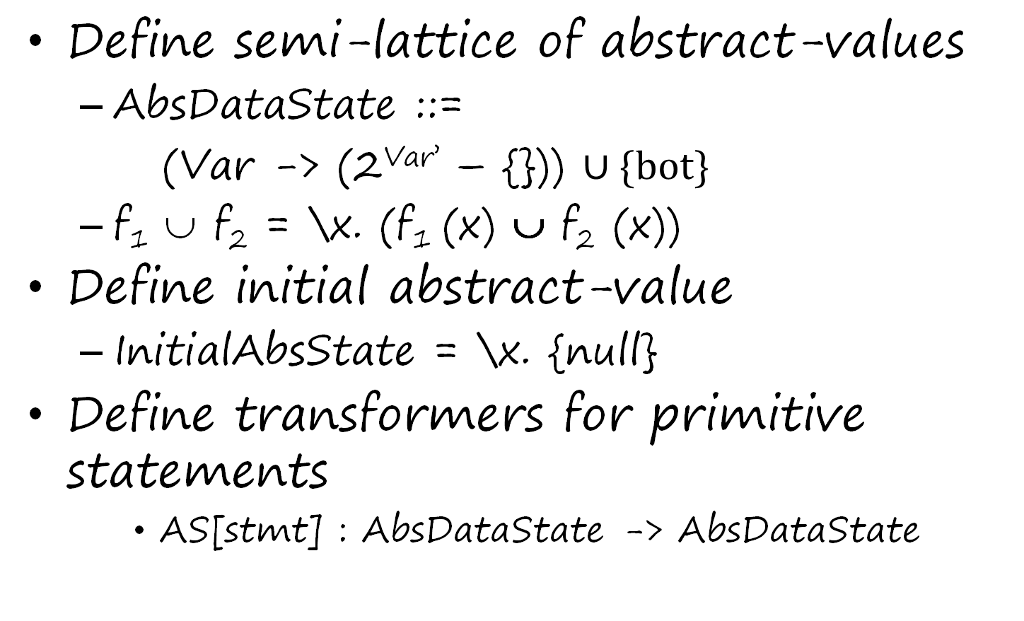
Algorithm A: A Formal Definition The “Data Flow Analysis” Recipe
Define semi-lattice of abstract-values
AbsDataState ::=
(Var -> (2^{Var’} – {})) $∪\{bot\}$
f₁ ∪ f₂ = \x. (f₁ (x) ∪ f₂ (x))
Define initial abstract-value
InitialAbsState = \x. {null}
Define transformers for primitive statements
AS[stmt] : AbsDataState -> AbsDataState

Slide 25
Algorithm A: A Formal Definition The “Data Flow Analysis” Recipe
Apply Kildall’s algorithm, using AbsDataState lattice, and AS transfer functions.

Slide 26
Algorithm A: The Transformers
Abstract transformers for primitive statements
AS[stmt] : AbsDataState -> AbsDataState
AS[ x = y ] s = s[x → s(y)]
AS[ x = null ] s = s[x → {null}]
AS[ x = &y ] s = s[x → {y}]
AS[ x = *y ] s = s[x → s*(s(y)-{null})],
if s(y) is not = {null}
= bot, otherwise
where s*({v₁,…,v_{n}}) = s(v₁) ∪ … ∪ s(v_{n}),

Slide 27

Algorithm A
AS[ *x = y ] s =
After fix-point solution is obtained, AbsDataState(u) is emitted as MayPT(u), for each program point u
bot if s(x) = {null}
s[z → s(y)] if s(x)-{null} = {z}
s[z₁ → s(z₁) $∪$ s(y)] if s(x)-{null} = {z_{1, …,} z_{k}}
[z₂ → s(z₂) $∪$ s(y)] (where k > 1)
…
[z_{k} → s(z_{k}) $∪$ s(y)]

Slide 28
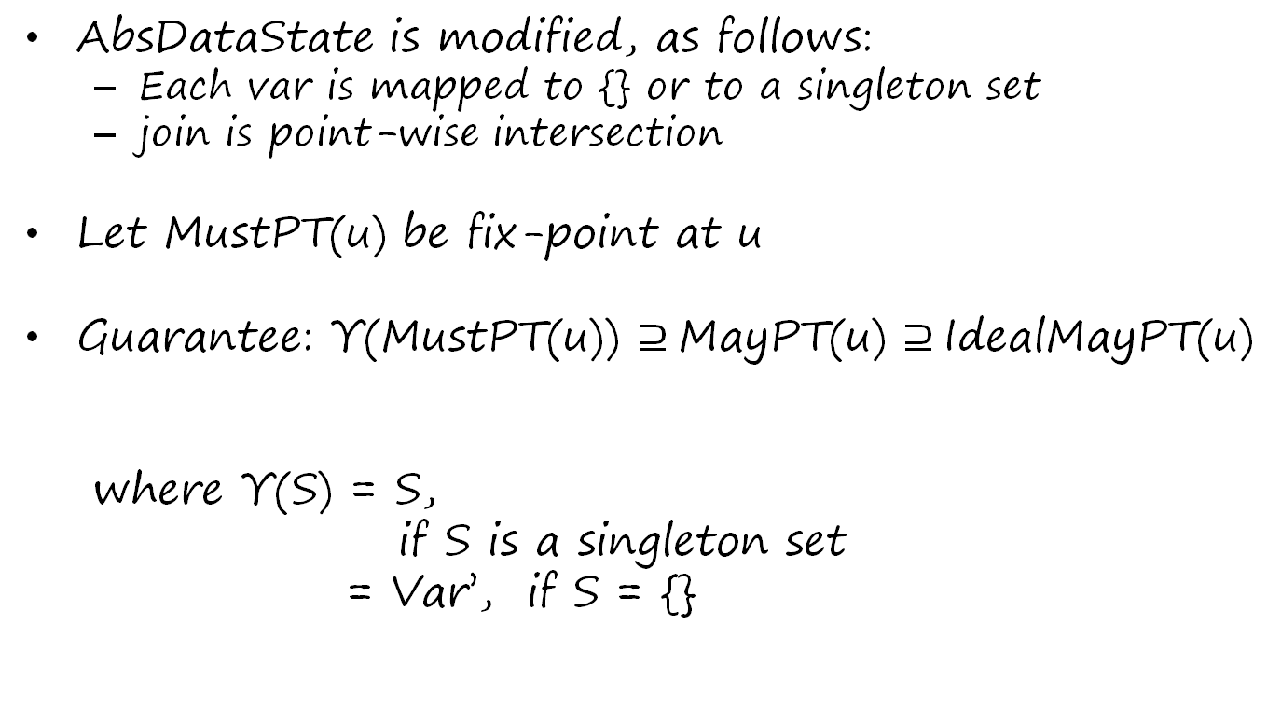
An alternative algorithm: must points-to analysis
AbsDataState is modified, as follows:
Each var is mapped to {} or to a singleton set
join is point-wise intersection
Let MustPT(u) be fix-point at u
Guarantee: Υ(MustPT(u)) $⊇$MayPT(u) $⊇$IdealMayPT(u)
where Υ(S) = S,
if S is a singleton set
= Var’, if S = {}

Slide 29
Must points-to analysis algorithm
AS transfer functions same as in Algorithm A for x = y, x = null, and x = &y
AS[ x = *y ] s
= bot, if s(y) = {null}
= s[x → {}], if s(y) = {}
= s[x → s(z)], if s(y) = {z}

Slide 30
Must points-to analysis algorithm
AS[ *x = y ] s = bot,
if s(x) = {null}
= s[z → s(y)]
if s(x) = {z}
= \v. {},
otherwise
This analysis is less precise than the may-points-to analysis (Algorithm A), but is more efficient

