Slide 1
Pointer Analysis Lecture 2
G. Ramalingam
Microsoft Research, India
&
K. V. Raghavan

Slide 2
Correctness and precision of Algorithm A

Slide 3
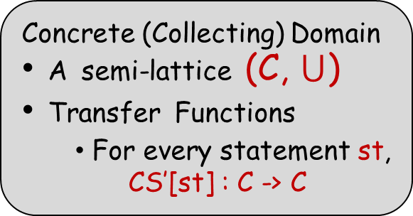
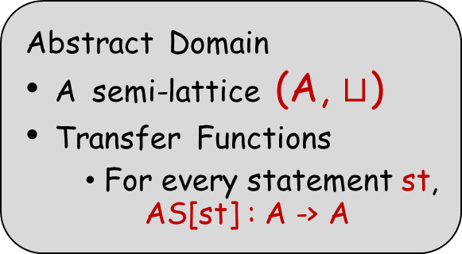
Enter: The French Recipe (Abstract Interpretation)
Concrete (Collecting) Domain
A semi-lattice (C, $⋃$)
Transfer Functions
For every statement st,
CS’[st] : C -> C
α
Abstract Domain
A semi-lattice (A, $⊔$)
Transfer Functions
For every statement st,
AS[st] : A -> A
γ
C ≡ 2^{DataState}
A ≡ AbsDataState

Slide 4
Points-To Analysis (Abstract Interpretation)
α(Y) = \p. {x | exists s in Y. s(p) == x }
γ(a) = {s | for each pointer variable p, s(p) ∊ a(p)}

Slide 5
Approximating Transformers: Correctness Criterion
It can be shown that for any statement st, and for any a1 ∊ A
AS[st](a1) ≥ α (CS[st]( γ(a1))

Slide 6
Correctness illustration
x: &y
y: &x
z: &a
γ
x: {&y}
y: {&x,&z}
z: {&a}
x: &y
y: &z
z: &a
CS’
AS
*y = &b;
*y = &b;
x: &b
y: &x
z: &a
α
x: {&y,&b}
y: {&x,&z}
z: {&a,&b}
x: &y
y: &z
z: &b

Slide 7
Is The Precise Solution Computable?
Claim: The set RS(u) of reachable concrete states (for our language) is precisely computable.
(However, Algorithm A is imprecise)
Note: This is true for any collecting semantics with a finite state space.
This is true only for restricted language!

Slide 8
Precise Points-To Analysis: Computational Complexity
What’s the complexity of the least-fixed point computation using the collecting semantics?
The worst-case complexity of computing reachable states is exponential in the number of variables.
Can we do better?
Theorem: Computing precise may-point-to is PSPACE-hard even if we have only two-level pointers.

Slide 9
Precise Points-To Analysis: Caveats
Theorem: Precise may-alias analysis is undecidable in the presence of dynamic memory allocation.
Add “x = new/malloc ()” to language
State-space becomes infinite
Digression: Integer variables + conditional-branching involving integer variables also makes any precise analysis undecidable.

Slide 10
Dynamic Memory Allocation
s: x = new () / malloc ()
Assume, for now, that allocated object stores one pointer
s: x = malloc ( sizeof(void*) )
Introduce a pseudo-variable V_{s} to represent objects allocated at statement s, and use previous algorithm
treat s as if it were “x = &V_{s}”
also track possible values of V_{s}
allocation-site based approach

Slide 11
α in the presence of pseudo variables
α(Y) = \p. {x | exist s in Y such that s(y) = z
such that:
((p is a normal variable and y is p) OR
(p is V_{r} and y is an address
allocated at site r ))
AND
((x is a normal variable and x is z) OR
(x is V_{t} and z is an address
allocated at site t )) }
(For simplicity, assume that the set of all concrete addresses is partitioned upfront among all allocation sites in the program)

Slide 12
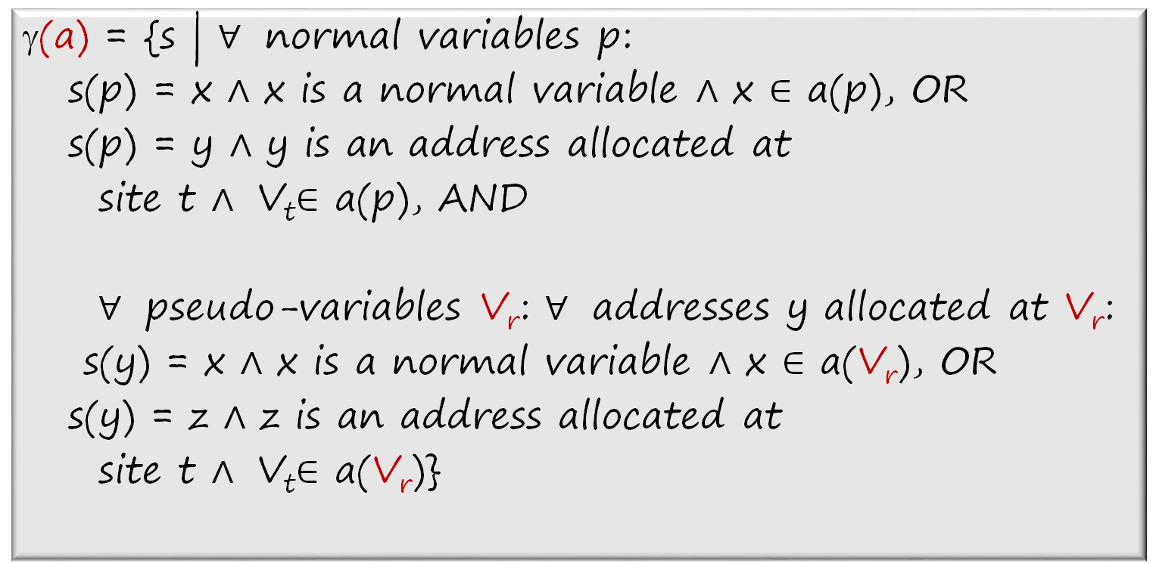
γ in the presence of pseudo variables
γ(a) = {s | $∀$ normal variables p:
s(p) = x $∧$ x is a normal variable $∧$ x $∈$ a(p), OR
s(p) = y $∧$ y is an address allocated at
site t $∧$ V_{t}$∈$ a(p), AND
$∀$ pseudo-variables V_{r}: $∀$ addresses y allocated at V_{r}:
s(y) = x $∧$ x is a normal variable $∧$ x $∈$ a(V_{r}), OR
s(y) = z $∧$ z is an address allocated at
site t $∧$ V_{t}$∈$ a(V_{r})}

Slide 13
Dynamic Memory Allocation: A run of the algorithm
x = new; // 1
y = x;
*y = &b;
*y = &a;
1
x -> {V₁}, y -> {null}, V₁ -> {null}
2
x -> {V₁}, y -> {V₁}, V₁ -> {null}
3
x -> {V₁}, y -> {V₁}, V₁ -> {null,b}
4
x -> {V₁}, y -> {V₁}, V₁ -> {null,a,b}
5

Slide 14
Illustrating need for weak updates on pseudo variables
Key aspect: V_{s} represents a set of memory locations, not a single location
if x->{V_{s}}, to be safe “*x = ..” still needs weak update!
Consider this program:
do {x = new /* V₁ */; *x = &a} while(..);
*x = &b;
Exercise: Say in the last stmt above we set V₁ -> {b}. Show that \gamma(V₁ -> {b}) does not include all concrete states that can arise at the end of the program.

Slide 15
Handling structures/objects
Concrete state maps each variable to a variable or address of an object or null, and for each object o and each field f of o, maps (o,f) to the address of some other object (or to null)
Let PseudoVar be the set of pseudo-variables, let Var’ = Var ⋃ PseudoVar ⋃ {null}
Each AbsDataState maps each variable to a subset of Var’, and also maps (V_{s} ,f) to a subset of Var’ for each V_{s} and for each field f in struct allocated at site s

Slide 16
Handling structures/objects
Transfer function of an update statement “v->f = w” should perform weak update if v points to a singleton and that element is a pseudo-variable.
That is, if v -> {V_{s}} in incoming abstract state, then add points-to set of w to points-to set of (V_{s,} f)

Slide 17
Inter-procedural analysis
Context-sensitivity can be achieved using standard techniques
Indirect (virtual) function call sites need to be resolved to candidate functions using points-to analysis. And points-to analysis needs calls to be resolved! Therefore, the two have to happen hand in hand.

Slide 18
Andersen’s Analysis
A flow-insensitive analysis
computes a single points-to solution, which over-approximates points-to solutions at all program points
ignores control-flow – treats program as a set of statements
equivalent to collapsing the given program to have a single program point, and then applying Algorithm A on it.

Slide 19
Andersen’s Analysis
If program has statements s1, s2, …, sn, then create
collapsed CFG as follows:
Initial fact
Single program point that Kildall updates
?
s1
s2
……
sn
After algorithm terminates, final solution at the
single program point over-approximates result
computed by flow-sensitive analysis at any point

Slide 20
Example: Andersen’s Analysis
x = &a;
*x = &w;
y = x;
x = &b;
*x = &t;
z = x;
Before first iteration: all variables null
After first iteration of Kildall:
x -> {a,b,null}, y -> {a, null}, z -> {a,b,null}, all other variables null
After 2nd iteration:
x -> {a,b,null}, y,z -> {a,b,null}, a,b -> {w,t,null},
all other variables null
After 3rd iteration:
X -> {a,b,null}, y,z -> {a,b,null}, a,b -> {w,t,null}, all other variables null

Slide 21
Notes about Andersen’s Analysis
Strong updates never happen in Andersen’s analysis!
If x->{y} and y->{w} before we process statement “*x = &z”, then even if transfer function returns y->{z}, due to subsequent join, y will point to {w,z} after this step.
Flow-insensitive style can be adopted for any analysis, not just for pointer analysis

Slide 22
Why Flow-Insensitive Analysis?
Reduced space requirements
a single points-to solution
Reduced time complexity
no copying of points-to facts
individual updates more efficient
a cubic-time algorithm
Scales to millions of lines of code
most popular points-to analysis

Slide 23
Andersen’s Analysis: An alternative formulation
Introduce a constraint variable PT_{x} for each program variable x
Create a constraint from each assignment statement, as follows:
x = y: PT_{y} ⊆ PT_{x}
*x = y: PT_{y} ⊆ PT_{v,} forall variables v in PT_{x}
x = &y: {y} ⊆ PT_{x}
x = *y: PT_{v} ⊆ PT_{x,} forall variables v in PT_{y}
Find least solution to set of all constraints that were generated above. (A solution is a mapping from constraint variables to sets of program variables.) Emit this least solution as the final solution.
Note: Solution s1 dominates Solution s2 if for each program variable v, s2(PT_{v}) ⊆ s1(PT_{v})
Note: This approach computes exact same result as previous approach that collapses program and then uses Algorithm A.

Slide 24
May-Point-To Analyses
Ideal-May-Point-To
more efficient / less precise
Algorithm A
more efficient / less precise
Andersen’s

Slide 25
Andersen’s Analysis: Further Optimizations and Extensions
Fahndrich et al., Partial online cycle elimination in inclusion constraint graphs, PLDI 1998.
Rountev and Chandra, Offline variable substitution for scaling points-to analysis, 2000.
Heintze and Tardieu, Ultra-fast aliasing analysis using CLA: a million lines of C code in a second, PLDI 2001.
M. Hind, Pointer analysis: Haven’t we solved this problem yet?, PASTE 2001.
Hardekopf and Lin, The ant and the grasshopper: fast and accurate pointer analysis for millions of lines of code, PLDI 2007.
Hardekopf and Lin, Exploiting pointer and location equivalence to optimize pointer analysis, SAS 2007.
Hardekopf and Lin, Semi-sparse flow-sensitive pointer analysis, POPL 2009.

Slide 26
Context-Sensitivity Etc.
Liang & Harrold, Efficient computation of parameterized pointer information for interprocedural analyses. SAS 2001.
Lattner et al., Making context-sensitive points-to analysis with heap cloning practical for the real world, PLDI 2007.
Zhu & Calman, Symbolic pointer analysis revisited. PLDI 2004.
Whaley & Lam, Cloning-based context-sensitive pointer alias analysis using BDD, PLDI 2004.
Rountev et al. Points-to analysis for Java using annotated constraints. OOPSLA 2001.
Milanova et al. Parameterized object sensitivity for points-to and side-effect analyses for Java. ISSTA 2002.

Slide 27
Applications
Compiler optimizations
Verification & Bug Finding
use in preliminary phases
use in verification itself

