Slide 1
01
Connecting Intelligence Across Organizations
PRESENTED BY
Gokul S Gautham Krishna R Nair Sreenidhi V T Maheswaran
GUIDE
Assistant Professor Nisha Soman
DEPARTMENT OF ARTIFICIAL INTELLIGENCE AND MACHINE LEARNING
A DISTRIBUTED INTELLIGENCE INFRASTRUCTURE FOR SECURE AI COLLABORATION
Marian Engineering College Kazhakuttam Thiruvananthapuram

Slide 2
02
ABSTRACT
SECURE COLLABORATION
Enables trusted communication between independent AI systems across organizations.
PRIVACY PRESERVATION
Protects data ownership and ensures privacy through decentralized and secure interaction.
As Artificial Intelligence systems become more powerful and widespread, they remain largely isolated within organizational boundaries. This isolation limits collaboration, causes repeated development of similar solutions, and prevents systems from sharing capabilities or knowledge.
This project proposes a distributed intelligence infrastructure that enables independent AI systems to communicate, collaborate, and coordinate securely while preserving each organization’s autonomy and data privacy.
CONNECTED AI ECOSYSTEM
Builds a collaborative ecosystem where AI systems can share capabilities, coordinate tasks, and create value together.

Slide 3
03
CONNECTING INTELLIGENCE ACROSS ORGANIZATIONS
Problem Statement
Today, AI systems are developed and deployed within isolated organizational boundaries. This fragmentation creates significant barriers to collaboration, leads to duplicated efforts, and slows down collective progress.
01
02
03
04
INDEPENDENT AI SYSTEMS
LIMITED COLLABORATION
REPEATED DEVELOPMENT
NO COMMON INFRASTRUCTURE
AI systems operate in silos with no communication or interoperability.
Lack of a common platform prevents sharing of capabilities and knowledge.
Organizations build similar solutions independently, wasting time and resources.
Absence of a trusted infrastructure hinders secure and scalable collaboration.
“ The next challenge in AI is enabling independent systems to collaborate securely. ”

Slide 4
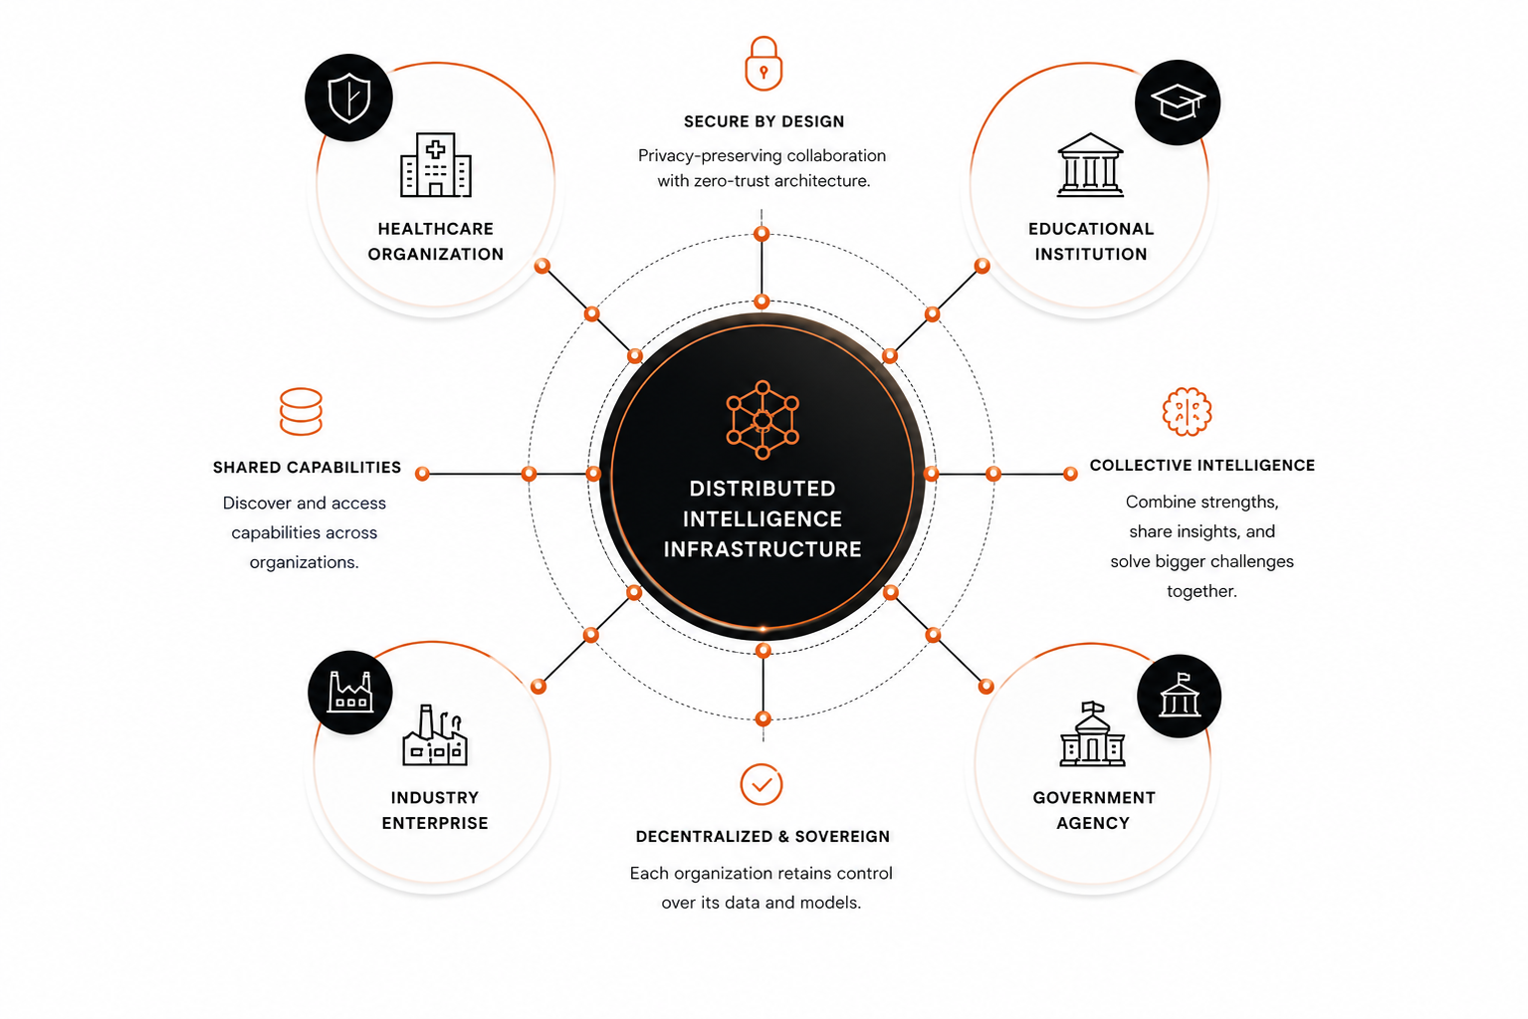
04
CONNECTING INTELLIGENCE ACROSS ORGANIZATIONS
OUR SOLUTION
THE SOLUTION
DISTRIBUTED INTELLIGENCE INFRASTRUCTURE
A secure, decentralized foundation that enables independent AI systems to connect, collaborate, and create collective impact.
Connecting independent intelligence.
Empowering collective progress.
“ Turning isolated AI systems into a network of collaborative intelligence. ”

Slide 5
05
CONNECTING INTELLIGENCE ACROSS ORGANIZATIONS
KEY BENEFITS
KEY BENEFITS
UNLOCKING THE POWER OF COLLABORATIVE INTELLIGENCE
STRONGER COLLABORATION
ACCELERATED INNOVATION
ENHANCED SECURITY & TRUST
Break down silos and enable seamless collaboration across organizations.
Combine diverse data, models, and expertise to drive faster breakthroughs.
Built with privacy-preserving technology and zero-trust architecture.
$
Our solution transforms isolated AI systems into a connected ecosystem that drives measurable impact across organizations and industries.
GREATER EFFICIENCY
IMPACT AT SCALE
FUTURE-READY ECOSYSTEM
Reduce duplication, optimize resources, and lower operational costs.
Solve bigger challenges together and create lasting value for society.
A scalable foundation designed to evolve with emerging technologies.
Together, we can turn independent intelligence into collective impact.
CONNECTED INTELLIGENCE. STRONGER TOGETHER.

Slide 6
LITERATURE SURVEY
CONNECTING INTELLIGENCE ACROSS ORGANIZATIONS
EXISTING RESEARCH PAPER
KEY CONTRIBUTION
LIMITATION
RESEARCH GAP ADDRESSED
Communication-Efficient Learning of Deep Networks from Decentralized Data
McMahan et al.
AISTATS, 2017
Introduced Federated Learning, enabling collaborative model training without sharing raw data.
Limited to model parameter aggregation; does not support AI-to-AI collaboration or capability sharing.
Need an infrastructure enabling secure collaboration beyond distributed training.
A Survey on Large Language Models
Zhao et al.
arXiv, 2023
Comprehensive overview of LLM architectures, capabilities, and applications.
Focuses on individual intelligent models rather than collaboration between independent AI systems.
Enable multiple AI systems to work together across organizational boundaries.
AutoGen: Enabling Next-Gen LLM Applications via Multi-Agent Conversation
Wu et al. (Microsoft)
arXiv, 2023
Demonstrated collaborative problem-solving using multiple AI agents through conversational interaction.
Collaboration is confined to a single application and lacks decentralized organizational support.
Support collaboration between autonomous AI systems owned by different organizations.
Model Context Protocol
Anthropic
2024
Introduced a standardized protocol for connecting AI models with external tools and resources.
Designed for model-tool interaction rather than communication among independent AI infrastructures.
Extend standardized communication to AI-to-AI collaboration across organizations.
The Rise and Potential of Large Language Model Based Agents: A Survey
Xi et al.
arXiv, 2023
Reviews autonomous AI agents, memory, planning, reasoning, and tool usage.
Primarily focuses on standalone intelligent agents without large-scale inter-organizational collaboration.
Build an infrastructure where autonomous agents can securely discover and collaborate with each other.
Multi-Agent Reinforcement Learning: A Selective Overview of Theories and Algorithms
Zhang, Yang & Başar
Handbook of Reinforcement Learning and Control, 2021
Presents theories for coordination, cooperation, and communication among multiple agents.
Mainly theoretical and simulation-oriented, with limited support for enterprise-scale distributed AI collaboration.
Apply multi-agent coordination principles to real-world organizational AI ecosystems.
Although existing research has significantly advanced Federated Learning, Large Language Models, Multi-Agent Systems, AI Agents, and AI communication protocols, these studies solve only specific aspects of distributed intelligence. Current approaches focus on collaborative model training, agent coordination within controlled environments, or interaction between AI models and external tools. No existing work provides a unified infrastructure that enables independent AI systems across different organizations to securely discover each other, communicate, share capabilities, coordinate tasks, and collaboratively solve problems while preserving privacy, autonomy, and organizational ownership. This gap motivates the development of a distributed intelligence infrastructure for connecting AI ecosystems.
RESEARCH GAP

Slide 7
06
CONNECTING INTELLIGENCE ACROSS ORGANIZATIONS
IMPLEMENTATION PLAN
IMPLEMENTATION PLAN
01
02
03
04
05
RESEARCH & ANALYSIS
SYSTEM DESIGN
PROTOTYPE DEVELOPMENT
TESTING & VALIDATION
FUTURE EXPANSION
• Identify AI collaboration challenges
• Study existing approaches
• Define project objectives and requirements
• Design distributed architecture
• Define secure communication
• Plan collaboration mechanisms
• Develop a proof of concept
• Connect multiple AI nodes
• Demonstrate secure collaboration
• Test communication reliability
• Evaluate system performance
• Verify privacy and security
• Support more organizations
• Improve scalability and efficiency
• Enable broader intelligent collaboration

Slide 8
07
CONNECTING INTELLIGENCE ACROSS ORGANIZATIONS
EXPECTED IMPACT
EXPECTED IMPACT
Building a connected intelligence infrastructure will create value for organizations, industries, and society at large.
SECURE COLLABORATION
FASTER INNOVATION
STRONGER ECOSYSTEM
GREATER EFFICIENCY
PRIVACY & TRUST
SOCIETAL IMPACT
Organizations can share and collaborate without compromising privacy or control.
Combine diverse intelligence and expertise to solve complex problems faster.
Build a trusted network of organizations working together toward common goals.
Reduce duplication of efforts and optimize the use of resources.
Ensure transparency, accountability, and data protection at every step.
Drive inclusive growth and create positive impact across industries and communities.
A connected intelligence ecosystem leads to a smarter, more collaborative, and sustainable future for everyone.

Slide 9

08
CONNECTING INTELLIGENCE ACROSS ORGANIZATIONS
CONCLUSION
CONCLUSION
Our vision is to build a future where intelligence is not isolated within organizations, but connected across them to create a more collaborative, secure, and intelligent world.
“ The future of Artificial Intelligence is not defined by the intelligence of individual systems, but by their ability to collaborate. ”
CONNECT. COLLABORATE. CREATE IMPACT.

Slide 10
THANK YOU!

