Slide 1
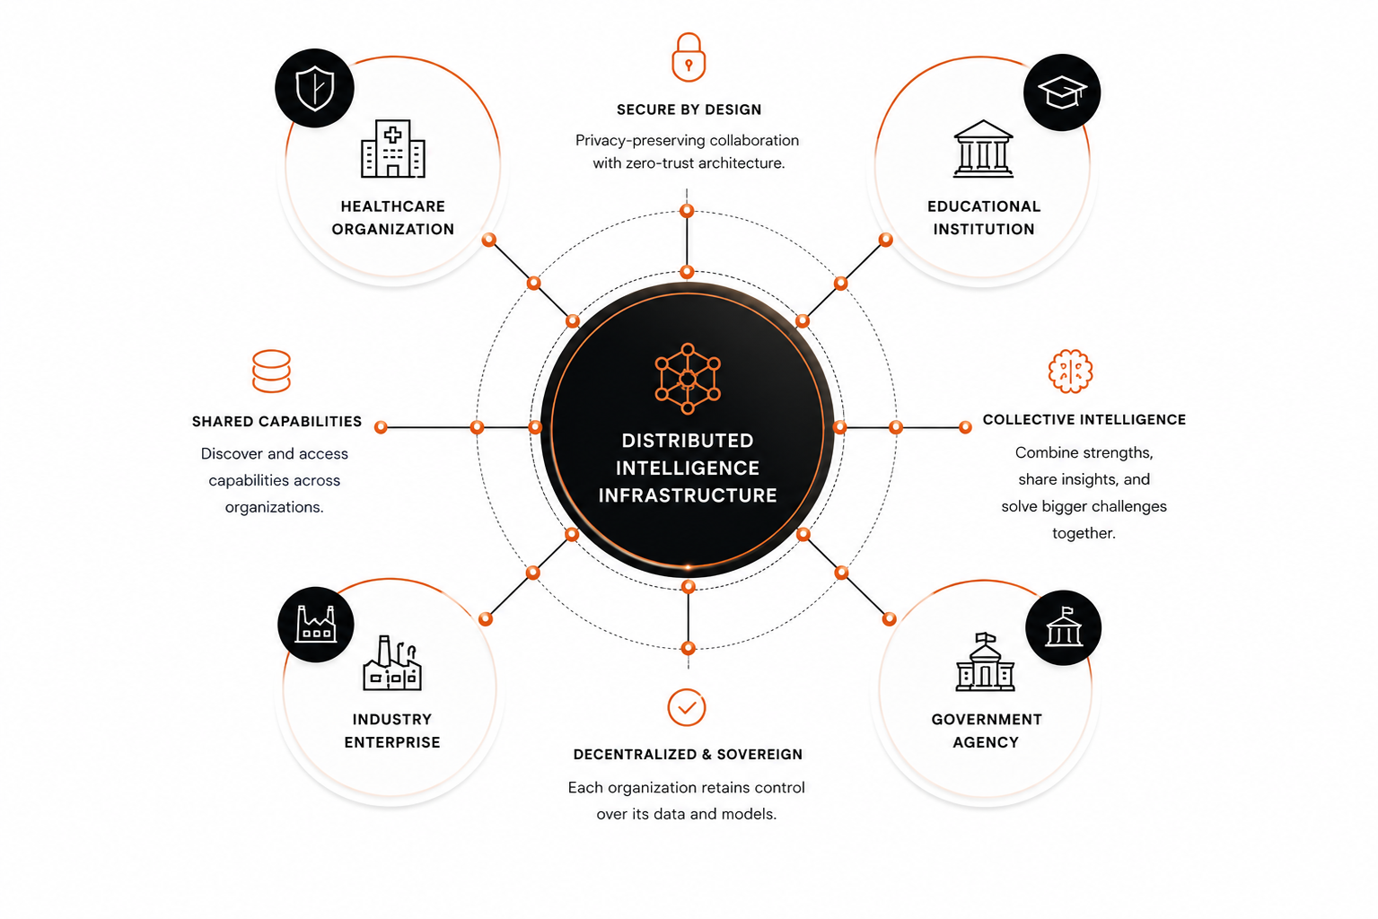
04
CONNECTING INTELLIGENCE ACROSS ORGANIZATIONS
OUR SOLUTION
THE SOLUTION
DISTRIBUTED INTELLIGENCE INFRASTRUCTURE
A secure, decentralized foundation that enables independent AI systems to connect, collaborate, and create collective impact.
Connecting independent intelligence.
Empowering collective progress.
“ Turning isolated AI systems into a network of collaborative intelligence. ”

