Slide 1
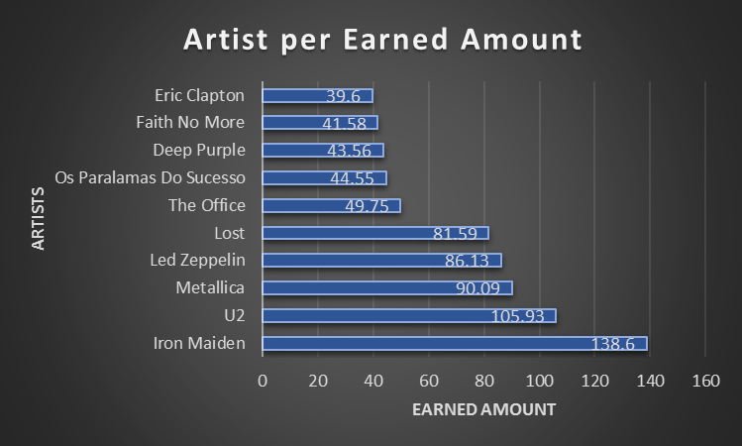
Who has earned the most?
<visualization>
The chart illustrates that Iron Maiden has earned the most money among artists.

Slide 2
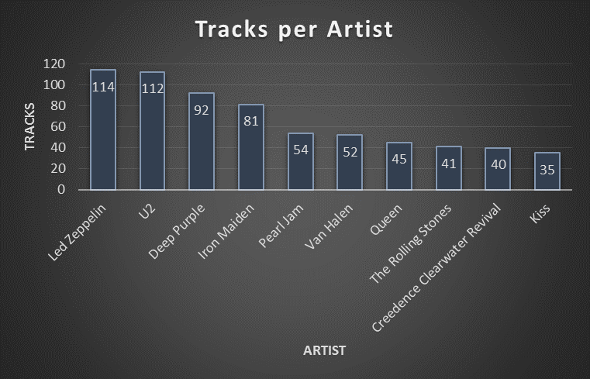
Who is writing the rock music?
<visualization>
Led Zeppelin holds the record for the most songs created by an artist, with 114 tracks. U2 holds the second with 112 tracks.

Slide 3
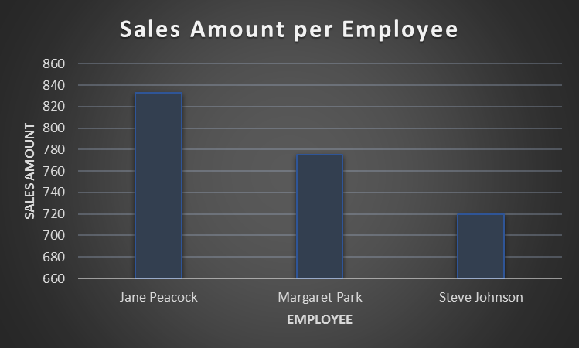
Which employee made the most sales?
<visualization>
With $833 (nearly 36% of the total sales), Jane Peacock holds the first place. Margaret Park came second with $775, while Steve Johnson placed the third with $720 total sales.

Slide 4
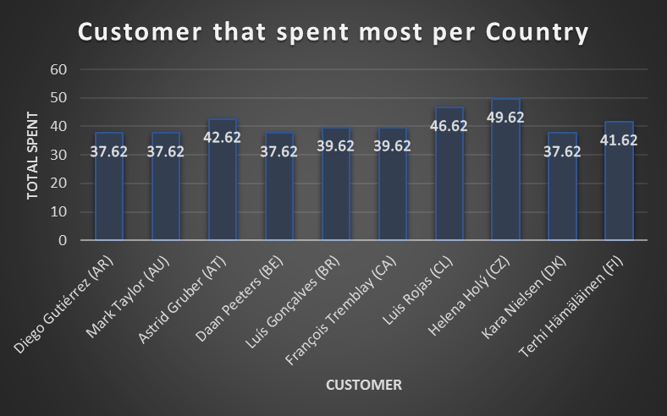
Who spent the most on music for each country?
<visualization>
For each country, the chart shows the customer who has spent the most money on music.
The customer's name is followed by the country's code name.

