Slide 1
openETCS project ReqCycle support for traceability between .reqIF and Papyrus SysML
V1.2 – 21st of November 2015
Raphael Faudou

Slide 2
Agenda
ReqCycle installation with patches for bugs 625, 626, 627 and 642
Setup of openETCS ReqCycle configuration
Tutorial to create and remove links with chapter4. reqIF
Export/import of traeability
Current limits

Slide 3
1. ReqCycle installation

Slide 4
ReqCycle 0.8.0 openETCS installation
Download openETCS ReqCycle patched installation:
https://github.com/openETCS/toolchain/blob/master/T7.3/TraceabilityArchitecture/reqCycleUse/openETCS-ReqCycle-updatesite-0.8.0-Luna.zip
In Eclipse, go to menu Help>Install new software...
On the top area, click "Add" button to add a repository.
Set "ReqCycle OpenETCS update site" as name, click « archive » button and select downloaded .zip file (step 1)
Click Next until the end of wizard (Finish).
Restart Eclipse platform as requested by wizard.
That' it: ReqCycle is installed. You can check that installation is OK by looking at "ReqCycle" perspective and selecting it.

Slide 5
openETCS reqCycle configuration

Slide 6
Setup ReqCycle openETCS configuration
Launch Eclipse and open « ReqCycle » perspective
Two options
Fast but opaque: import openETCS configuration file (easier but less explanation - already done for you – cannot modify it, just extend it). See next slide to perform import – presentation of configuration is shown in slides 8 and 9
Create your own configuration: explained step by step in ReqCycle wiki tutorial available here:https://polarsys.org/wiki/Model_Based_System_Engineering_tutorial_with_ATM_system

Slide 7
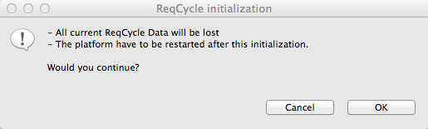
Import configuration file
Go to « ReqCycle » top menu and select « initialize configuration »
Say OK and select « openETCSReqCycle-Conf.zip »
Restart, that’s it

Slide 8
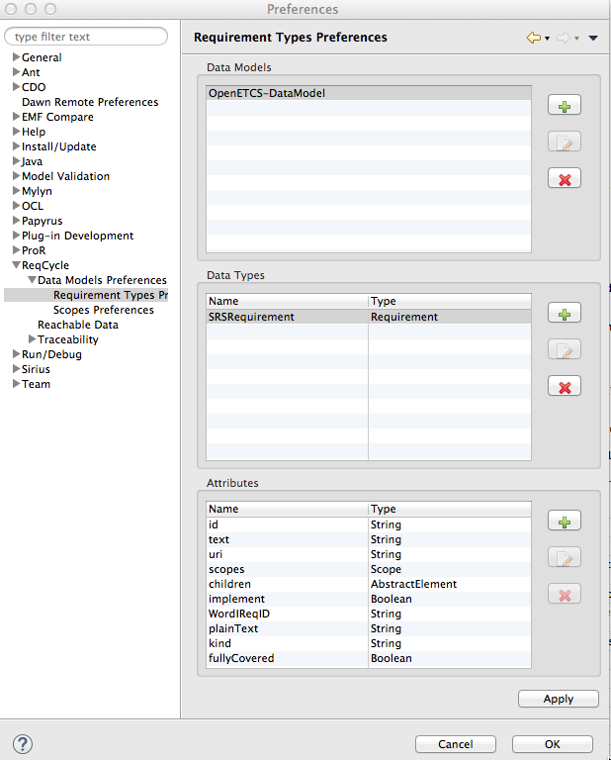
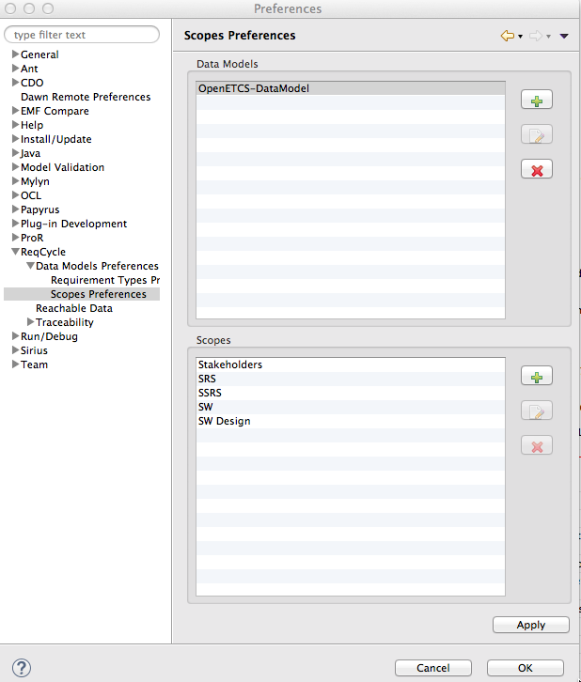
ReqCycle OpenETCS illustrated configuration
Attributes reflect ReqIF attributes
+ fullCovered specific attribute
5 scopes created
but only SRS will be used to manage Subset 26

Slide 9
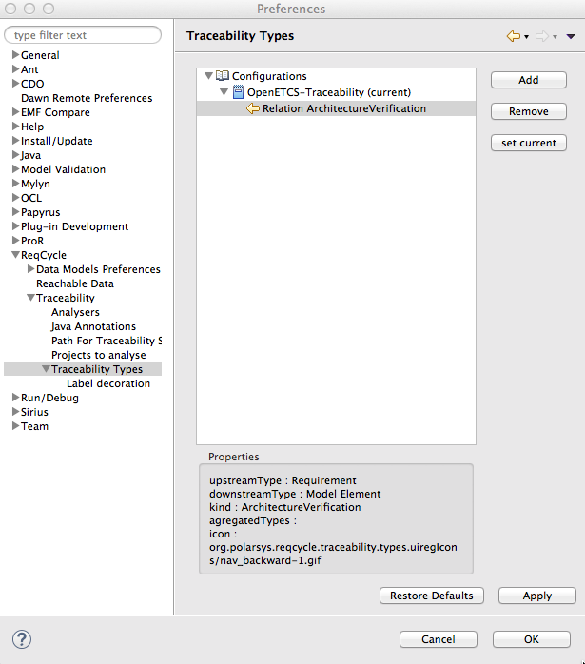
ReqCycle OpenETCS illustrated configuration
Traceability link type defined to support architecture verification: beween a requirement anda a model element

Slide 10
Creation of traceability links
Quick openETCS Tutorial in next slides
Full tutorial on wiki:
https://polarsys.org/wiki/Step_2:_import_or_reference_system_requirements
https://polarsys.org/wiki/Step_3:_refine_system_requirements_through_a_SysML_model

Slide 11
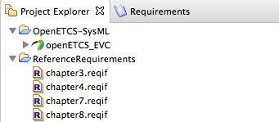
Initialize Eclipse projects
Launch Eclipse platform, choose a workpace (for instance « openETCS »)
Open ReqCycle perspective
Create « Reference requirements » general project.
Copy/paste .reqIF SRS chapter files in project
Then create another Eclipse general project for model
Import (or copy/paste) SysML model files

Slide 12
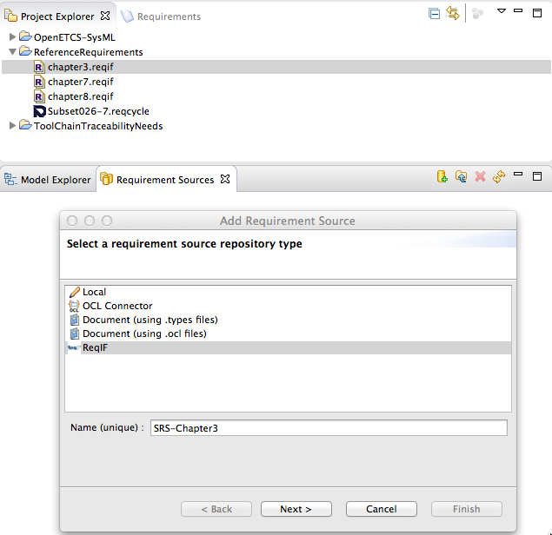
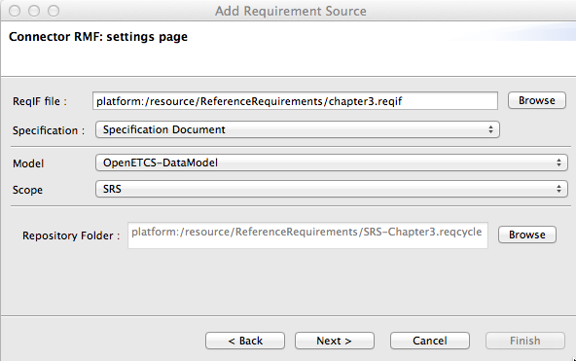
Goto « Requirement sources view » and create ReqIF requirement source for chapter3 by following tutorial (below and next slides) To do for all other chapters
Avoid special characters in name: « - » is OK but other ones might raise bugs

Slide 13
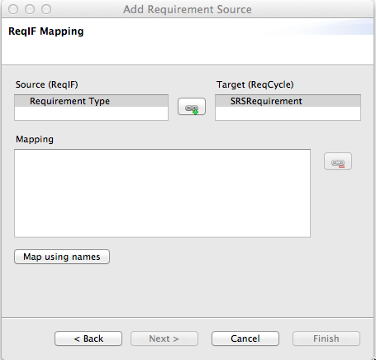
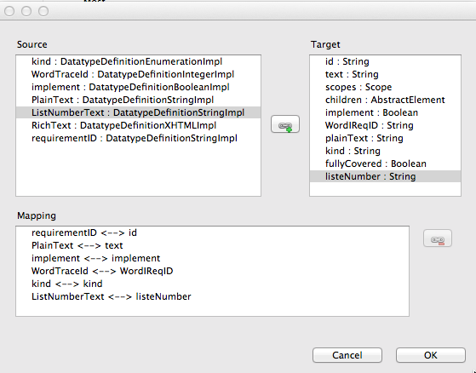
Import of chapter3.reqIF – mapping with custom data model (select both elements and map)

Slide 14
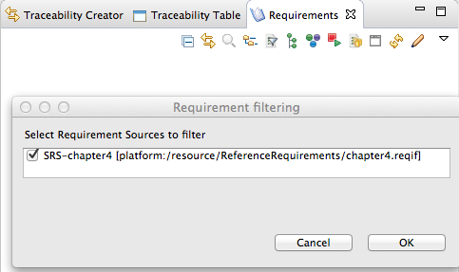
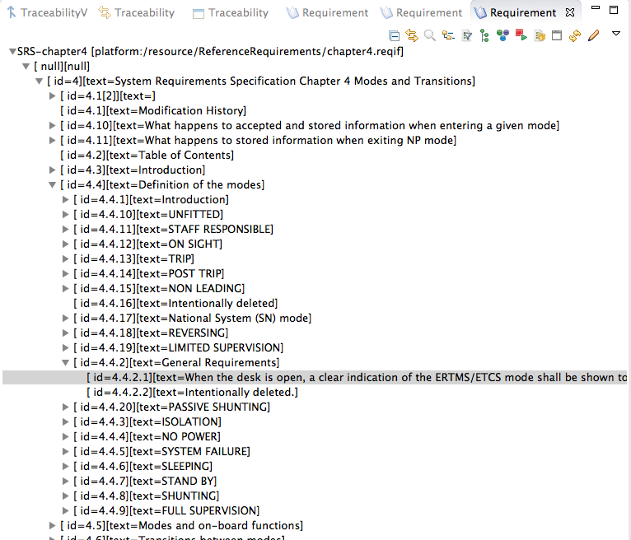
Load requirement view with requirement source (click on « database » icon and select chapter you want to trace) and then expand nodes

Slide 15
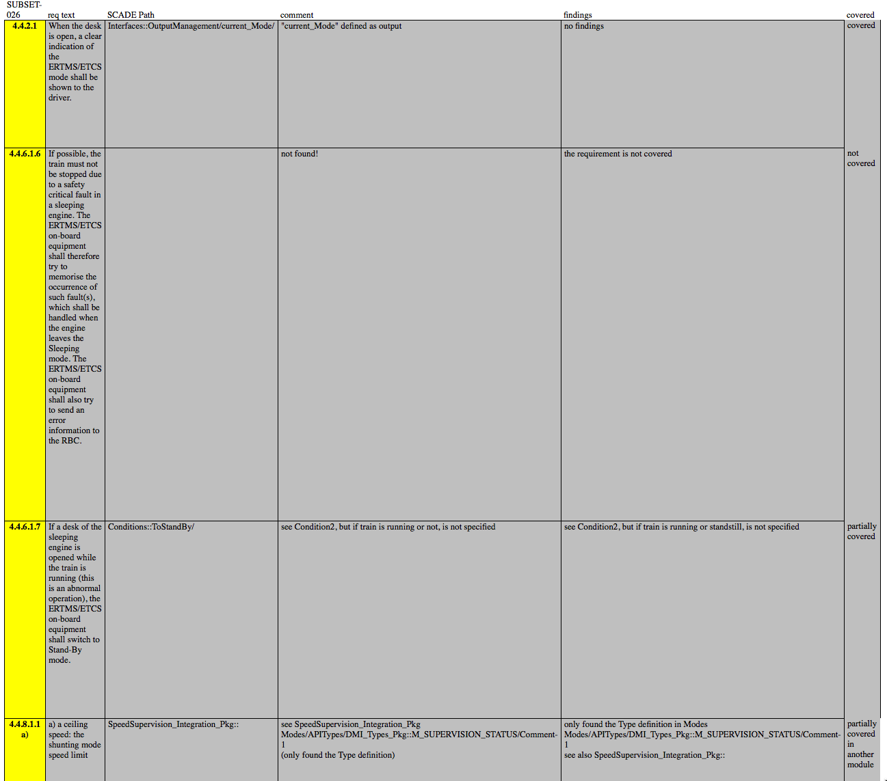
Examples of links to create

Slide 16
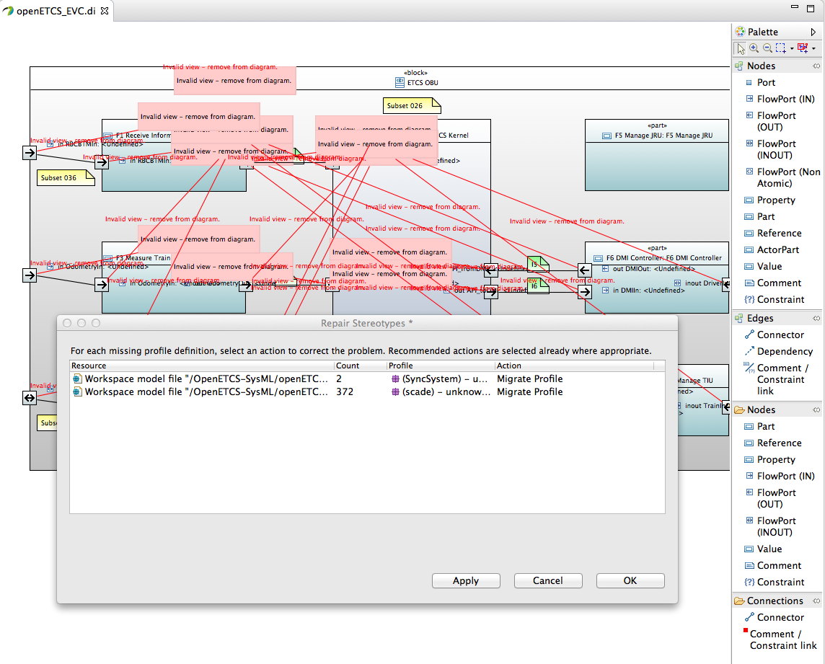
Load ETCS papyrus SysML model (in project explorer view, double click on openETCS_EVC element with Papyrus icon) and click « cancel » on the first popup windows that is displayed about missing profiles (we do not care of missing Scade profiles for now)

Slide 17
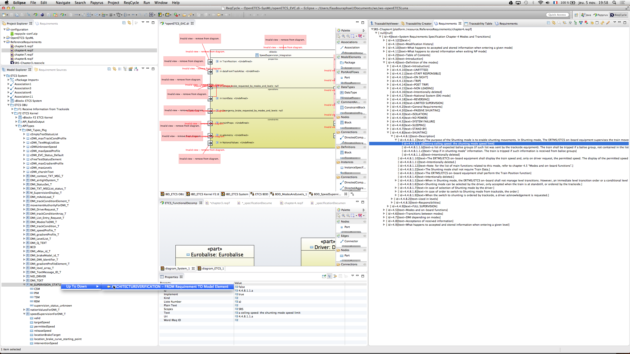
Create trace link through DnD

Slide 18
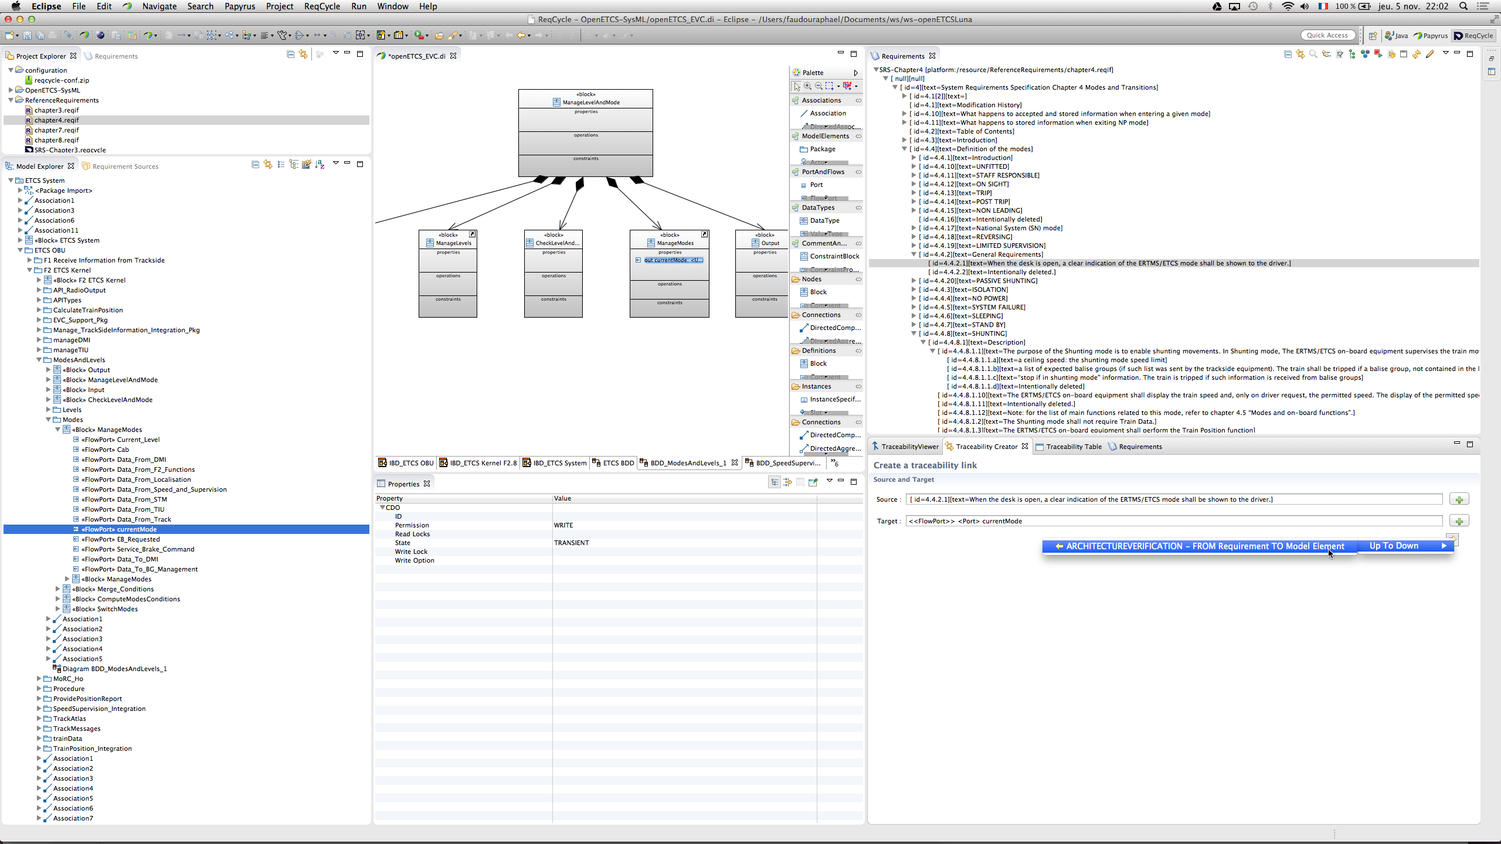
Or create trace link through traceability creator view (select source, click +, select target, click + and click arrow)

Slide 19
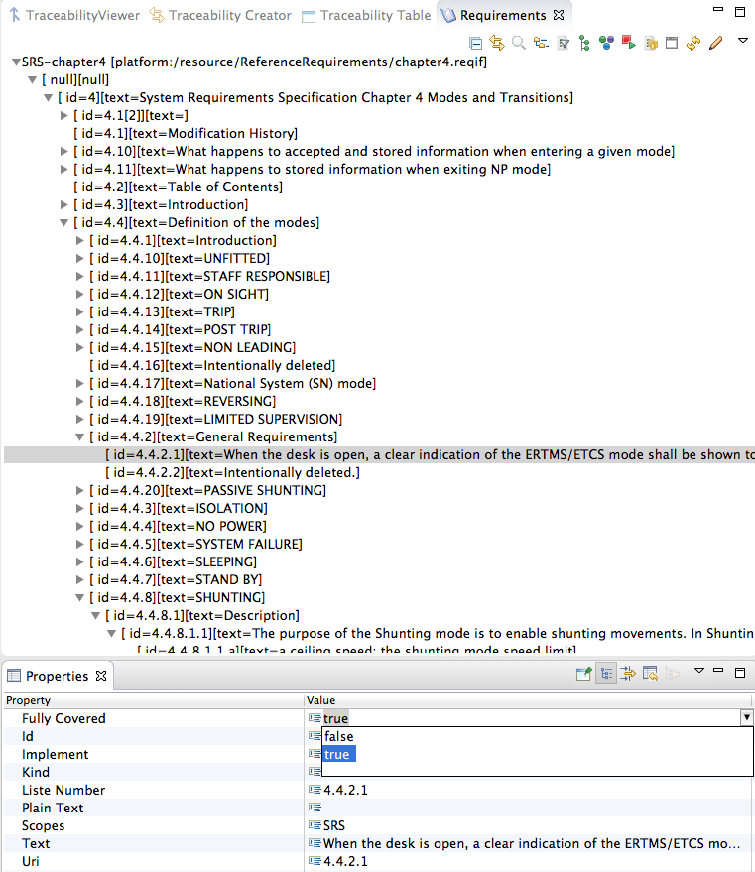
Use « properties » view to adapt « FullyCovered » req attribute
Note: cannot change ID nor text

Slide 20
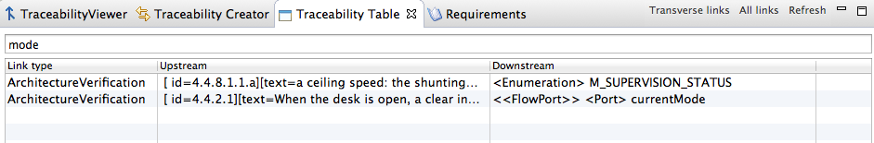
See traceability in ReqCycle with traceability table view (click « all links » and « refresh »)
Can filter results by a string...

Slide 21
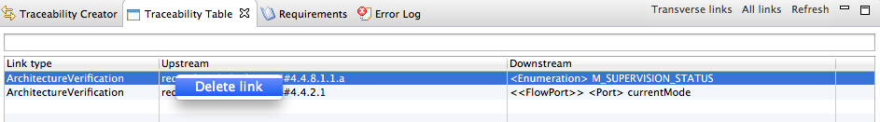
Remove links
Removal of links can only be done by end user from traceability table in « transverse links » mode
Click « transverse links » and select the models Eclipse project (where you put the SysML model) : it contains the traceability.rdf hidden file with links.
Right click on link to delete, a popup menu shows

Slide 22
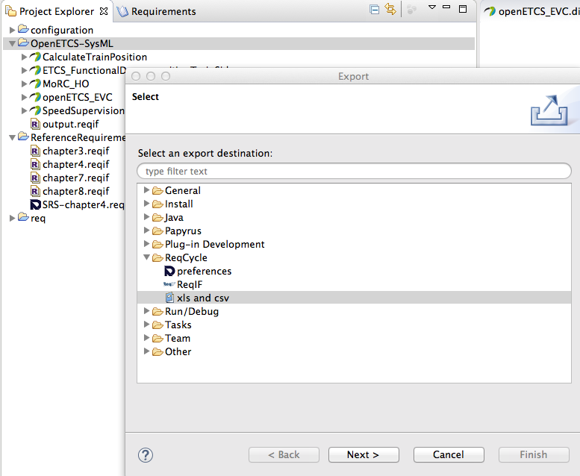
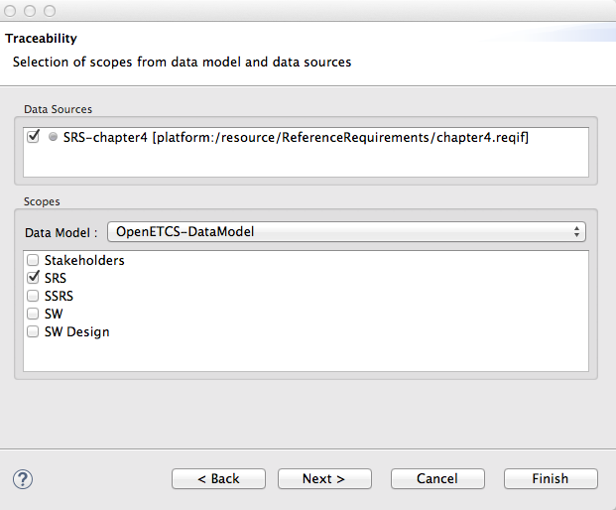
Export traceability with File>export...>Reqcycle>xls and csv

Slide 23
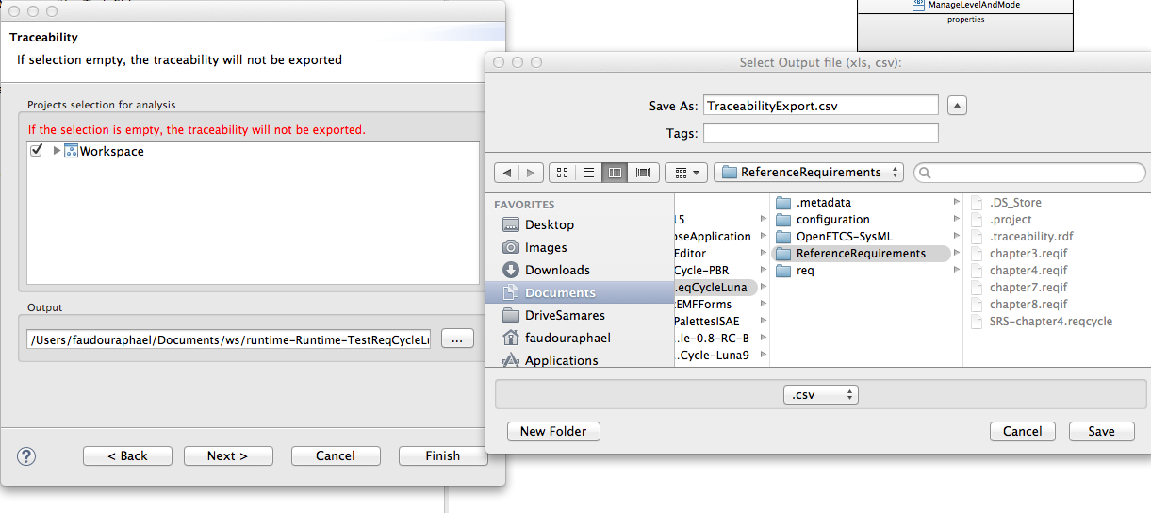
File>export...>Reqcycle>xls and csv, check workspace, choose.csv and choose a directory, then click finish

Slide 24
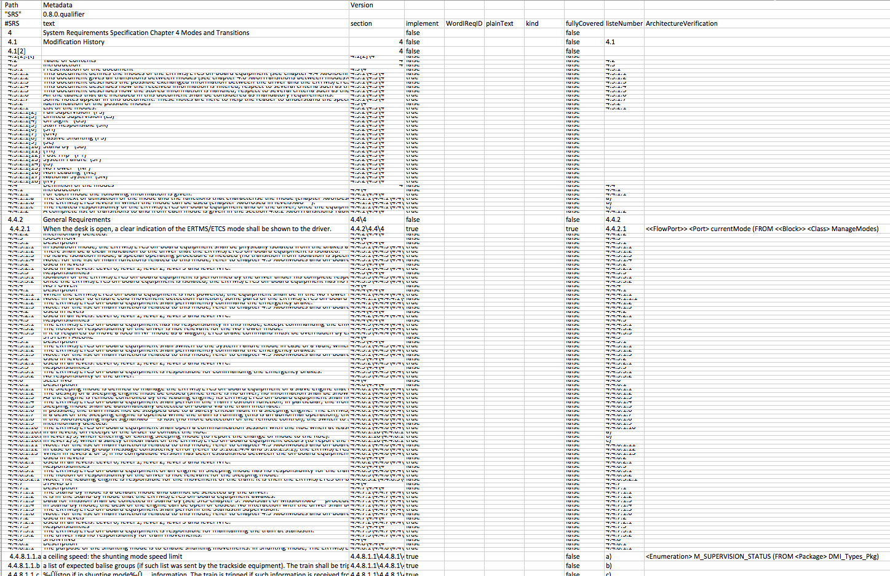
Finish export and open .csv Links are available with target element

Slide 25
Export and import of traceability data

Slide 26
Export and import configuration, requirements and traceability
Go to top menu ReqCycle
Select export configuration
Select « requirement sources »
Click ok: a .zip file is created
Do not forget to export projects
requirement project owns .reqCycle files that contain requirement in reqcycle format
Models project owns .traceability.rdf file (hidden) that contains traceability data
On another computer with ReqCycle installed, first import projects and then import exported configuration zip file (through ReqCycle top menu) to get req data model and req sources and traceability data.

Slide 27
Current limits

Slide 28
Not yet support for concurrent work in ReqCycle
See export/import feature previously
One can create links and then export work
Another one can then import projects and ReqCycle configuration and continue work
But if two people work concurrently, it is not yet possible to merge traceability results in ReqCycle
But can be done in Excel after concurrent exports...

Slide 29
Advanced features

Slide 30
Following of traceability progress in ReqCycle

Slide 31
Can use a custom visualization to highlight already traced requirements and those that are fully covered
Can be done through custom visualization
Tutorial to provide if needed

Slide 32
Questions?

