Slide 1
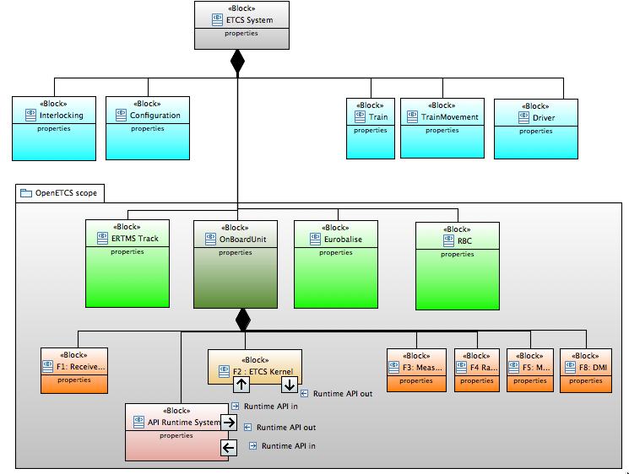
Experience of partners
UNISIG specifications
ITEA 2 project application documents
ETCS track side equipment
National and Operational rules of operators
Cenelec EN~50126-1:1999 and EN~50128:2011
Utrecht- Amsterdam track
SRS – Subset 26
refinement
User stories
User stories model
Scope
OpenETCS architecture SysML model
Validation scenario
OpenETCS (formal) executable SCADE
Model
Reflect architecture
Integration model
Functional block
integration
Architecture and Design Document
(Draft)
produces
Detailed design function model
Types model
openETCS API
Runtime API interface
Generates (KCG)
SW Runtime System
SW application executable code
Runtime API interface

Slide 2
Experience of partners
UNISIG specifications
ITEA 2 project application documents
ETCS track side equipment
National and Operational rules of operators
Cenelec EN~50126-1:1999 and EN~50128:2011
Utrecht- Amsterdam reference track
SRS – Subset 26
refinement
Provides scope
User stories model
User stories
OpenETCS product definition
OpenETCS stakeholder
reference (baselined) requirements
REQUIRED REQUIREMENT ORGANIZATION TO COMPLY WITH CENELEC EN5026 and EN5028
OpenETCS System Requirements
System level
Subsystem level
OpenETCS Software Requirements
Software level
openETCS API
Trace to
Component level
Deduce (import) requirements

Slide 3
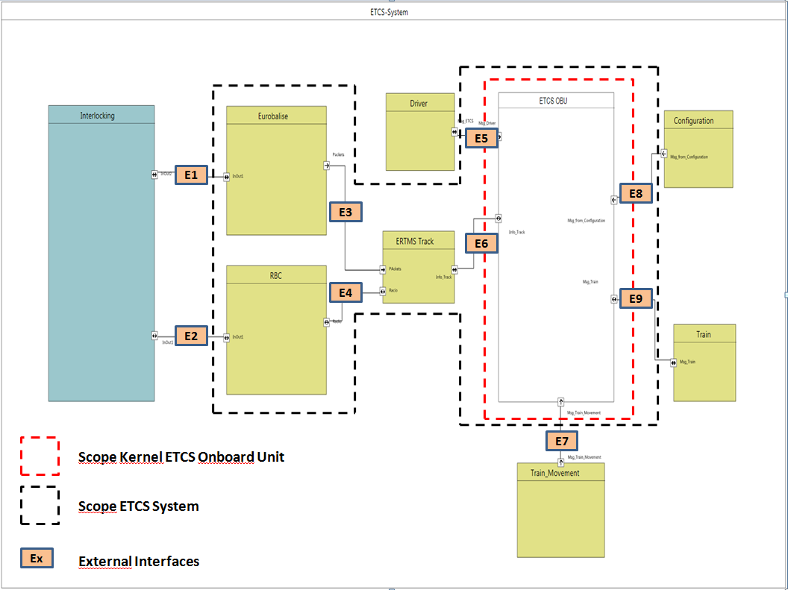
requirement creation at system level
OpenETCS product definition
Deduce (create) requirements
OpenETCS architecture SysML model - system level definition
OpenETCS System requirements
External IF
System level
External IF
Subsystem level

Slide 4
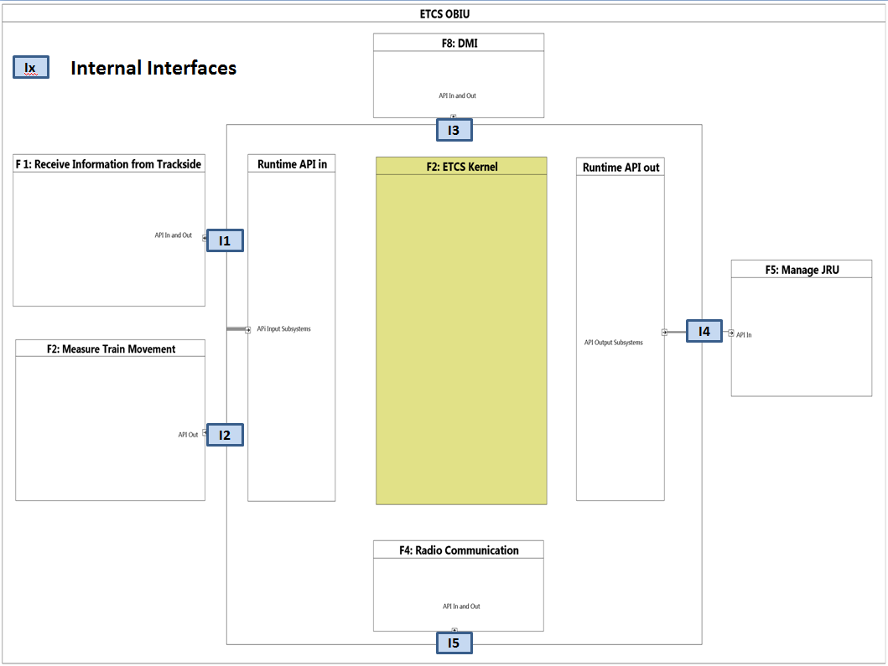
requirement creation at software level
OpenETCS product definition
OpenETCS architecture SysML model - system level definition
Deduce (create) requirements
OpenETCS Software
Requirements
System functions and Internal IF
Reflect architecture
OpenETCS (formal) executable SCADE
Model
Software level
Integration model
OpenETCS SW Architecture and Design Document (Draft)
Functional block
integration
Detailed design function model
Component
level
Types model
Generates (KCG)
SW application executable code

Slide 5
Summary of requirement creation
OpenETCS product definition
OpenETCS architecture SysML model - system level definition
Deduce (create) requirements
OpenETCS System
Requirements
System level
OpenETCS (formal) executable SCADE
Model
Subsystem level
Reflect architecture
OpenETCS Software
Requirements
Integration model
Functional block
OpenETCS SW Architecture and Design Document (Draft)
Software level
integration
Detailed design function model
Component
level
Types model
Generates (KCG)
SW application executable code

