Slide 1
openETCS project ReqCycle support for traceability between .reqIF and Papyrus SysML
V1.0 – 8th of November 2015
Raphael Faudou

Slide 2
Agenda
ReqCycle installation (with patchs) for modification of attribute values and csv export
Setup of openETCS ReqCycle configuration
Tutorial to create abd remove links with chapter4. reqIF
Export/import of traeability
Current limits

Slide 3
Installation part

Slide 4
ReqCycle 0.8.0 installation
Install official current release (0.8.0) for Luna
https://polarsys.org/wiki/Installation_guide

Slide 5
Patch of ReqCycle installation
In Eclipse plugins directory: copy the 2 patch plugins (.jar files)
In Eclipse directory: complete Artifacts.xml with two patch plugins descriptions:
<artifact classifier='osgi.bundle' id='org.polarsys.reqcycle.utils.configuration' version='0.8.0.201511071501'>
<properties size='1'>
<property name='download.size' value='20613'/>
</properties>
</artifact>
<artifact classifier='osgi.bundle' id='org.polarsys.reqcycle.export' version='0.8.0.201511071451'>
<properties size='1'>
<property name='download.size' value='79814'/>
</properties>
</artifact>
in Eclipse>configuration>org.eclipse.equinox.simpleconfigurator directory:
Search org.polarsys.reqcycle.utils.configuration and replace line with :
org.polarsys.reqcycle.utils.configuration,0.8.0.201511071501,plugins/org.polarsys.reqcycle.utils.configuration_0.8.0.201511071501.jar,4,false
search org.polarsys.reqcycle.export (not export.rmf nor export.xls, just export) and replace line with :
org.polarsys.reqcycle.export,0.8.0.201511071451,plugins/org.polarsys.reqcycle.export_0.8.0.201511071451.jar,4,false

Slide 6
openETCS reqCycle configuration

Slide 7
Setup ReqCycle openETCS configuration
Launch Eclipse and open « ReqCycle » perspective
Two options
Fast but opaque: import openETCS configuration file (easier but less explanation - already done for you – cannot modify it, just extend it). See next slide (8)
Create own configuration: explained step by step in wiki tutorial https://polarsys.org/wiki/Model_Based_System_Engineering_tutorial_with_ATM_system
and illustrated on openETCS in slides 9 to 11

Slide 8
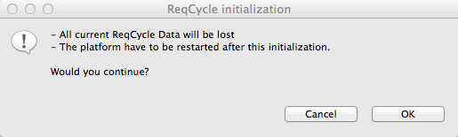
Import configuration file
Go to « ReqCycle » top menu and select « initialize configuration »
Say OK and select « openETCSReqCycle-Conf.zip »
Restart, that’s it

Slide 9
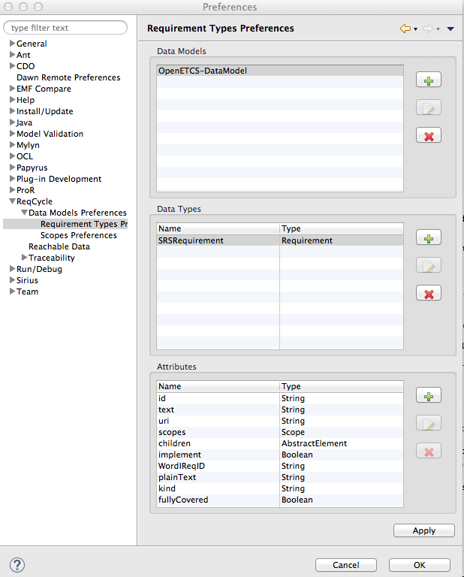
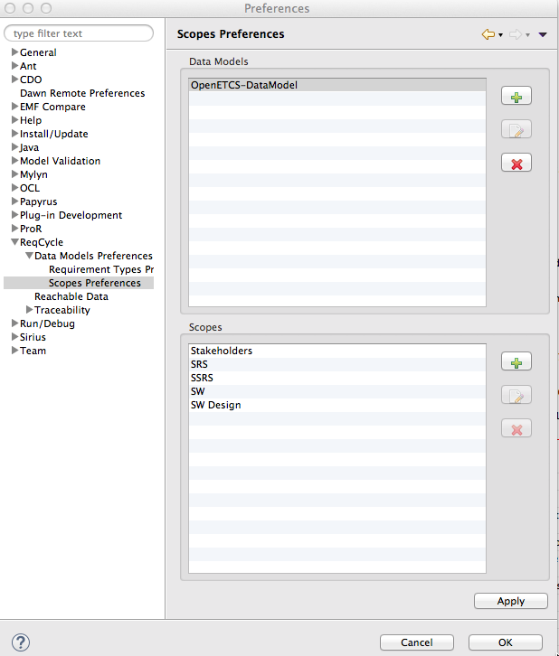
ReqCycle OpenETCS illustrated configuration
Attributes reflect ReqIF attributes
+ fullCovered specific attribute
5 scopes created
but only SRS will be used to manage Subset 26

Slide 10
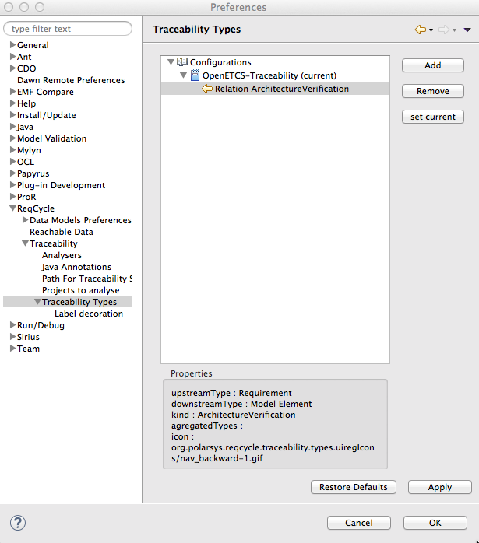
ReqCycle OpenETCS configuration
Traceability link type defined to support architecture verification: beween a requirement anda a model element

Slide 11
Creation of traceability links
Full tutorial on wiki:
https://polarsys.org/wiki/Step_2:_import_or_reference_system_requirements
https://polarsys.org/wiki/Step_3:_refine_system_requirements_through_a_SysML_model
Quick openETCS Tutorial in next slides

Slide 12
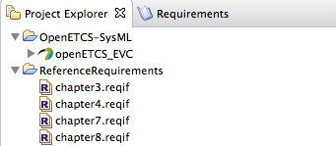
Initialize Eclipse projects
Launch Eclipse, choose openETCS workpace
open Reqcycle perspective
Create « Rererence requirements » general project.
Copy/paste .reqIF SRS chapter files in project
Then create another Eclipse general project for model
Import (or copy/paste) SysML model files

Slide 13
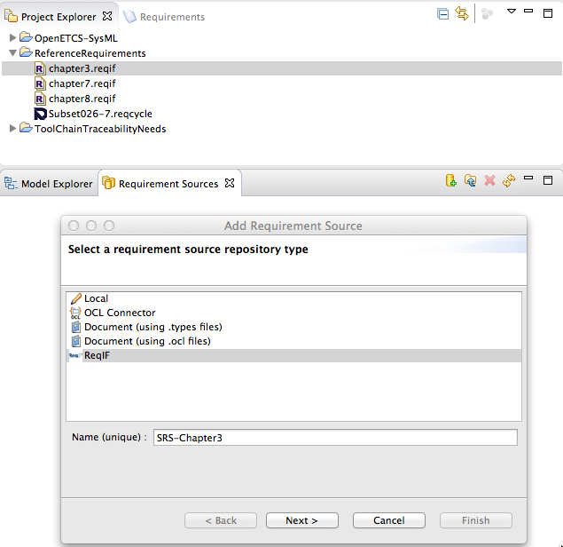
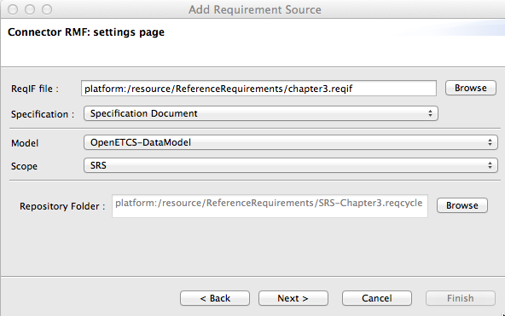
Goto « Requirement sources view » and create ReqIF requirement source for chapter3 by following tutorial (see next slides) To do for all other chapters

Slide 14
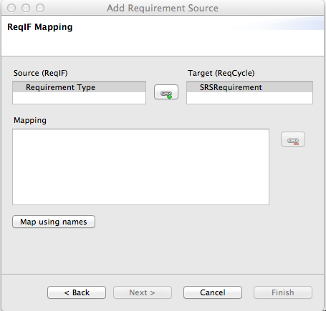
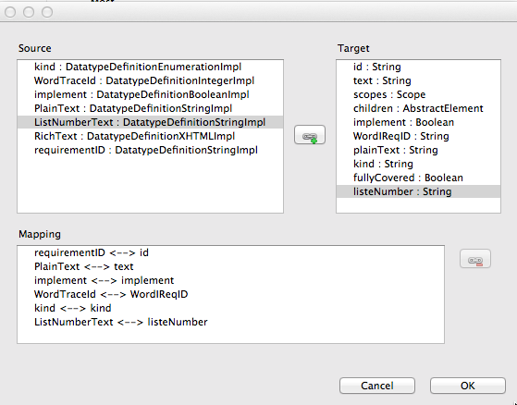
Import of chapter3.reqIF – mapping with custom data model (select both elements and map)

Slide 15
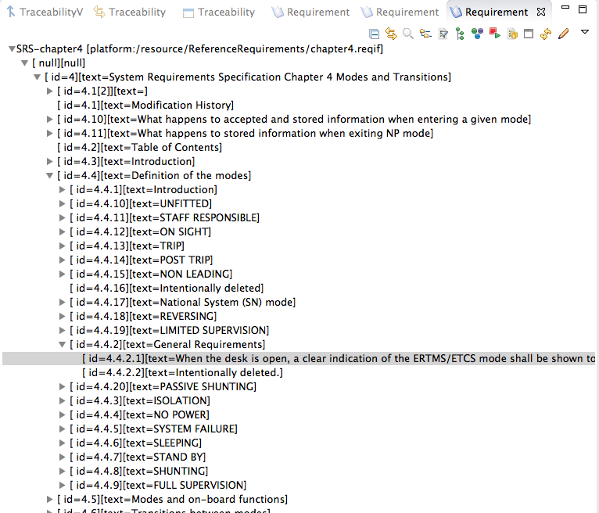
Open requirement view and expand nodes

Slide 16
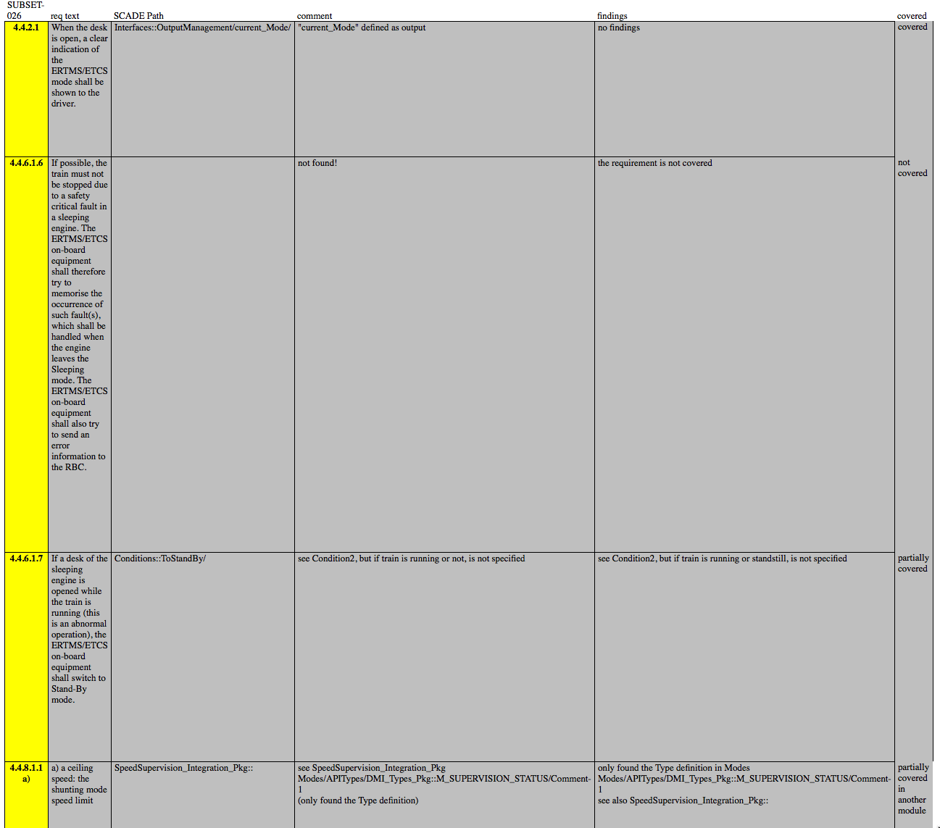
Examples of links to create

Slide 17
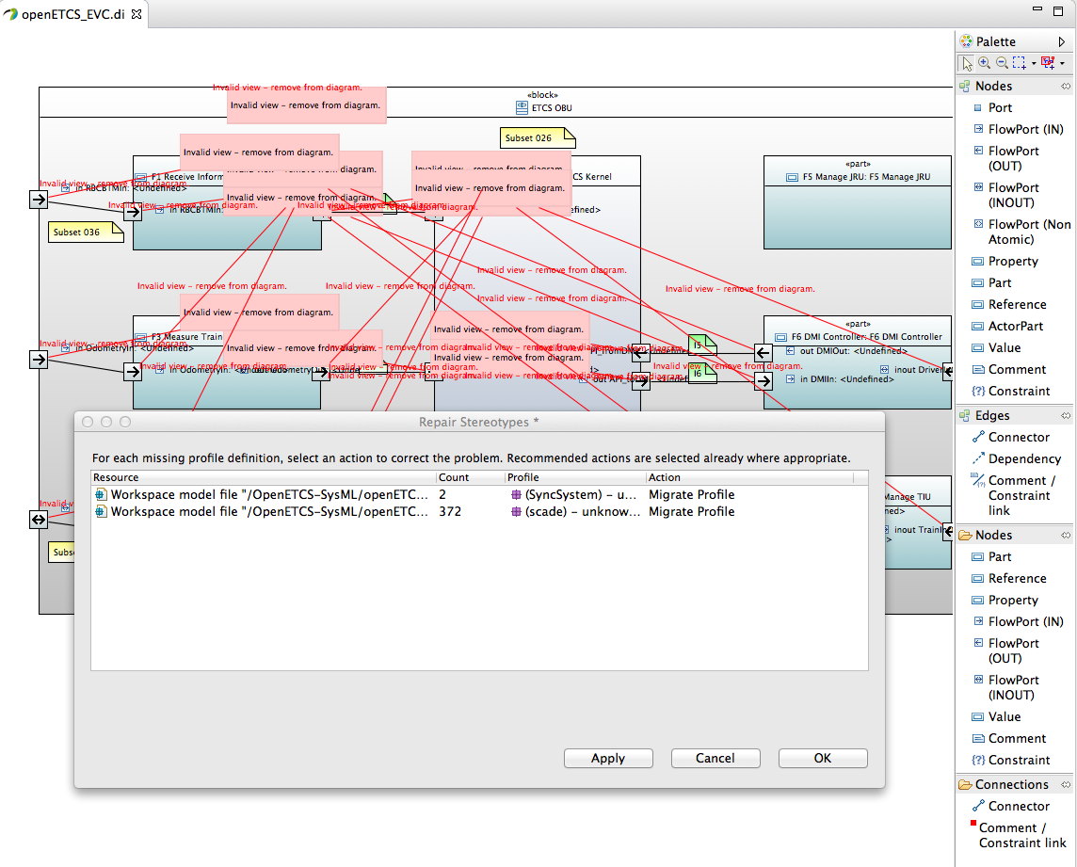
Load ETCS papyrus SysML model (do not care of Scade profiles for now)

Slide 18
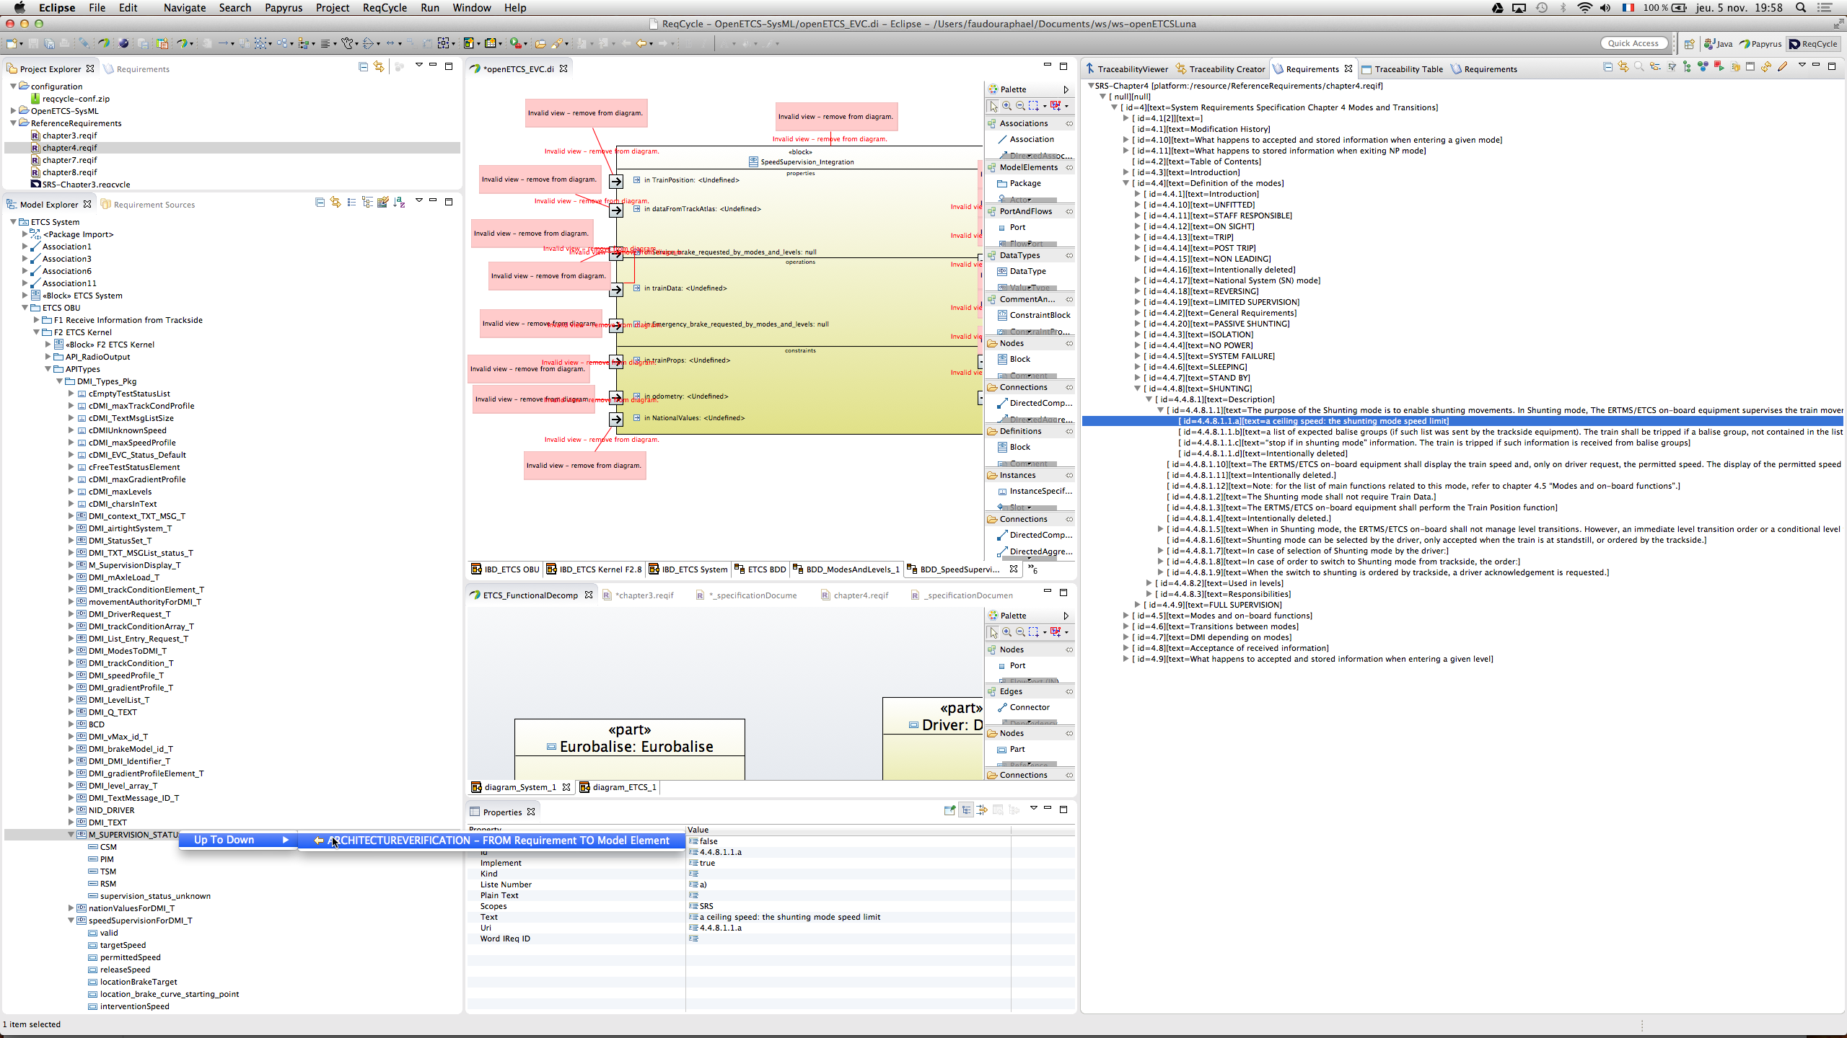
Create trace link through DnD

Slide 19
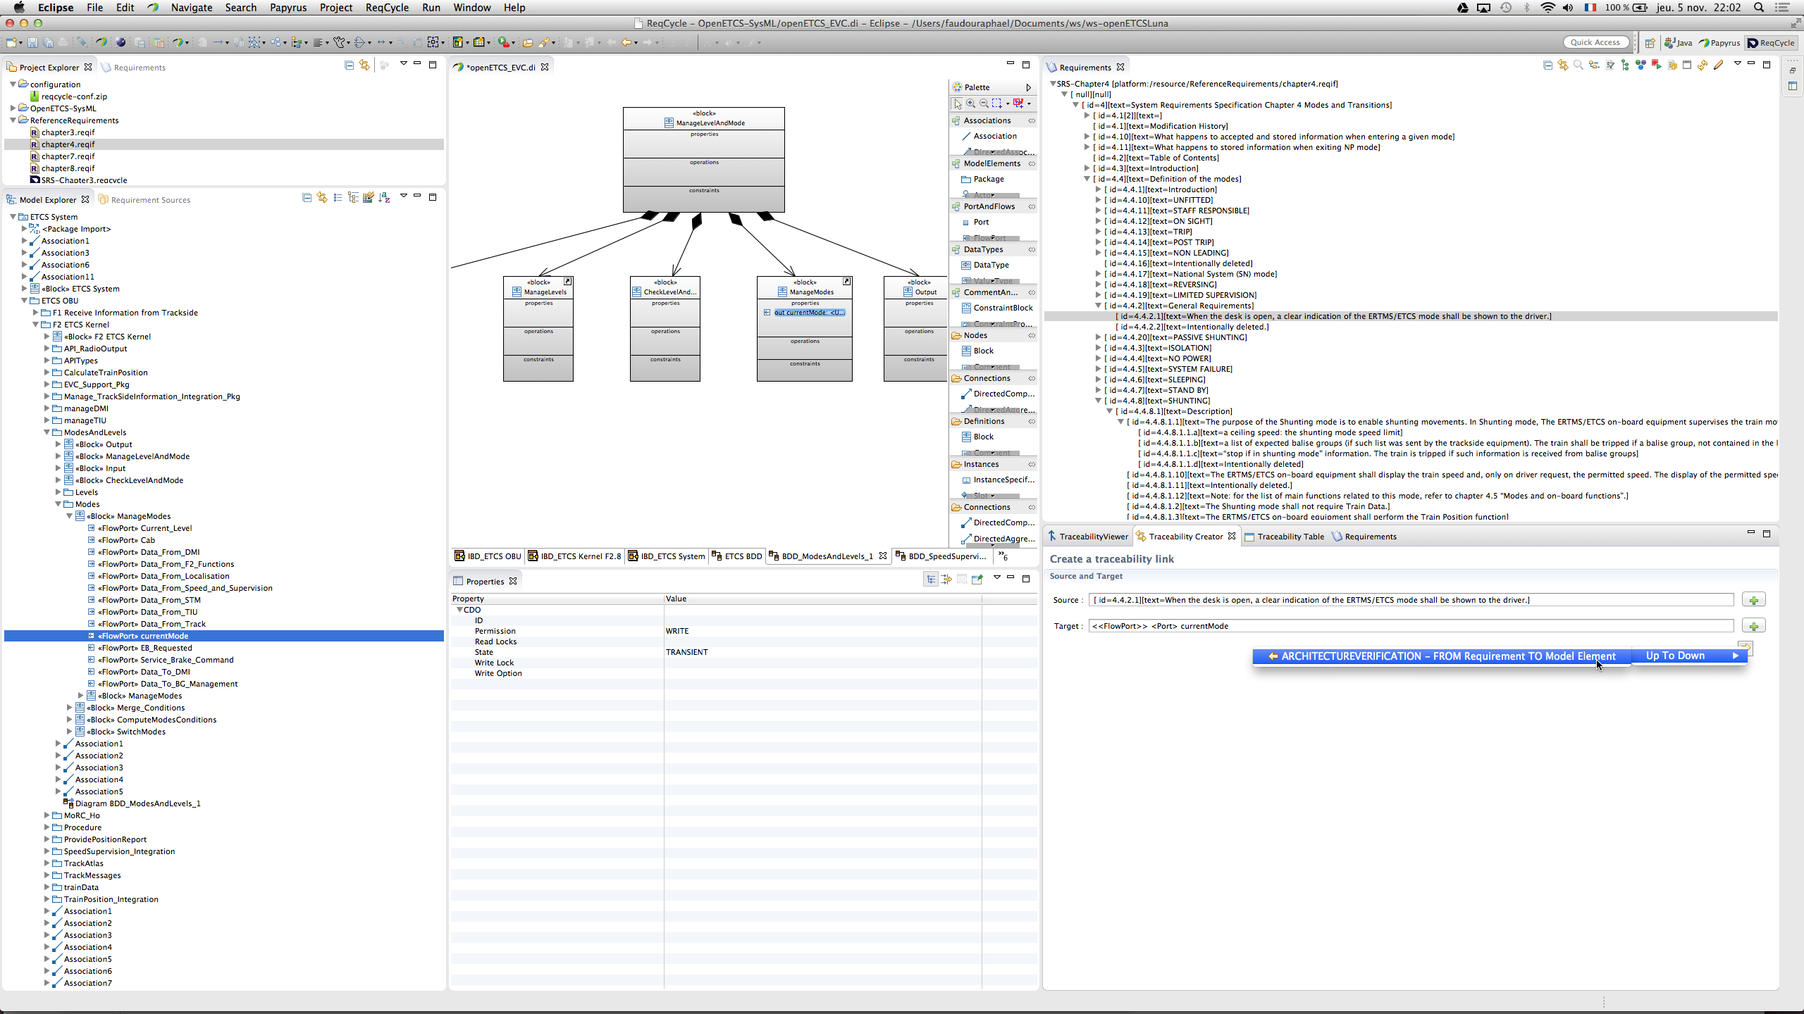
Or create trace link through traceability creator view (select source, click +, select target, click + and click arrow)

Slide 20
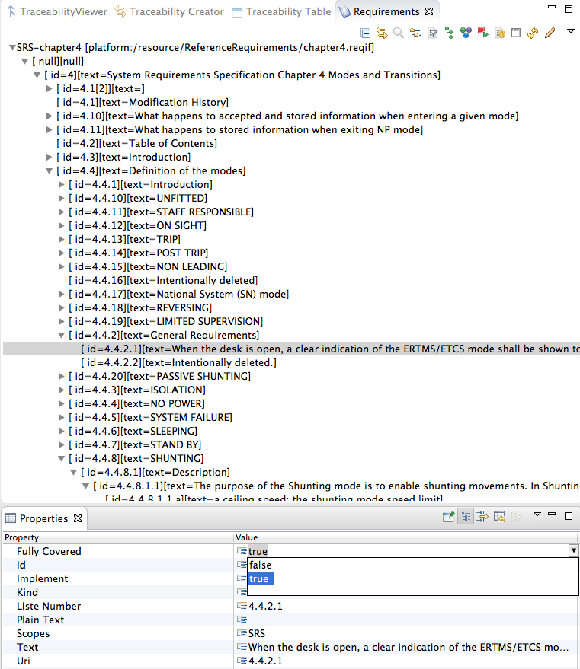
Use « properties » view to adapt « FullyCovered » req attribute
Note: cannot change ID nor text

Slide 21
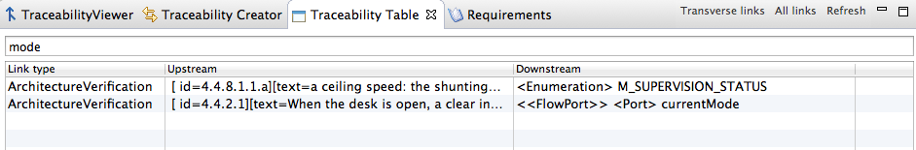
See traceability in ReqCycle with traceability table view (click « all links » to refresh)
Can filter results by a string...

Slide 22
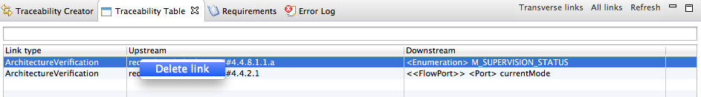
Remove links
Removal of links can only be done by end user from traceability table in « transverse links » mode
Click « transverse links » and select the models Eclipse project (where you put the SysML model) : it contains the traceability.rdf hidden file with links.
Right click on link to delete, a popup menu shows

Slide 23
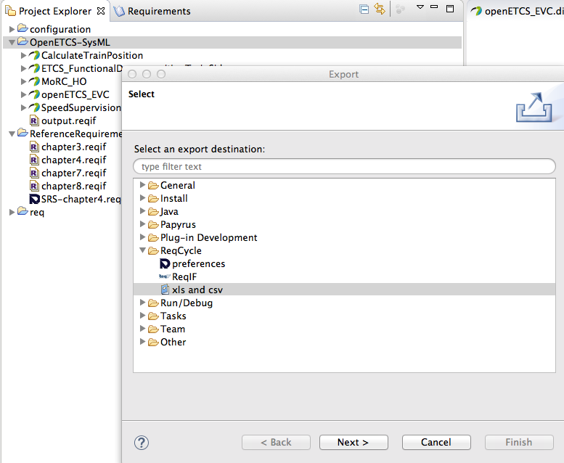
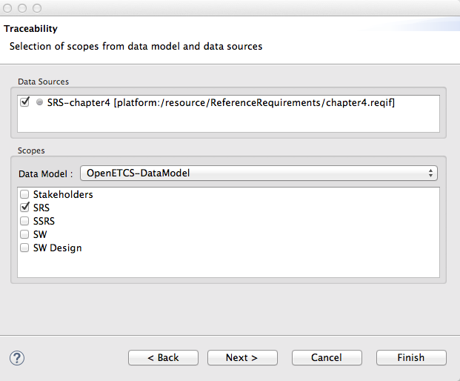
Export traceability with File>export...>Reqcycle>xls and csv

Slide 24
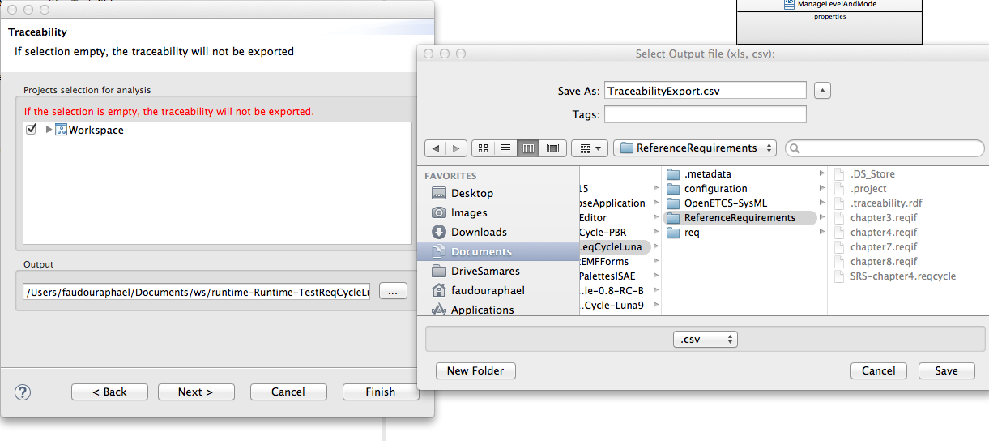
File>export...>Reqcycle>xls and csv, check workspace, choose.csv and choose a directory, then click finish

Slide 25
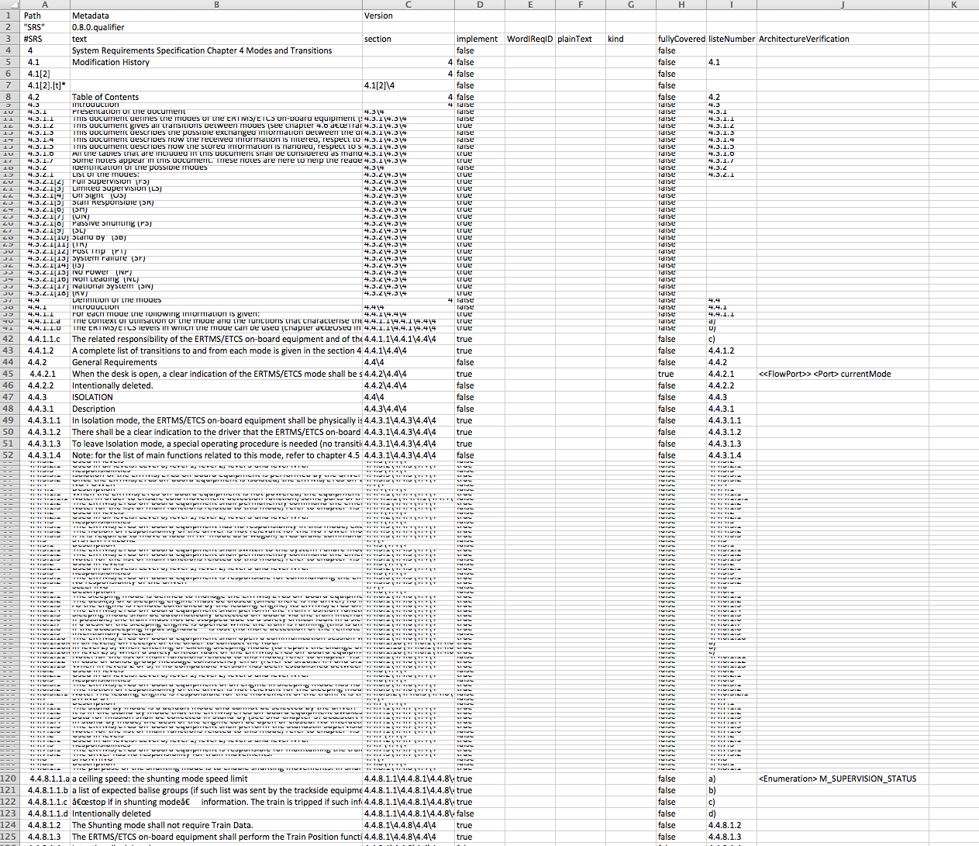
Finish export and open .csv Links are available with target element

Slide 26
Export and import of traceability data

Slide 27
Export and import configuration, requirements and traceability
Go to top menu ReqCycle
Select export configuration
Select « requirement sources »
Click ok: a .zip file is created
Do not forget to export projects
requirement project owns .reqCycle files that contain requirement in reqcycle format
Models project owns .traceability.rdf file (hidden) that contains traceability data
On another computer with ReqCycle installed, first import projects and then import exported configuration zip file (through ReqCycle top menu) to get req data model and req sources and traceability data.

Slide 28
Following of traceability progress in ReqCycle

Slide 29
Can use a custom visualization to highlight already traced requirements and those that are fully covered
Can be done through custom visualization
Tutorial to provide if needed

Slide 30
Current limits

Slide 31
Not yet support for concurrent work in ReqCycle
See export/import feature previously
One can create links and then export work
Another one can then import projects and ReqCycle configuration and continue work
But if two people work concurrently, it is not yet possible to merge traceability results in ReqCycle
But can be done in Excel after concurrent exports...

Slide 32
Traceability CSV export limits
CSV export file mentions model element name only and does not display full path (qualified name) => can be hard to locate model element
PolarSys Bug 627 created
https://polarsys.org/bugs/show_bug.cgi?id=627
Can be fixed within a week if needed

Slide 33
Questions?

