Slide 1
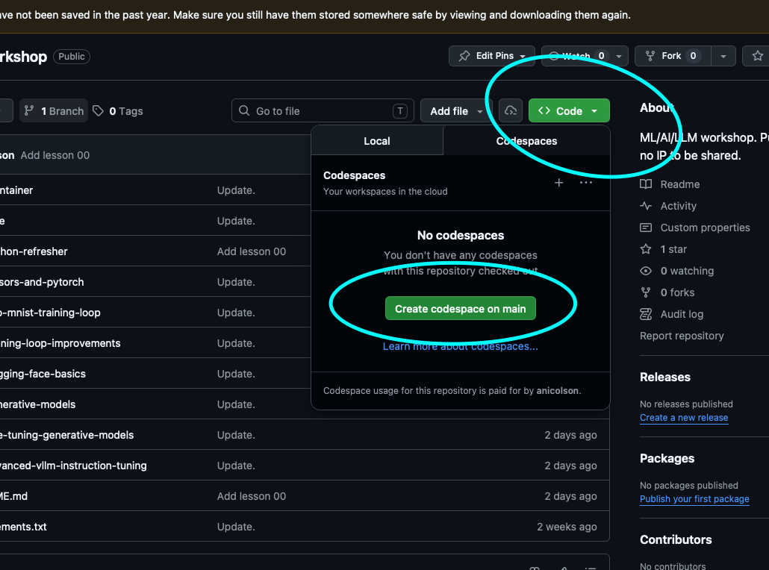
How to get to GitHub Codespaces:
Login/create GitHub account: https://github.com/login (Jin will put in the chat a few times).
Go to https://github.com/aehrc/ai_workshop (Jin will put in the chat a few times).
See below on how to create a Codespace (it will take about 5 mins to boot up):
What we are learning today:
Python refresher.
PyTorch Tensors.
Nice and easy.
(Also, Jin – record the meeting please :D).

