Slide 1
Piotr Szul, CSIRO (Australia)
How to integrate FHIR with your analytics pipeline
Notes:
Good morning!
Welcome to this tutorial session on integrating FHIR with analytics pipelines.

Slide 2

Who am I?
Piotr Szul
Senior Engineer @ CSIRO
  AEHRC (Australian e-Health Research Centre)
  FHIR Terminology and Tooling Team
Three years of experience developing tools enabling FHIR based analytics
Many more years of developing tools for analyzing research data
Notes:
My name is Piotr Szul
I am a Senior (Software) Engineer in CSIRO – which is Australia’s National Science Agency.
More precisely I am member of FHIR Ter … Team in the Austran e-Health Research Centre
I have 3 years of experience working with FHIR primarily developing tools for FHIR based analytics.
And before that I had been working for many years developing tools supporting analysis of various types of research data.

Slide 3
Learning Objectives
Learn how to
  build a simple, automated, batch analytics pipeline for FHIR data using open-source software, including Apache Spark and Pathling.
  use FHIRPath and SQL to transform complex FHIR data into simpler, use-case centric tabular views
  to tackle some of the complexities of working with FHIR data, including: codes and terminology, Questionnaires, and extensions
Notes:
At this session we will learn
To build aa simple analytics pipeline for FHIR data, using open source tools such as Apache Spark and Pathling
How to use FHIR Path and SQL to transform complex FHIR data into simpler, tabular use-case centic views..
And how tackle some of the complexities of working with FHIR data, that include codes :and terminoly, questionnaire and extensions.

Slide 4

Agenda
FHIR analytics pipeline
  Introduce the analytics use case
  Discuss the solution pipeline and the technologies used
  LAB: Demonstrate the implementation of the pipeline
Additional FHIR specific topics
  Extensions and recursive structures
  LAB: Demonstrate how to incorporate data above
https://github.com/aehrc/fhir-analytics-pipeline
https://tinyurl.com/ydnax4as
Notes:
The session has two parts:
In part one we will focus on buiiding the FHIR analytics pipeline.
First will introduce a use case
Then discuss the solution pipline
And finally switch into the lab mode and go through the implementation of the pipeline on the Databricks platform
In the seond part we will focus some of the complexities of working of FHIR data
And again we will discuss them first and then switch to the lab mode go though some code examples.

Slide 5

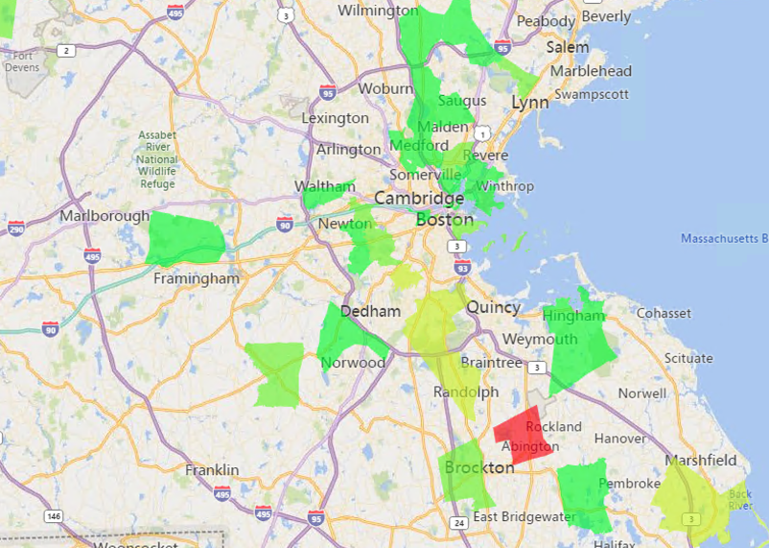
Self-service analytics for COVID-19 management
FHIR Data
Self-service Analytics
The objective is to allow data analysts with BI tools leverage FHIR data for analytics
COVID-19 management, e.g.: the number of unvaccinated patients by location stratified by a customizable risk score
  Based on ”Pathling: analytics on FHIR” DOI:10.1186/s13326-022-00277-1
Data Analyst
(BI Tools)
Notes:
The scenario we are going to consider is that of self-service analytics.
We have Data Analyst user with some knowledge of SQL and access to BI Tools such a Power BI or Tablaux
and we want the to be able to leverage FHIR data for their analytics.
Our specific use-case is the analytics related to COVID-19 management, so we would like Data Analyst to be able to answer questions such as:
How many of unvaccinated patients are there in various areas stratified by some customizable risk score?
Or which areas have the highest aggregate risk score?
So oversimplifying it a bit produce visualization similar to that on the slide.

Slide 6
The scenario: Details
FHIR Server
Complex, interrelated, FHIR resources
SNOMED etc. codes
COIVD-19 centric data view
  Patient data
    DOB
    Postal Code
  COVID-19 Immunization status
  Risk factors:
    Diagnosed with chronic kidney disease
    Diagnosed with heart disease
    Recorded body mass index (BMI) greater than 30
Flexibility (extend to other use-cases)
FHIR Analytics Pipeline
Use-case centric flat views with relevant data
SQL Database
Analyst BI Tools
(Power BI, Tableaux, ...)
Data Analyst
Notes:
So we have to challenges here:
The first one it and that is that our BI tools and our DA ideally want to use as SQL database while our data are stored in a FHIR server
The data model one – FHIR data model is very complex, nested, and composed of interrelated resources so even if we were able to represent FHIR data in an SQL database the
DA user and the tools they use may not be able work with it
So our solution pipeline needs to perform tasks:
Move the data from the FHIR server to an SQL dabase.e
And at the same time transform the complex FHIR data into a simpler view with data relevant to the used case, which the DA can work with.
In our case the view may include some basic patient data, the immunization status and some of the factors known to influence COVID -19 risk.
However we would like the pipeline design the be flexible so that we it extended to other use cases.

Slide 7
Pipeline design (batch)
Incremental updates supported with MERGE
Terminology
Server
FHIR Server
End User BI Tools
Bulk Export
Encode & Merge
Extract & Load
File or Object Storage
Apache Spark
Delta Lake
SQL Database
<<extract>>
FHIR ndjson files:
Patient.0.ndjson
Condition.0.ndjson
Condition.1.ndjson
…
<<replica>>
‘SQL on FHIR’ tables:
patient
condition
observation
…
<<views>
Use-case centric tables:
covid19_risk_view
Notes:
So now let’s look at a possible design of the pipeline and we are going to start from the end.
So what we want to do is to create the use-case centric view in our SQL database.
One the ways to achieve that, is to create a replica of our FHIR data in a database or warehouse that supports SQL queries on FHIR data projected into SQL tables.
Then we can use SQL, possibly enriched with some user defined functions to handle terminology queries, to extract the relevant data from the FHIR tables and populate the use-case centric view.
One of the possible option here is Apache Spark Delta Lake, which is a data warehousing solution in which the data tables are stored in binary columnar format, that allows efficient and scalable execution of SQL queries on large datasets.
In order to populate FHIR data in our Delta Lake use FHIR Bulk Export API to export the required resources from the FHIR server as ndjson files to the staging area.
And then we encode the FHIR data into the binary columnar format and load them into the Delta Lake. In our case we use the ‘delta’ format, which is an enhanced parquet format, that support updates to the data.
This allows us to implement incremental updates: we merge the new data with the data already in the data lake based on the resource id – we append new resource and update existing ones.
So let’s summarize the pipeline desith:
- In the first step we use FHIR bulk export capabilities to export data for required resources (most likely Patient, Condition, Obsevation) form a FHIR server to njdson file in our data staging area (say cloud object storage)
In the second step we encode ndsjon file to delta files and merge them into the Delta Lake
In third step we use SQL queries to extract the relevant data from the FHIR the DeltaLake and load the simplified view into the SQL database.
It’s also worth noting that this design supports a degree of flexibly as it allows for creation of different use case centric view from the same replica of FHIR data in the DeltaLake.

Slide 8
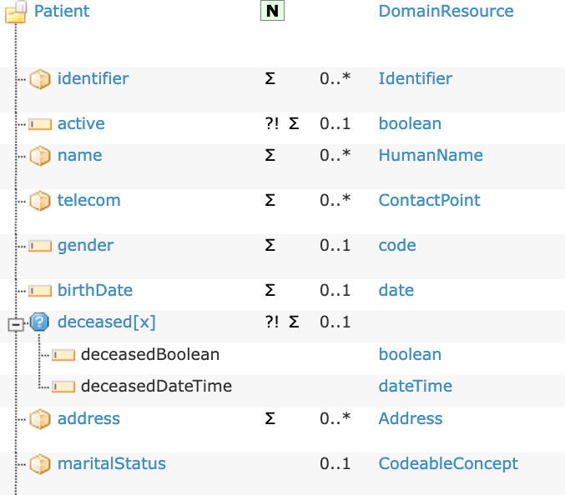
FHIR mapping to SQL
”SQL on FHIR”
work in progress
root
|-- id: string
|-- active: boolean
|-- name: array
| |-- element: struct
| | |-- id: string
| | |-- use: string
| | |-- family: string
| | |-- given: array
| | | |-- element: string
|-- gender: string
|-- birthDate: string
|-- deceasedBoolean: boolean
|-- deceasedDateTime: string
|-- address: array
| |-- element: struct
| | |-- id: string
FHIR Structure
(Spark) SQL Schema
Notes:
So, let have a quick look on how FHIR data can be represented in SQL schema, so that we have an idea of the data looks linke in our DeltaLake.
Some of the mapping is intuintive:
Primitive elements like ‘activie’ in FHIR can be represented as simple fields in SQL.
Fiels with zero-to-many caridinaly can be represented as arrays
ComplexTypes can be represented as structures
The represnetaion of gther like choices, extensions and recursive data types is more complex. Wwill discuss some of them later in the presentation.
But there is also the ongoing work standardizing the mapping under the “SQL on FHIR” umbrella.

Slide 9
The implementation
Technologies
  Apache Spark, Spark SQL, PySpark,
  Pathling and Ontoserver (for terminology queries)
  ndjson, parquet/delta
  Python, SQL, FHIRPath
Databricks (for convenience)
  Spark cluster for execution of the pipeline code
  Notebooks for exploratory examples
  Data flow orchestration + SQL Analytics and reporting
The pipeline can be deployed on any Apache Spark enabled platform (AWS, Azure, … )
Notes:
In our implementation we leverage a number of technologies as shown on the slide.
Most prominently it relies various elements of Apache Spark ecosystem and Pathing, which I will introduce on the next slide.
This actual implementation I am demonstrating is deployed in on the Databricks platform in the form of notebooks.
We chose this platform primarily because the use of notebooks and some other features the platofgmr makes it easy demonstrate the code and the working of the pipeline.
But I just want to emphasize that a similar pipeline can be deployed on any Apache Spark enabled platform, and the popular cloud platforms such as AWS, Google Cloud and AZURE.

Slide 10

Pathling@AeHRC
Pathling is a set of open source tools facilitating the use clinical terminology and FHIR® within health data analytics.
Built on Apache Spark for scalability
Python, Java/Scala libraries and FHIR REST API
Relevant features
  Encoding of FHIR ndjson resources to Apache Spark delta tables
  Extracting tabular views from FHIR data with FHIRPath expressions
  Support for terminology queries against coded fields within the FHIR data from SQL and FHIRPath
See: https://pathling.csiro.au/
Notes:
And just a few words about Pathilng, which on of the technologies we are developing at AeHRC.
Pathling is a set open source tools eabligin and simplifying FHIR based analytics.
In our case the most relevant part is the python library that supports,
Encoding of FHIR ndjon to Apache Spark dataframes
Running terminology queries in Spark SQL and FhirPath
Extracing data from FHIR dataframes with FHIRpath.

Slide 11
LAB: The pipeline
Incremental updates supported with MERGE
Terminology
Server
FHIR Server
End User BI Tools
Bulk Export
Encode & Merge
Extract & Load
File or Object Storage
Apache Spark
Delta Lake
SQL Database
<<extract>>
FHIR ndjson files:
Patient.0.ndjson
Condition.0.ndjson
Condition.1.ndjson
…
<<replica>>
‘SQL on FHIR’ tables:
patient
condition
observation
…
<<views>
Use-case centric tables:
covid19_risk_view
Notes:
OK, so now we are ready to dive into the implementation.
I am going to keep the slide with the pipeline design open, for the reference as we progress through the implementation..

Slide 12
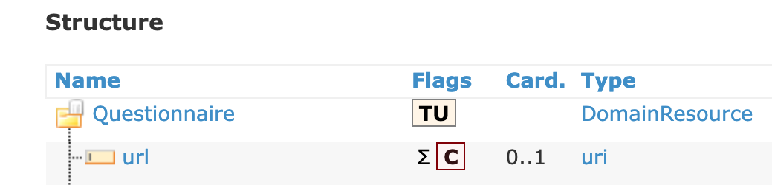
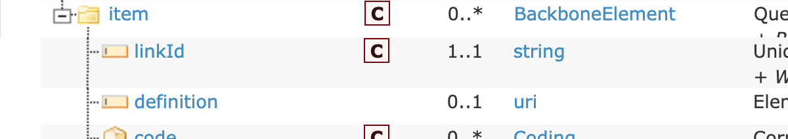

Recursive nested types
Recursive nested structures
  E.g. `item` in Questionnaire
  In principle allows for unlimited and undetermined levels of nesting
Pathling solution
  Allow for limited predetermined level of nesting
  max_nesting_level parameter applied globally to encoding of all recursive nested structures (except for extensions)
max_nesting_level = 0
max_nesting_level = 2
Questionnaire
Questionnaire
Item
item[]
Item[]
Item
Item[]
Item
Item[]
Item
Notes:
No we will look at some specific challenges of working with SQL recreations of FHIR data.
The first one the FHIR recursive datatypes, that is types at either directly or indirectly have element of the same type.
An example of such a type can be the item element in the Questionannire resource, which itself can include other item elemnts.
The problem here is that FHIR allows for infinite nesting, which cannot be directly represented in the SQL schema.
The solution that we adopted assumes that very deep and in particular arbitrary levels or nesting are not common in practice and as such we chose to allow for the configurable but predetermined level of nesting in the encoder.
The suitable level can be chosen based on the data that need to be represented (e.g. the maximum of the Questionnaires that are being used).

Slide 13
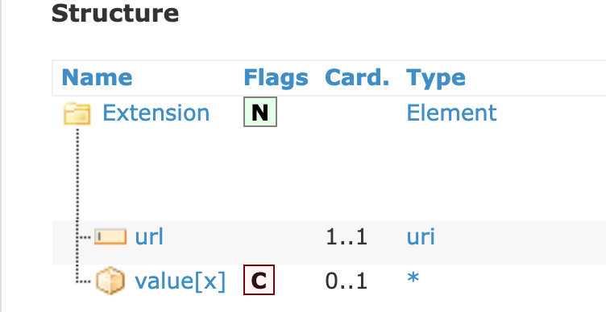
Extensions
Challenges
  Every resource or datatype element may include one or more "extensions"
  Complex extensions contain one or more nested extensions
  value[x] can be of 50+ types
Pathling solution
  Annotate each field and and element with unique id and store extensions in a single MAP column indexed by the id
  Constraint the types allowed as values (enabled_open_types)
Patient
0001
extensions[]
Extension
_extensions: MAP
_fid = 1001
_fid = 0001
0002
extensions[]
Extension
gender
_gender_fid = 0002
_fid = 1002
1001
extensions[]
name[]
Extension
Name
_fid = 0003
_fid = 1003
Notes:
The second challenge for representing FHIR data in SQL schema are extensions, which not only are recursive types but also can be attached not only to complexe but also primitive elements and and their value is the choice of more than 50 types.
Representing them directly, even with limited nesting level would cause enormous blow out of the SQL schema.
Instead in our encoder we chose to annotate each field both primitive and complex with a unique id (_fid or _gender_fid) and then store all the extensions a map column in which the key is the field is and the value the list of the extension attached to the field.
So for example if we want to represent extensions for the ‘gender’ fields
And since the extensions themselves are also complex type with the therid field ids, we also support extension to extensions with no arbitrary limit on the level of nesting.

Slide 14
LAB: Questionnaires and Extensions
  Accessing Questionnaire using FHIRPath (and SQL)
  Accessing extensions FHIRPath (and SQL)
Notes:
So, let’s have a look at some code examples for working with Questionnaies and extensions.

Slide 15
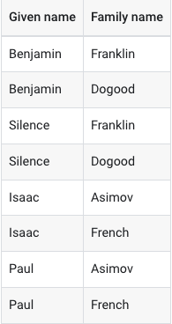
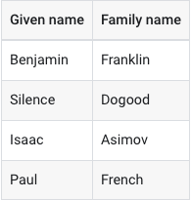
Pathling `extract()` operation
Smart Unnesting
only the combinations that exists in the FHIR data are created
Create tabular views/extracts from FHIR data:
define the columns as FHIRPath expressions
filter resources with FHIRPath
{
'id':'1’,
'name’[
{ 'given': 'Benjamin', 'family':'Franklin’},
{ 'given': 'Silence', 'family':'Dodood’}
]
},
{
'id':'2’,
'name’[
{ 'given': ‘Isaac', 'family':'Asimov’},
{ 'given': 'Paul', 'family':'French’}
]
}
extract(’Patient’,
columns = [
‘name.given’,
‘name.family’
],
filters = [])
Notes:
So, let me just talk a little bit more about the `extract` operation.
It can be use to create tabular extracts from FHIR data.
We can define the columns with FHIR path expression
And also use FHR path to filter the resources included in the view.
I’s important to note that: extract combines the the values of the columns in such a way that only the rows with the combinations that exists in the FHIR data are created.
So for example, if we extact ’name.given’ and ‘name.famly’ the produced combination are ’…. That do exist in the FHIR data
That is as oppose to creating the cartesian product of alt the given and family names.
And that concludes part one of the session.

Slide 16
What did you learn?
How to
  use Apache Spark and Pathing to encode FHIR data into delta tables optimized for large scale SQL queries
  use FHIRPath and SQL to transform FHIR data into tabular views :
    simple, complex data types, Quantities
    data in related resources
    codes and terminology functions
    extensions and nested structures.
  create an batch ETL pipeline that automates the extraction of data from a FHIR server and loading of the relevant data to the end user analytical database.
Databricks is just one of many possible deployment platforms.
Notes:
So just to sumarise, we lerned
How to use Apache Spak and Pathing to encode FHIR data into the binary format optimized for large scale queries
How to use Spark SQL and FHiRpath to extract data relevant for use case centric views from raw FHIR data.
How to combine FHIR bulk export API and the two elements above to create an automated pipeline for self service analytics.

Slide 17
Contact
During DevDays, you can find / reach me here:
  Via Whova App – Speaker’s Gallery
  Email: piotr.szul@csiro.au
Github:
  The Pipeline: https://github.com/aehrc/fhir-analytics-pipeline
  Pathling: https://github.com/aehrc/pathling
Related sessions:
  Wed 10:15 – 11:00: The FHIR Bulk Data API and what's new in v2!
  Wed 15:45 – 16:30: SQL on FHIR 2.0 BOF
  Wed 15:45 – 16:30: Let's Build! Hands-on FHIRPath
Notes:
I would be very happy to connect with anybody interested in this or similar topics, and here are my contact details,
As well the the links to the github repositored to both the notbooks we have been using and Pathglin.

Slide 18

Q&A
https://www.devdays.com/feedback/
Notes:
So that all from me, now I would be happy to answer any questions that you may have.

