Slide 1
FHIR services for architects
What do I need, what exists, and how does it ﬁt?
Jörn Guy Süß · AEHRC, CSIRO
Track 2: FHIR for Services · Architecture breakout
FHIR in Queensland Health Connectathon · 29–30 October 2026

Slide 2
The architect's four questions
1. Find. Who oﬀers what, and which codes do we agree on?
2. Do. How is work requested, tracked and scheduled?
3. Connect. How does the legacy estate join in?
4. Prove. How do I know it works?
And for each one: what is there to reuse, what is mine to build, and where do I look?
FHIR in Queensland Health Connectathon · 29–30 October 2026
2

Slide 3
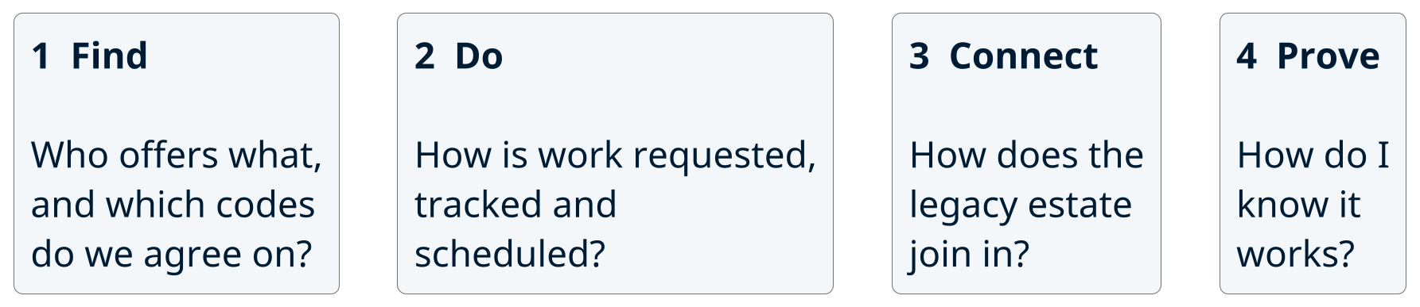
Four families of service
Each family has a few ready-made services. We look at what is in each, and what it takes to use it.
FHIR in Queensland Health Connectathon · 29–30 October 2026
3

Slide 4
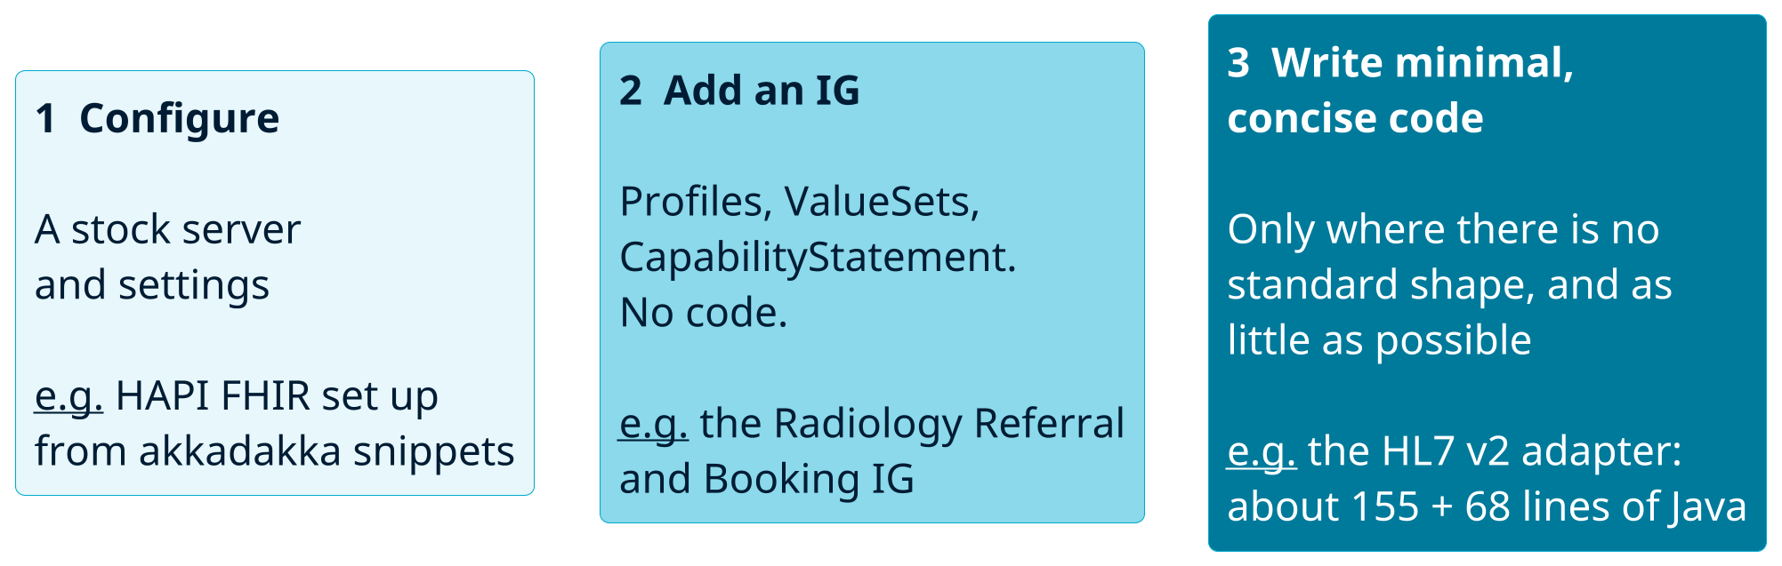
Three levels of eﬀort
The colour follows the eﬀort: the darker, the more custom work. Most of an architecture is levels 1 and 2.
FHIR in Queensland Health Connectathon · 29–30 October 2026
4

Slide 5
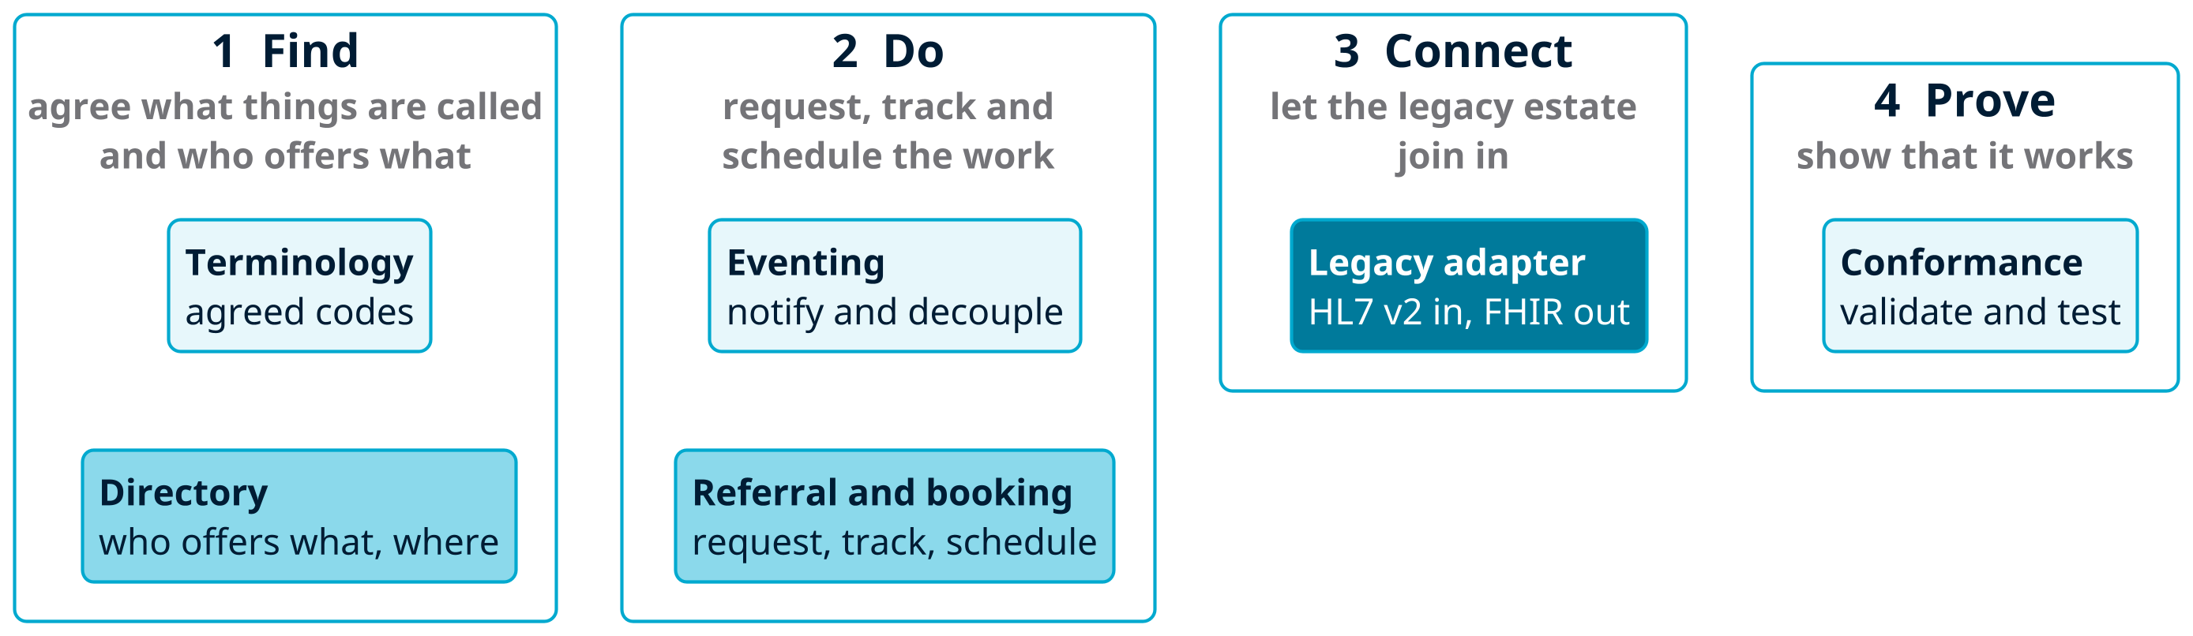
Six services across the four families
Pale services are conﬁguration, mid-tone ones need an IG, the dark one needs a little code.
FHIR in Queensland Health Connectathon · 29–30 October 2026
5

Slide 6
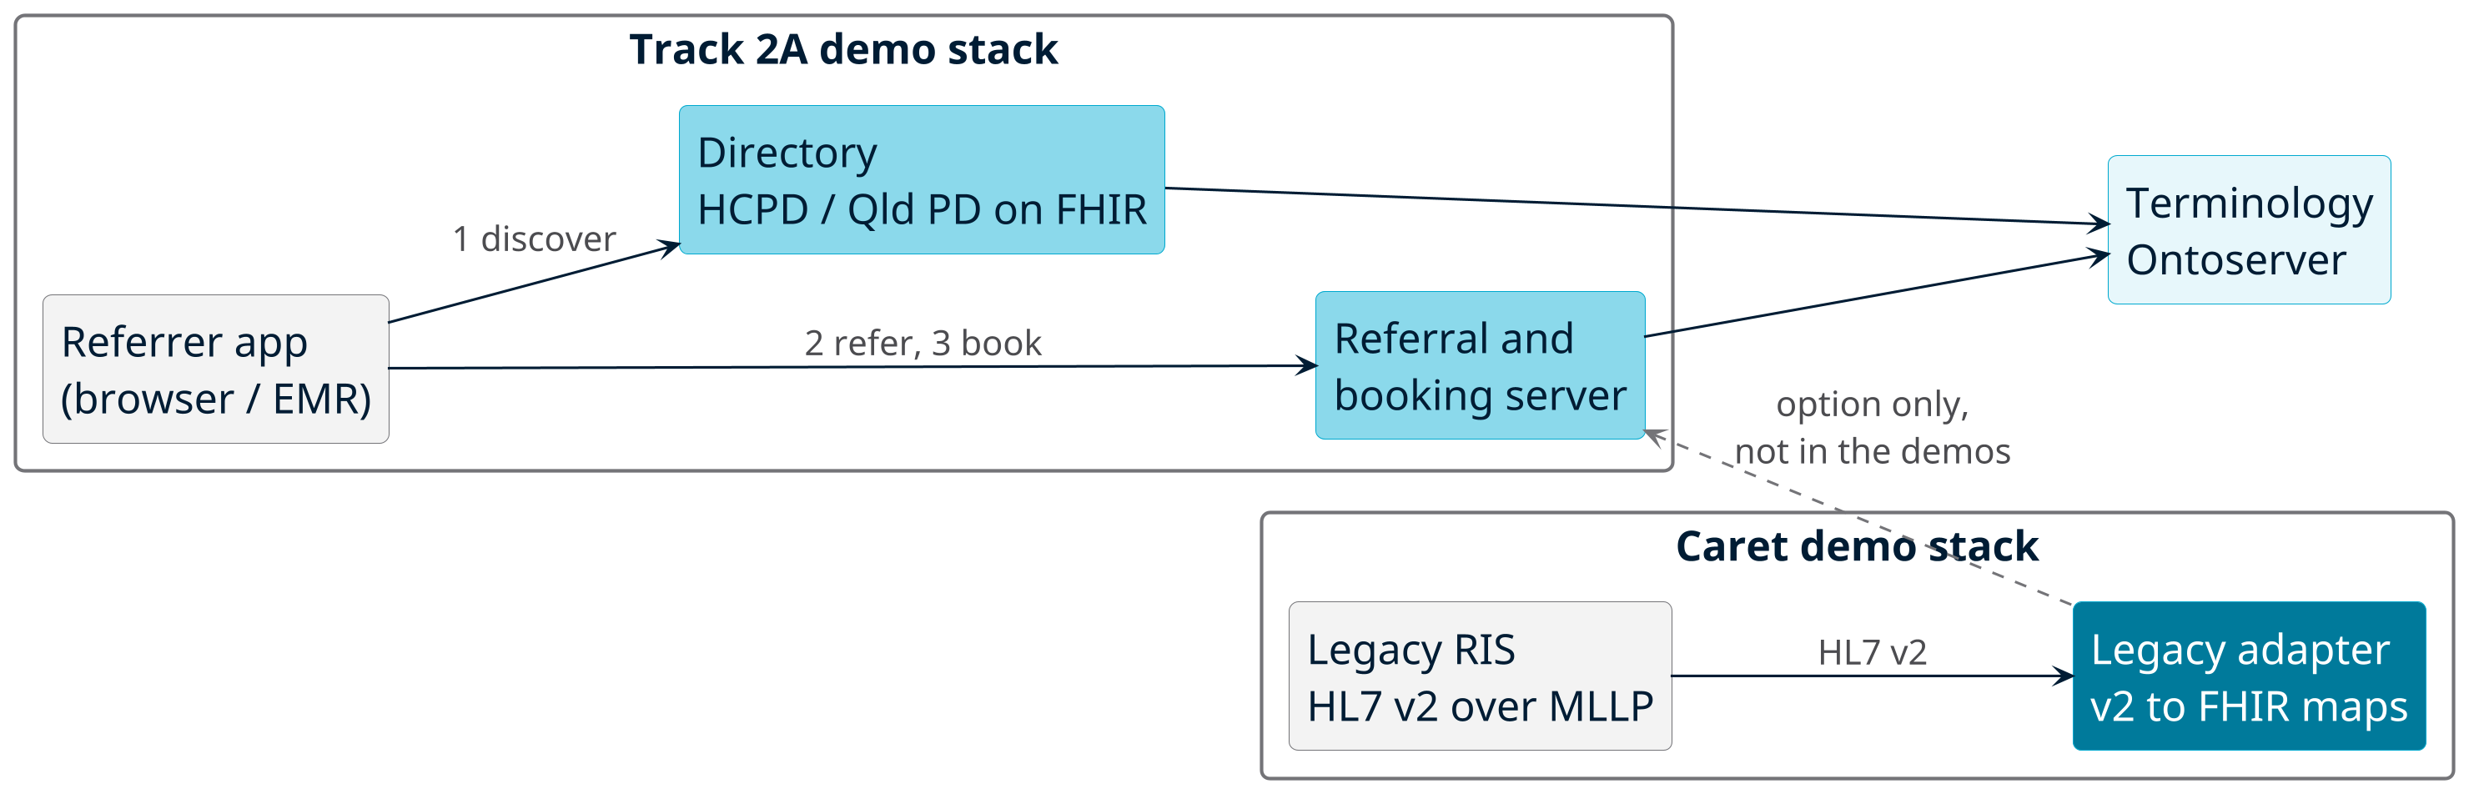
How they could combine (illustrative)
The demo stacks are separate: Track 2A and Caret share no infrastructure or data. The dashed line is a
design option, not something we run.
FHIR in Queensland Health Connectathon · 29–30 October 2026
6

Slide 7
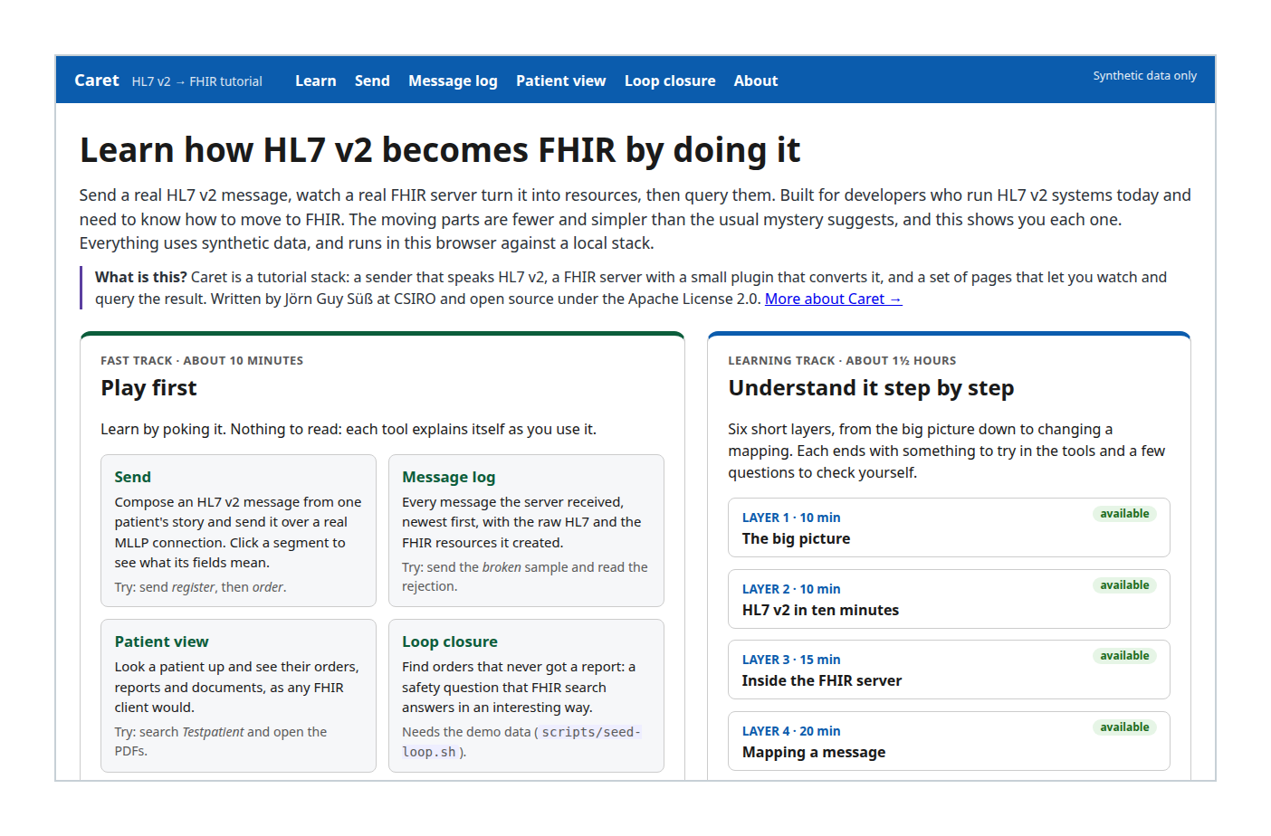
Worked example: Caret
Stock: HAPI FHIR server, validator, mapping engine,
storage, Postgres.
Ours: a small plugin (listener 155 lines, parser 68) and
maps of 45 to 105 lines each.
Apache-2.0. Synthetic data. Source · Try it live
FHIR in Queensland Health Connectathon · 29–30 October 2026
7

Slide 8
Limits of Caret
Reference, not a product: ﬁve message types, no authentication or TLS, one ﬁctional hospital.
Two defects ﬁxed in the plugin: unescaped "^" gave AE with no audit record; a contained Observation
showed an object name.
Failures now get a rejected acknowledgement and an AuditEvent.
Details and code: Caret on GitLab.
FHIR in Queensland Health Connectathon · 29–30 October 2026
8

Slide 9

Which pattern answers which question
Question
Pattern
Who oﬀers this service, and where?
Naming and Trading Service
How do I request work and track it?
Asynchronous Invocation
How do I tell others something changed?
Event Observer, Broker
How does the legacy system join in?
Legacy Adapter
Do we mean the same codes?
PL-09, PL-10
How do I know it works?
PL-15, PL-17
Source: fhirpatterns.net
FHIR in Queensland Health Connectathon · 29–30 October 2026
9

Slide 10

Experiments: akkadakka
Wiki, snippets and tutorial trail for the HAPI FHIR JPA Starter.
Conﬁguration and reuse; no HAPI code held.
More than a dozen snippets. No snippet yet for terminology, directory or the legacy adapter.
When conﬁguration is not enough, small plugins on stock HAPI: PSGC and Duke UCUM (terminology),
AU Patient Summary, and the HL7 v2 adapter behind Caret.
"Activate IPS" (International Patient Summary) leads to the AU Patient Summary plugin.
akkadakka on GitLab
FHIR in Queensland Health Connectathon · 29–30 October 2026
10

Slide 11

Conformance checks
Two layers: HAPI $validate for resources, fhir-frog for conformance test scripts.
frog-runner is public (early trial); a live runner is up for the event.
Track 2 test report: directory bundle 1 of 1 and referral bundle 6 of 6 pass on AWS and on DiSP; 40
users for 8 minutes, no errors.
AU eRequesting ﬁxtures ﬁxed for 1.0.1 (merge request): 7 of 7 pass, was 3 of 7.
Patterns: PL-15, PL-17.
FHIR in Queensland Health Connectathon · 29–30 October 2026
11

Slide 12
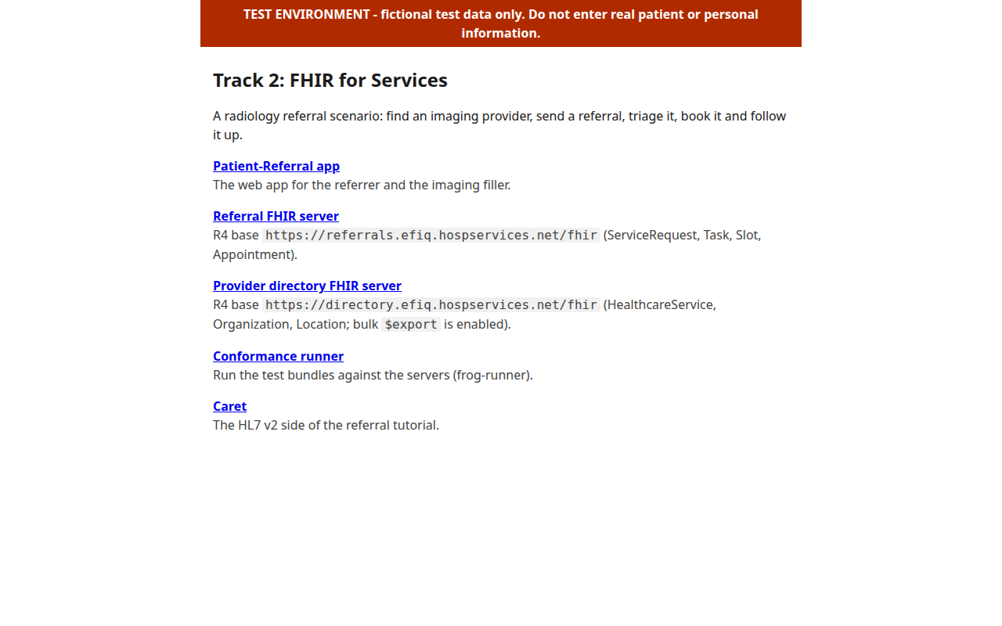
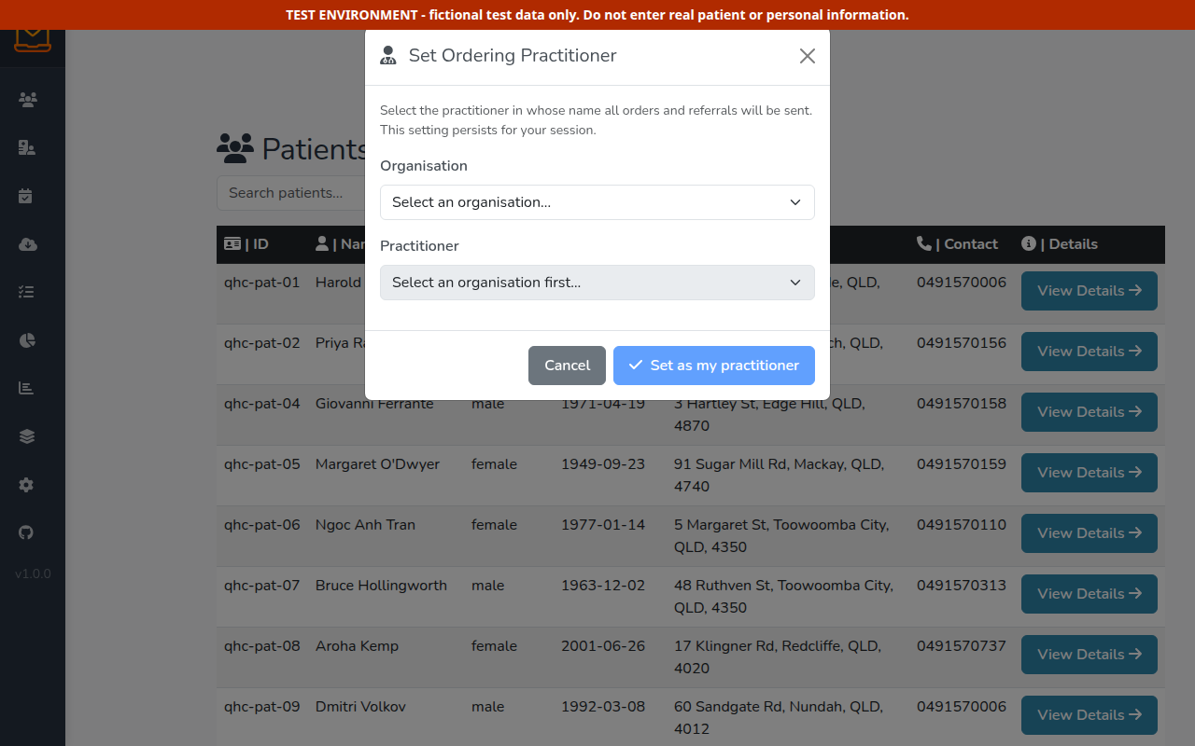
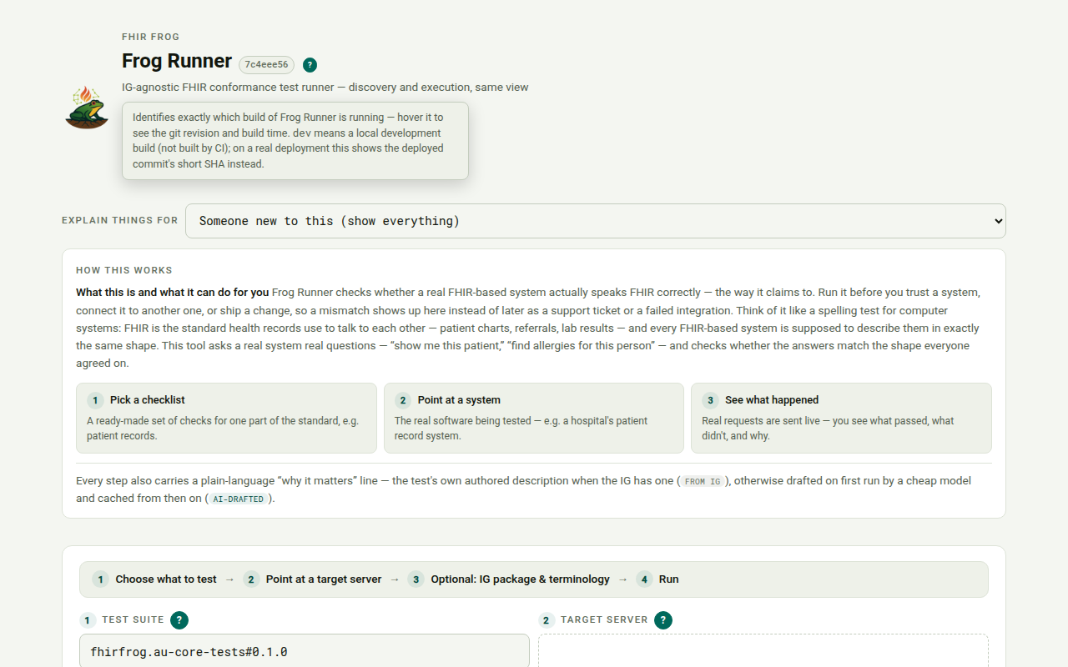
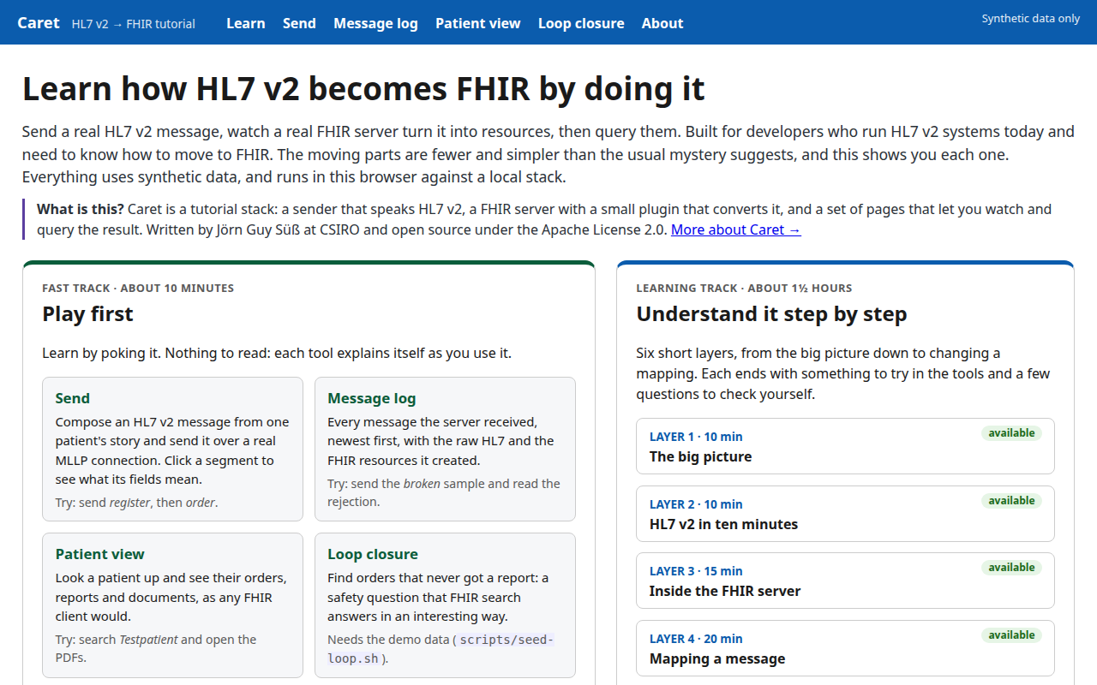
Try it live
Landing page
Referral app
Conformance runner
Caret (HL7 v2)
Up for the event, 29 and 30 October. Fictional test data only. FHIR bases: referrals and directory.
FHIR in Queensland Health Connectathon · 29–30 October 2026
12

Slide 13
Where to look
Topic
Advice
Try it
Run it
Ontoserver on Docker Compose, public
Terminology
PL-09, PL-10
PSGC, Duke UCUM
Ontoserver
Directory
Naming and Trading
gap
repo, live
Referral and
Async Invocation
snippet
repo, IG, app
booking
Eventing
Event Observer
snippet
the akkadakka snippets
Legacy adapter
Legacy Adapter
v2 adapter
Caret, live
International Patient
Activate IPS
Patient summary
AU-PS sample, tests
Summary
snippet
Conformance
PL-15
snippet
frog-runner, live
FHIR in Queensland Health Connectathon · 29–30 October 2026
13

Slide 14
Scan for the sources
Patterns
Track 2 repo
Test report
Caret
akkadakka
frog-runner
FHIR in Queensland Health Connectathon · 29–30 October 2026
14

