Slide 1
Caret: a message's journey into FHIR
Hands-on: send HL7 v2, watch FHIR appear, read the map
Jörn Guy Süß · AEHRC, CSIRO
Track 2: FHIR for Services · Messaging breakout
FHIR in Queensland Health Connectathon · 29–30 October 2026 · Messaging breakout

Slide 2
What you will do
1. Compose an HL7 v2 message in the browser.
2. Send it over a real MLLP socket and read the ACK.
3. Watch it validate and transform: one AuditEvent per message.
4. Consume the FHIR it became.
5. Extend it: change a map, add a message type, or build a client.
Synthetic data only. A small sender stands in for the RIS (radiology information system).
FHIR in Queensland Health Connectathon · 29–30 October 2026 · Messaging breakout
2

Slide 3
Get in
https://v2.eﬁq.hospservices.net/ (up for the event; ﬁctional data only)
Source and tutorial: Caret on GitLab. It also runs locally with
docker compose up -d --wait
.
FHIR in Queensland Health Connectathon · 29–30 October 2026 · Messaging breakout
3

Slide 4
The pieces
Piece
Role
Sender (
send.html
)
Stands in for the RIS; frames messages as MLLP
HL7 v2 adapter plugin
Receives MLLP inside a stock HAPI FHIR server
FHIR Mapping Language maps
Turn each message type into FHIR resources
HAPI FHIR server
Stores the resources and the AuditEvents
Pages (
log.html
,
patient.html
,
loop.html
)
Show what happened
Message types: ADT A04 and A08, ORM O01, ORU R01, MDM T02, OMI O23.
FHIR in Queensland Health Connectathon · 29–30 October 2026 · Messaging breakout
4

Slide 5
Stage 1: compose
HL7 v2 is pipe-and-hat (ER7): segments (
MSH
,
PID
,
OBR
,
OBX
) carry ﬁelds in ﬁxed positions.
MSH|^~\&|RIS|HOSP|...|ADT^A04|AUTO|P|2.5
PID|1||QH000123^^^HOSP^MR||Testpatient^Tina
Open
send.html
and pick the ﬁrst sample, register.
Hover a ﬁeld to see its name. Find
PID-3
(the MRN) and
PID-5
(the name).
FHIR in Queensland Health Connectathon · 29–30 October 2026 · Messaging breakout
5

Slide 6
Stage 2: send
The browser cannot speak MLLP, so the sender frames the message (
<VT>
...
<FS><CR>
) and
delivers it over a real socket.
You get an ACK back:
AA
means accepted, with the message's control id.
MSH-10
is
AUTO
: the sender assigns a unique control id, so re-sending is safe.
Try it: send register, read the
AA
, follow the Patient link.
FHIR in Queensland Health Connectathon · 29–30 October 2026 · Messaging breakout
6

Slide 7
Stage 3: watch
Open
log.html
. Every message writes one AuditEvent: outcome, message type, and the raw HL7 v2.
Send
What happens
nonconformant
Accepted, but a sparse PID records validation warnings
broken
Malformed
MSH
: rejected with
AE
, nothing created
Expand a row to see the raw message. The log refreshes every 5 seconds.
FHIR in Queensland Health Connectathon · 29–30 October 2026 · Messaging breakout
7

Slide 8
The patient's story: send in this order
#
Sample
Message
Becomes
1
register
ADT^A04
Patient
(MRN
QH000123
)
2
order
ORM^O01
active
ServiceRequest
3
study
OMI^O23
ImagingStudy
, linked to the order
4
report-text
ORU^R01
DiagnosticReport
+
Observation
s
5
report-pdf
ORU^R01
DiagnosticReport
with inline PDF
6
scanned
MDM^T02
DocumentReference
with a PDF
FHIR in Queensland Health Connectathon · 29–30 October 2026 · Messaging breakout
8

Slide 9
The story continues
#
Sample
Message
Eﬀect
7
update
ADT^A08
Updates the same
Patient
in place (no duplicate)
8
cancel
ORM^O01
Revokes the
ServiceRequest
from step 2
9
nonconformant
ADT^A04
Accepted, with validation warnings
10
broken
(bad MSH)
Rejected
AE
, nothing created
Because the same MRN is reused, v2 updates and cancellations land on the right FHIR resource.
FHIR in Queensland Health Connectathon · 29–30 October 2026 · Messaging breakout
9

Slide 10
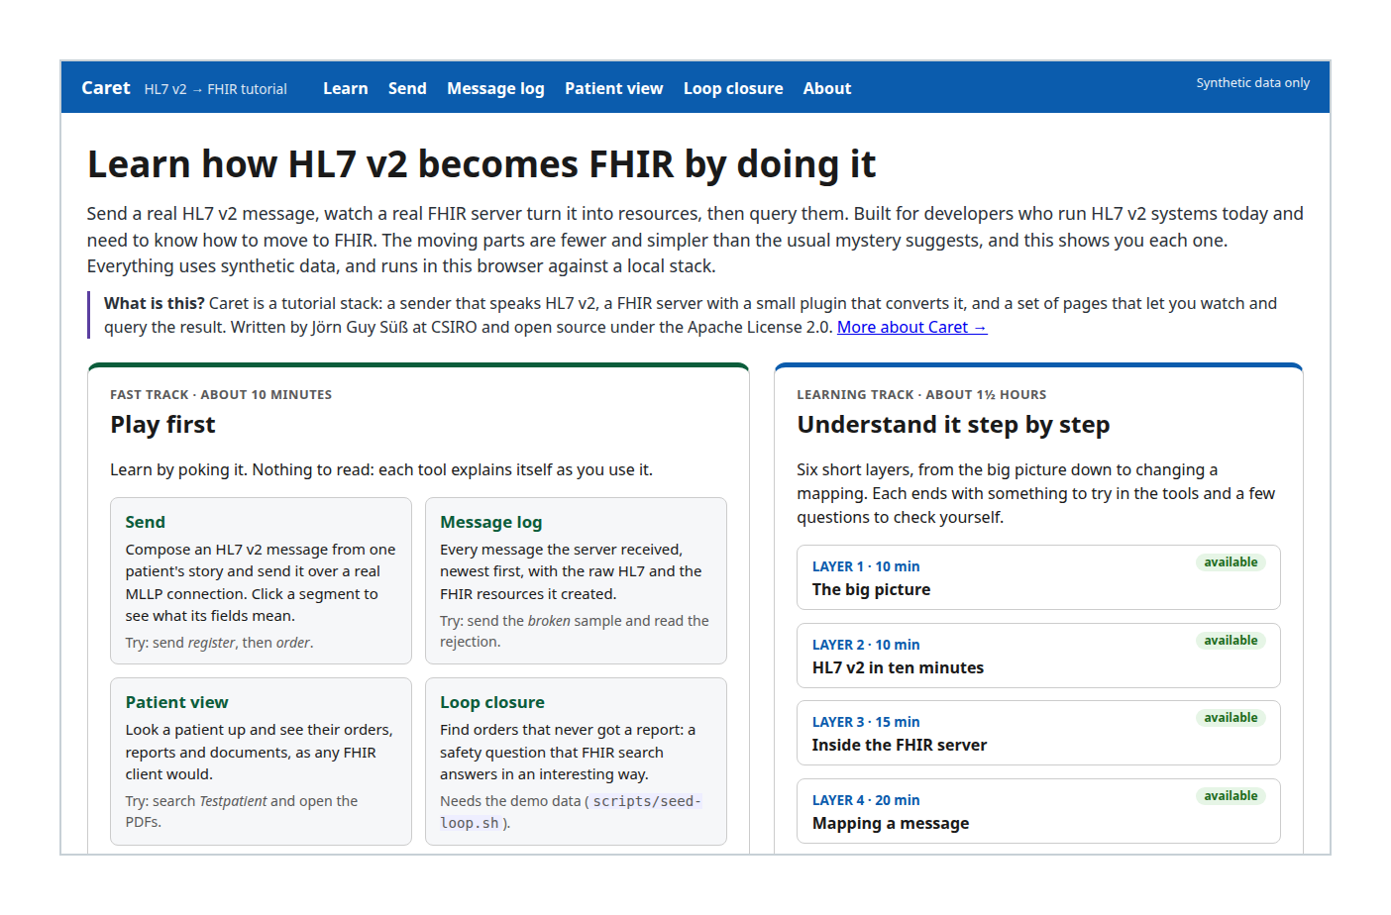
Stage 4: consume the FHIR
Open
patient.html
and search
Testpatient
(or MRN
QH000123
).
The page shows the FHIR request URLs it used.
Open the report PDF and the scanned referral (allow pop-ups if blocked).
FHIR in Queensland Health Connectathon · 29–30 October 2026 · Messaging breakout
10

Slide 11
Finale: the order that never came back
The real safety risk in radiology: an order goes to a RIS, the report never returns, and nobody sees it is
missing.
loop.html
lists active orders older than N days that no ﬁnal or amended report closes.
1. One
_revinclude
query, diﬀerence on the client:
ServiceRequest?
status=active&authored=lt<date>&_revinclude=DiagnosticReport:based-on
2. The positive form with
_has
:
ServiceRequest?...&_has:DiagnosticReport:based-on:status=final
Open set = old active orders minus the closed ones. One order is ﬂagged:
LOOP-OPEN-001
.
FHIR in Queensland Health Connectathon · 29–30 October 2026 · Messaging breakout
11

Slide 12
Why that works
FHIR search ﬁnds what exists. The safety question is about what is missing.
R4 has no negative
_has
, so you take a set diﬀerence.
Both queries need literal references: the report's
basedOn
must resolve to
ServiceRequest/<id>
.
Early on the reports carried only a logical identiﬁer, and both queries returned nothing. Check your
references.
FHIR in Queensland Health Connectathon · 29–30 October 2026 · Messaging breakout
12

Slide 13
Stage 5: extend it
Easiest ﬁrst. Mapping work happens in the adapter's
ris-ingest-plugin
.
Add a ﬁeld to a map. Carry one more OBX/OBR ﬁeld into the FHIR resource, rebuild, re-send, check
patient.html
.
Add a message type. Add a route and a StructureMap, for example
ADT^A40
merge, plus a synthetic
sample.
Build a client. Script or notebook against the FHIR API via the sender's
/fhir
proxy: list a patient's
DiagnosticReports, pull the PDFs. No credentials in this stack.
FHIR in Queensland Health Connectathon · 29–30 October 2026 · Messaging breakout
13

Slide 14
What building Caret taught us
Two real faults, both ﬁxed in the plugin (merged):
An unescaped caret in a text report made the server answer
AE
with no audit record.
A contained Observation showed an object name instead of the report text.
Failed messages now get a rejected acknowledgement with a reason and an AuditEvent. A reader of a map
can ﬁnd and ﬁx this kind of fault.
FHIR in Queensland Health Connectathon · 29–30 October 2026 · Messaging breakout
14

Slide 15
Limits of Caret
Reference, not a product: ﬁve message types, no authentication or TLS, one ﬁctional hospital.
Production needs authentication, TLS, more message types and monitoring. Layer 6 of the tutorial lists
what.
Details and code: Caret on GitLab.
FHIR in Queensland Health Connectathon · 29–30 October 2026 · Messaging breakout
15

Slide 16
Where to look
Live
Source
Pattern
Caret
Tutorial
Legacy Adapter
HL7 v2 adapter
FHIR in Queensland Health Connectathon · 29–30 October 2026 · Messaging breakout
16

Slide 17

One last thing
HL7 v3 was meant to tame messaging with a reference
information model and XML schemas for everything.
Caret's v2 maps are small enough to read, and you can ﬁx a
fault in one. That is the point of the exercise.
The Thing from V3: coming to a legacy interface near you.
FHIR in Queensland Health Connectathon · 29–30 October 2026 · Messaging breakout

