Slide 1
Humanities 101—Expository Writing
Library Tools: The researcher as detective

Slide 2
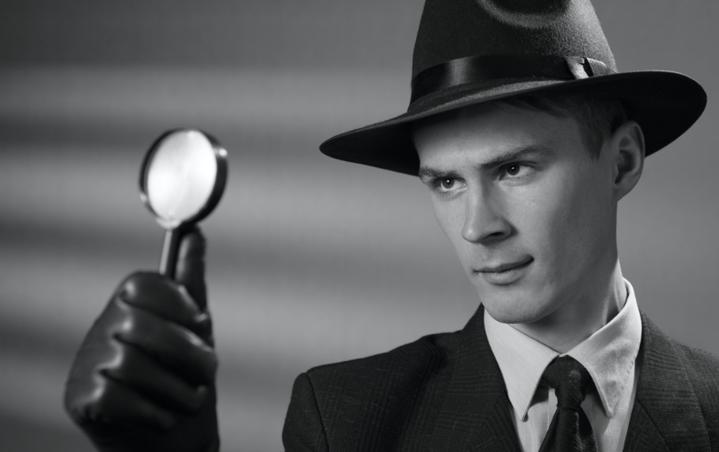


Detectives, Researchers, and You
analyze
revise
discover
Image: thewashingtongazette.com
Image: stock.adobe.com
Image: www.stemcell.com
Notes:
The goals and tasks of literary detectives, professional researchers, and college students are quite similar. They all must go through a process of discovery to find evidence to solve a mystery or answer another type of important question.
All three must perform multiple intellectual tasks as they probe for clues:
Comprehend the importance and relevance of the task at hand (solve a murder, contribute new knowledge, show they have mastered a new skill).
Formulate one or more guiding questions they are trying to answer; they may come up with more questions as they go.
Identify and evaluate the claims of others about the same topic to see if they are relevant, helpful, or unhelpful.
Situate their arguments in a larger debate about a topic or subject.
Check-in questions:
Which of these tasks have you found yourself performing in this writing course so far? Any examples?
The four detective characters you’ve read about have different styles of detection. Do you think it’s possible to have different styles of expository college writing? How so?

Slide 3

Make a research plan
Do you have a thesis idea or organizing question yet?
Depending on your answer, plan your initial round of research accordingly.
What’s your ultimate goal?
ID a few initial research tasks that can further your goal.
Where can you go to start looking for clues and answer questions?
Be ready to cite any sources that help make your argument. Take notes!
Notes:
Thesis idea or organizing question?
If you just have a topic in mind when you start, e.g., character development, try to learn more about how perform analysis for that topic:
read some character development analysis by pros.
look up definitions for your topic.
What’s your ultimate goal?- how do you want to make your argument?
Explain how character development makes the detective’s work more difficult?
Show how social values in the narrative affect the detective’s reasoning?
Compare and contrast two different detectives to create a detective definition?
Not sure?- you may want to brainstorm with classmates or other peers.
After you have a sense of your approach, you can dig into details in your primary source and secondary source.
Where to start?
Your primary text
Library
Internet sources (be careful to use reliable sources / talk to your instructor).
Brainstorm with your peers.
Consult an expert for guidance, e.g., your instructor, another faculty member.

Slide 4


The Search Process
DRAFT
Research Plan
Assume refinement!
Incorporate
Search
Select
Read
Revise/ Refine Approach
Notes:
When answering questions about relevance for yourself, you may find that the source is both relevant and causes you to refine your approach.
Plan to follow this process several times in the course of a research project.

Slide 5

Concisely describe your text
Start your process by describing to yourself what the text is about.
“[An] avant-garde mystery metafiction, [Ghosts] follows a predictable, essentially familiar scenario: a detective, hired to shadow an enigmatic stranger, finds himself caught up in an existential, doppelganger-ish identity crisis. The detective, N.Y.C. circa 1947, is called Blue. He's hired by White to keep a close watch on Black, who spends nearly all his time writing (the story we're reading, perhaps?) in a Brooklyn Heights apartment.”
--Kirkus Reviews (www.kirkusreviews.com)
Image: Ghosts cover art, Penguin Contemporary Fiction
Notes:
The “aboutness” of a text can provide us or remind us of essential clues to solve our problem.
Revisit your thesis paragraph from your original assignment
Use notes from classes lectures or discussions.
Find a synopsis written by someone else.
Look for interesting terms that seem to make the text unique or noteworthy.
Questions
What questions or topics could you add to a research plan based on this synopsis?

Slide 6
Library Assignment: Original Thesis Idea
New York City’s way of life frustrates Blue’s ability to solve the mystery.

Slide 7
Strategies for searching
“[An] avant-garde mystery metafiction, [Ghosts] follows a predictable, essentially familiar scenario: a detective, hired to shadow an enigmatic stranger, finds himself caught up in an existential, doppelganger-ish identity crisis. The detective, N.Y.C. circa 1947, is called Blue. He's hired by White to keep a close watch on Black, who spends nearly all his time writing (the story we're reading, perhaps?) in a Brooklyn Heights apartment.”
Key terms:
Avant-garde mystery
metafiction
Interesting phrases and facts
Enigmatic stranger
Doppelganger-ish identity crisis
NYC circa 1947
Black may be writing the story we’re reading
Other things to notice?
Notes:
Solicit key terms and facts & phrases from the synopsis.
Discuss how student-provided suggestions align or don’t align with the example approach.

Slide 8
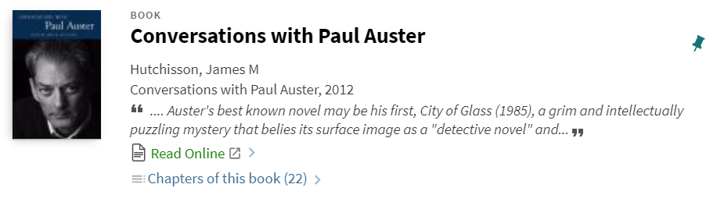

Searching: first crack
Use detection!
Notes:
2nd result on list. Are there other relevant results nearby? (No).
Relevant but not directly related to Ghosts.
Assessment: best to use a third-party analysis before an author interview.

Slide 9
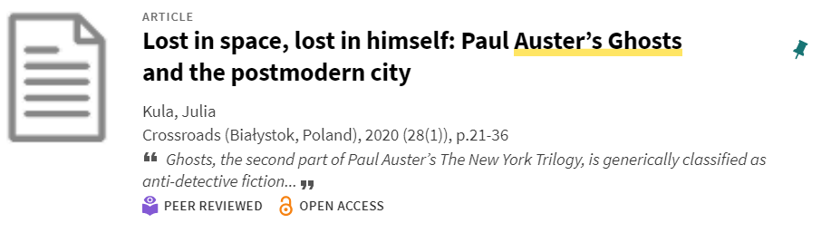
Searching: try a different approach
Use detection!
Notes:
6th result on list. Other relevant results nearby? (Yes)
Terms from article’s title align somewhat with original thesis idea: idea of being lost; idea of the city; new term—post-modern.
Assessment: Opportunity to refine approach.

Slide 10
Searching: keep in mind…
You can increase relevance and specificity by choosing a particular database to search, e.g., “Arts and Humanities Database;” “Science Direct Journals”.
Your initial source materials may decrease in relevance if you continue to refine your search and discovery. Don’t be afraid to discard.
If you find complex material that you don’t fully understand but want to use, it’s OK to discuss it with someone who can help explain.
BUT don’t ask that person to develop your argument for you or tell you how to integrate your understanding into your own work.

Slide 11
Library Assignment: Revised Thesis Idea
Auster describes New York as a post-modern city in which everything is false, an imitation of something else. In this unreal environment Blue’s traditional detective skills don’t work.

Slide 12



The researcher as detective
This process of information seeking is fundamentally the same in the humanities, the sciences and the social sciences.

