Slide 1
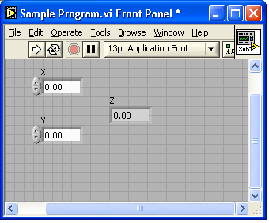
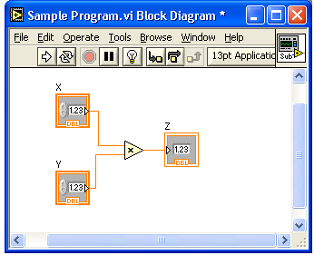
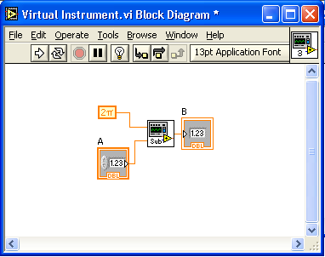
Lecture 2 – SubVIs
What is a subVI?
Making an icon and connector for a subVI
Using a VI as a subVI

Slide 2




Block Diagram Nodes
Icon Expandable Node Expanded Node
Function Generator VI
Same VI, viewed three different ways
Yellow field designates a standard VI
Blue field designates an Express VI
Express VI
Notes:
Just as control or indicator terminals on the block diagram can be viewed as an icon or a simple terminal, subVIs can be viewed as an icon, an expandable node, or an expanded node. The different views merely depend on user preference and do not change the functionality of the subVI.

Slide 3
SubVIs
A SubVI is a VI that can be used within another VI
Similar to a subroutine
Advantages
  Modular
  Easier to debug
  Don’t have to recreate code
  Require less memory
Notes:
After you build a VI and create its icon and connector pane, you can use it in another VI. A VI within another VI is called a subVI. A subVI corresponds to a subroutine in text-based programming languages. Using subVIs helps you manage changes and debug the block diagram quickly.

Slide 4



Icon and Connector
An icon represents a VI in other block diagrams
A connector shows available terminals for data transfer
Icon
Terminals
Connector
Notes:
Every VI displays an icon, shown above, in the upper right corner of the front panel and block diagram windows. An icon is a graphical representation of a VI. It can contain text, images, or a combination of both. If you use a VI as a subVI, the icon identifies the subVI on the block diagram of the VI.
The connector shows terminals available for transfer or data to and from the subVI. There are several connector patterns to choose from. Right click on the connector and select the pattern from the Patterns menu. From there you can assign controls and indicators on the front panel to the connector terminal, as we will see later.

Slide 5
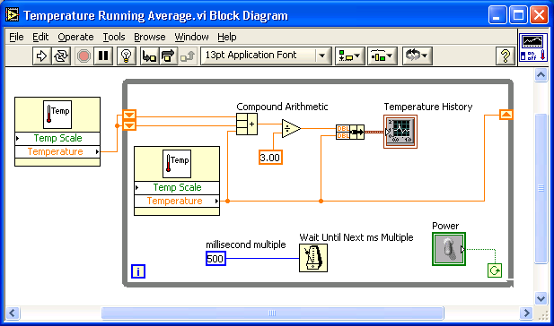
SubVIs
Sub VIs
Notes:
The above block diagram contains two subVIs. To see the front panel of a subVI, simply double click the subVI. You can also view the hierarchy of subVIs within a top level VI by clicking on Browse » Show VI Hierarchy.

Slide 6
Steps to Create a SubVI
Create the Icon
Create the Connector
Assign Terminals
Save the VI
Insert the VI into a Top Level VI

Slide 7
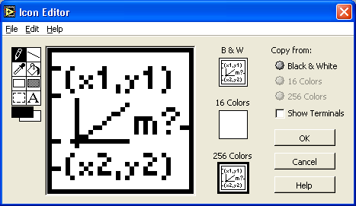
Create the Icon
Right-click on the icon in the block diagram or front panel
Notes:
Create custom icons to replace the default icon by right-clicking the icon in the upper right corner of the front panel or block diagram and selecting Edit Icon from the shortcut menu or by double-clicking the icon in the upper right corner of the front panel. You also can edit icons by selecting File»VI Properties, selecting General from the Category pull-down menu, and clicking the Edit Icon button. Use the tools on the left side of the Icon Editor dialog box to create the icon design in the editing area. The normal size image of the icon appears in the appropriate box to the right of the editing area.
You also can drag a graphic from anywhere in your file system and drop it in the upper right corner of the front panel or block diagram. LabVIEW converts the graphic to a 32 × 32 pixel icon.

Slide 8
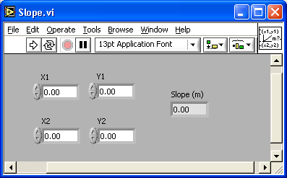
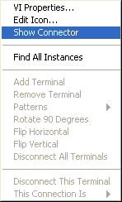
Create the Connector
Right click on the icon pane (front panel only)
Notes:
To use a VI as a subVI, you need to build a connector pane. The connector pane is a set of terminals that corresponds to the controls and indicators of that VI, similar to the parameter list of a function call in text-based programming languages. The connector pane defines the inputs and outputs you can wire to the VI so you can use it as a subVI.
Define connections by assigning a front panel control or indicator to each of the connector pane terminals. To define a connector pane, right-click the icon in the upper right corner of the front panel window and select Show Connector from the shortcut menu. The connector pane replaces the icon. Each rectangle on the connector pane represents a terminal. Use the rectangles to assign inputs and outputs. The number of terminals LabVIEW displays on the connector pane depends on the number of controls and indicators on the front panel. The above front panel has four controls and one indicator, so LabVIEW displays four input terminals and one output terminal on the connector pane.

Slide 9
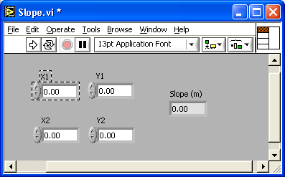

Assign Terminals
Notes:
After you select a pattern to use for your connector pane, you must define connections by assigning a front panel control or indicator to each of the connector pane terminals. When you link controls and indicators to the connector pane, place inputs on the left and outputs on the right to prevent complicated, unclear wiring patterns in your VIs. To assign a terminal to a front panel control or indicator, click a terminal of the connector pane. Click the front panel control or indicator you want to assign to the terminal. Click an open area of the front panel. The terminal changes to the data type color of the control to indicate that you connected the terminal. You also can select the control or indicator first and then select the terminal.
Make sure you save the VI after you have made the terminal assignments.

Slide 10
Save The VI
Choose an Easy to Remember Location
Organize by Functionality
  Save Similar VIs into one directory (e.g. Math Utilities)
Organize by Application
  Save all VIs Used for a Specific Application into one directory or library file (e.g. Lab 1 – Frequency Response)
    Library Files (.llbs) combine many VI’s into a single file, ideal for transferring entire applications across computers
Notes:
There are several ways to organize your subVIs. The most common way is to organize by application. In this case, all the VI’s for a particular application are saved into the same directory or into a VI Library file. Saving into a library file allows you to transport an entire application within a single file.
Saving into library is simple. After clicking Save As…, click New VI Library. This will allow you to name the library, and then save your VI into it. To add subsequent VI’s, simply double click the .llb file from the standard Save window, and give the VI a name.

Slide 11
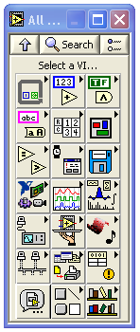
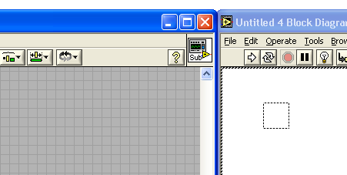
Insert the SubVI into a Top Level VI
Accessing user-made subVIs
  Functions >>All Functions >> Select a VI
Or
  Drag icon onto target diagram
Notes:
After you build a VI and create its icon and connector pane, you can use it as a subVI. To place a subVI on the block diagram, select Functions»Select a VI. Navigate to and double-click the VI you want to use as a subVI and place it on the block diagram.
You also can place an open VI on the block diagram of another open VI by using the Positioning tool to click the icon in the upper right corner of the front panel or block diagram of the VI you want to use as a subVI and drag the icon to the block diagram of the other VI.

