Slide 1
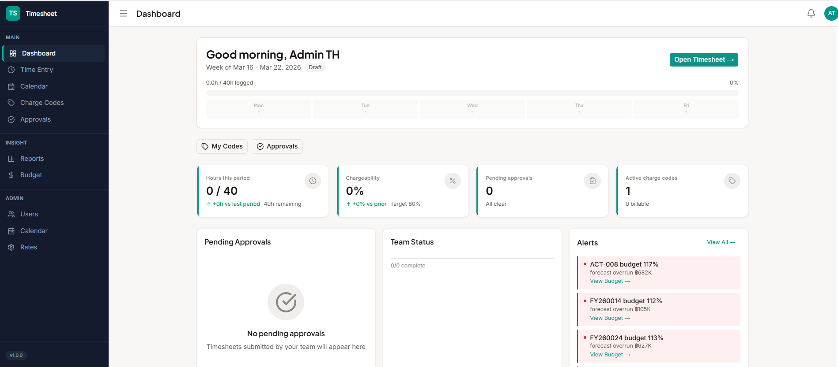
Add % Chargeability YTD.
Add Chargeability trend graph YTD
Add Pie Chart distribution of program the person spending time (charge to) for this current period and YTD

Slide 2
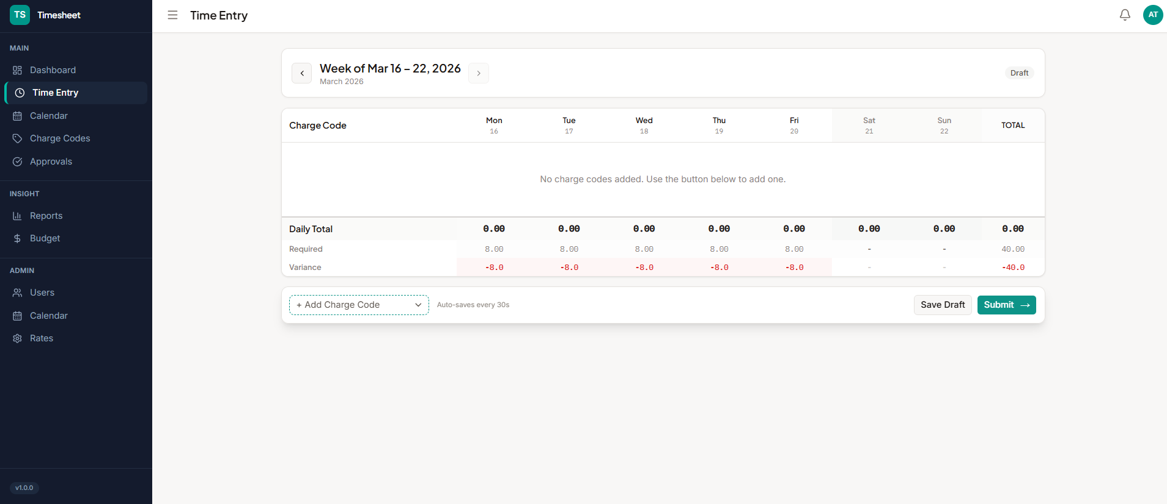
Dropdown selection of Period
Showing last period for reference and make it easy to copy or reuse the charge code for this period entry because most of the time we log to the same charge code for many weeks
Since vacation is approved in Cnext, we should just let employee entry the vacation hours in timesheet without having the request another leave approval
Should have a way to request for new charge code (with information of the charge code owner) if they don’t have access to. Charge code owner to approve before usage.

Slide 3
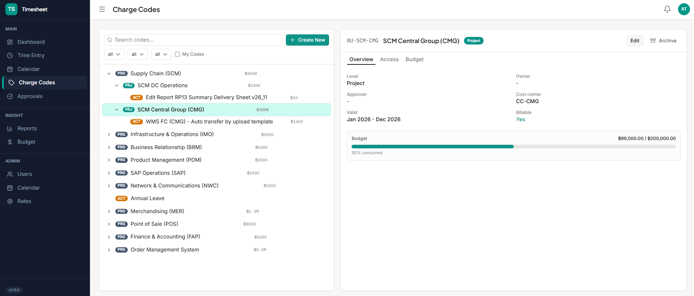
To be able to drill down to detail of the budget spent. Breakdown of Budget vs Actual at parent and child. Also to be able to see the detail of how much which team (and each person) are charging to these charge code. So it is easier to analyze where the charges are coming from.
Make the summary view on the left easier to look at. It is hard to see the hierarchy and numbers lay out are not aligned.
Able to add access and option to cascade the access to all the child charge code

Slide 4
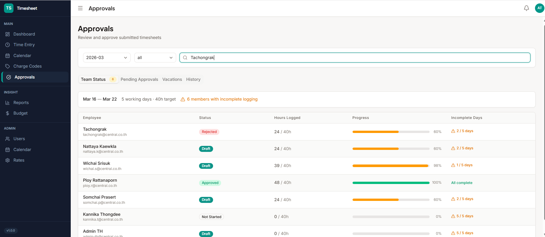
Search seems not working

Slide 5
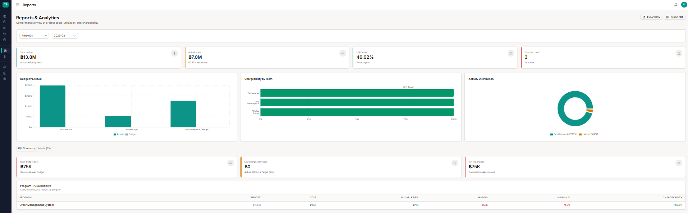
Report by Program
Showing Budget vs Actual of the program
Breakdown Charging Distribution by Task, Team
Report by Cost Center
Chargeability of Team. e.g. Engineer to see the % chargeability of all engineer team
Breakdown Charge Distribution to see how much is charging to which program ; how much is non chargeable etc.
Report by Person – to see their historical charge history and individual summary of their time spent in each project / vacation , etc.

Slide 6
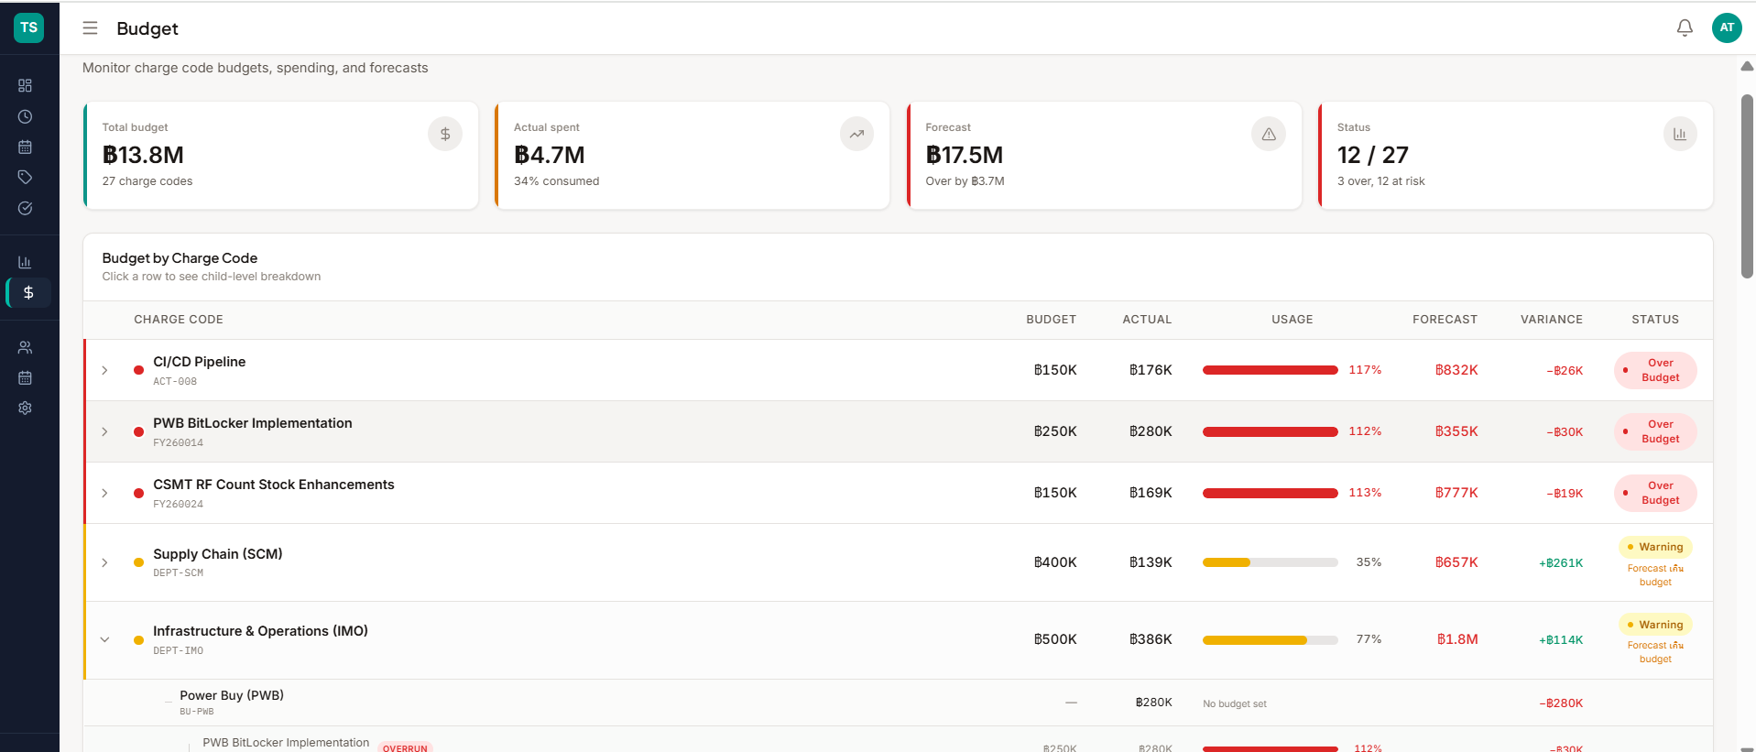
Add multi-select filtering of charge code/program
Add detail somewhere to be able to see break down of the actual are charged by which team or show top teams. E.g., Backend API for OMS are charged 80% to engineer, 10% to BA and 10% to all others.

Slide 7
Log In session – seems after we log out and re-login with different name, need to refresh the browser for info to update
Let’s add RIS logo as well
Add profile photo
Chatbot as discussed (if feasible)
System should be able to support 200 active employees ; 100 active projects ; and 5 years of historical data.

