Slide 1
Data Sources
Age, Income, and Population data pulled from US Census 5yr ACS (American Community Survey) API
Population Density pulled form US Census Population Estimate and Projection API
Walk Score Professional (https://www.walkscore.com/professional/api.php)
FBI Crime data: https://www.ucrdatatool.gov/Search/Crime/Local/OneYearofDataLarge.cfm
Filters:
Population Group: All
Agencies: All from VA
Variable Groups: All, although we only ended up using violent crime total and property crime total.
Year: 2014 (most recent year available)

Slide 2
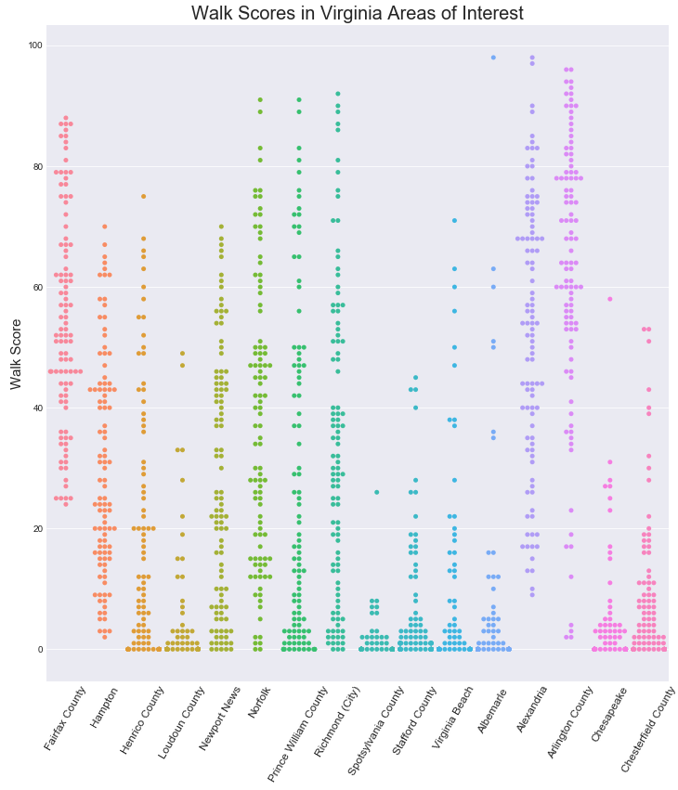
Methodology & Process
Simple data approach
Execute three API data pulls
Join data together in Jupyter Notebook
Visualize scatterplots and run statistical tests
Issues
Overwhelming amount of Census data
Granularity
Solutions
Perseverance
Random selection of 100 latitude and longitude from city and county maps to produce city/county averages
Notes:
* Describe the exploration and cleanup process
* Discuss insights you had while exploring the data that you didn't anticipate * Discuss any problems that arose after exploring the data, and how you resolved them

