Slide 1
Cluster Computer Analysis and report With Word-Cloud

Slide 2
Introduction
Goal of project
Steps taken
Problems & Solutions
Results

Slide 3

Preparing for the project

Slide 4
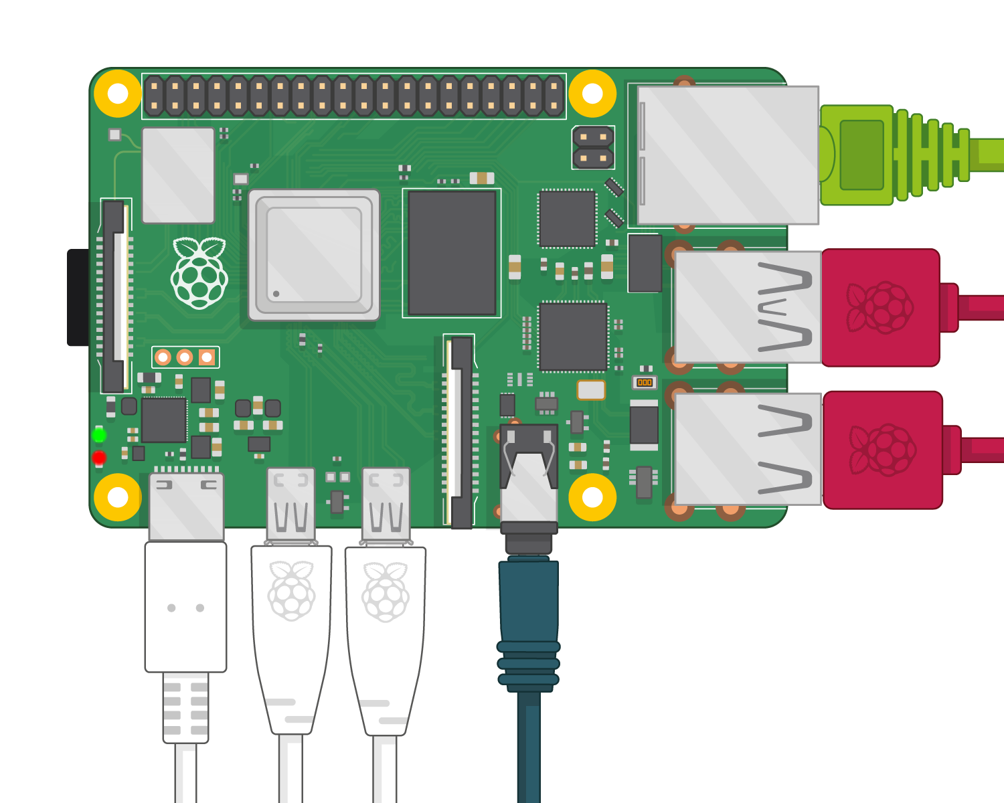
Resources Used
4 Raspberry Pi v4s
Micro HDMI
USB-C Cords
4 Flash Drives
Ethernet Switch
Power bank
Mouse, keyboard, and monitor

Slide 5
Challenges Faced
Storage
Wi-Fi
Master-Worker Interactions
Submitting Spark Job
Time Restraints

Slide 6
Dataset: ARXiv scientific research papers

Slide 7
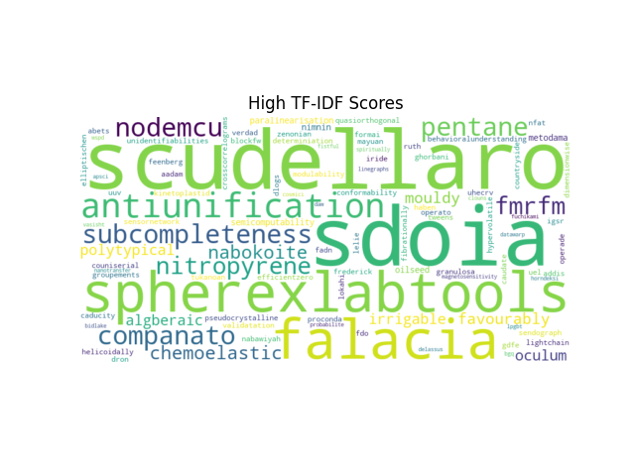
Inverse document frequency on titles
Measures how commonly a word is used across titles in the dataset.
Total number of documents / number of times the word appears across all documents
High score = infrequent usage = indicates unique terms in the dataset
Data cleaning

Slide 8
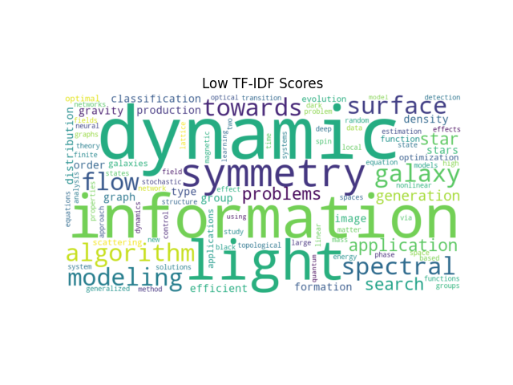
Interpreting results
Low score = frequent usage
In the context of research paper titles, both low and high IDF scores may be useful in understanding which terms are considered important
Frequent usage = popular topics
Infrequent usage = unique/ novel topics
Full 4GB Datastet 5min 24sec

Slide 9
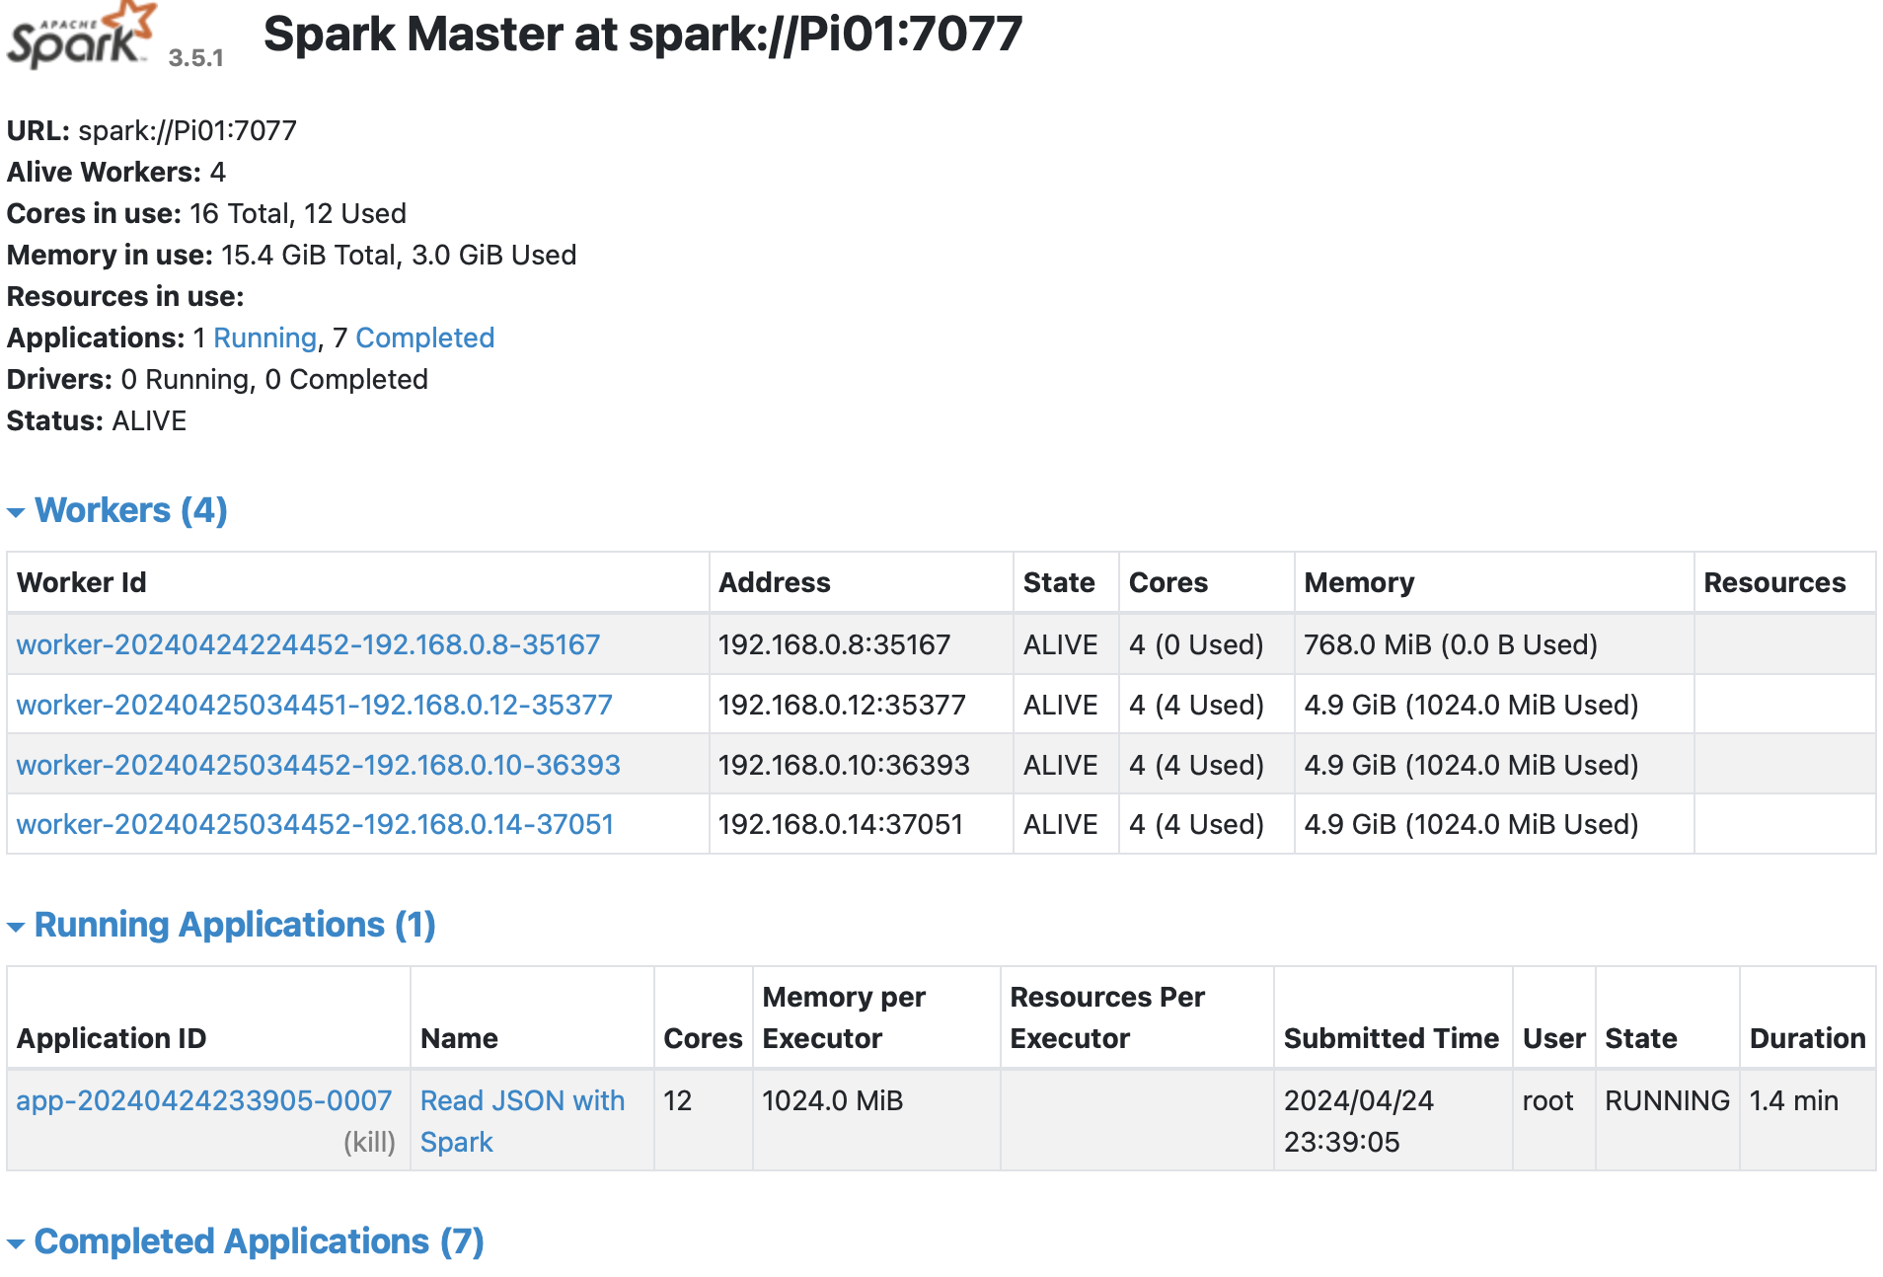
Running the job

Slide 10
Submit Job to Spark
/opt/spark/bin ./spark-submit --master spark://172.18.2.243:7077 –conf spark.dynamicAllocation.enabled=false –num-executors 3 –executor-cores 4 /home/raspberries/EXTERNDV/idf_raspberries.py

Slide 11
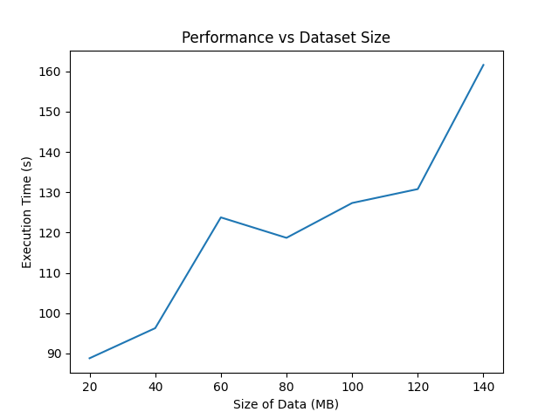
Spark performance

