Slide 1
Parameter | Meaning | Units | Source
m_{p} | Proportion of perennial adults that survive for a year |  | Literature
s_{i} | Proportion of dormant seeds of species i that survive for a year |  | Literature
g_{i} | Germination rate of species i | seedlings/seed | Composite parameter
𝛾_{I} | Germination rate in the absence of competition for species i | seedlings/ seed | Greenhouse experiment
𝛼_{iL} | Competitive effect of litter on germination rate | g⁻¹ | Greenhouse experiment
b | Proportion of litter biomass remaining after one year | g | Literature
h_{i} | Proportion of seedlings of species i that survive through the growing season |  | Field experiment
f_{i} | Seed production of species i | Seeds/ individual | Composite parameter
𝜆_{i} | Seeds produced by species i in the absence of competition | seeds/ individual | Field experiment (currently literature)
𝛼_{ij} | Competitive effect of species j on seed production of species i | individuals | Field experiment (currently estimated)

Slide 2

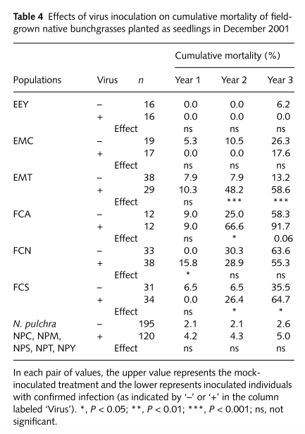
Ev adult survival:
m_{p} = 0.95
Notes:
1 - Mean of (Year 3)/3 across species
EEY: Elymus elymoides
EMC: Elymus multisetus (Contra costa county)
EMT: Elymus multisetus (Tehama county)

Slide 3
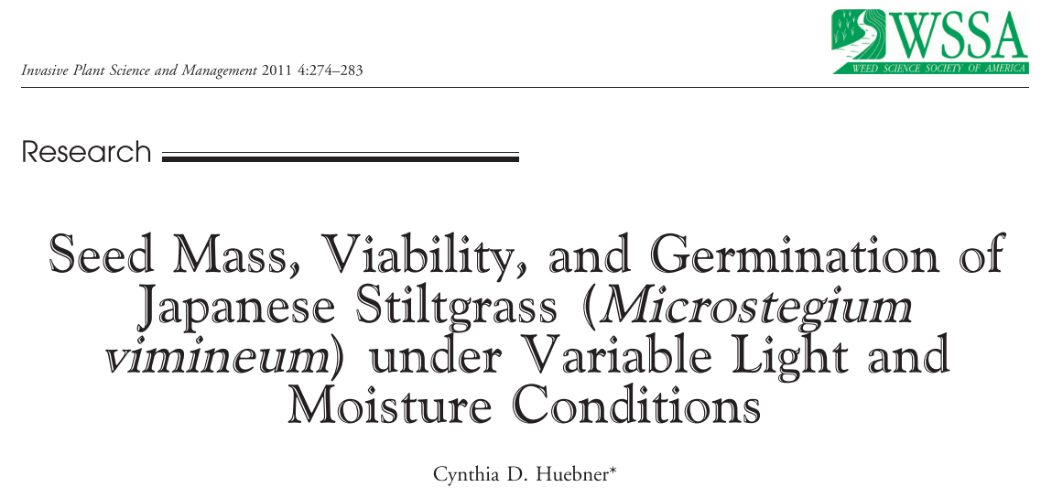
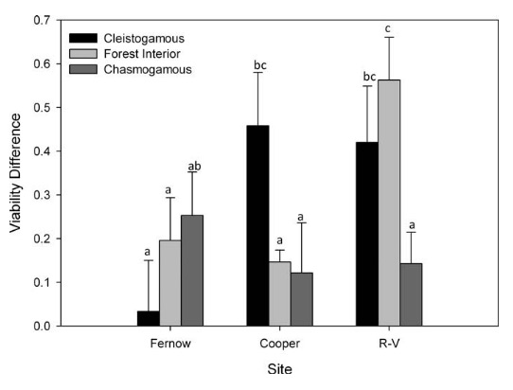
Mv seed survival:
s_{a} = 0.74
Notes:
1 – mean of forest interior values
Change in percent viability from one year post collection to two years post collection
Assume first year was 100% survival
Notes:
Figure out how long seeds are staying in the seedbank in simulations (shouldn’t be too long)
Luke knows Cynthia – can ask for raw data

Slide 4
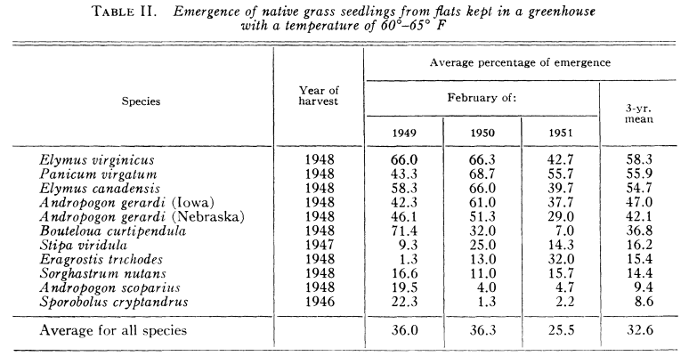
Robocker et al. 1953
Ecology
Ev seed survival:
s_{s} = 1

Slide 5
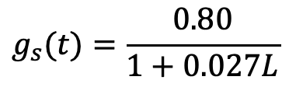
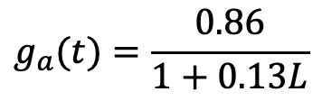
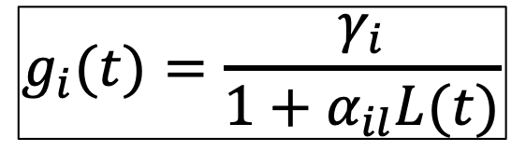
$$g_{i}(t)=\frac{γ_{i}}{1+α_{il}L(t)}$$
$$g_{a}(t)=\frac{0.86}{1+0.13L}$$
$$g_{s}(t)=\frac{0.80}{1+0.027L}$$
Notes:
Density-dependent germination?
Could do greenhouse experiment
Warren, Oikos
Can reverse estimate Elymus germination in the field by using the other parameters and assuming a constant population

Slide 6
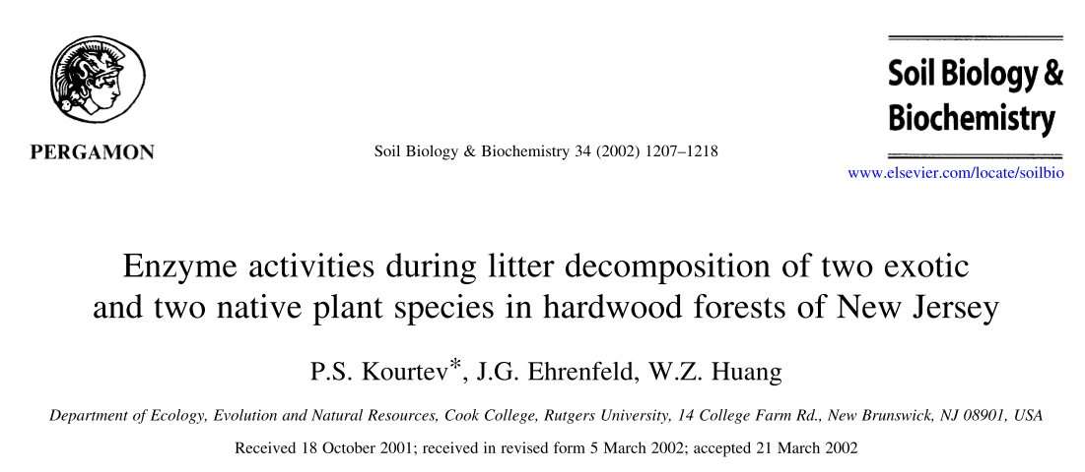
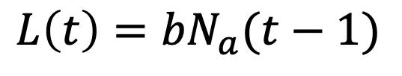
Average mass of 6 g surface litter bags following one year = 3.4 g
b = 0.56
Notes: averaged across 2 sites and 2 contexts (invaded and uninvaded), n = 4
$$L\left(t\right)={bN}_{a}(t−1)$$
Need to convert to biomass
Notes:
Litter could lead to new infection

Slide 7
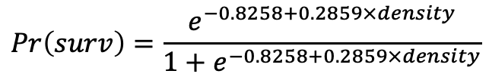
Survival to reproduction
(makes Ev population explode in simulation)
0.95
0.90
p = 0.004
0.46
$$Pr\left(surv\right)=\frac{e^{−0.8258+0.2859×density}}{1+e^{−0.8258+0.2859×density}}$$
Notes:
Note: survival analysis is for time until death (or event)
Look at height and basal circumference as a function of seedling density. If it’s soil microbes helping with resource acquisition, this should also be positive
Could be soil feedbacks or competing with antagonistic species. More likely to be the latter (?) because it takes a while for the former to build up.
This shouldn’t cause it to explode because it asymptotes to 1

Slide 8
Future model expansion: Fungicide and soil moisture affect Mv survival
Notes:
Do greenhouse experiments on fungicide effects on seedling survival

Slide 9
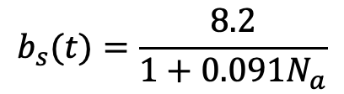
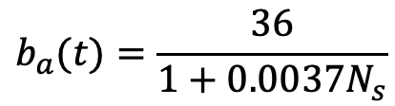
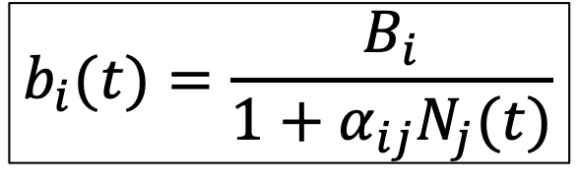
Initial competition coefficient estimates from greenhouse biomass data. Need to work on evaluating model fit if I’m going to use these.
$$b_{i}(t)=\frac{B_{i}}{1+α_{ij}N_{j}(t)}$$
$$b_{a}(t)=\frac{36}{1+0.0037N_{s}}$$
$$b_{s}(t)=\frac{8.2}{1+0.091N_{a}}$$

Slide 10
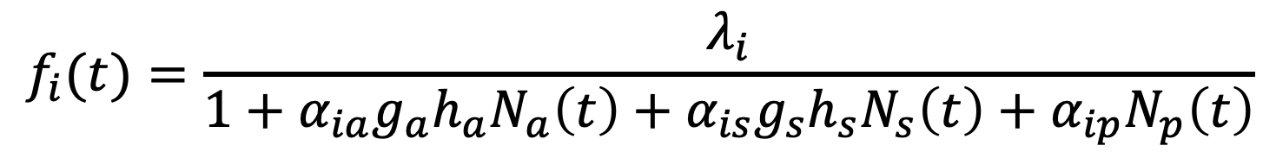
Seed production
$$f_{i}(t)=\frac{λ_{i}}{1+α_{ia}g_{a}{h_{a}N}_{a}\left(t\right)+α_{is}g_{s}h_{s}N_{s}\left(t\right)+α_{ip}N_{p}\left(t\right)}$$
Current 𝛼 assumptions:
 | Species j
Species i |  | Mv (a) | Ev seedling (s) | Ev adult (p)
 | Mv (a) | 0.05, 0.15 | 0.0037 | 0.037
 | Ev seedling (s) | 0.091 | 0.0037 | 0.037
 | Ev adult (p) | 0.0091 | 0 | 0.02,0.06

Slide 11
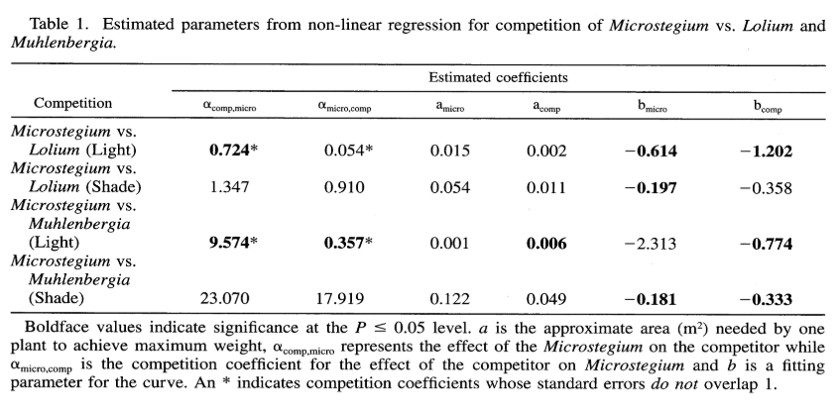
For a constant intraspecific competition coefficient for Microstegium, I too the mean of the two coefficients measured under high light (0.008).
Leicht et al. 2005

Slide 12
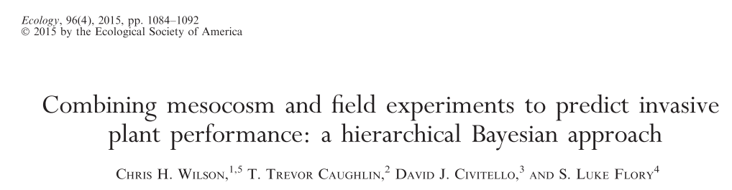
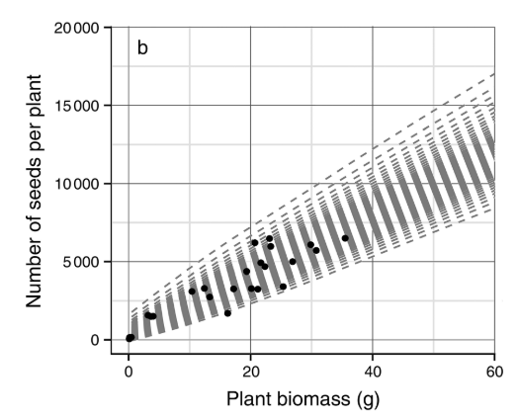
“At peak biomass observed in the mesocosm experiment (~30 g), seed production per plant is between 6000-7000 seeds”
Mv seed production:
𝜆_{a} = 6500
Notes:
Assumed the values above are on a per plant basis
Notes:
Meet with Chris and/or Luke to get raw data and figure out how to convert it to needed values.
Probably divide by 9 instead of 20

Slide 13
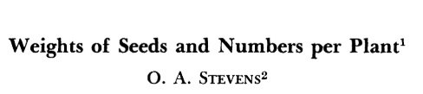
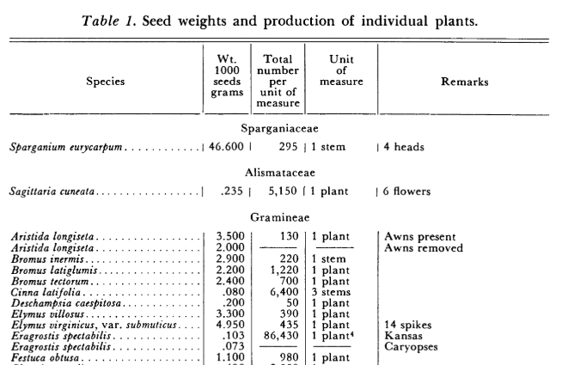
Weeds, 1957
Ev seed production by adults:
𝜆_{p} = 435
Assume for first-years:
𝜆_{s} = 43.5

Slide 14
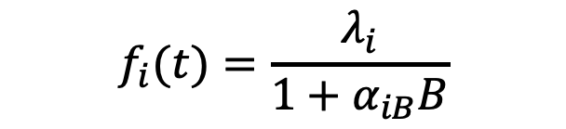
Baseline seed production rates from field experiment
Mv (𝜆_{a})
Plots with 3 Mv planted (7 plants total) and fungicide (n = 4 plots)
Seeds/tiller x tillers/plant
Assumes all tillers produce seeds
Ignores cleistogamous seeds
Seeds/g
Includes ~1-3 plants
Need to convert to plant⁻¹
Ev (𝜆_{p})
Plots with 1 adult Ev and 3 Ev seedlings planted (7 plants total) and fungicide (n = 4 plots)
Seeds/plant
Plots with 1 adult Ev planted, Mv seeds, and litter treatment (n = 25 plots)
Seeds/plant
Correct for background Mv biomass collected at one of four time points (choose one with the most variation in B):
$$f_{i}(t)=\frac{λ_{i}}{1+α_{iB}B}$$

Slide 15
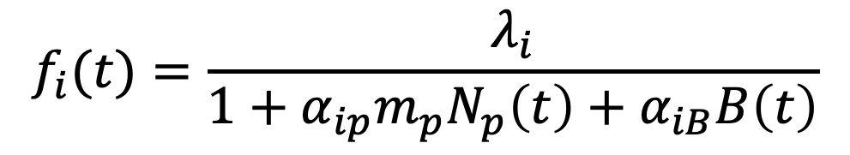
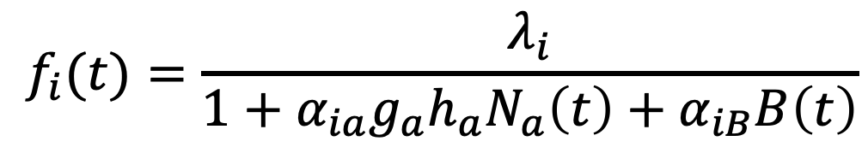
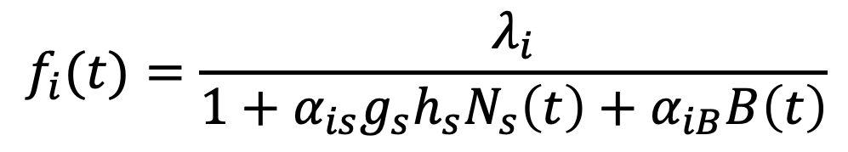
Competition coefficients
Same metrics for seed number as previous slide (fungicide plots)
j = Mv: planted density + background Mv biomass
j = Ev seedling: live density + background Mv biomass
j = Ev adult: live density + background Mv biomass
Use 𝛼_{iB}, 𝜆_{i}, h_{j}, m_{p}, and g_{j} from previous analyses
$$f_{i}(t)=\frac{λ_{i}}{1+α_{ia}g_{a}{h_{a}N}_{a}\left(t\right)+α_{iB}B\left(t\right)}$$
$$f_{i}(t)=\frac{λ_{i}}{1+α_{is}g_{s}{h_{s}N}_{s}\left(t\right)+α_{iB}B\left(t\right)}$$
$$f_{i}(t)=\frac{λ_{i}}{1+α_{ip}m_{p}N_{p}\left(t\right)+α_{iB}B\left(t\right)}$$

Slide 16
Annual seeds:
$$N_{a}(t+1) =s_{a}\left(1−g_{a}(t)\right)N_{a}(t)+g_{a}(t)h_{a}(t)f_{a}(t)N_{a}(t)$$
survival of dormant seeds
seed production by individuals that have germinated and established
Perennial seeds:
$N_{s}(t+1) =s_{s}\left(1−g_{s}(t)\right)N_{s}(t)+g_{s}(t)h_{s}(t)f_{s}(t)N_{s}(t)$ $+{m_{p}f_{p}(t)N}_{p}(t)$
survival of dormant seeds
seed production by individuals that have germinated and established
seed production by adults
Perennial adults:
$$N_{p}(t+1) =m_{p}N_{p}(t)+g_{s}(t)h_{s}(t) N_{s}(t)$$
survival of adults
established first-years

Slide 17




s_{i}
g_{i}
h_{i}
f_{i}
m_{i}
b
t
t+1

Slide 18
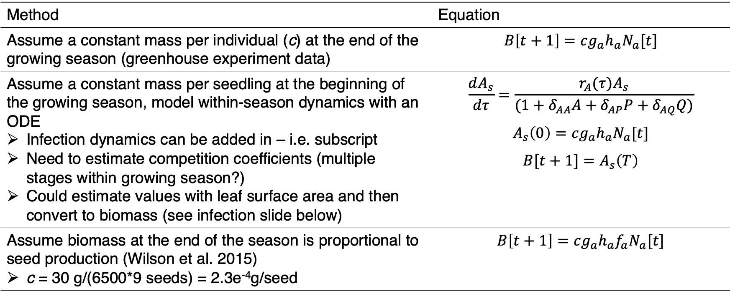
Converting Microstegium density to biomass
Method | Equation
Assume a constant mass per individual (c) at the end of the growing season (greenhouse experiment data) | $$B\left[t+1\right]=cg_{a}h_{a}N_{a}[t]$$
Assume a constant mass per seedling at the beginning of the growing season, model within-season dynamics with an ODE Infection dynamics can be added in – i.e. subscript Need to estimate competition coefficients (multiple stages within growing season?) Could estimate values with leaf surface area and then convert to biomass (see infection slide below) | $$\frac{dA_{s}}{dτ}=\frac{r_{A}(τ)A_{s}}{(1+δ_{AA}A+δ_{AP}P+δ_{AQ}Q)}$$ $$A_{s}\left(0\right)=cg_{a}h_{a}N_{a}[t]$$ $$B[t+1]=A_{s}\left(T\right)$$
Assume biomass at the end of the season is proportional to seed production (Wilson et al. 2015) c = 30 g/(6500*9 seeds) = 2.3e⁻⁴g/seed | $$B\left[t+1\right]=cg_{a}h_{a}{f_{a}N}_{a}[t]$$
Notes:
Can add biomass from seed production to a decay rate for the litter so that the litter keeps adding on

Slide 19
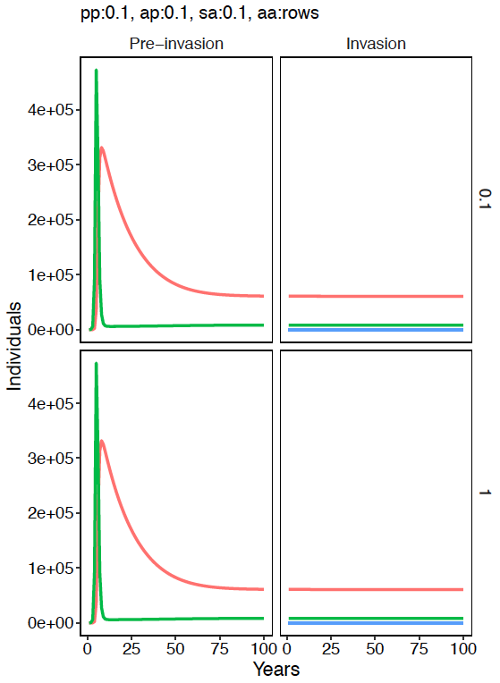
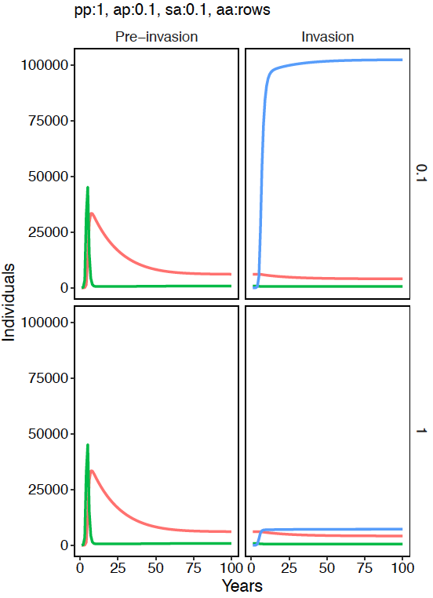
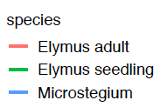
Notes:
No seedling facilitation
Increased intraspecific competition by the perennial, especially with lower intraspecific competition by the annual, allows invasion

Slide 20
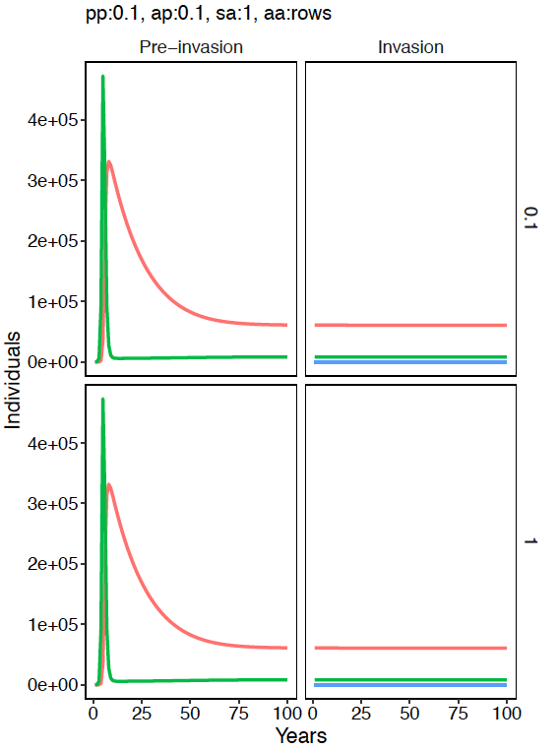
Notes:
Increased interspecific competitive effects of the annual on perennial seedlings does not promote invasion

Slide 21
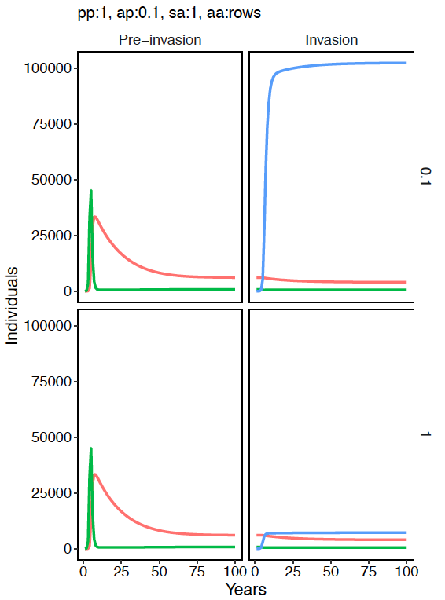
Notes:
And there are no interactive effects of increasing perennial intraspecific competition and annual interspecific competition

Slide 22
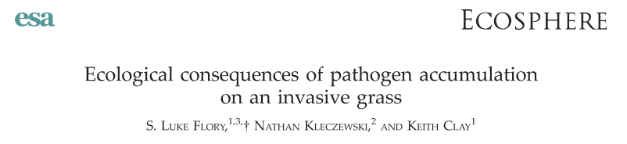

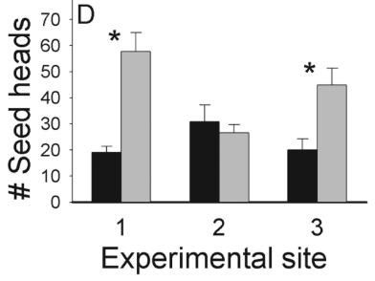


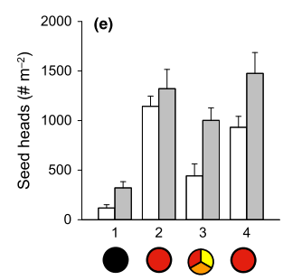
Flory et al. 2011:
Fungicide vs. infected control: 85% increase (F = 1.85 x I)
Fungicide vs. healthy control: 43% decrease (F = 0.57 x H)
I = 0.31 x H
Stricker et al. 2016:
Fungicide vs. infected control: 68% increase (F = 1.68 x I)
No significant effect on healthy plant seed production
Using above: I = 0.60 x H

Slide 23
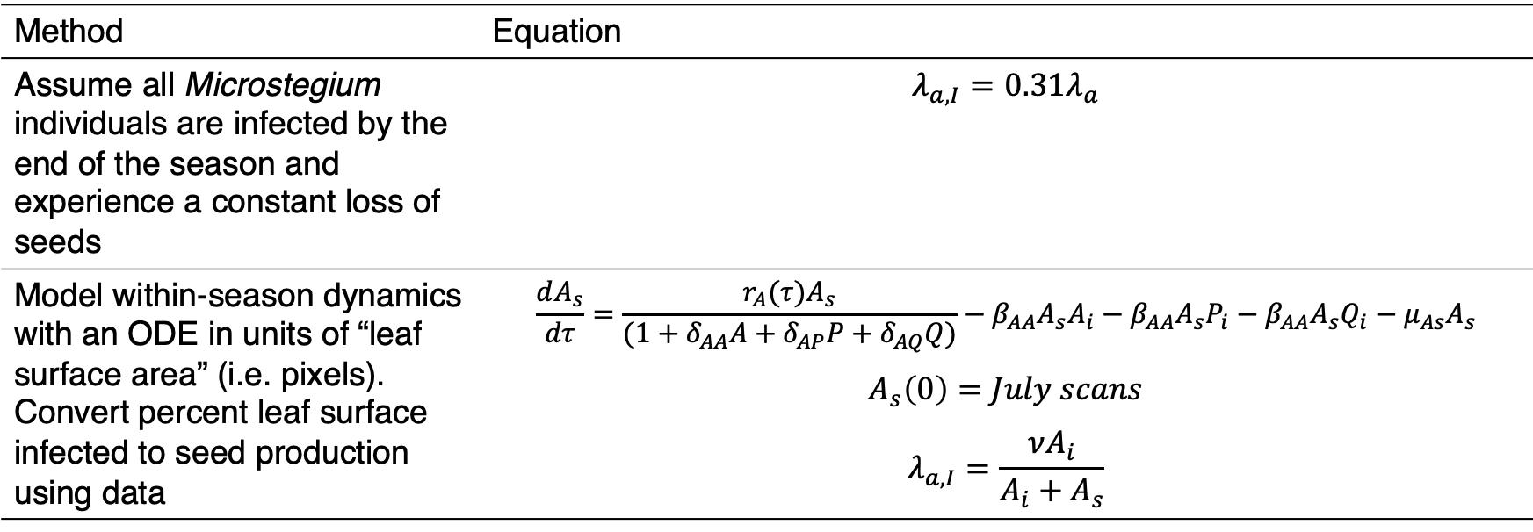
Adding infection into the model
Method | Equation
Assume all Microstegium individuals are infected by the end of the season and experience a constant loss of seeds | $$λ_{a,I}=0.31λ_{a}$$
Model within-season dynamics with an ODE in units of “leaf surface area” (i.e. pixels). Convert percent leaf surface infected to seed production using data | $$\frac{dA_{s}}{dτ}=\frac{r_{A}(τ)A_{s}}{(1+δ_{AA}A+δ_{AP}P+δ_{AQ}Q)}−β_{AA}A_{s}A_{i}−β_{AA}A_{s}P_{i}−β_{AA}A_{s}Q_{i}−μ_{As}A_{s}$$ $$A_{s}\left(0\right)=July scans$$ $$λ_{a,I}=\frac{νA_{i}}{A_{i}+A_{s}}$$
Notes:
Make sure to account for the fact that total leaf area might decrease with infected plants

Slide 24
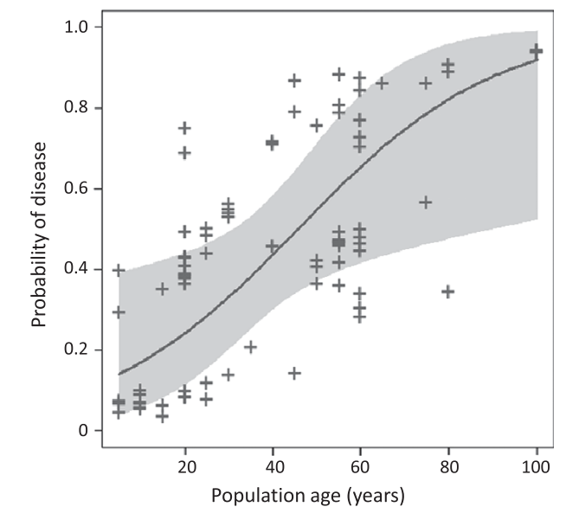
Assume infection has accumulated by 100 years post invasion
(Stricker et al. 2016)

Slide 25
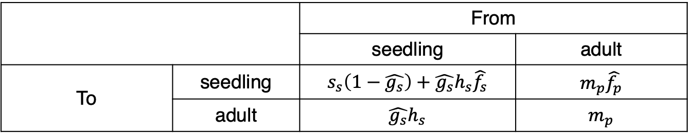
Growth rate when rare: perennials
Use dominant Eigenvalue of seedling-adult transition matrix when perennial is rare (no effect on itself) and annual is common (Mordecai 2013)
Hat indicates variable is affected by annual density
 |  | From
 |  | seedling | adult
To | seedling | $$s_{s}\left(1−\hat{g_{s}}\right)+\hat{g_{s}}h_{s}\hat{f_{s}}$$ | $$m_{p}\hat{f_{p}}$$
 | adult | $$\hat{g_{s}}h_{s}$$ | $$m_{p}$$

Slide 26
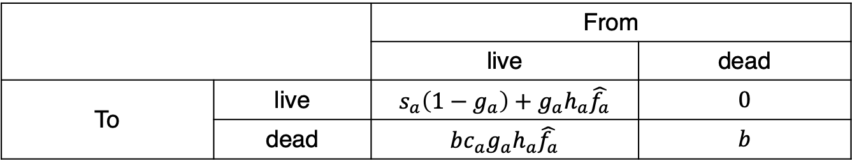
Growth rate when rare: annuals
The annual also has two life stages – apply same method
 |  | From
 |  | live | dead
To | live | $$s_{a}\left(1−g_{a}\right)+g_{a}h_{a}\hat{f_{a}}$$ | $$0$$
 | dead | $$bc_{a}g_{a}h_{a}\hat{f_{a}}$$ | $$b$$
Re-do without this and check. From Mike: I would ignore the litter in this calculation, because, as you write, it doesn't contribute to population growth. I don't think it would make any difference if you did have a two-stage model, with one stage being living plant and one being litter. In this case, the matrix would have a 0 in the off-diagonal element that gives living plant produced from litter. For a two-by-two matrix with an off-diagonal element equal to 0, the eigenvalues are the main diagonal elements. One of these is the litter decomposition rate, which is less than 1. So the other one, which is the living plant growth rate (over a complete generation, for example, seed to seed), determines whether the annual increases when rare.
As for whether the litter affects plant growth, since you are assuming the annual is rare, then I think you could ignore the effect of the litter, assuming the litter has an effect on, say, germination, only when it creates a continuous mat. I would think an isolated plant would not produce enough litter to interfere much with growth from its seed the next year. If it would, then you'd need to include that effect. But I would think that litter would slow the annual's growth rate only when the annual became abundant.

