Slide 1

Collected seeds in early December 2010
Put them in nylon mesh bags and buried them in mid-December 2010
100 seeds/bag
12 bags/site (one for each collection time)
10 sites
Germination test on lab bench
Visually tested non-germinated seeds for viability
Visual test consistent with tetrazolium
Only report total survival (germinated + non-germinated, but viable) and the proportion of surviving seeds that germinated
Using April 2011 values
g_{A} = 0.32 year⁻¹
s_{A} = 0.12 year⁻¹

Slide 2
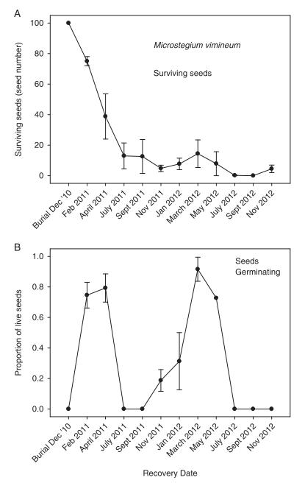
gN = 0.8 * 0.4 = 0.32
0.32 + s(1 – 0.32) = 0.4
s = 0.12
Let N = 1, gN + s(1-g)N = 0.4
gN/(gN + s(1-g)N) = 0.8

Slide 3
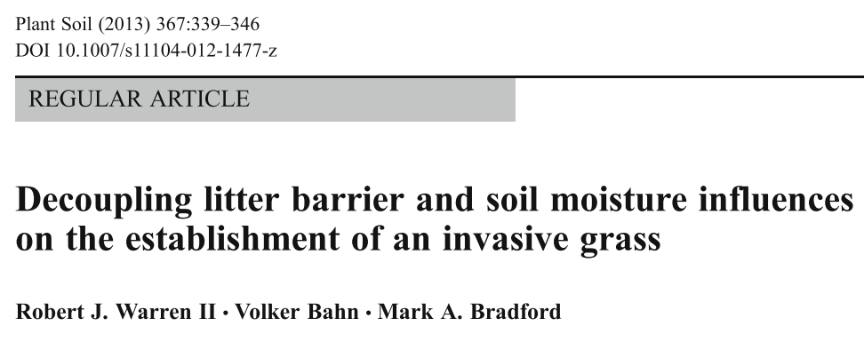
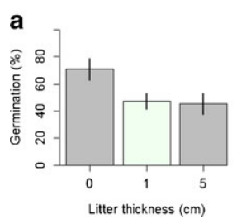
Mv germination rate without litter:
alternative g_{A} = 0.7 year⁻¹
Notes:
16 seeds added to PVC plots with forest soil
Litter is mostly from deciduous trees
0.7 estimated from figure, not reported
Germination suppression looks like Beverton-Holt function

Slide 4

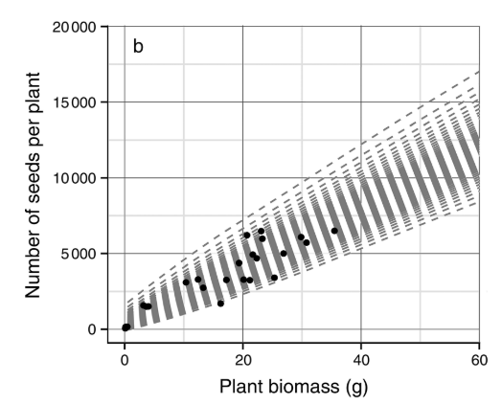
“At peak biomass observed in the mesocosm experiment (~30 g), seed production per plant is between 6000-7000 seeds”
Mv biomass-to-seed conversion:
y_{A} = 6500/30 = 216.67 seeds g⁻¹ year⁻¹
Notes:
Meet with Chris and/or Luke to get raw data and figure out how to convert it to needed values.
Probably divide by 9 instead of 20

Slide 5
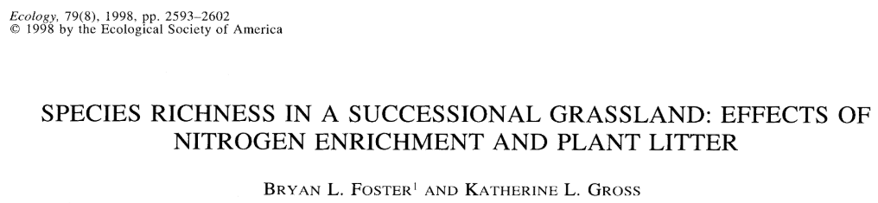
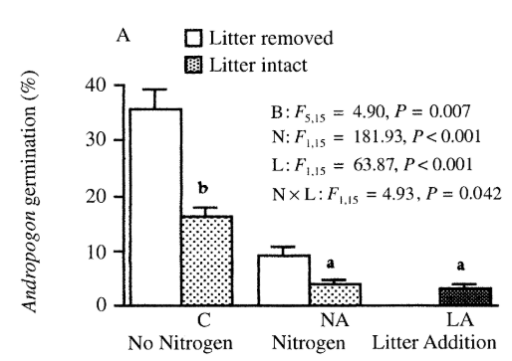
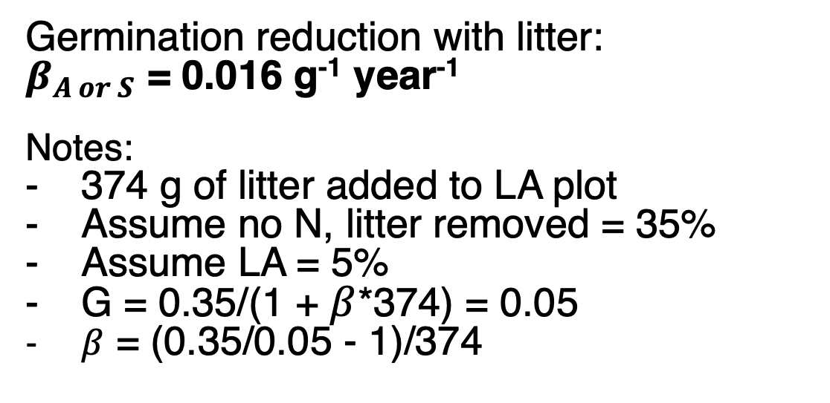
Germination reduction with litter:
$β_{A or S}$ = 0.016 g⁻¹ year⁻¹
Notes:
374 g of litter added to LA plot
Assume no N, litter removed = 35%
Assume LA = 5%
G = 0.35/(1 + $β$*374) = 0.05
$β$ = (0.35/0.05 - 1)/374

Slide 6
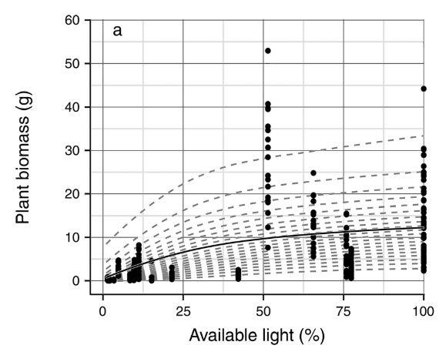
Maximum Mv biomass without competition:
v_{A} = 17.4 g year⁻¹
Notes
Plants spaced 0.5 m apart in field
Prior from mesocosm experiment (18.2 g)
Notes:
Some alternative values in literature for greenhouse pots – smaller biomass

Slide 7

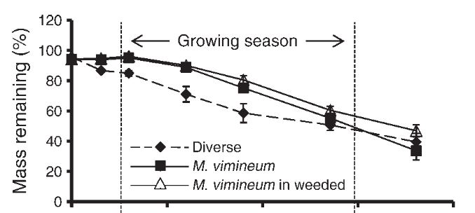
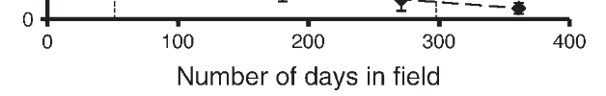
Mv biomass-to-litter conversion:
a = 0.95 g litter (g biomass)⁻¹ year⁻¹
Mv litter decomposition rate:
b = 0.6 year⁻¹
Notes:
Dead standing biomass clipped at end of growing season
Litter bags put out in January
a estimated from figure, b reported

Slide 8
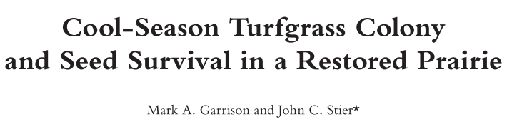
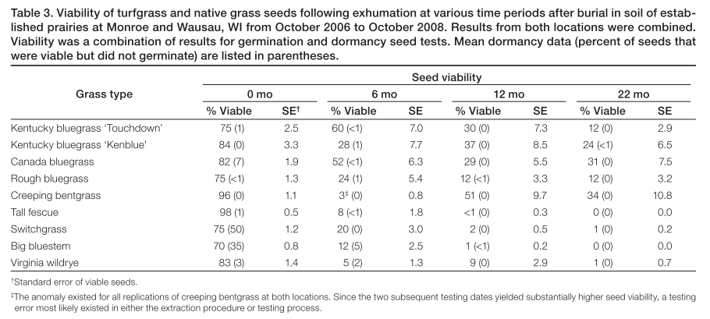
Ev germination:
g_{S} = 0.8 year⁻¹
Ev seed survival:
h_{S} = 0.17 year⁻¹
Crop Science, 2010
Notes:
Connelly and Orrock 2015, seed pathogens killed 21.4% of Elymus seeds (short term lab study)

Slide 9
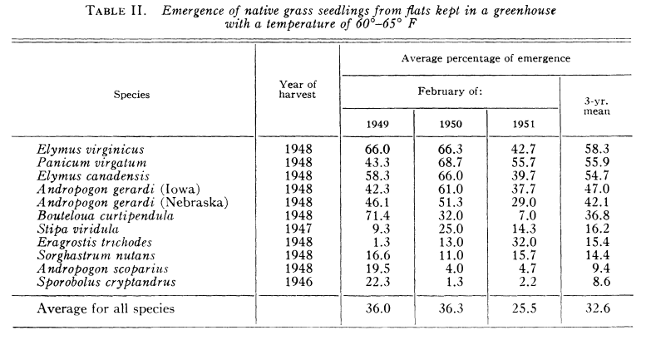
Robocker et al. 1953 Ecology
Ev germination:
g_{S} = 0.66 year⁻¹

Slide 10
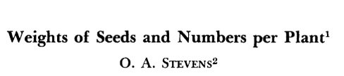
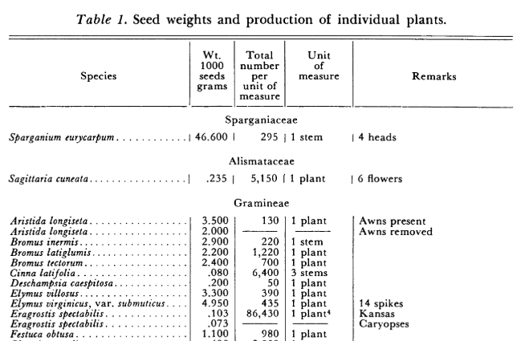
Weeds, 1957
Ev seed production by adults:
f_{P} = 435

Slide 11
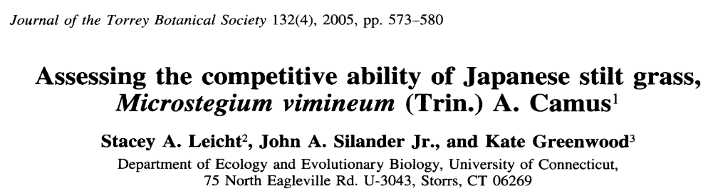
Mv response to competition:
𝛂_{A} = 0.002 year⁻¹
Notes:
Best fit Mv model (R² = 0.895): biomass = 5.9/(1 + 0.001(N_{Mv} + 0.356N_{Muhl}))^{2.312}
5.9 is the maximum biomass with no neighbors (g/plant), N is density
Assume N_{muhl} = 0 and 2.312 = 2

Slide 12
Start here

Slide 13
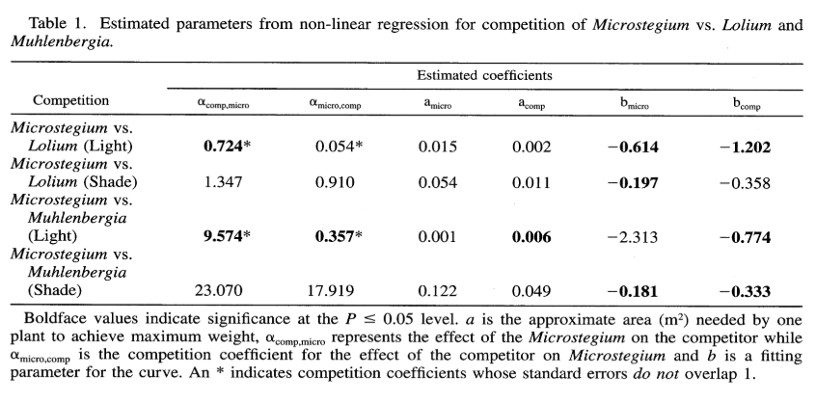
I took the mean of the two coefficients measured under high light for each coefficient
Leicht et al. 2005
Notes:
See Law and Watkinson for equations – need to alter competition coefficients because of different equations?

Slide 14

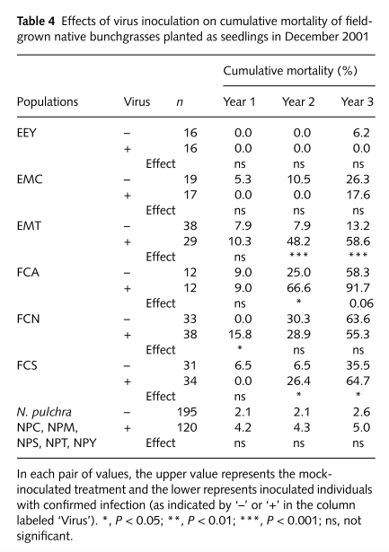
Ev adult survival:
m_{p} = 0.95
Notes:
1 - Mean of (Year 3)/3 across species
EEY: Elymus elymoides
EMC: Elymus multisetus (Contra costa county)
EMT: Elymus multisetus (Tehama county)

Slide 15
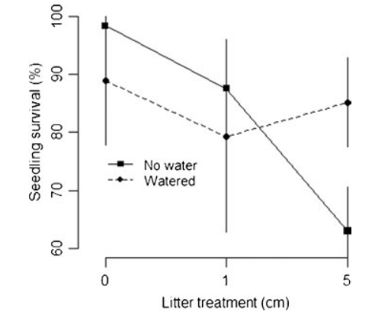
Mv seedling survival:
h_{a} = 0.95

Slide 16

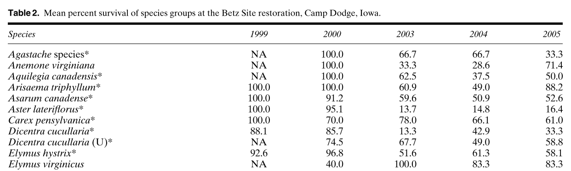
Restoration Ecology, 2006
Ev seedling survival:
h_{s} = 0.40
Ev adult survival:
h_{p} = 0.83

Slide 17
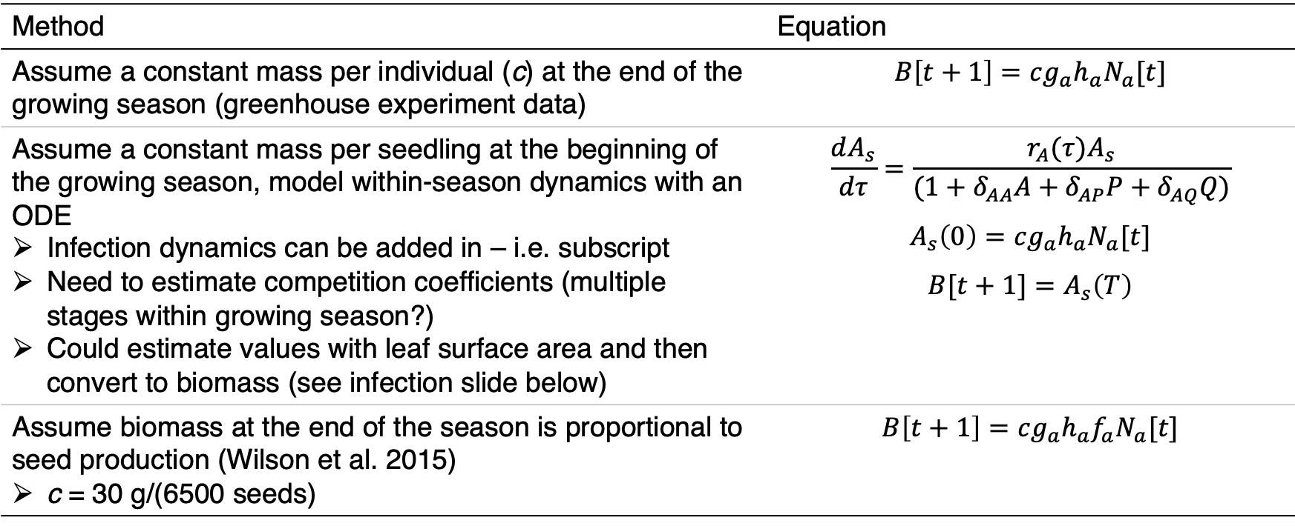
Converting Microstegium density to biomass
Method | Equation
Assume a constant mass per individual (c) at the end of the growing season (greenhouse experiment data) | $$B\left[t+1\right]=cg_{a}h_{a}N_{a}[t]$$
Assume a constant mass per seedling at the beginning of the growing season, model within-season dynamics with an ODE Infection dynamics can be added in – i.e. subscript Need to estimate competition coefficients (multiple stages within growing season?) Could estimate values with leaf surface area and then convert to biomass (see infection slide below) | $$\frac{dA_{s}}{dτ}=\frac{r_{A}(τ)A_{s}}{(1+δ_{AA}A+δ_{AP}P+δ_{AQ}Q)}$$ $$A_{s}\left(0\right)=cg_{a}h_{a}N_{a}[t]$$ $$B[t+1]=A_{s}\left(T\right)$$
Assume biomass at the end of the season is proportional to seed production (Wilson et al. 2015) c = 30 g/(6500 seeds) | $$B\left[t+1\right]=cg_{a}h_{a}{f_{a}N}_{a}[t]$$
Notes:
Can add biomass from seed production to a decay rate for the litter so that the litter keeps adding on

Slide 18
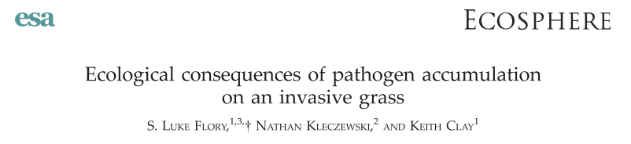

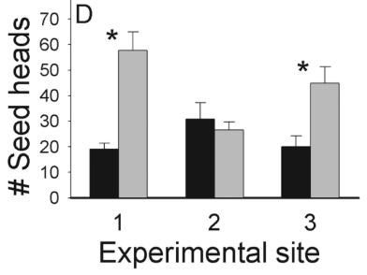


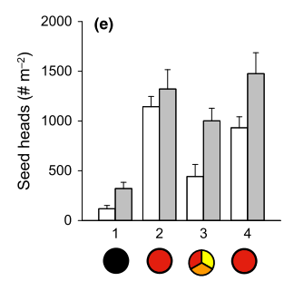
Flory et al. 2011:
Fungicide vs. infected control: 85% increase (F = 1.85 x I)
Max Fungicide vs. infected control: 203% increase (F = 3.03 x I
Fungicide vs. healthy control: 43% decrease (F = 0.57 x H)
I = 0.31 x H or I = 0.19 x H
Stricker et al. 2016:
Fungicide vs. infected control: 68% increase (F = 1.68 x I)
No significant effect on healthy plant seed production
Using above: I = 0.60 x H

Slide 19
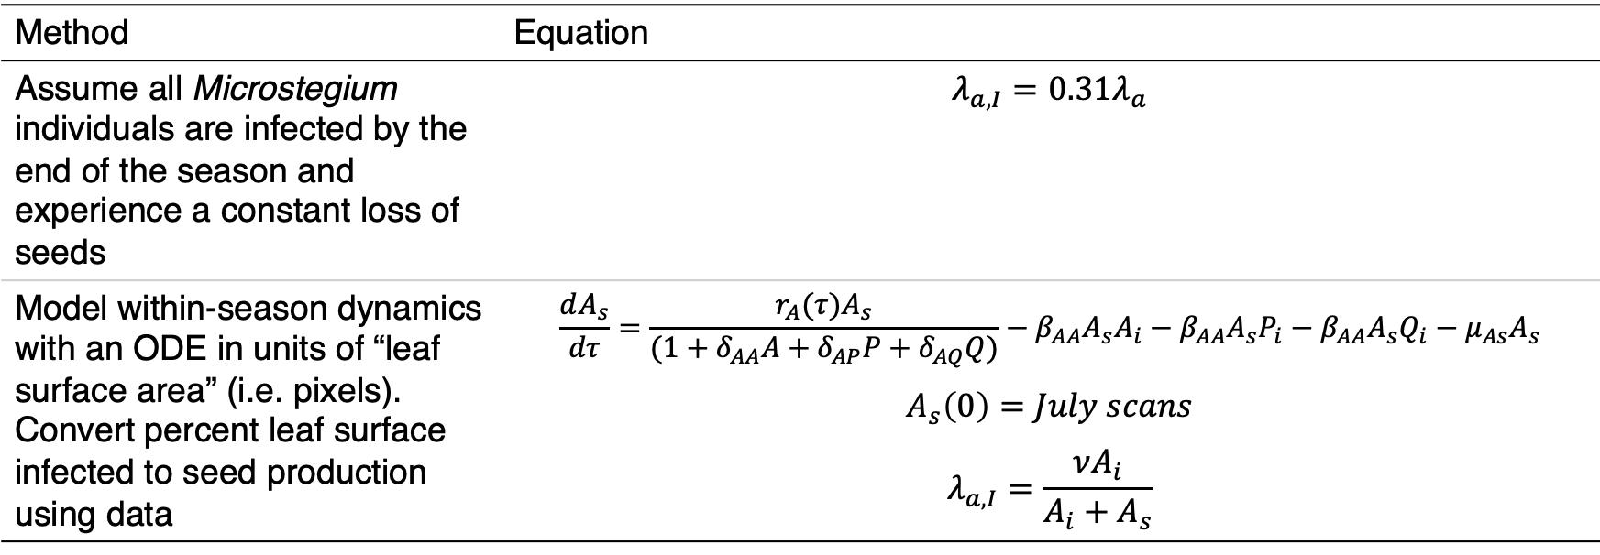
Adding infection into the model
Method | Equation
Assume all Microstegium individuals are infected by the end of the season and experience a constant loss of seeds | $$λ_{a,I}=0.31λ_{a}$$
Model within-season dynamics with an ODE in units of “leaf surface area” (i.e. pixels). Convert percent leaf surface infected to seed production using data | $$\frac{dA_{s}}{dτ}=\frac{r_{A}(τ)A_{s}}{(1+δ_{AA}A+δ_{AP}P+δ_{AQ}Q)}−β_{AA}A_{s}A_{i}−β_{AA}A_{s}P_{i}−β_{AA}A_{s}Q_{i}−μ_{As}A_{s}$$ $$A_{s}\left(0\right)=July scans$$ $$λ_{a,I}=\frac{νA_{i}}{A_{i}+A_{s}}$$
Notes:
Make sure to account for the fact that total leaf area might decrease with infected plants

Slide 20
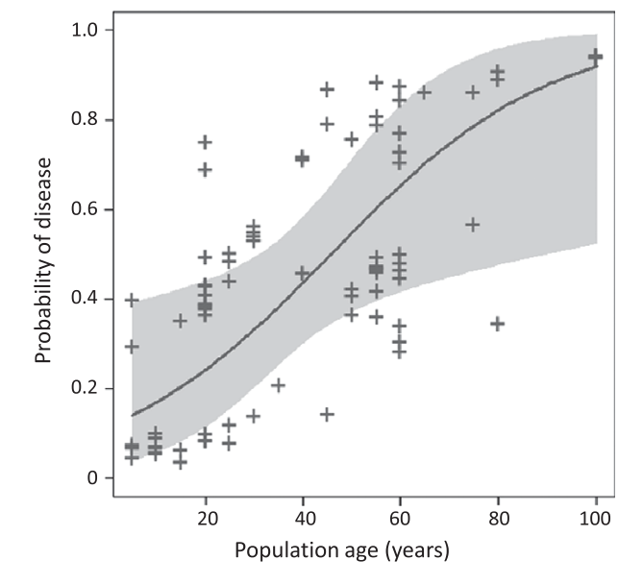
Assume infection has accumulated by 100 years post invasion
(Stricker et al. 2016)

Slide 21
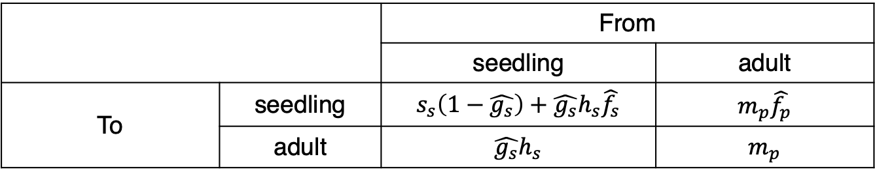
Growth rate when rare: perennials
Use dominant Eigenvalue of seedling-adult transition matrix when perennial is rare (no effect on itself) and annual is common (Mordecai 2013)
Hat indicates variable is affected by annual density
 |  | From
 |  | seedling | adult
To | seedling | $$s_{s}\left(1−\hat{g_{s}}\right)+\hat{g_{s}}h_{s}\hat{f_{s}}$$ | $$m_{p}\hat{f_{p}}$$
 | adult | $$\hat{g_{s}}h_{s}$$ | $$m_{p}$$

Slide 22
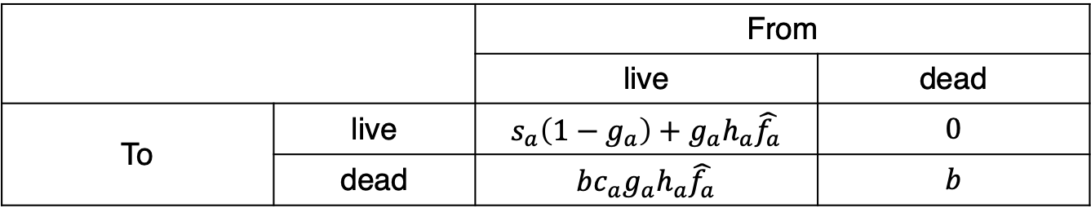
Growth rate when rare: annuals
The annual also has two life stages – apply same method
 |  | From
 |  | live | dead
To | live | $$s_{a}\left(1−g_{a}\right)+g_{a}h_{a}\hat{f_{a}}$$ | $$0$$
 | dead | $$bc_{a}g_{a}h_{a}\hat{f_{a}}$$ | $$b$$
Re-do without this and check. From Mike: I would ignore the litter in this calculation, because, as you write, it doesn't contribute to population growth. I don't think it would make any difference if you did have a two-stage model, with one stage being living plant and one being litter. In this case, the matrix would have a 0 in the off-diagonal element that gives living plant produced from litter. For a two-by-two matrix with an off-diagonal element equal to 0, the eigenvalues are the main diagonal elements. One of these is the litter decomposition rate, which is less than 1. So the other one, which is the living plant growth rate (over a complete generation, for example, seed to seed), determines whether the annual increases when rare.
As for whether the litter affects plant growth, since you are assuming the annual is rare, then I think you could ignore the effect of the litter, assuming the litter has an effect on, say, germination, only when it creates a continuous mat. I would think an isolated plant would not produce enough litter to interfere much with growth from its seed the next year. If it would, then you'd need to include that effect. But I would think that litter would slow the annual's growth rate only when the annual became abundant.

Slide 23

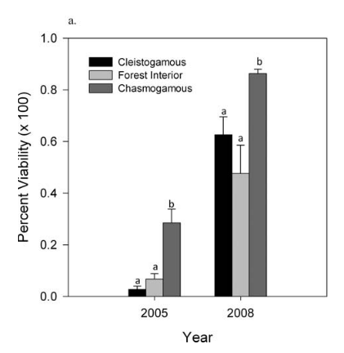
Mv seed survival:
s_{A} = 0.5 year⁻¹
Notes:
Tetrazolium to test viability of all seeds (may have germinated if allowed)
9 sites, 100 seeds each
2008 seeds collected in 2008 and tested in spring of 2009 (i.e., stored in lab)
CH and CL collected from roadside
Estimated from the forest interior value
Notes:
Figure out how long seeds are staying in the seedbank in simulations (shouldn’t be too long)
Luke knows Cynthia – can ask for raw data if needed

