Slide 1
Parameter | Meaning | Units | Source
m_{p} | Proportion of perennial adults that survive for a year |  | Literature
s_{i} | Proportion of dormant seeds of species i that survive for a year |  | Literature
g_{i} | Germination rate of species i | seedlings/seed | Composite parameter
𝛾_{I} | Germination rate in the absence of competition for species i | seedlings/ seed | Greenhouse experiment
𝛼_{iL} | Competitive effect of litter on germination rate | g⁻¹ | Greenhouse experiment
b | Proportion of litter biomass remaining after one year | g | Literature
h_{i} | Proportion of seedlings of species i that survive through the growing season |  | Field experiment
f_{i} | Seed production of species i | Seeds/ individual | Composite parameter
𝜆_{i} | Seeds produced by species i in the absence of competition | seeds/ individual | Field experiment (currently literature)
𝛼_{ij} | Competitive effect of species j on seed production of species i | individuals | Field experiment (currently estimated)

Slide 2

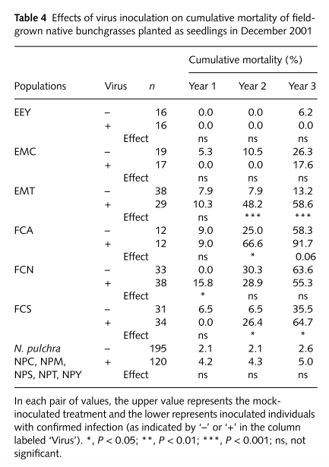
Ev adult survival:
m_{p} = 0.95
Notes:
1 - Mean of (Year 3)/3 across species
EEY: Elymus elymoides
EMC: Elymus multisetus (Contra costa county)
EMT: Elymus multisetus (Tehama county)

Slide 3
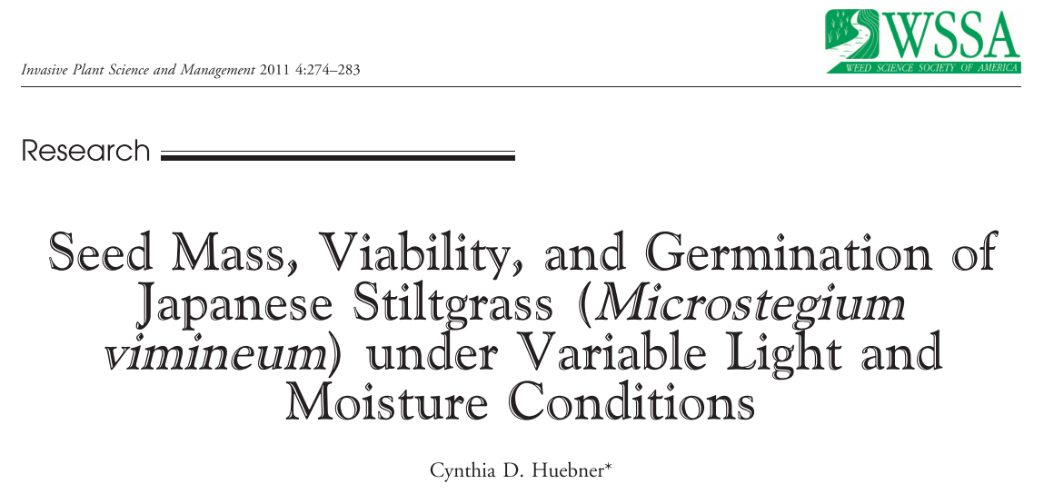
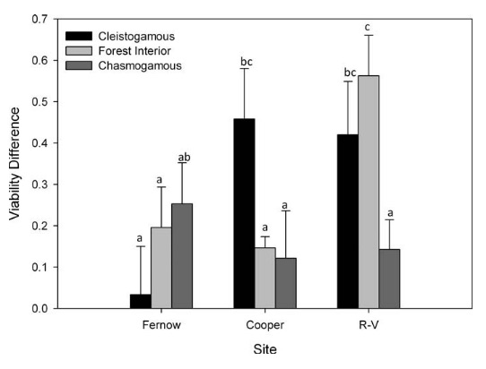
Mv seed survival:
s_{a} = 0.74
Notes:
1 – mean of forest interior values
Change in percent viability from one year post collection to two years post collection
Assume first year was 100% survival
Notes:
Figure out how long seeds are staying in the seedbank in simulations (shouldn’t be too long)
Luke knows Cynthia – can ask for raw data

Slide 4
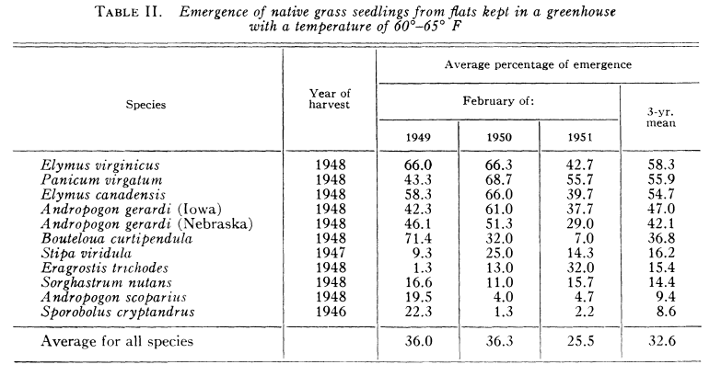
Robocker et al. 1953
Ecology
Ev seed survival:
s_{s} = 0.76
Notes:
23.6% didn’t germinate in year 3 that did germinate in the previous years – assume those died and the others are dormant

Slide 5
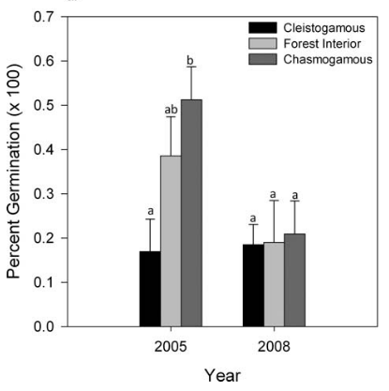
Mv germination rate:
g_{a} = 0.29
Notes:
Mean of forest interior values

Slide 6
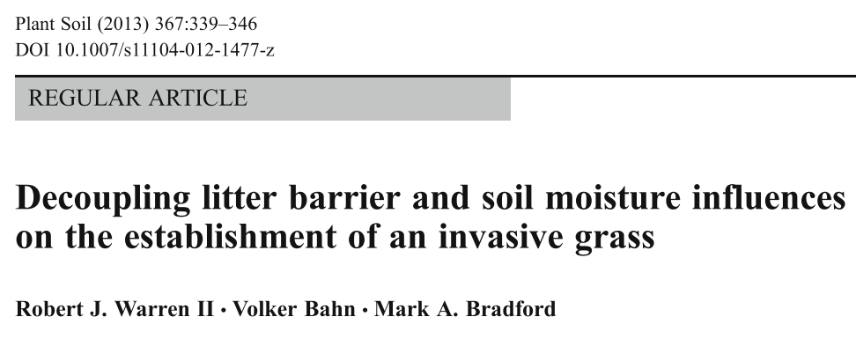
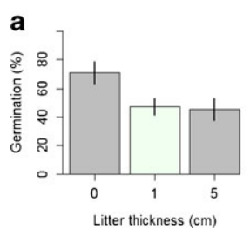
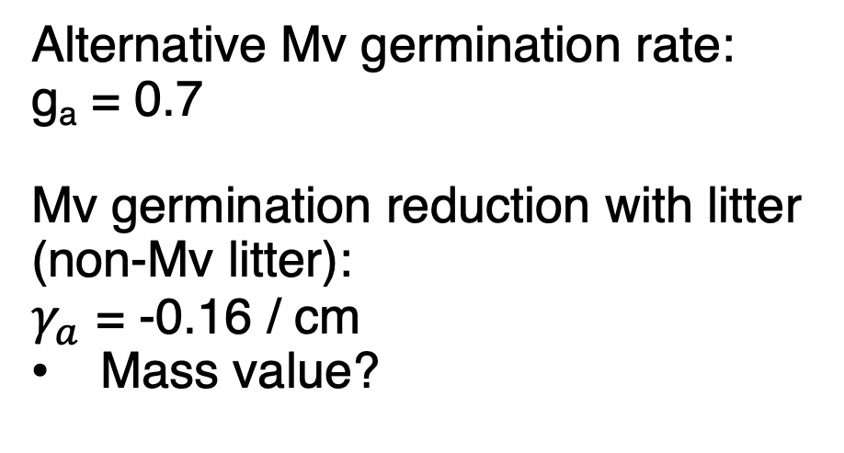
Alternative Mv germination rate:
g_{a} = 0.7
Mv germination reduction with litter (non-Mv litter):
$γ_{a}$ = -0.16 / cm
Mass value?

Slide 7
Robocker et al. 1953
Ecology
Ev germination rate:
g_{s} = 0.66

Slide 8
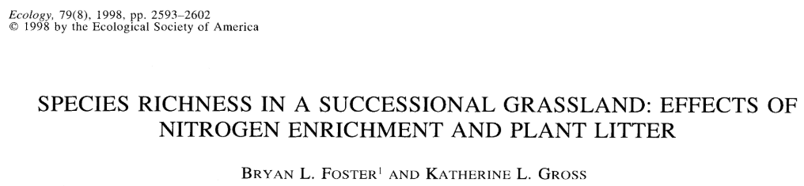
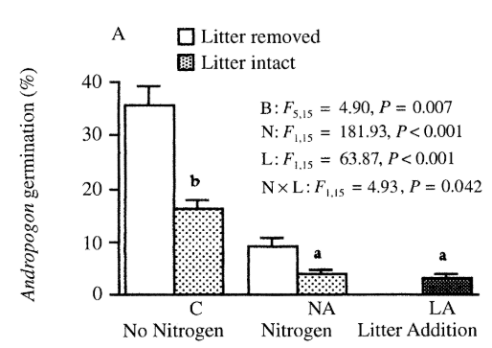
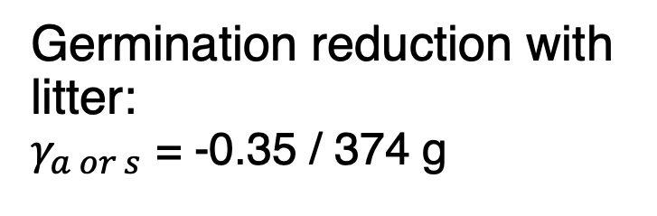
Germination reduction with litter:
$γ_{a or s}$ = -0.35 / 374 g

Slide 9
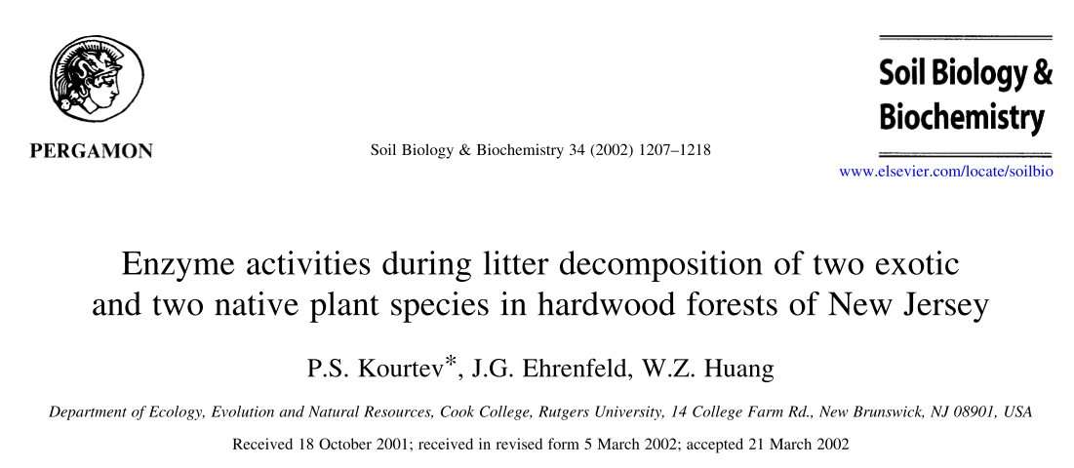

Average mass after 1 year = 56% of initial (averaged across 2 sites and 2 contexts (invaded and uninvaded)
Assume t = 1 year, L(t-1) = 1
Tried using average and solving for b, as well as solve for b from each of the 4 values and then average
b = 0.58 from first method (0.59 from previous method)
$$L\left(t\right)=L\left(t−1\right)e^{−bt}$$
Need to convert to biomass for first year
Notes:
Litter could lead to new infection

Slide 10
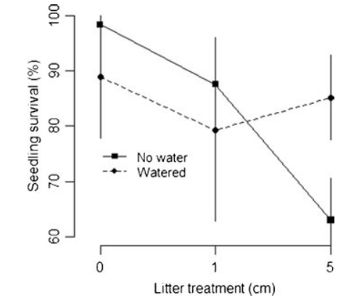
Mv seedling survival:
h_{a} = 0.95

Slide 11

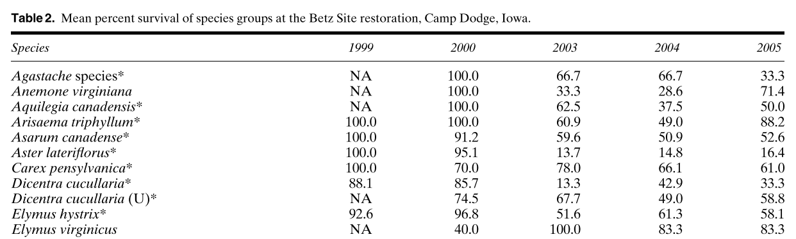
Restoration Ecology, 2006
Ev seedling survival:
h_{s} = 0.40
Ev adult survival:
h_{p} = 0.83

Slide 12
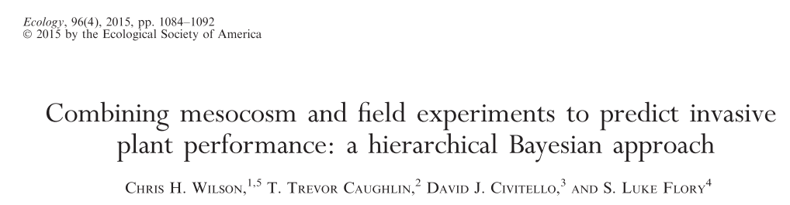
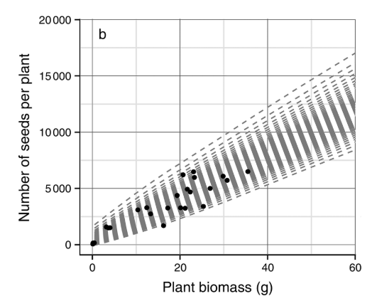
“At peak biomass observed in the mesocosm experiment (~30 g), seed production per plant is between 6000-7000 seeds”
Mv seed production:
𝜆_{a} = 6500
Notes:
Assumed the values above are on a per plant basis
Notes:
Meet with Chris and/or Luke to get raw data and figure out how to convert it to needed values.
Probably divide by 9 instead of 20

Slide 13
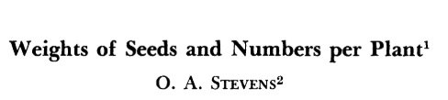
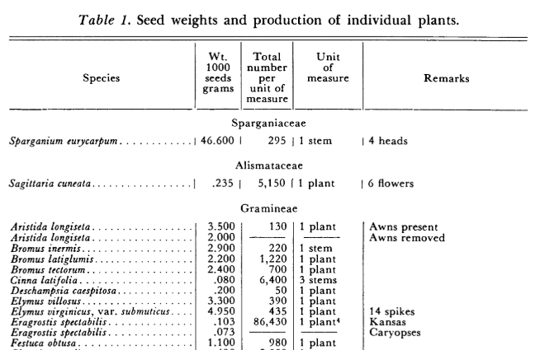
Weeds, 1957
Ev seed production by adults:
𝜆_{p} = 435
Assume for first-years:
𝜆_{s} = 43.5

Slide 14
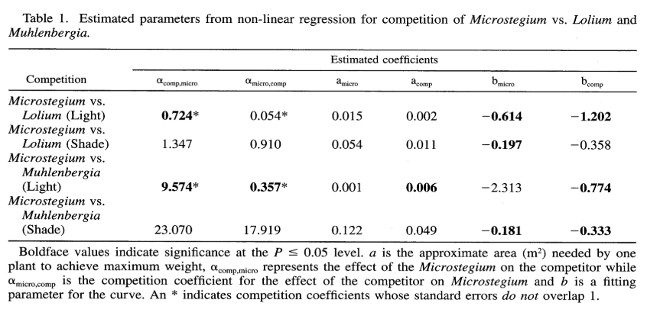
I took the mean of the two coefficients measured under high light for each coefficient
Leicht et al. 2005

Slide 15
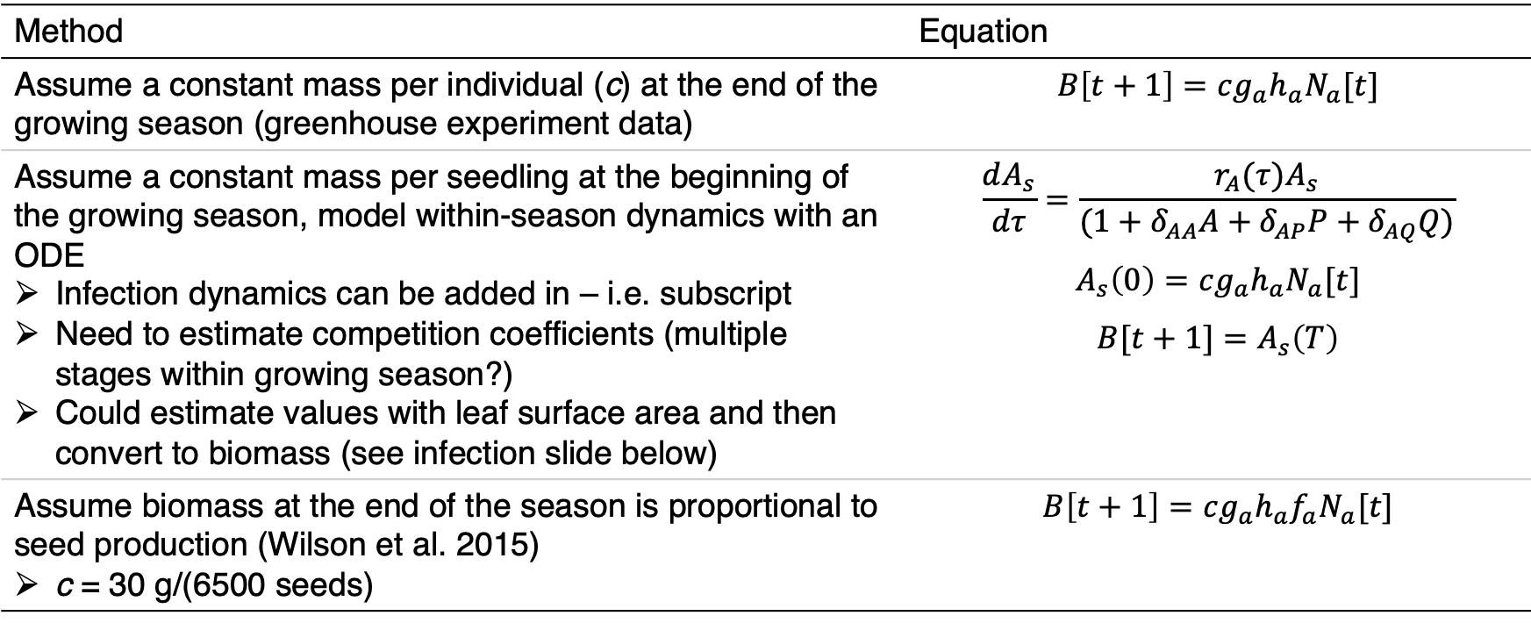
Converting Microstegium density to biomass
Method | Equation
Assume a constant mass per individual (c) at the end of the growing season (greenhouse experiment data) | $$B\left[t+1\right]=cg_{a}h_{a}N_{a}[t]$$
Assume a constant mass per seedling at the beginning of the growing season, model within-season dynamics with an ODE Infection dynamics can be added in – i.e. subscript Need to estimate competition coefficients (multiple stages within growing season?) Could estimate values with leaf surface area and then convert to biomass (see infection slide below) | $$\frac{dA_{s}}{dτ}=\frac{r_{A}(τ)A_{s}}{(1+δ_{AA}A+δ_{AP}P+δ_{AQ}Q)}$$ $$A_{s}\left(0\right)=cg_{a}h_{a}N_{a}[t]$$ $$B[t+1]=A_{s}\left(T\right)$$
Assume biomass at the end of the season is proportional to seed production (Wilson et al. 2015) c = 30 g/(6500 seeds) | $$B\left[t+1\right]=cg_{a}h_{a}{f_{a}N}_{a}[t]$$
Notes:
Can add biomass from seed production to a decay rate for the litter so that the litter keeps adding on

Slide 16
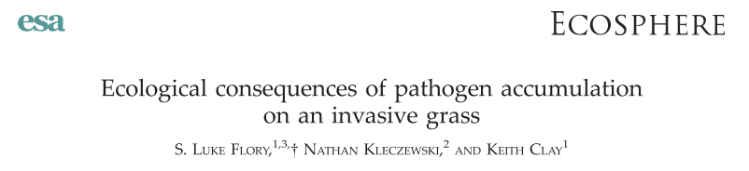

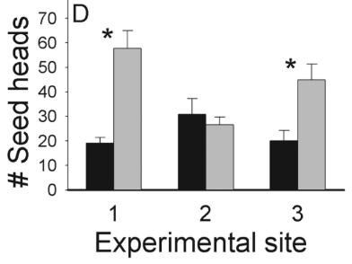


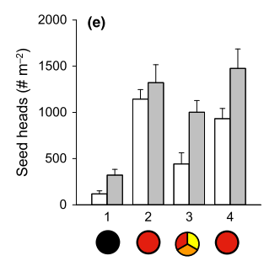
Flory et al. 2011:
Fungicide vs. infected control: 85% increase (F = 1.85 x I)
Max Fungicide vs. infected control: 203% increase (F = 3.03 x I
Fungicide vs. healthy control: 43% decrease (F = 0.57 x H)
I = 0.31 x H or I = 0.19 x H
Stricker et al. 2016:
Fungicide vs. infected control: 68% increase (F = 1.68 x I)
No significant effect on healthy plant seed production
Using above: I = 0.60 x H

Slide 17
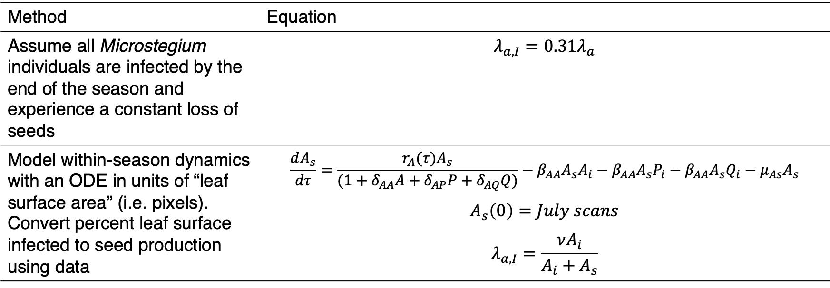
Adding infection into the model
Method | Equation
Assume all Microstegium individuals are infected by the end of the season and experience a constant loss of seeds | $$λ_{a,I}=0.31λ_{a}$$
Model within-season dynamics with an ODE in units of “leaf surface area” (i.e. pixels). Convert percent leaf surface infected to seed production using data | $$\frac{dA_{s}}{dτ}=\frac{r_{A}(τ)A_{s}}{(1+δ_{AA}A+δ_{AP}P+δ_{AQ}Q)}−β_{AA}A_{s}A_{i}−β_{AA}A_{s}P_{i}−β_{AA}A_{s}Q_{i}−μ_{As}A_{s}$$ $$A_{s}\left(0\right)=July scans$$ $$λ_{a,I}=\frac{νA_{i}}{A_{i}+A_{s}}$$
Notes:
Make sure to account for the fact that total leaf area might decrease with infected plants

Slide 18
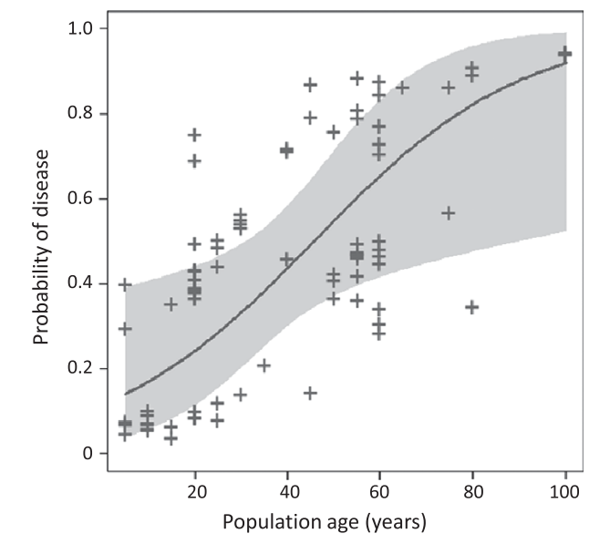
Assume infection has accumulated by 100 years post invasion
(Stricker et al. 2016)

Slide 19
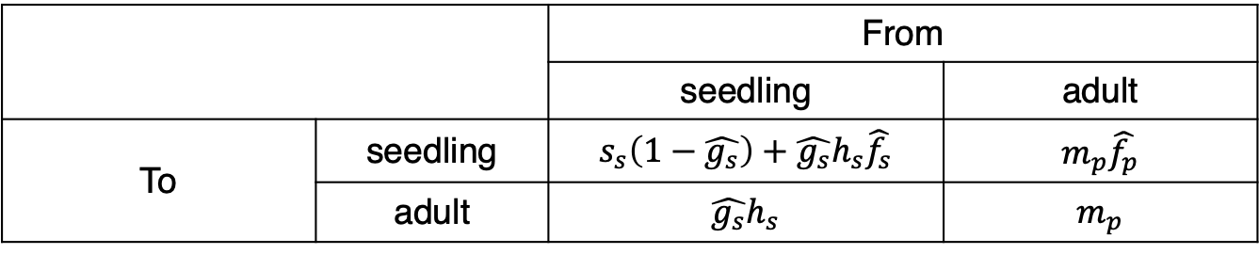
Growth rate when rare: perennials
Use dominant Eigenvalue of seedling-adult transition matrix when perennial is rare (no effect on itself) and annual is common (Mordecai 2013)
Hat indicates variable is affected by annual density
 |  | From
 |  | seedling | adult
To | seedling | $$s_{s}\left(1−\hat{g_{s}}\right)+\hat{g_{s}}h_{s}\hat{f_{s}}$$ | $$m_{p}\hat{f_{p}}$$
 | adult | $$\hat{g_{s}}h_{s}$$ | $$m_{p}$$

Slide 20
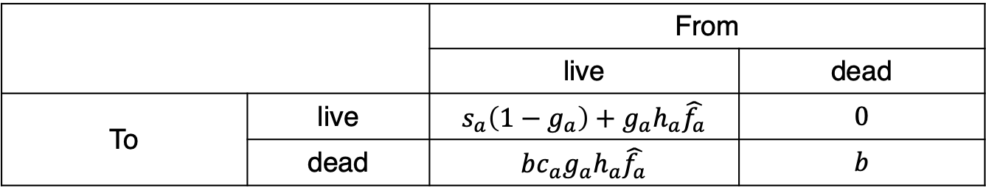
Growth rate when rare: annuals
The annual also has two life stages – apply same method
 |  | From
 |  | live | dead
To | live | $$s_{a}\left(1−g_{a}\right)+g_{a}h_{a}\hat{f_{a}}$$ | $$0$$
 | dead | $$bc_{a}g_{a}h_{a}\hat{f_{a}}$$ | $$b$$
Re-do without this and check. From Mike: I would ignore the litter in this calculation, because, as you write, it doesn't contribute to population growth. I don't think it would make any difference if you did have a two-stage model, with one stage being living plant and one being litter. In this case, the matrix would have a 0 in the off-diagonal element that gives living plant produced from litter. For a two-by-two matrix with an off-diagonal element equal to 0, the eigenvalues are the main diagonal elements. One of these is the litter decomposition rate, which is less than 1. So the other one, which is the living plant growth rate (over a complete generation, for example, seed to seed), determines whether the annual increases when rare.
As for whether the litter affects plant growth, since you are assuming the annual is rare, then I think you could ignore the effect of the litter, assuming the litter has an effect on, say, germination, only when it creates a continuous mat. I would think an isolated plant would not produce enough litter to interfere much with growth from its seed the next year. If it would, then you'd need to include that effect. But I would think that litter would slow the annual's growth rate only when the annual became abundant.

