Slide 1
Long-term consequences for pathogen-mediated competition between Microstegium vimineum and native species

Slide 2
Questions
What is the expected long-term outcome of competition between M. vimineum and a representative native species (Elymus virginicus)?
How do we expect disease to modify this outcome?
What information do we gain by empirically testing the effect of disease on competition between M. vimineum and E. virginicus?
Functional form of litter-mediated and live competition
Changes in competitive effects or responses due to disease
Unexpected interactions (e.g., facilitation)
How does this new knowledge modify our previous expectations?

Slide 3
Annual plant parameters | symbol | value | units | reference
annual germination without litter | g.A | 0.8 | year⁻¹ | Redwood et al. 2018
annual seed survival | s.A | 0.13 | year⁻¹ | Redwood et al. 2018
annual biomass without competition | v.A | 17.4 | g year⁻¹ | Wilson et al. 2015
intraspecific effect of competition on annual | alpha.AA | 0.002 | year⁻¹ | Leicht et al. 2005
interspecific seedling effect of competition on annual | alpha.AS | 0.0007 | year⁻¹ | Leicht et al. 2005
interspecific adult effect of competition on annual | alpha.AP | 0.007 | year⁻¹ | 10x alpha.AS
annual biomass-seed conversion | y.A | 86 | seeds g⁻¹ year⁻¹ | Wilson et al. 2015, Redwood et al. 2018

Slide 4
Perennial seedling parameters | symbol | value | units | reference
perennial germination without litter | g.S | 0.8 | year⁻¹ | Garrison and Stier 2010
perennial seed survival | s.S | 1 | year⁻¹ | Garrison and Stier 2010
perennial seedling survival | s.1 | 0.4 | year⁻¹ | Mottl et al. 2006
seedling perennial seed production without competition | f.1 | 2 | seeds year⁻¹ | 1/10 of f.P
intraspecific seedling effect of competition on perennial seedling | alpha.SS | 0.006 | year⁻¹ | Leicht et al. 2005
interspecific effect of competition on perennial seedling | alpha.SA | 0.06 | year⁻¹ | Leicht et al. 2005
intraspecific adult effect of competition on perennial seedling | alpha.SP | 0.06 | year⁻¹ | 10x alpha.SS

Slide 5
Perennial adult parameters | symbol | value | units | reference
adult perennial seed production without competition | f.P | 22 | seeds year⁻¹ | Stevens 1957, Garrison and Stier 2010
intraspecific adult effect of competition on perennial adult | alpha.PP | 0.006 | year⁻¹ | equal to alpha.SS
intraspecific seedling effect of competition on perennial adult | alpha.PS | 0.0006 | year⁻¹ | 1/10 of alpha.SS
interspecific effect of competition on perennial adult | alpha.PA | 0.006 | year⁻¹ | 1/10 of alpha.SA
intraspecific adult effect of competition on perennial adult | alpha.PP | 0.006 | year⁻¹ | equal to alpha.SS
perennial adult survival | s.P | 0.89 | year⁻¹ | Mottl et al. 2006

Slide 6
Litter parameters | symbol | value | units | reference
litter suppression of germination | beta | 0.0065 | g⁻¹ year⁻¹ | Foster and Gross 1998
litter-biomass conversion | a | 0.95 | year⁻¹ | DeMeester and Richter 2010
litter decomposition rate | b | 0.67 | year⁻¹ | DeMeester and Richter 2010
Disease parameters | symbol | value | units | reference
reduction in biomass due to disease | dis | 0.35 | year⁻¹ | Flory et al. 2011, Stricker et al. 2016

Slide 7
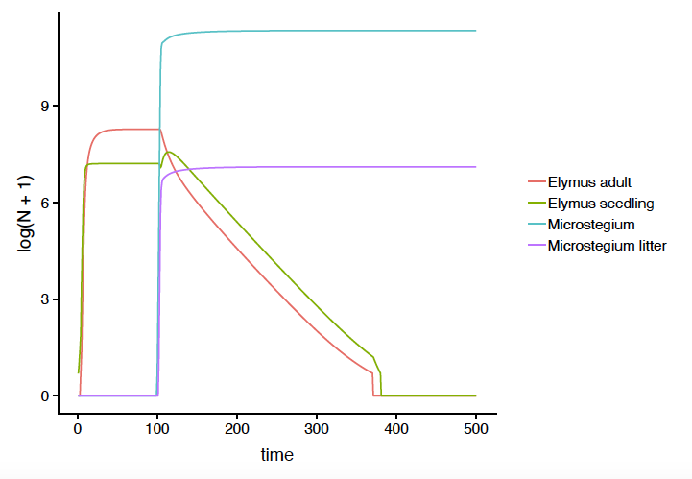
M. vimineum excludes E. virginicus 281 years after invasion

Slide 8
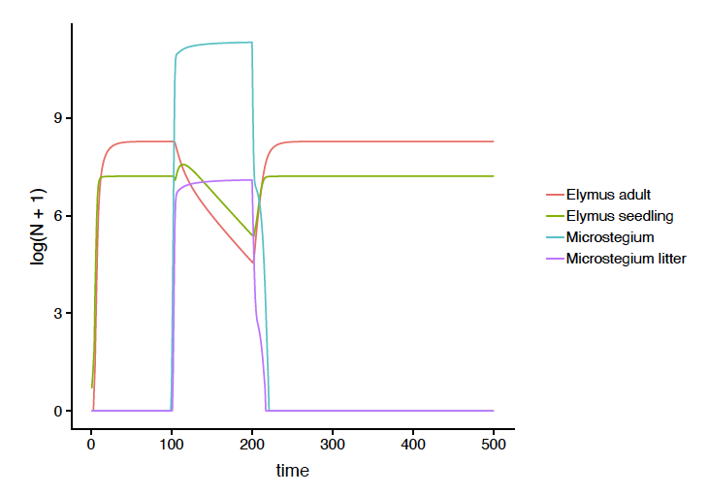
Disease promotes the exclusion of M. vimineum 21 years after the initial epidemic

Slide 9
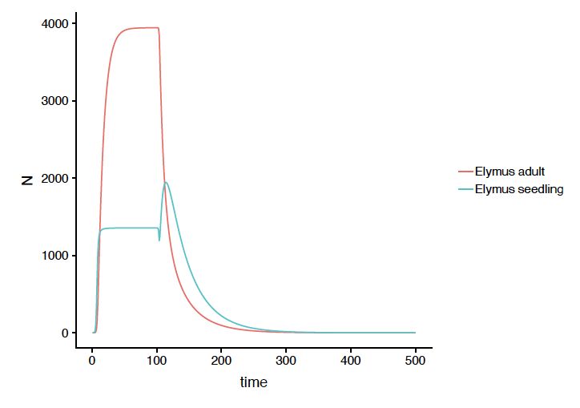
Zoom in on E. virginicus exclusion

