Slide 1

Assignment 4: Concept Video
Raina K, Avni K, Anna E

Slide 2
Value Proposition
Problem/Solution Overview
Young voters typically don’t know which politicians best aligns with their views, or what their views really are. As a result, they tend to follow the views of their parents or friends.
Our solution is to provide an interface where young voters can learn more about voter issues and assess which are most important to them, then match with a candidate that will best represent them for upcoming voting cycles.
To streamline political information and empower young voters to shape their futures.

Slide 3
Tasks
Simple: Discover which candidates are running for national and local elections, and what issues they find most important. This allows young voters to know what campaigns are being run and get a general idea of what elections are coming up.
Moderate: Learn about which policies matter to them. Young voters can learn more about what voter issues matter to them the most, so they know what to prioritize in elections.
Complex: Assess the differences between candidates and match with the one that best represents their views, so they can come to the conclusion on their own with no outside influence or bias.

Slide 4
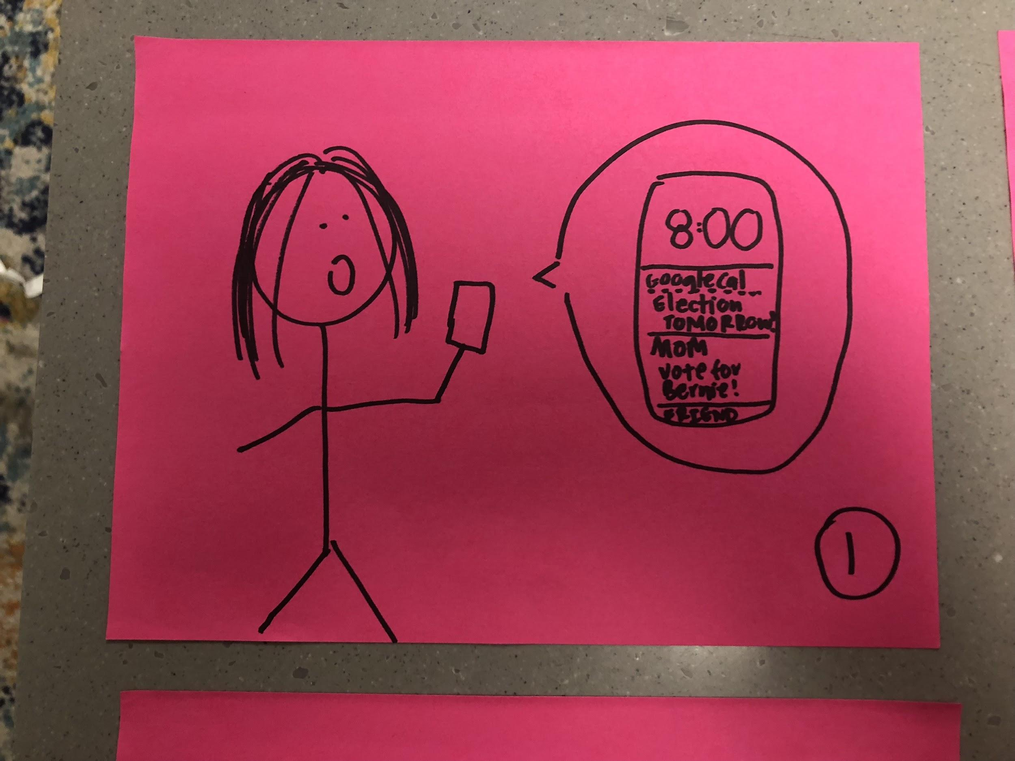
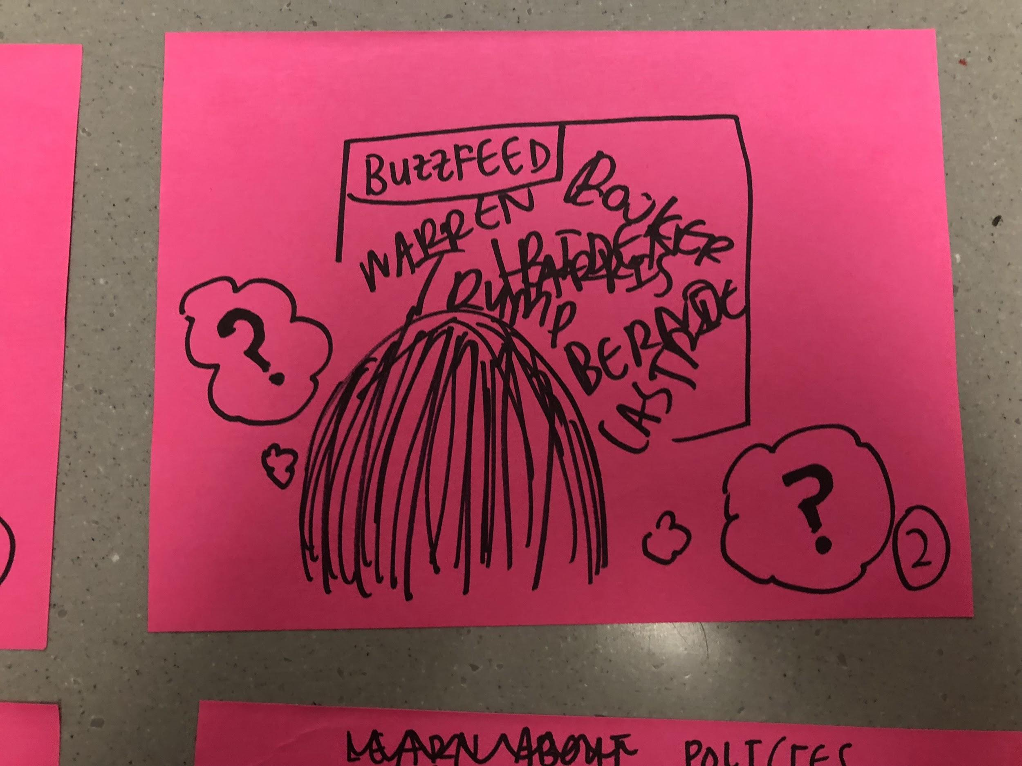
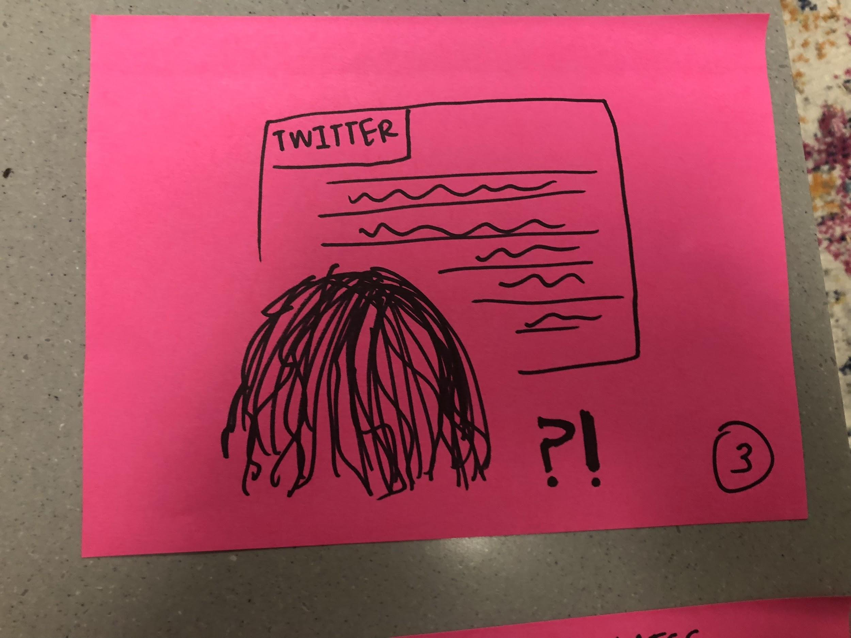
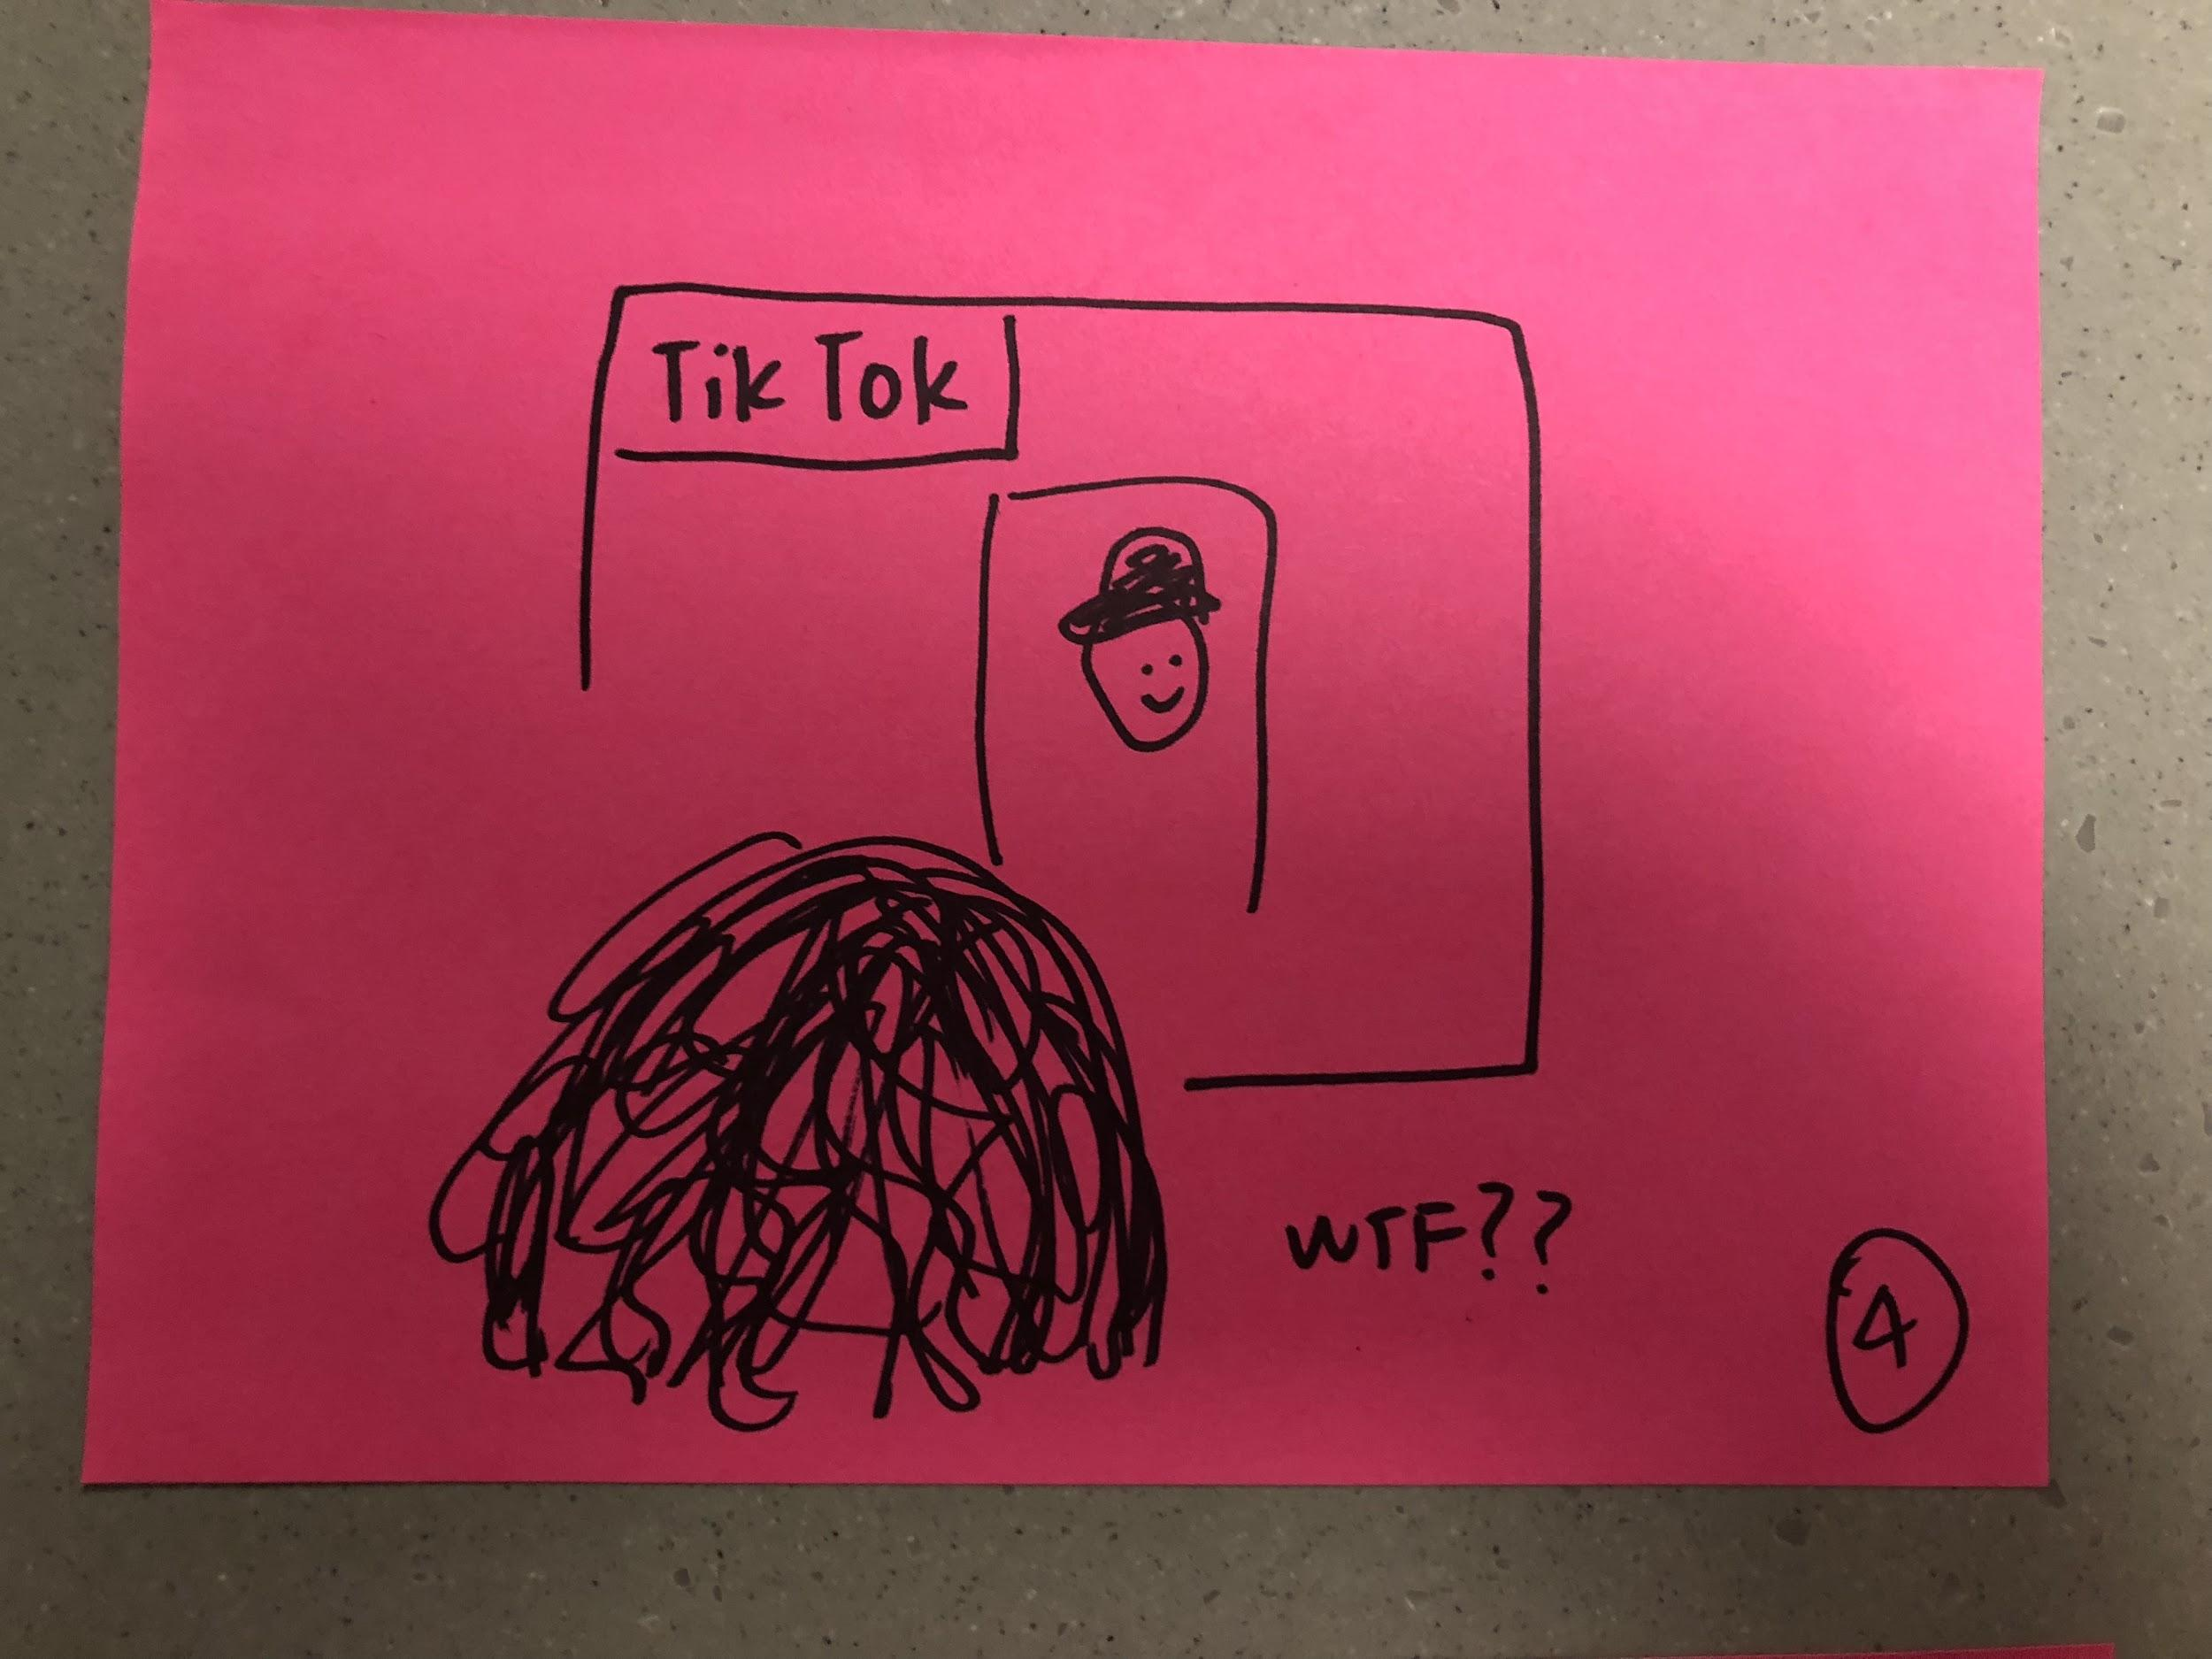
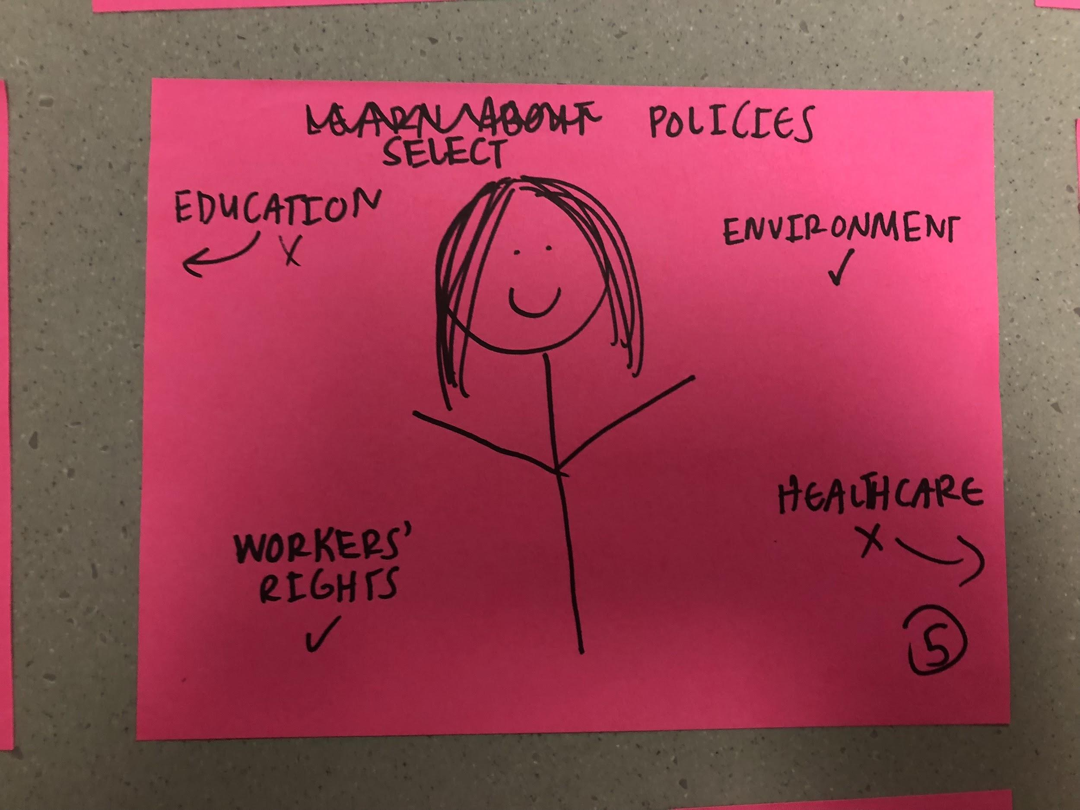
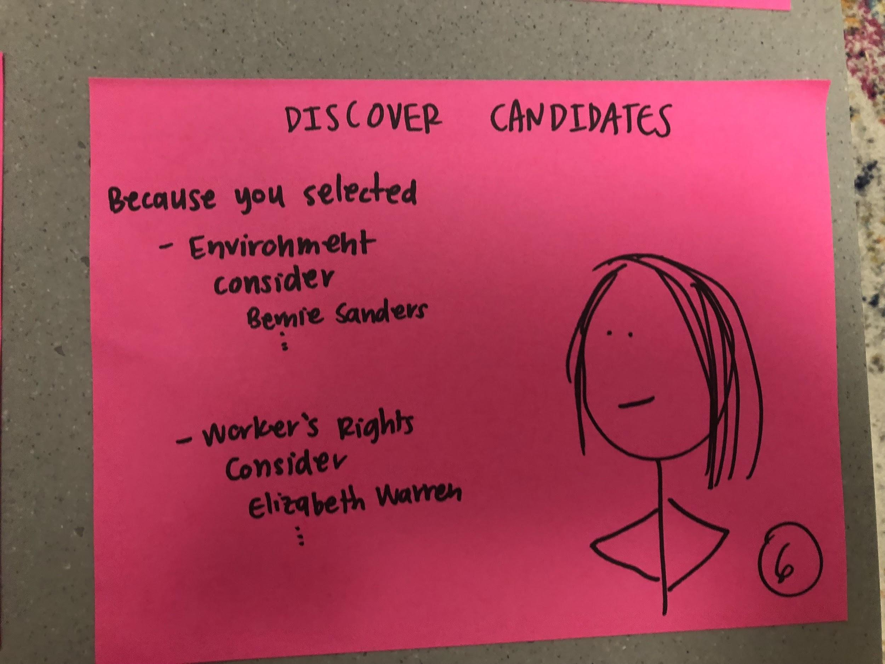
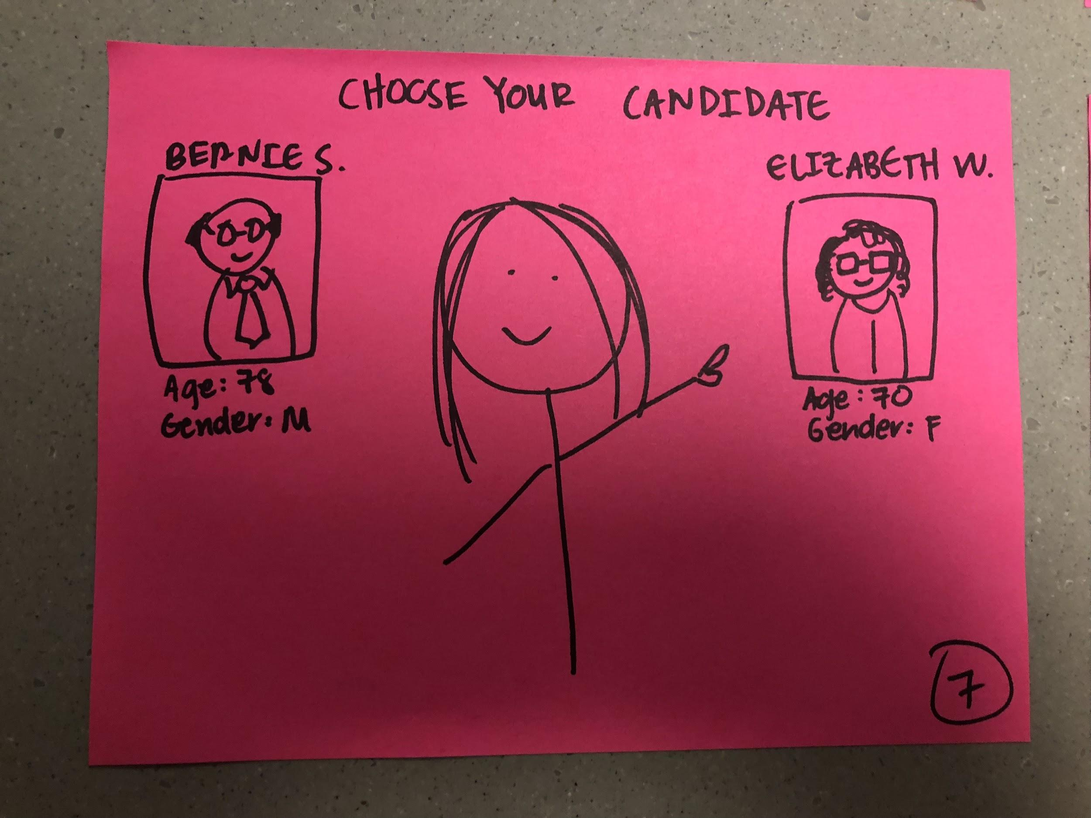
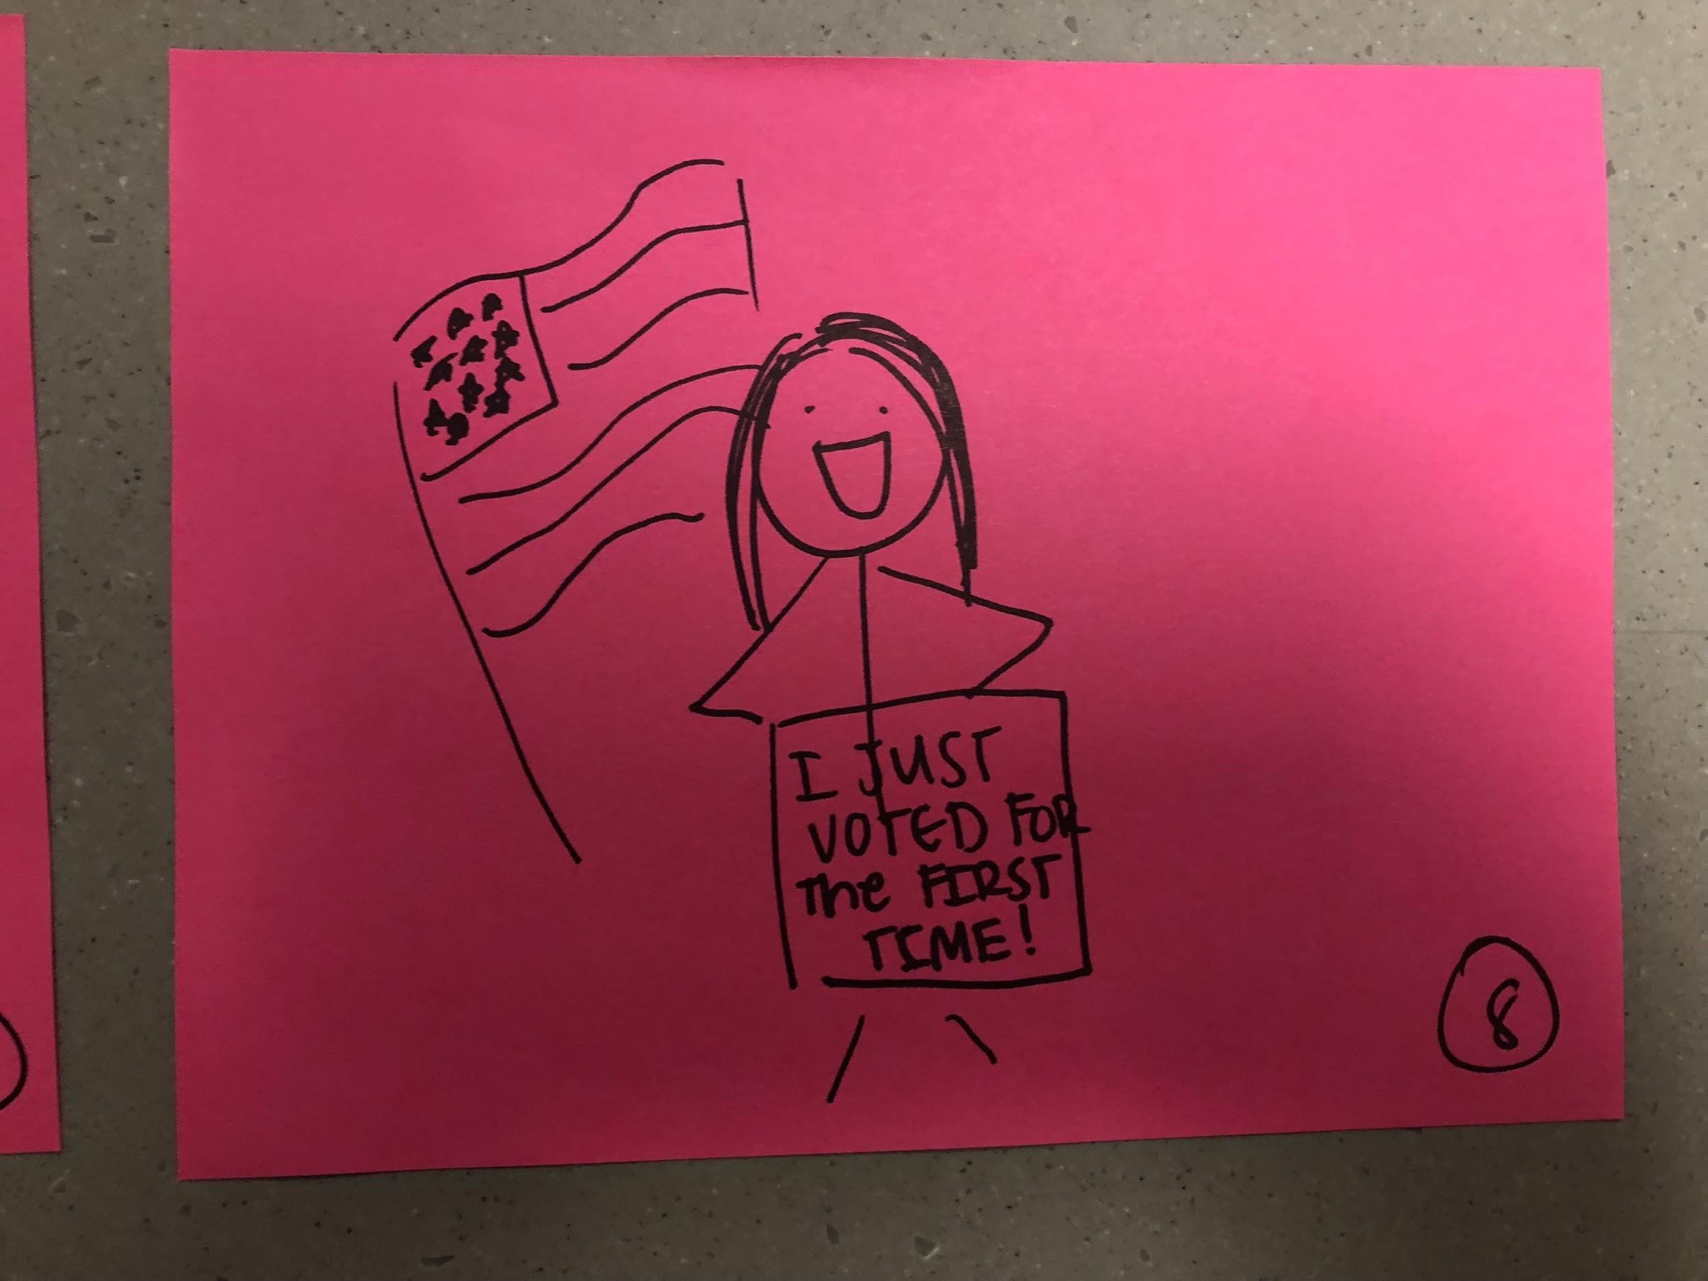
Storyboard

