Slide 1
Anna, Avni, Raina
🔥BALLIT🔥

Slide 2
Problem
Currently, political news outlets are not targeting young consumers. As a result, Gen Z feels lost, disillusioned, and cynical about politics. They are overwhelmed by the constant barrage of news that. They need a fun, accessible way to learn about policies and organize their views.

Slide 3
Solution
We propose a simple application, BALLIT, that has features (social media memes, emojis, Tinder “swiping”) that make politics feel fun and young. Our solution helps young voters understand what policies matter to them and learn more about upcoming elections.

Slide 4
Heuristic Evaluation Summary
8 violations of severity 3 and 4
Most reflected our policy matching task
Most Common Heuristic:
Visibility of System Status

Slide 5
Addressed Violations
H10: “Icons on the bottom are misleading as to what screens they will bring. The location symbol suggests an interactive map, while the paper symbol does not clearly convey policies. It lacks clear instruction.”
Revamped our navigation system to use a sidebar, so we can include text

Slide 6
Addressed Violations
H3: If the user makes a mistake in liking or disliking a policy, there is no way for them to return to the screen. While this feature is appealing for Tinder, where excitement is key, it is not desirable when selecting on which topics you want to receive news. No screens have back buttons.
Added back buttons to all applicable screens

Slide 7
Addressed Violations
H1: Too much empty space on the screen detailing upcoming elections. The screen is not informative.
Added upcoming elections that don’t have ballots yet

Slide 8
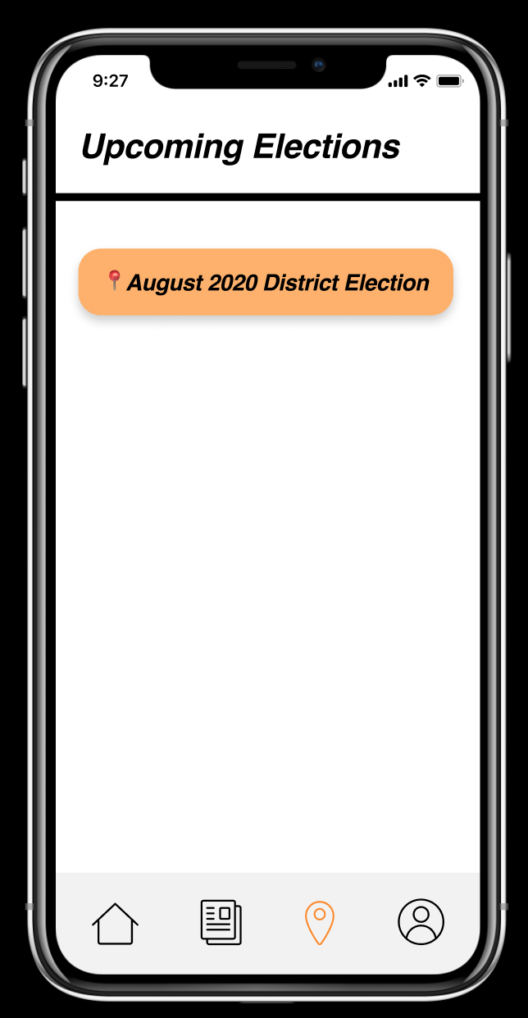
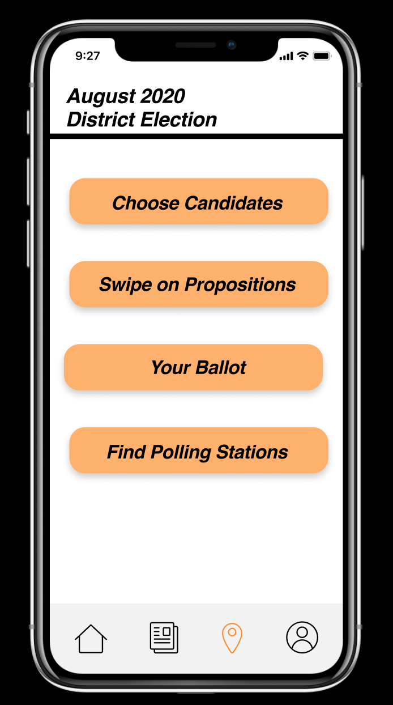
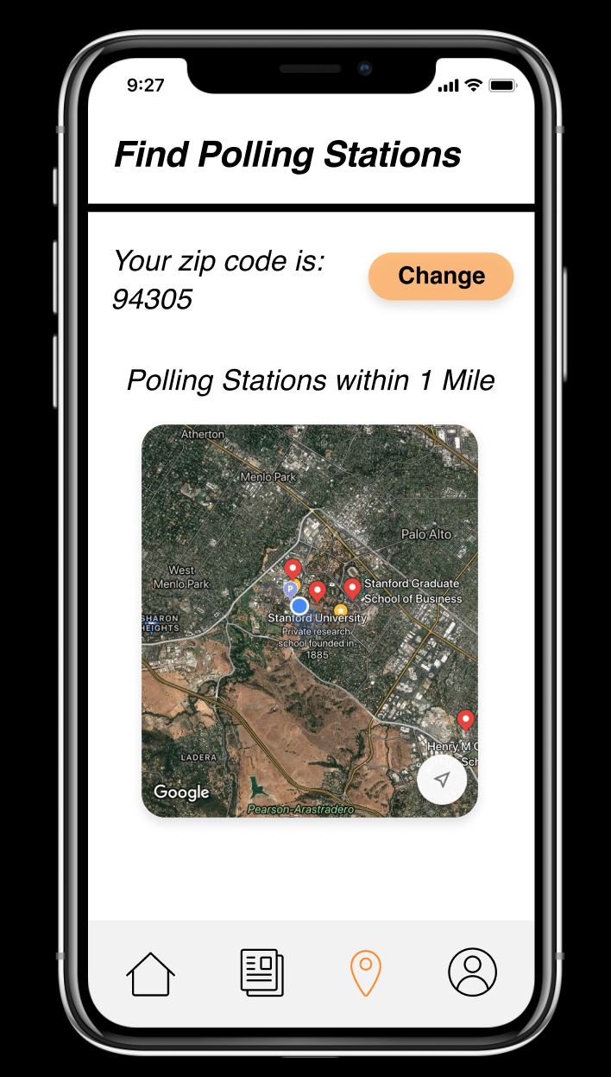
Previous Design
click
click

Slide 9
Previous Design
No back button
click
Not enough upcoming elections
click
Confusing Icons

Slide 10
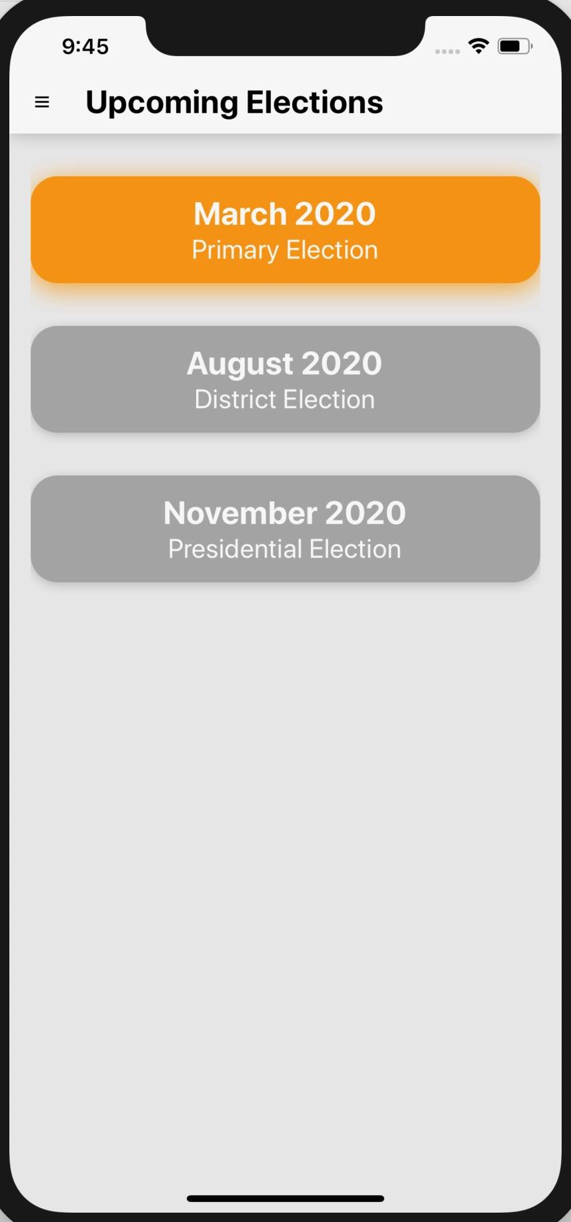
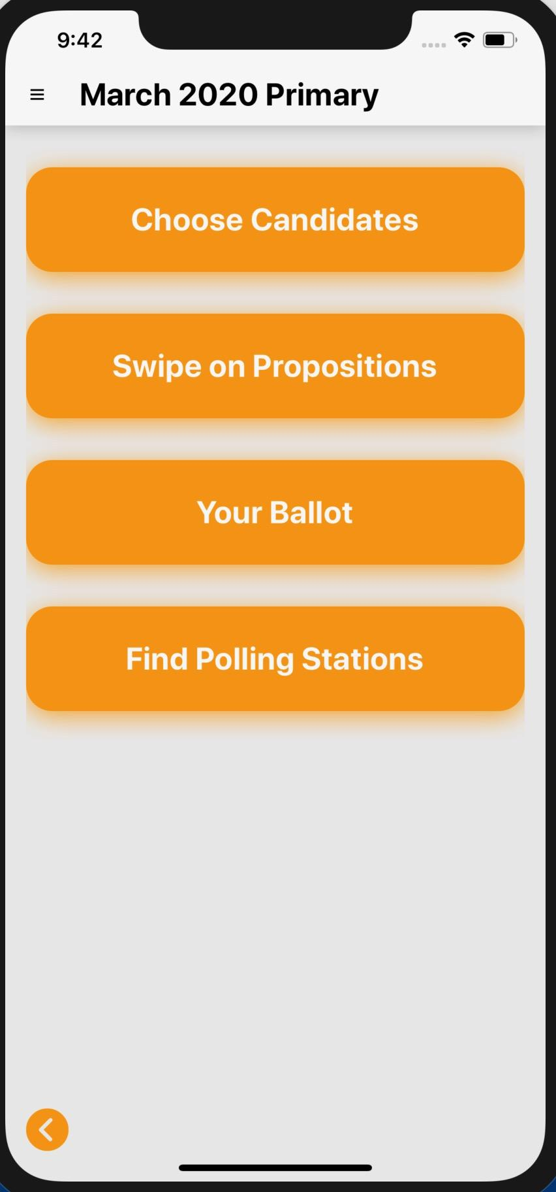
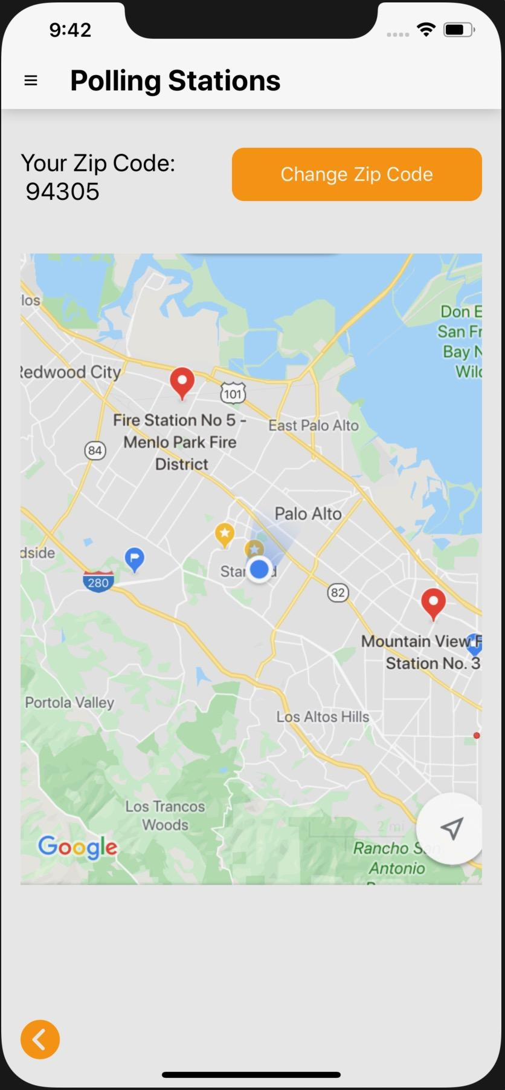
Revised Design
click
click
Notes:
Add bar for current vs upcoming elections
Countdown on upcoming elections
When clicked, go to different page with a little information

Slide 11
Revised Design
New Navigation
click
click
More elections, even if they aren’t currently open
Back button

Slide 12
Implementation
React Native & Expo
Steep learning curve
To be implemented:
Swipe on Policies
Swipe Function
Edit preferences
Save to profile
Home Screen
Choose your Candidates
Information about candidates
Edit preferences
Save to profile

Slide 13
Wizard of Oz Hard-Coding
No responses from us for the app
Polling stations
Election information
Candidate profiles
Home screen images
List of policies

Slide 14
Demo Time!

Slide 15

Task 3: Find Polling Station

Slide 16
Summary
Implemented:
Upcoming Elections → March 2020 Primary Election → Find Polling Stations
Need to do:
Home Screen
Policies → Swipe on Policies → See Chosen Policies
March 2020 Primary Election → Choose Candidates → See Chosen Candidates
Clean up navigation and design more

Slide 17
Thanks!

