Slide 1


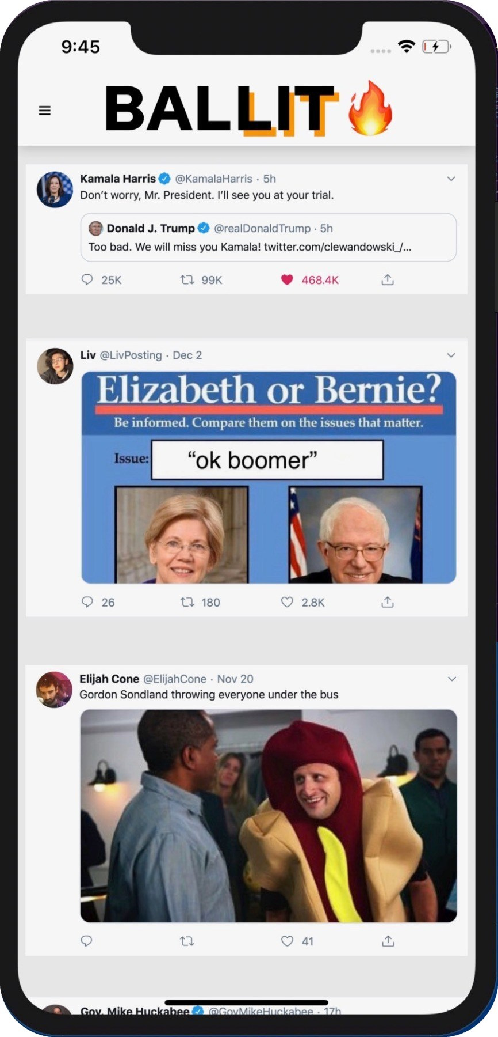
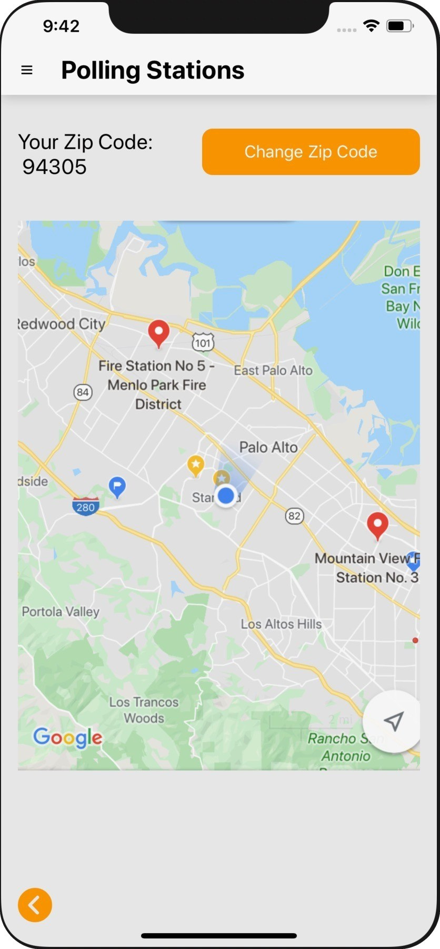
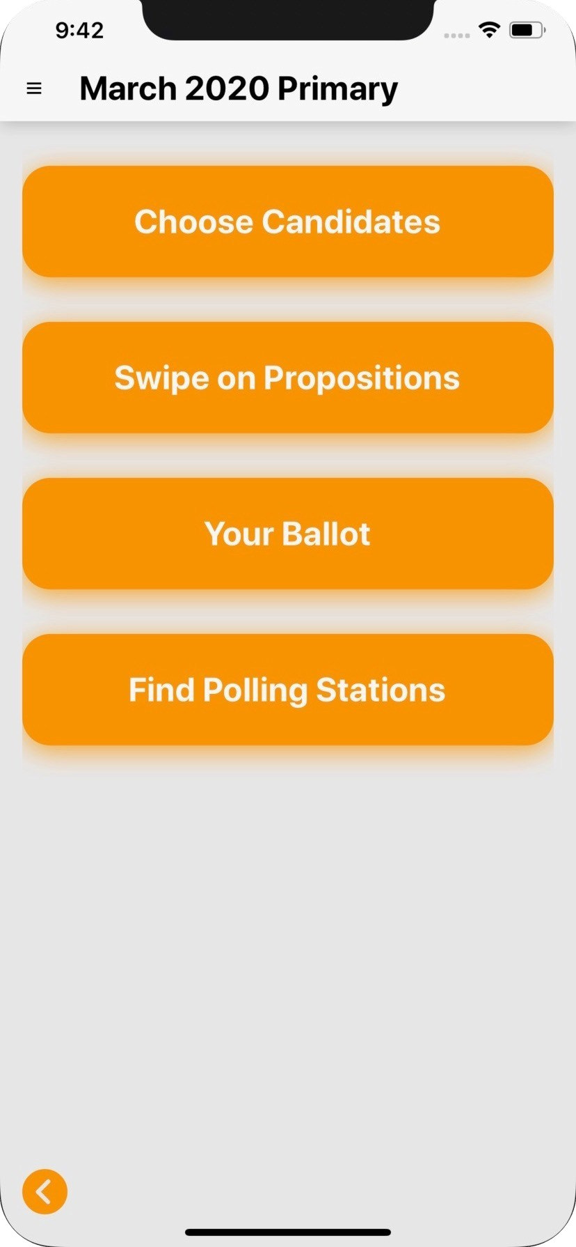
BALLIT
LIT
✓
Choose policies
✓
Choose candidates
✓
Find polling locations
✓
Shape your future.

