Slide 1
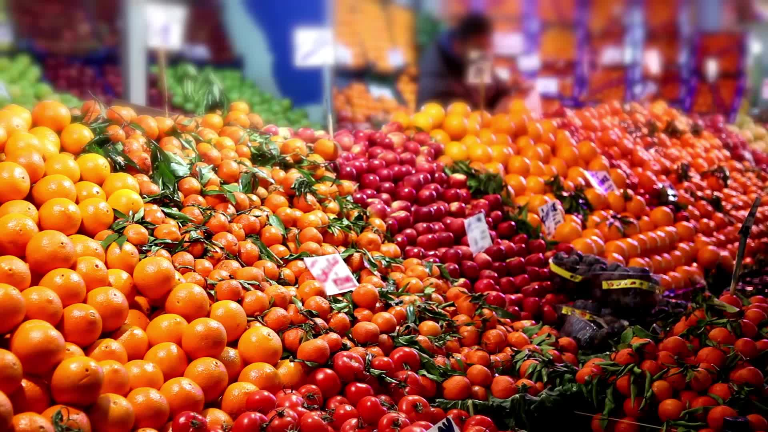
The Impact of Inflation and Exchange Rates on Grocery Prices in Turkey
DSA210-Term Project
Ayşe Ece Kültür-29338

Slide 2
Contents
Motivation
Data Sources
Data Analysis
Findings
Limitations and future work

Slide 3

Introduction and Motivation
Purchasing power in Türkiye has fallen significantly in the last five years.
Especially in the last 5 years, Turkey has experienced many difficulties in shaping the cost of living due to high inflation and variable exchange rates
This project aims to analyze:
the relationship between inflation, exchange rates, and grocery prices in Turkey
to observe the impact of these changes on consumers.

Slide 4
Hypothesis
H₀(Null Hypothesis): Grocery prices are significantly influenced by inflation and changes in exchange rates; higher inflation and devaluation of currencies drive higher food prices.
Hₐ(Alternative Hypothesis): Grocery prices in Turkey are not statistically significantly influenced by inflation or trade policies.

Slide 5
Data Sources
Central Bank of Turkey (CBRT): Historical exchange rate data (USD/TRY, EUR/TRY).
Turkish Statistical Institute (TÜİK) and International Monetary Fund: Monthly inflation rates, consumer price index (CPI), grocery price index and Unemployment Rate
Opet : Oil Prices

Slide 6
Project Plan
1. Data collection
2. Data preparation
3. Descriptive analysis
4. Hypothesis testing
5. Predictive modeling
6. Result interpretation

Slide 7
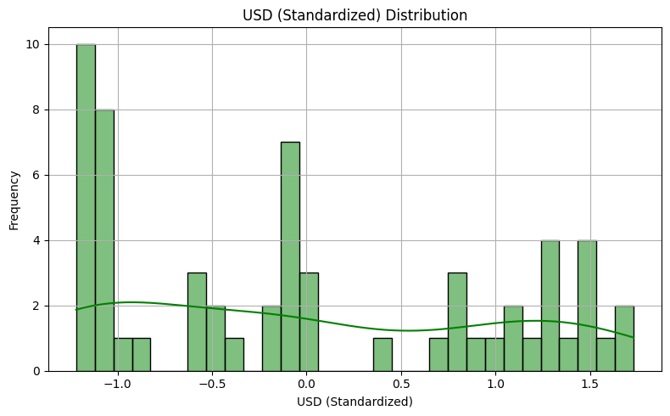
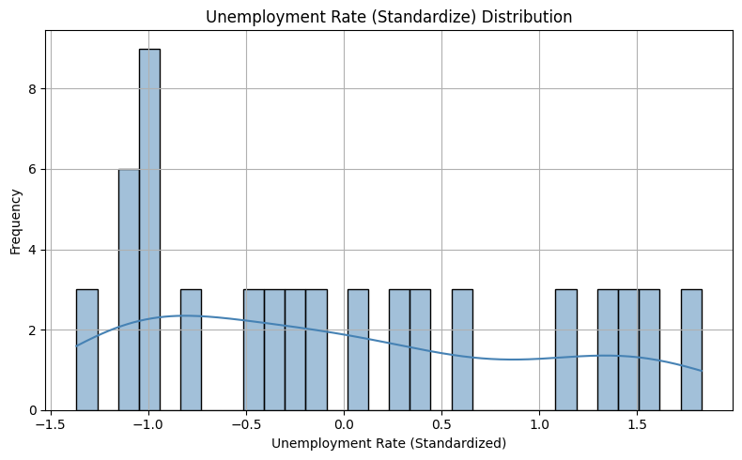
Histograms

Slide 8
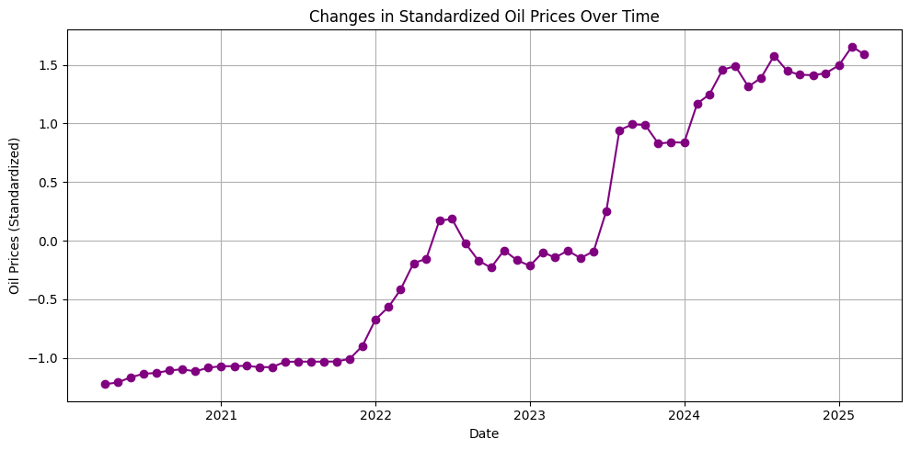
Time Series Line Plot

Slide 9
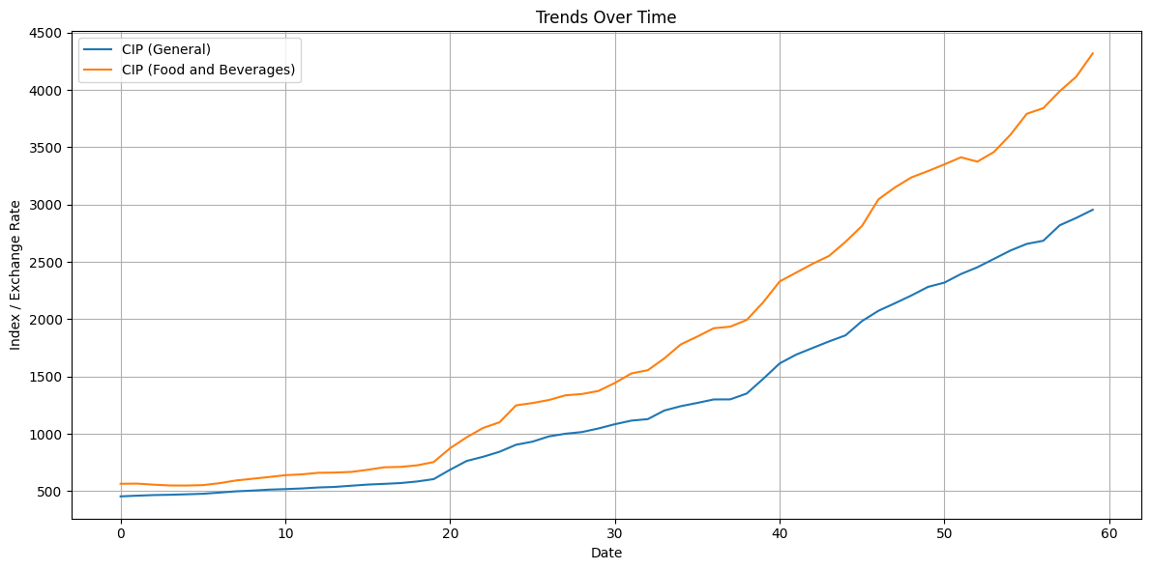
Trends Over Time Line Plot

Slide 10
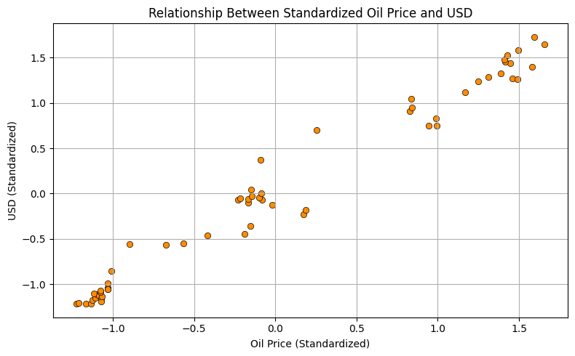
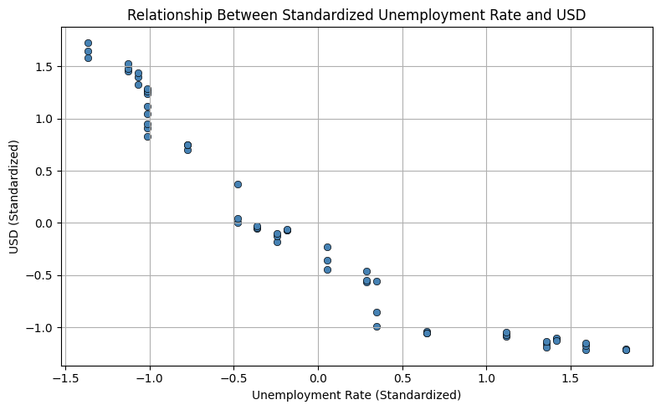
Scatter Plots

Slide 11
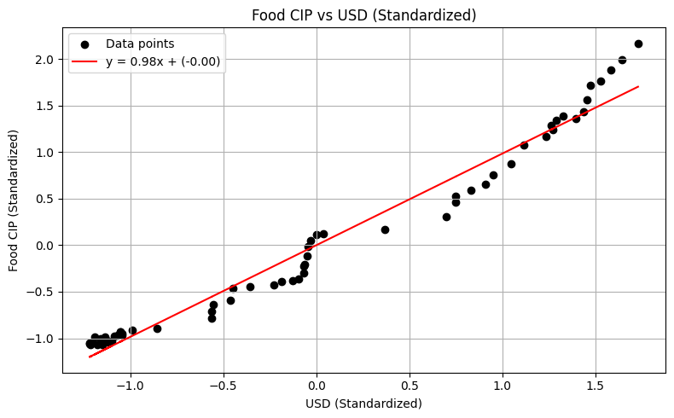
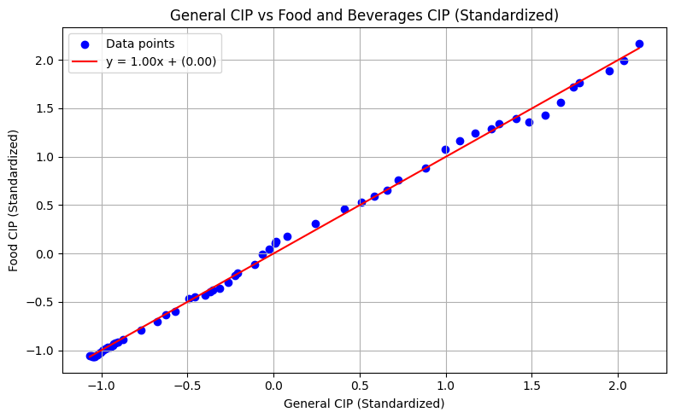
Scatter Plots with Regression Lines

Slide 12

Statistical Analysis
Simple Linear regression
Oil Prices vs USD
Unemployment Rate vs USD
Food CIP vs USD
General CIP vs USD
Pearson Correlation Test
Correlation Heatmap
Lagged Regression

Slide 13
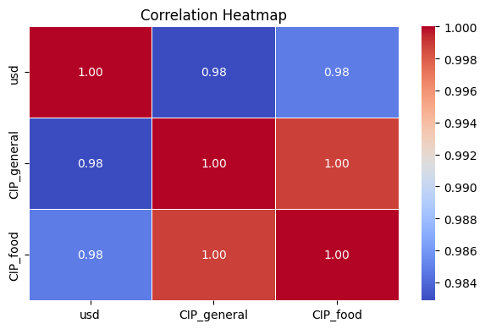
Correlation Heatmap

Slide 14
Machine Learning
Prophet Modelling
K-Means Modelling
Random Forest

Slide 15
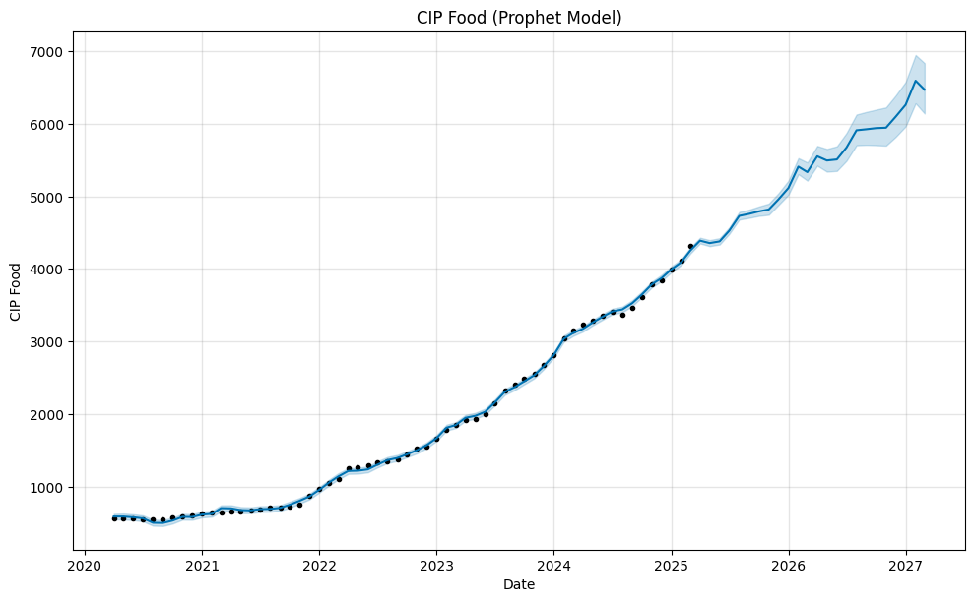
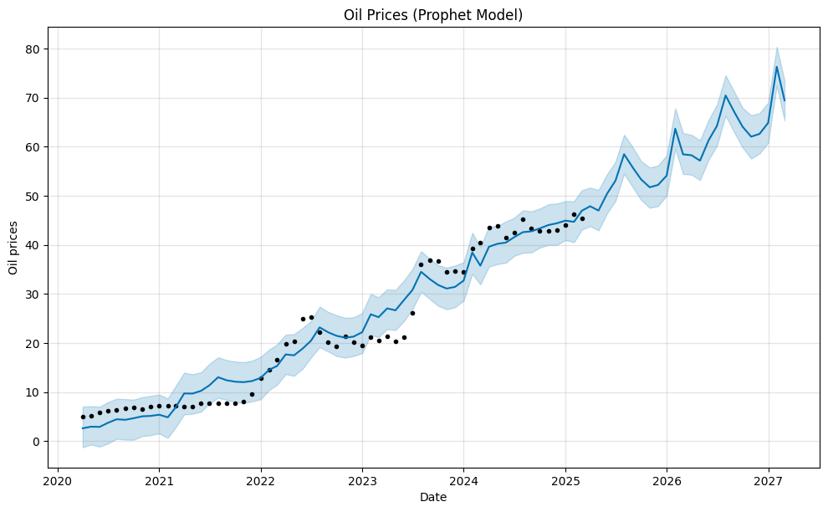
Prophet Modelling

Slide 16
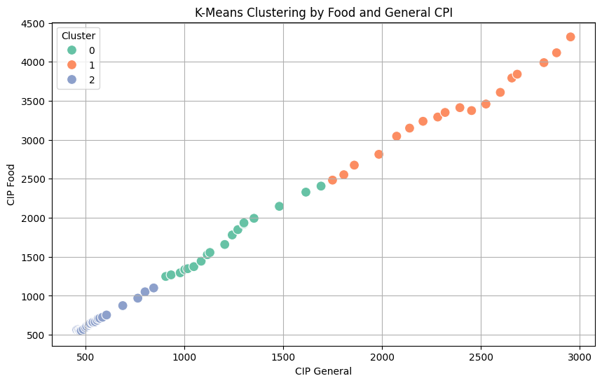
K-Means Modelling

Slide 17
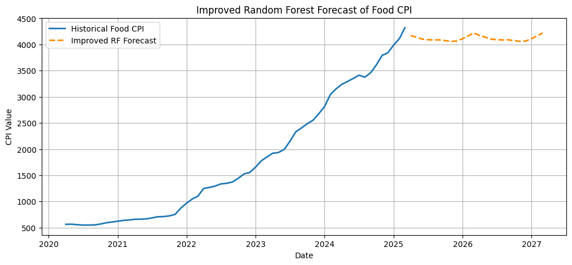
Random Forest

Slide 18
Limitations
Scope of Variables
Data Granularity
Import vs. Local Goods Segregation
Causality vs. Correlation

Slide 19
Future Work
Multi-variable Models
Product-Level Analysis
High-Frequency Data
More Forecasting Models

Slide 20
Findings
USD vs Food CPI: Pearson r ≈ 0.98, p ≪ 0.05 → Strong, significant relationship.
General CPI vs Food CPI: Nearly perfect linear link → Food prices closely mirror overall inflation.
We fail to reject the null hypothesis. Exchange rates have a statistically significant effect on grocery prices in Turkey.
Trends in unemployment may be a sign of inflationary pressure through consumer demand.
Visualizations show that changes in the global oil market affect food prices in Turkey.
Heatmaps: Confirm strong, consistent relationships across all variables.
Exchange rate fluctuations are a key driver of food price inflation in Turkey.

Slide 21
Conclusion
The project found a strong and statistically significant link between the USD exchange rate and the cost of food.
It was revealed that both inflation and the devaluation of the currency were big reasons why consumer prices went up, especially for basic food products.
Changes in food prices and the general CPI are closely linked to changes in the exchange rate.
Machine learning models, such as Random Forest, confirmed these connections and made it possible to make predictions, though they weren't always accurate for the long run.
The results show that financial instability has a direct effect on the cost of living for people in Turkey.

