Slide 1
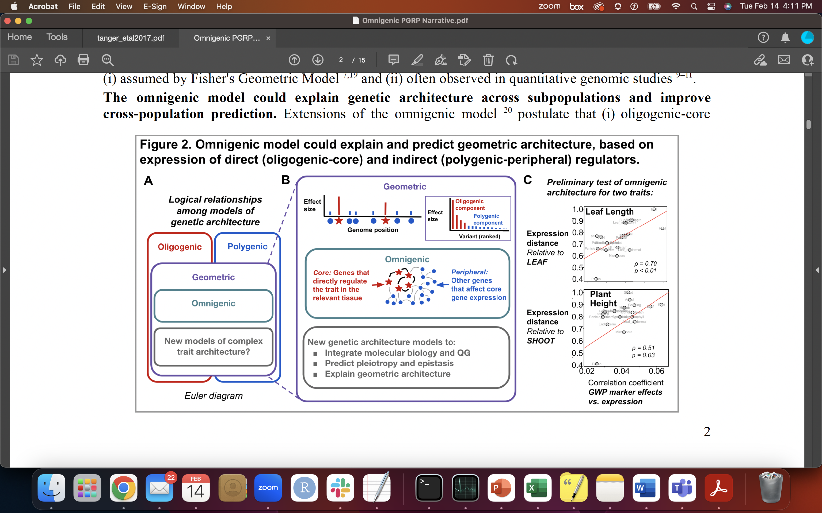
Competing hypotheses on omnigenic model
Hypothesis A: - Omnigenic model is an accurate representation of genetic architecture across subpopulations
…
Subpopulation 1
Subpopulation 2
Subpopulation k
Hypothesis B: - Omnigenic model is not an accurate representation of genetic architecture across subpopulations
…
Subpopulation 1
Subpopulation 2
Subpopulation k
GoHy is really helpful for thinking through research hypotheses

Slide 2


What I predict to see under Hypotheses A and B
Core genes ( ) have approximately the same effect sizes across subpopulations
Peripheral gene effects ( ) will be unique for each subpopulation
Cross-population prediction accuracies using existing genomic prediction models will be low
Hypothesis A: - Omnigenic model is an accurate representation of genetic architecture across subpopulations
…
Core genes ( ) have potentially vastly different effect sizes across subpopulations
Peripheral gene effects ( ) will not be unique for each subpopulation
Cross-population prediction accuracies using existing genomic prediction models will be reasonable
Subpopulation 1
Subpopulation 2
Subpopulation k
Hypothesis B: - Omnigenic model is not an accurate representation of genetic architecture across subpopulations
…
Subpopulation 1
Subpopulation 2
Subpopulation k
GoHy is really helpful for thinking through research hypotheses

