Slide 1

GNOD Project
Song recommender
Amr&Silvia

Slide 2

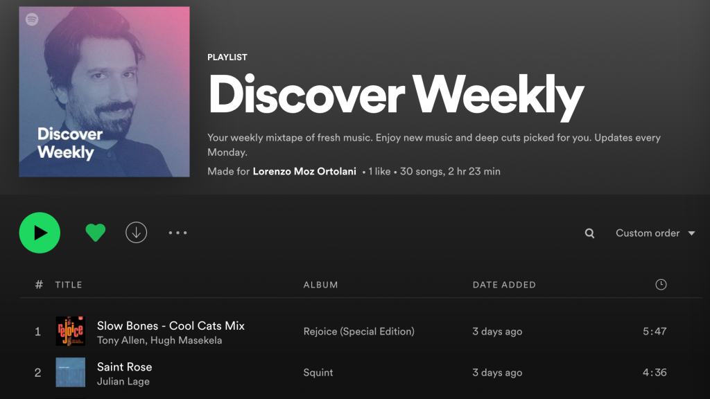


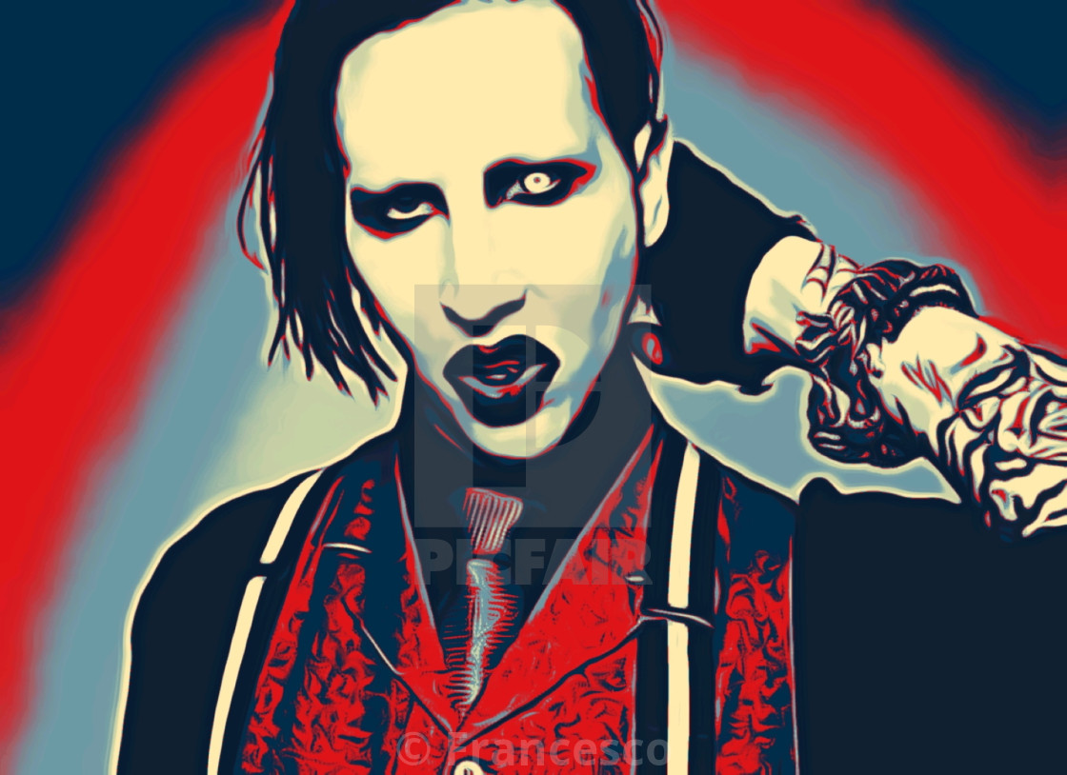
Are you not tired of WRONG music recommendations??

Slide 3
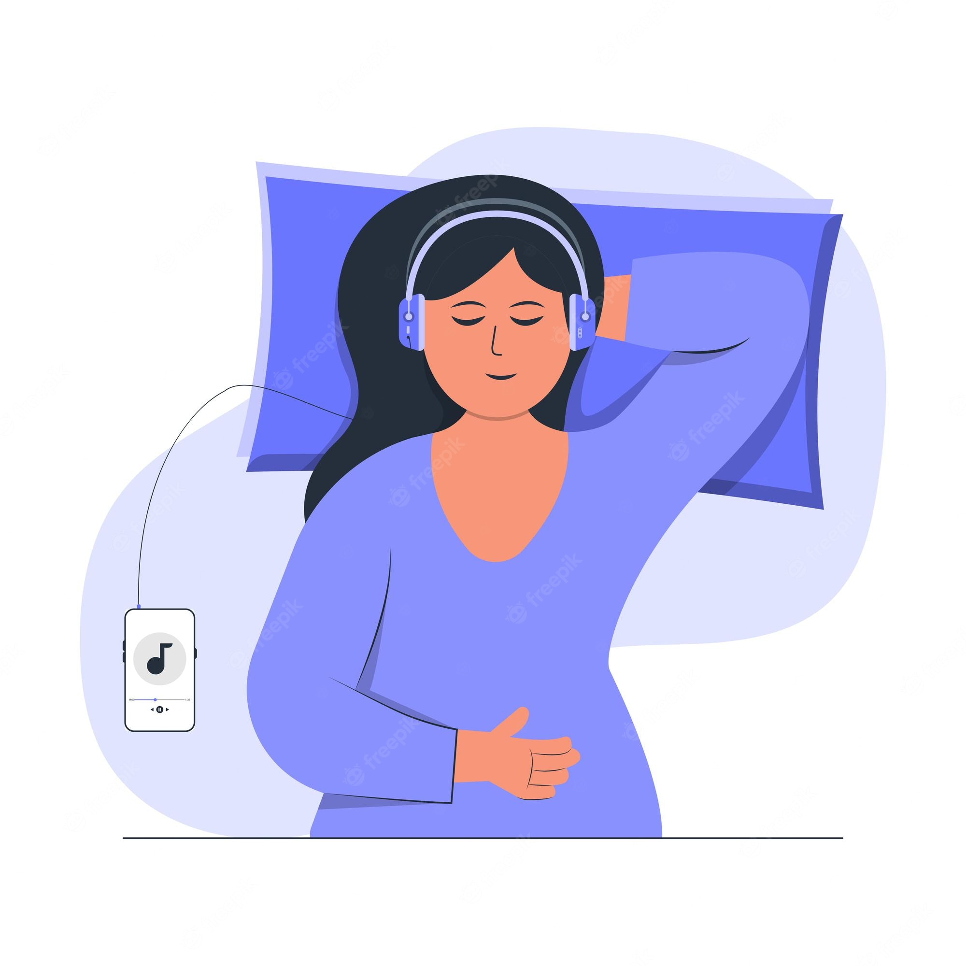
NoHustle Song Recommender
GNOD
Here the solution…
NoHustle
Chill
Trendy songs
yet fitting personal taste and user preferences

Slide 4
How our DEMO is working?
Accepts users´ inputs and returns recommendations
Based on almost 4000 currently trendy and all-times songs
Utilizes carefully selected and fine-tuned Songs´ features for the best performance
Tested for performance and reliability
NoHustle
Chill
GNOD

Slide 5


Outlook
Incorporate β-testers to fine tune → onging
Increase the database of songs to reach 100.000 → Q2 2023
Fine tune the model based on the new database → Q2 2023
Build an user-friendly Interface
- including user-defined moods → Q4 2023
Release for wide scale testing → Q1 2024
Approch potential buisness partners for monetization → Q2 2024

Slide 6
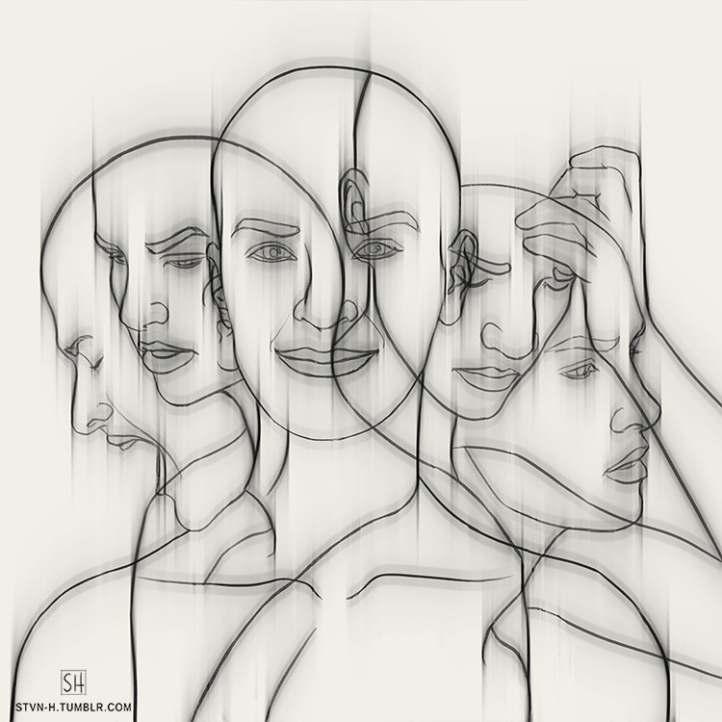
Outlook
User-friendly interface
How do you feel?
Incorporate β-testers to fine tune → onging
Increase the database of songs to reach 100.000 → Q2 2023
Fine tune the model based on the new database → Q2 2023
Build an user-friendly Interface
- including user-defined moods → Q4 2023
Release for wide scale testing → Q1 2024
Approch potential buisness partners for monetization → Q2 2024
Image modified from: https://www.artstation.com/artwork/r5RAa

Slide 7

Outlook
GNOD
NoHustle
Incorporate β-testers to fine tune → onging
Increase the database of songs to reach 100.000 → Q2 2023
Fine tune the model based on the new database → Q2 2023
Build an user-friendly Interface
- including user-defined moods → Q4 2023
Release for wide scale testing → Q1 2024
Approch potential business partners for monetization → Q2 2024
Chill
Image modified from: https://www.artstation.com/artwork/r5RAa

Slide 8

Acknowledgement
GNOD
GNOOSIC DISCOVER NEW MUSIC
NoHustle
Chill
Thank you!
Questions?
Amr&Silvia

