Slide 1
Customer data analysis findings

Slide 2
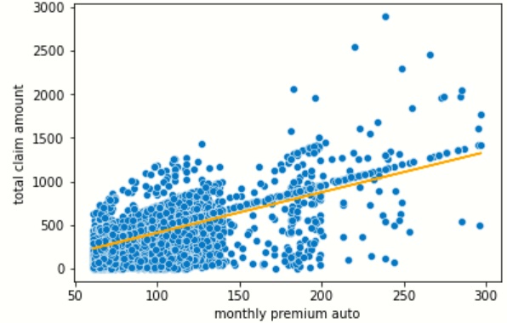
LINEAR REGRESSION BENCHMARK(1 Independent variable based on correlation heat map)
Intercept=-53.75
model.coef(slope)=4.64
MSE =37999.54
lm.score=0.40

Slide 3
SCENARIO 1 . BASE CASE
CONDITIONS:
Independent variable:
Minmaxscaler normalized numerical data + onehot code encoded categorical data
Train-Test split :
80%/20%
MSE =12092.37
RMSE =109.97
MAE =75.01
R2 TRAIN score=1
R2 TEST score=0.76
COMPARED TO BENCHMARK:
HUGE IMPROVEMENT IN MODEL ERROR /VALIDATION AND PREDICTION OF Y

Slide 4
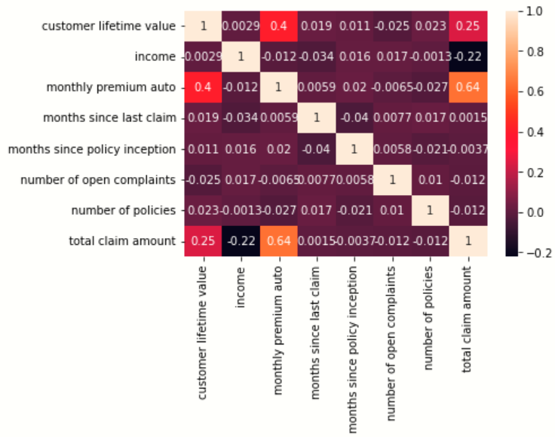
SCENARIO 2 . REDUCED NUMERICAL
CONDITIONS:
Independent variable:
Minmaxscaler normalized REDUCED numerical data. Numerical data reduced to the 3 variables having a trace of correlation with Y:
monthly premium auto
customer lifetime value
income
+ onehot code encoded categorical data
Train-Test split :
80%/20%
MSE =12406.98
RMSE =111.39
MAE =76.09
R2 TRAIN score=1
R2 TEST score=0.76
COMPARED TO SCNARIO:
SURPRISINGLY THE ERROR AND THE MODEL PREDICTION GOT WORSE.
THE RESULTS DEFINED THE DIRECTION FOR SCENARIO 3

Slide 5
SCENARIO 3 ( Scenario 2 in lab7) . BEST SCENARIO
CONDITIONS:
Independent variable:
STANDARDSSCARLER normalized numerical data
+
onehot code encoded categorical data
Train-Test split :
80%/20%
MSE =0.19
RMSE =0.43
MAE =0.29598
R2 TRAIN score=1
R2 TEST score=0.7725
COMPARED TO BENCHMARK, SCENARIO 1 AND 2 :
PRODUCED OUTSTANDING RESULTS IN TERMS OF ERROR.. THIS MEANS THAT THE PREDICTIONS ARE MORE CONSISTENT OVER THE RANGE OF DATA PRODUCING LOW CHANCES OF COMPLETELY WRONG PREDICITION.
MODEL PREDICTION IMPROVED BUT NOT AS DRASTIC AS THE IMPROVEMENT IN ERROR REDUCTION.
THE MODEL RETURNS OVER 77% TRUE PREDICTIONS REGARDLESS OF THE DATA POSITION GIVEN THE VERY LOW RMSE OF 0.43

Slide 6
SCENARIO 4 ( Scenario 3 in lab7) .
CONDITIONS:
Independent variable:
STANDARDSSCARLER normalized numerical data
+
onehot code encoded categorical data
LOG transformed Y and then
+
Normalized y using STANDARDSSCARLER
NB. Log transformed y has been run and the results were bad so decided normalized to check if it gets any better
Train-Test split :
80%/20%
MSE =0.19
RMSE =0.43
MAE =0.29598
R2 TRAIN score=1
R2 TEST score=0.7725
COMPARED TO BENCHMARK, SCENARIO 3:
NO CHANGE IN MODEL BUT MORE COMPUTING TIME.

Slide 7
IMPACT OF TRAIN TEST SPLIT ON BEST CASE SCENARIO (# 3)
MSE =0.21
RMSE =0.46
MAE =0.3224
R2 TRAIN score=1
R2 TEST score=0.7262
CONDITIONS:
SAME SCNENARIO 3 CONDITIONS
Train-Test split :
60%/40%
RESULTS:
CHECKED FOR TEST SPLIT OF 30 %. RESULTS WHERE A HAIR WORSE THAN WITH 20 % ( NO REAL APPARENT DIFFERENCE)
FOR 40 % TEST SPLIT , RESULTS ARE APPARENTLY MUCH WORSE ESPECIALLY IN THE 5 %
REDUCTION IN THE MODEL PREDICTION PERFORMANCE ( FROM OVER 77 % TO 72.6 %)
CONCLUSION: SWEET SPOT BETWEEN 20 % AND 30 %. TEST SPLIT.
RECOMMENDATION:
THE CURIOUS CASE OF WHY THE PERFORMANCE WAS BETTER WITH THE WHOLE NUMERICAL DATA FRAME GIVEN ALMOST NO CORRELATION IS TO BE STUDIED IN DEPTH TO UNDERSTAND HOW AND WHY THE MODEL BEHAVED IN SUCH A MANNER.

Slide 8
CONDITIONS:
Independent variable:
STANDARDSSCARLER normalized numerical data
+
onehot code encoded categorical data
LOG transformed Y and then
+
Normalized y using STANDARDSSCARLER
NB. Log transformed y has been run and the results were bad so decided normalized to check if it gets any better
Train-Test split :
80%/20%
MSE =0.19
RMSE =0.43
MAE =0.29598
R2 TRAIN score=1
R2 TEST score=0IMPACT OF TRAIN TEST SPLIT ON BEST CASE SCENARIO (# 3) .7725
COMPARED TO BENCHMARK, SCENARIO 3:
NO CHANGE IN MODEL BUT MORE COMPUTING TIME.

