Slide 1
M&A Datasets EDA:
Business intelligence: strategy perspective
Google, IBM, Microsoft, Apple, Facebook, Yahoo and Twitter

Slide 2
Business Questions:
What is the total number of acquisitions year on year. Did the number of acquisition increase over the years?
Which acquiring company is the most active with the highest total number of acquisitions
Acquiring companies by acquisition spend. Which company has the highest spend?
What is the frequency, spend and pattern of acquisitions over the years & in which businesses is MnA concentrated)
Countries with the highest number of acquisitions acquisition
What are the business domains with the highest acquisition value.
Are the acquiring companies competing in the same space?

Slide 3
Data exploration and wrangling:
Investigated missing values and data quality in 2 data sets
Enriched primary data set through merging
Cleared Nans with real data from researching acquired company attributes and other statistical means.

Slide 4
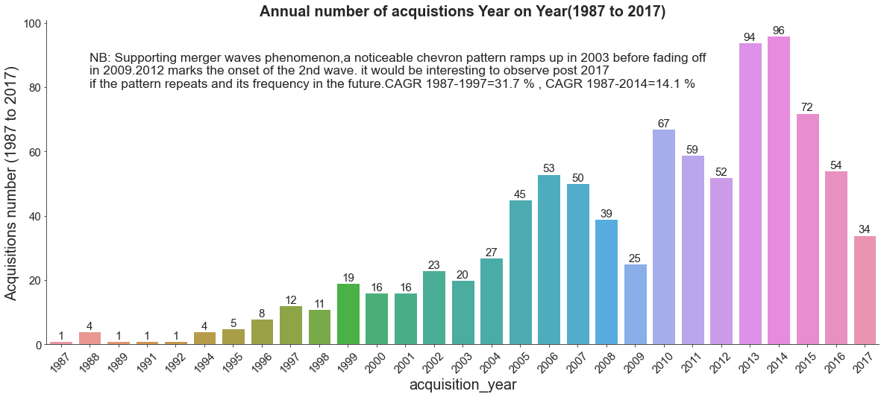
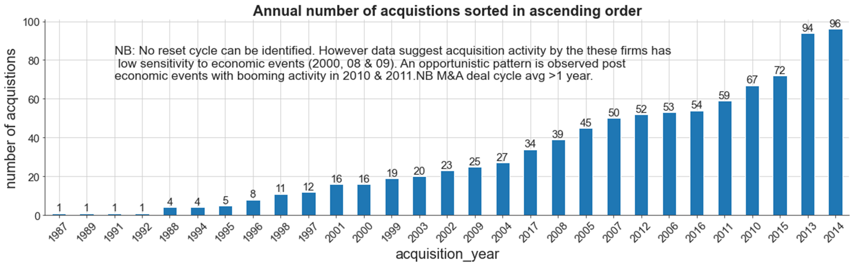
What is the total number of acquisitions year on year. Did the number of acquisition increase over the years :

Slide 5
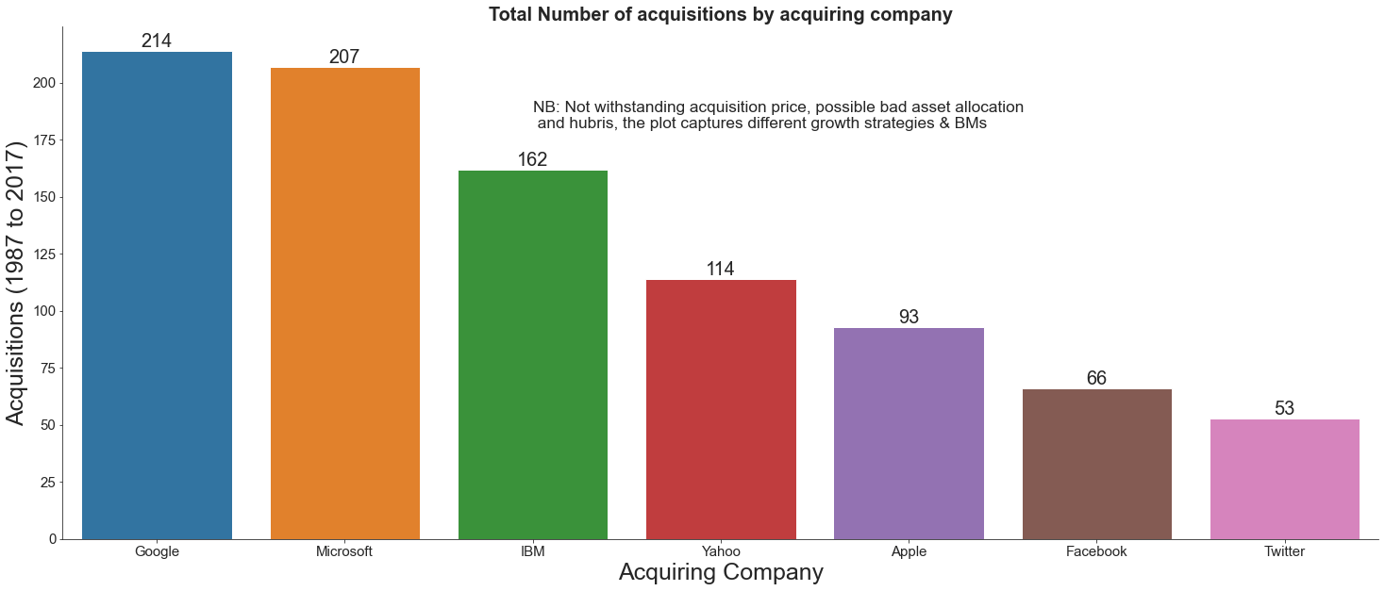
Acquiring company with the highest total number of acquisitions

Slide 6
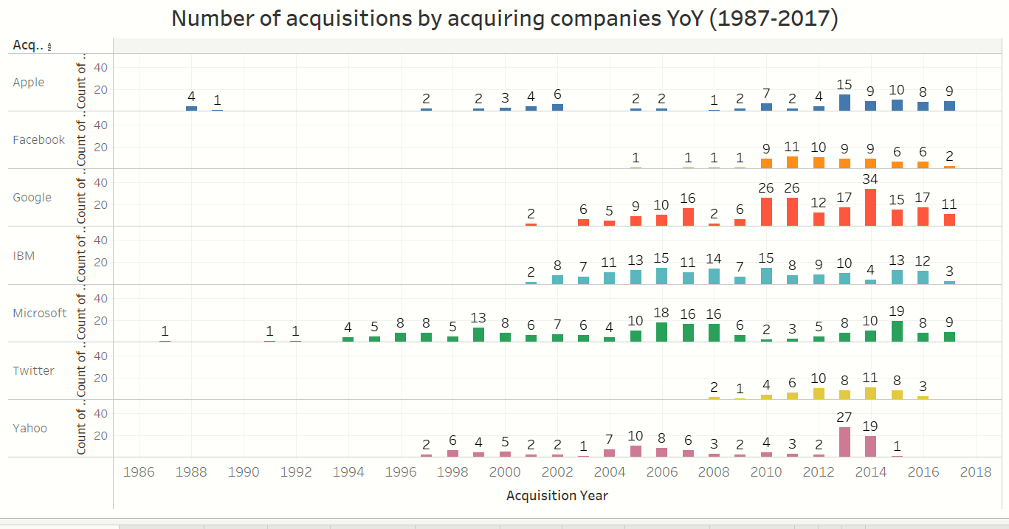
What is the frequency and pattern of acquisitions over the years :

Slide 7
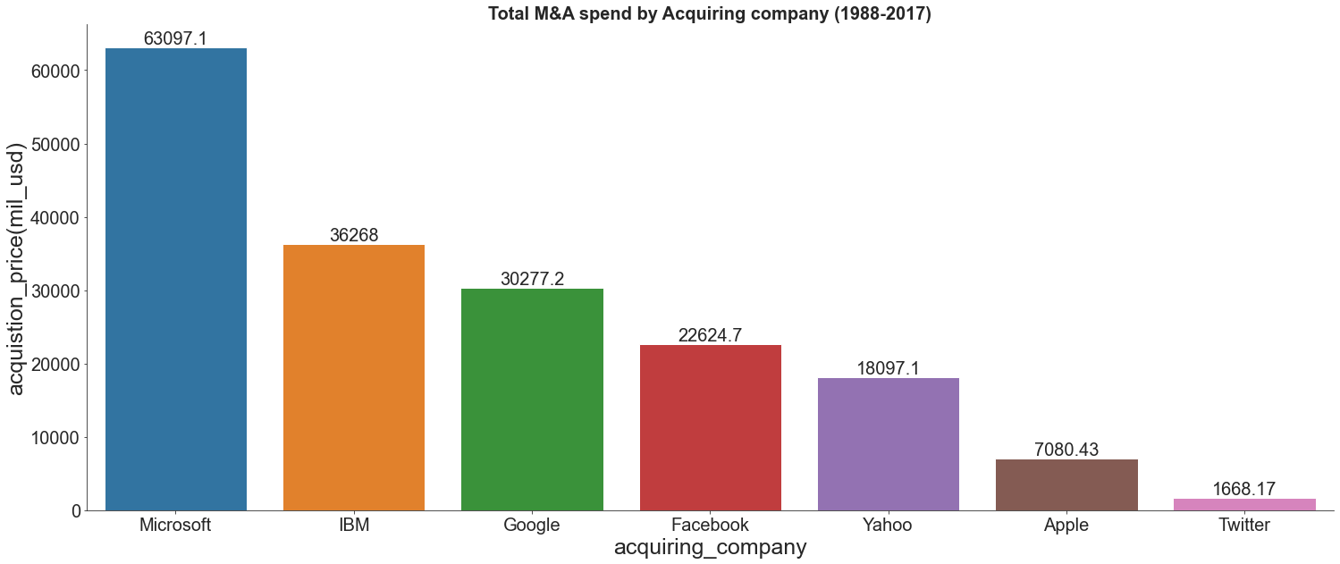
Acquiring companies by acquisition spend. Which company has the highest spend?

Slide 8
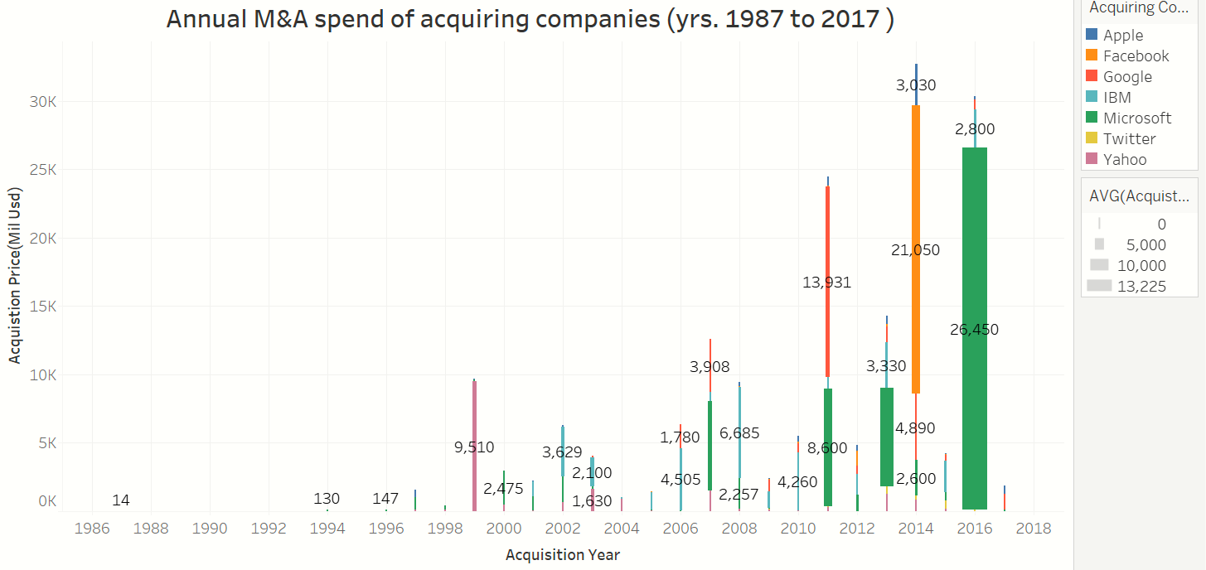
What is the spend and pattern of acquisitions over the years

Slide 9
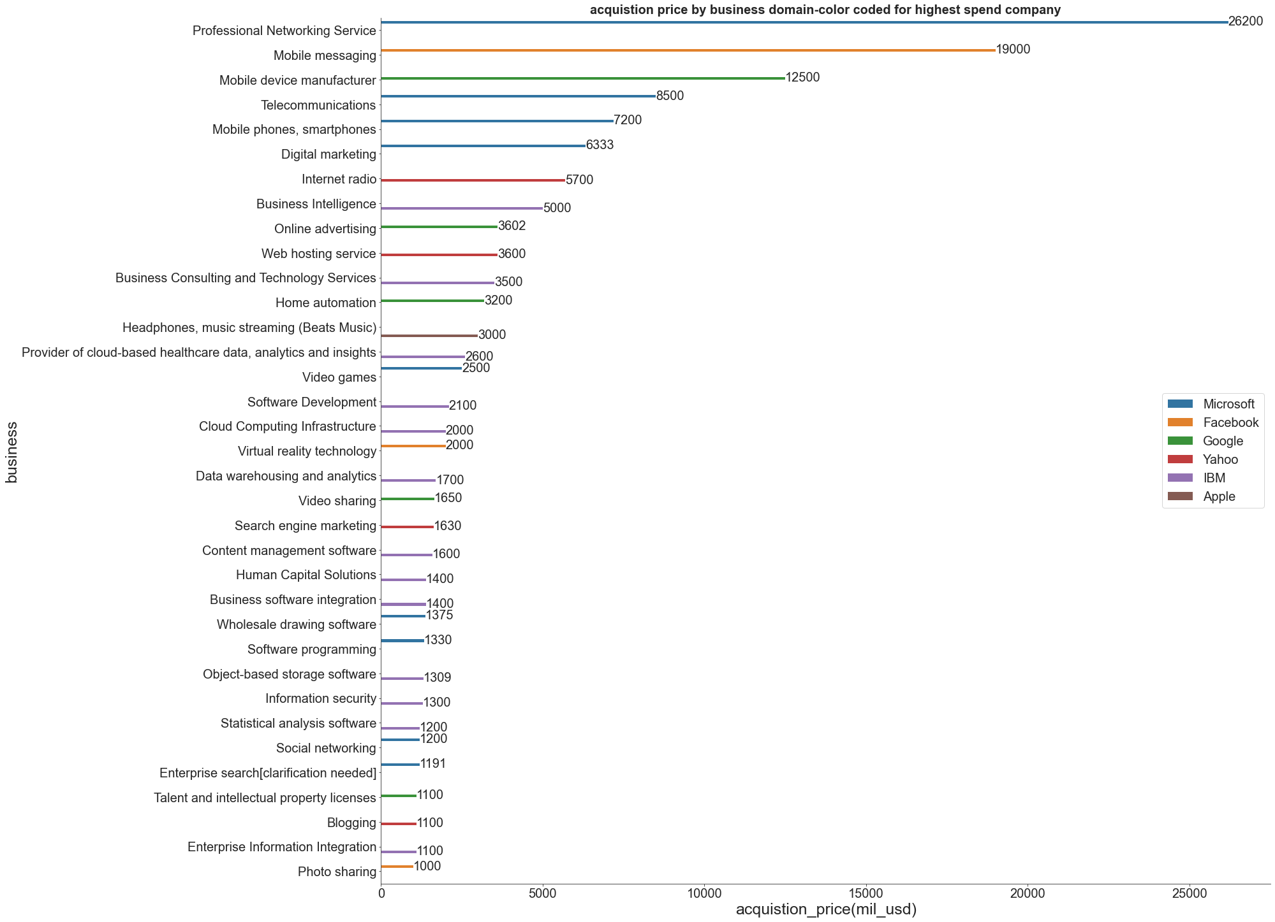
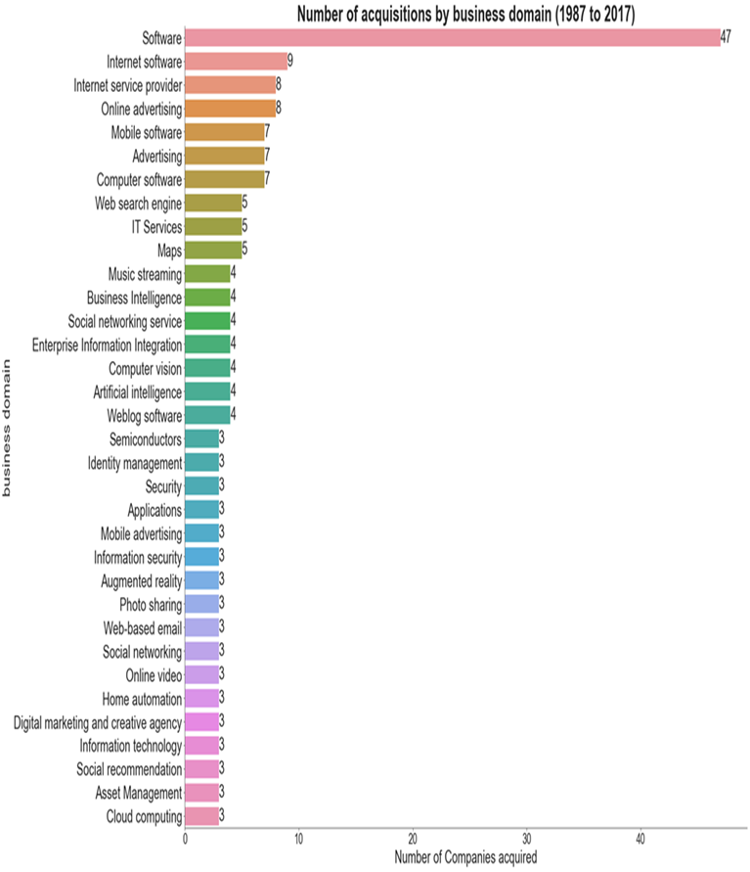
Countries with the highest number of acquisitions acquisition cont’d

Slide 10
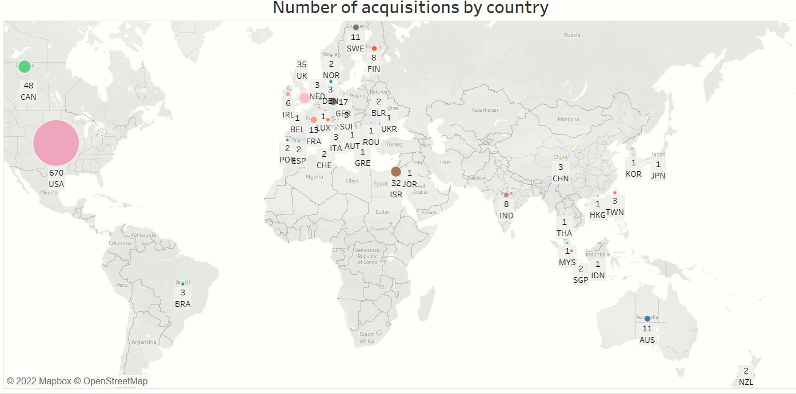
Countries with the highest number of acquisitions acquisition

Slide 11
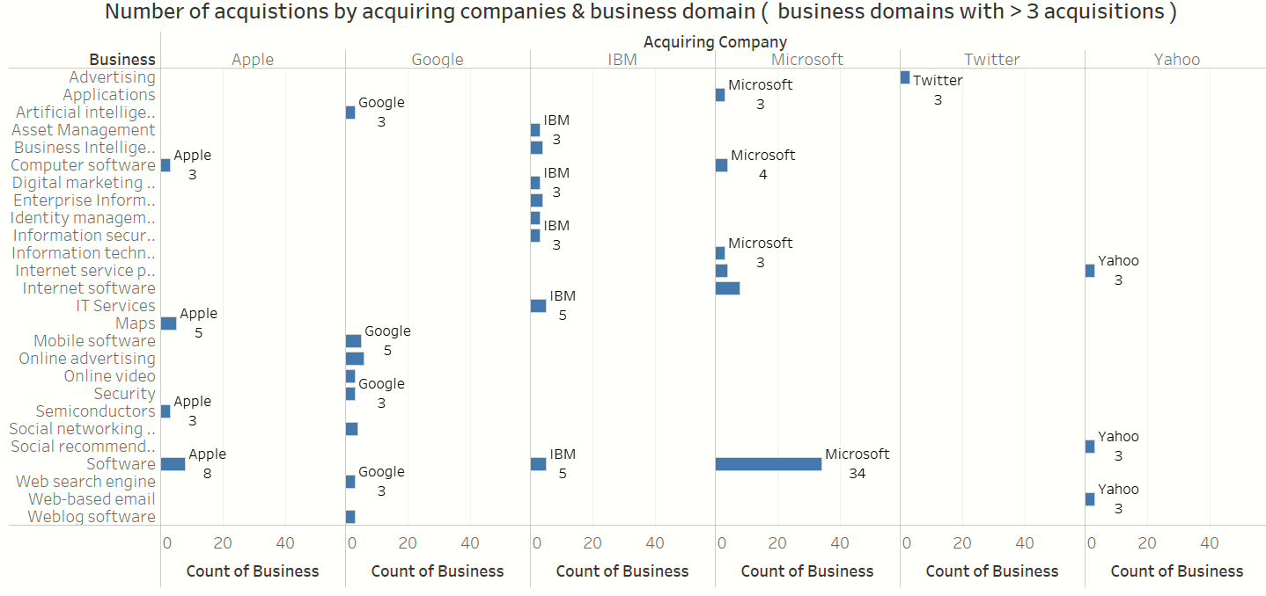
Are the players competing? Complete vs Compete

Slide 12
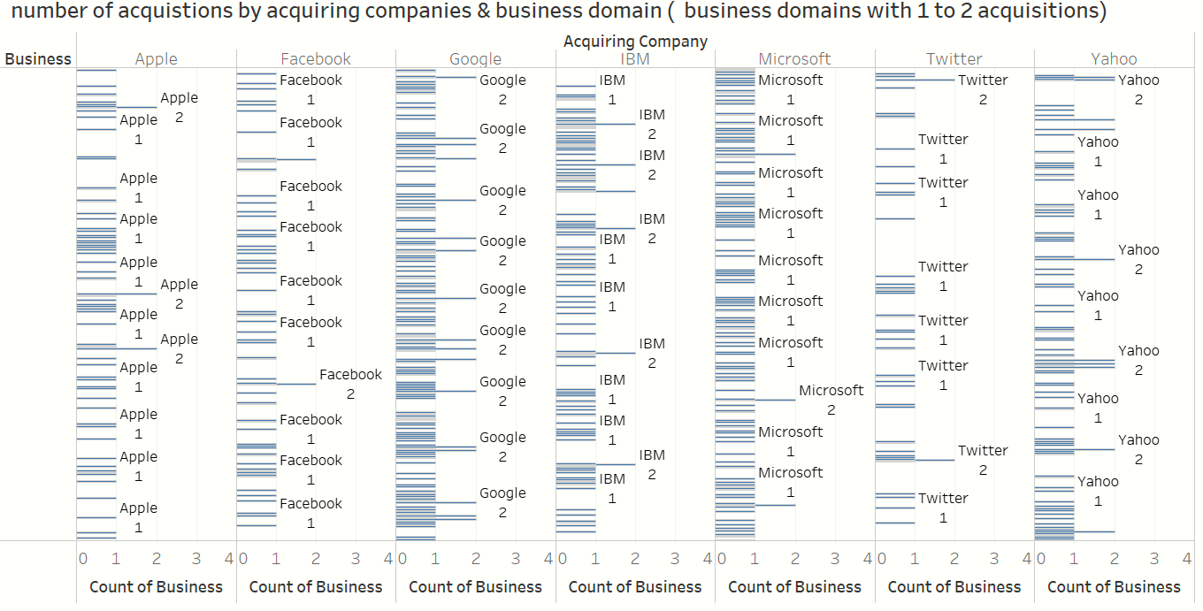
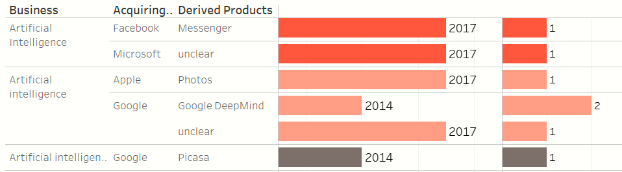
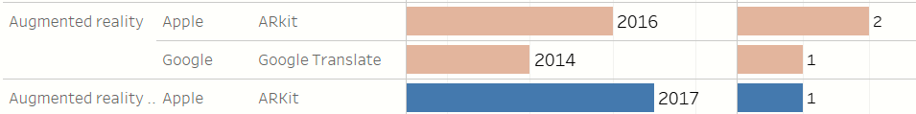
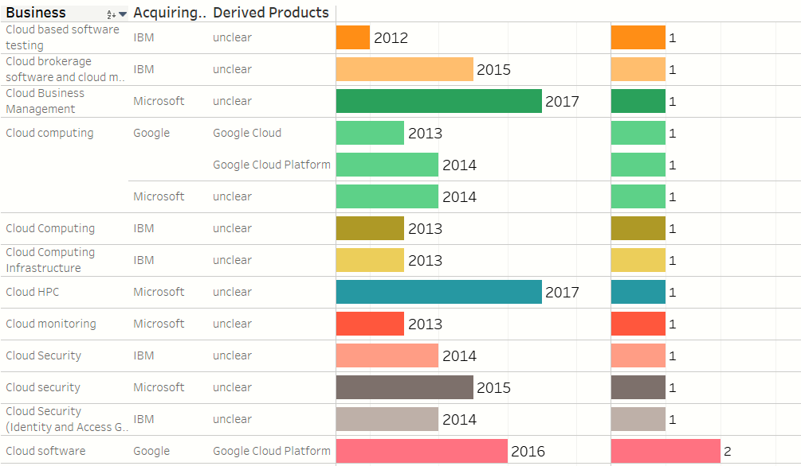
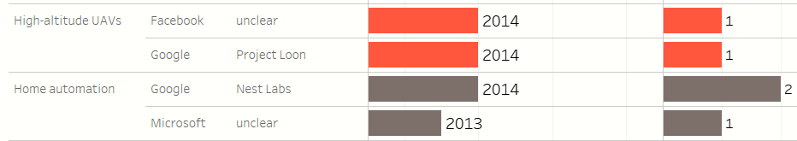
Are the players competing? Complete vs Compete cont’d
4382
Chi value= 4888.20 > critical value @ 4382.41
4.472503945332496e-12 < 0.05 alpha.
Hence The business domains & players are related.

Slide 13
Conclusion
M&A activity has become a part of how business is done over the last 4 decades. It is not more a specialty conglomerates and holding companies(shell type or blank cheque). GAGR is about 14.1 % for the period 1987 to 2017.
There is some evidence in the data to support opportunistic acquisition behavior of players with a war chest as suggested by the spree in M&A activity in the years following the financial crisis. Players with a big war chest are less sensitive to major economic events especially those with handsome operating cash flows.
While these players traditionally don't compete in the same space, there is evidence in the data to support merger waves triggered by potential rivals move in non legacy business domains.
The number, size, type nature of acquisition along with the age of the acquiring company all reflect the respective business models and the evolution of the strategic positioning of these acquiring players. Each of these styles has its pros and cons.
Notes:
For example, Apple follows an endogenous growth strategy making it more focused and less dependent on market at arms length. This is reflected through the number, size and type of acquisitions has its advantages such brand strength. Twitters seems to focus on startups typically with lower market value and huge room for an upside. The cons are clear here as manifested in the number of acquired SMEs winding up. Microsoft on the other hand is the Mercedes of the group, acquiring mature business but always getting it right ( Nokia for instance) while Google is to the likes of Airbus in this group of companies with high competence in merging and integrating acquisition to achieve a preset target. As such, the past learning and M&A history of the players as defined by their business style may aid in explaining the market sentiments and reaction to the announcement of the next acquisition.

Slide 14
Way forward
Dataframe must be updated with more recent data before an attempt is made to predict the next wave of M&A
The updated dataframe will further clarify the strategic intent of the players and the potential next moves
Investigate Bilateral relationships between these players to better understand the competitive forces between each pair. Running contingency test by pairs may shed further light on the matter.
The business domains names have to be standardized and reclassified and group by broad technology disciplines to paint a better picture.
It is worth investigating, given a complete and updated dataset, if a model can be built to accurately predict the next merger wave ( value by domain size and potential acquirers)

