Slide 1
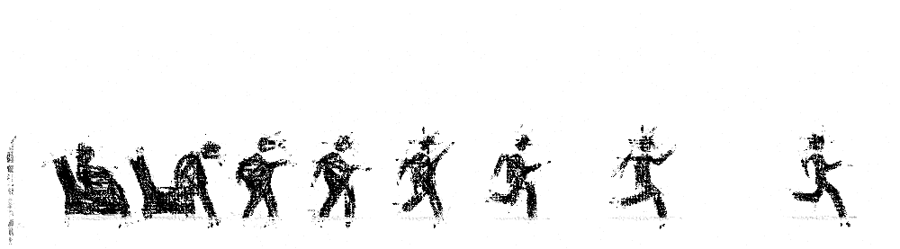
Human Activity Recognition modeling project
using gadgets
Amr Elarabi
July 1st 2022

Slide 2
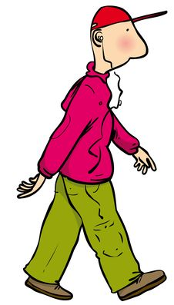
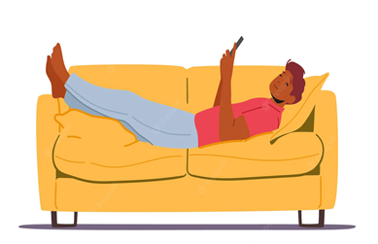
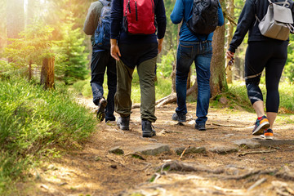

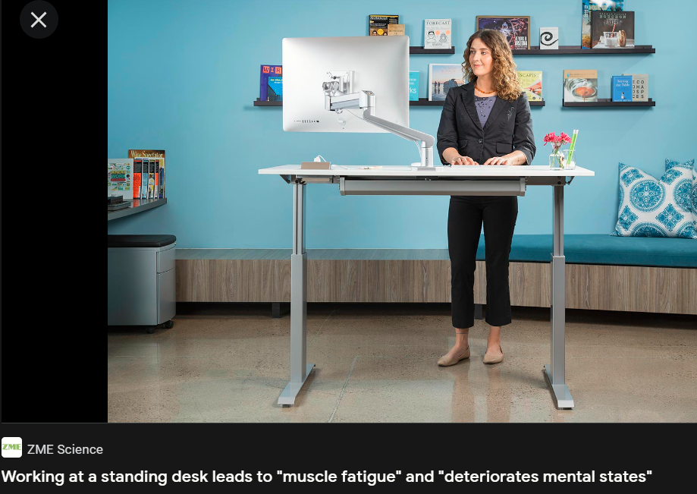
We spend our time Walking
Laying down
climbing up/down
Standing
Sitting
CAN WE MODEL IT?
(Training and unseen data donated )

Slide 3
Playbook
EDA (561 features & 10000 events)
Feature Selection:
VIF (561 to 27)
PCA evaluation
TSNE evaluation
Multi Model building
HP tuning
Model bagging
Model comparison and selection
Feature choice optimization

Slide 4
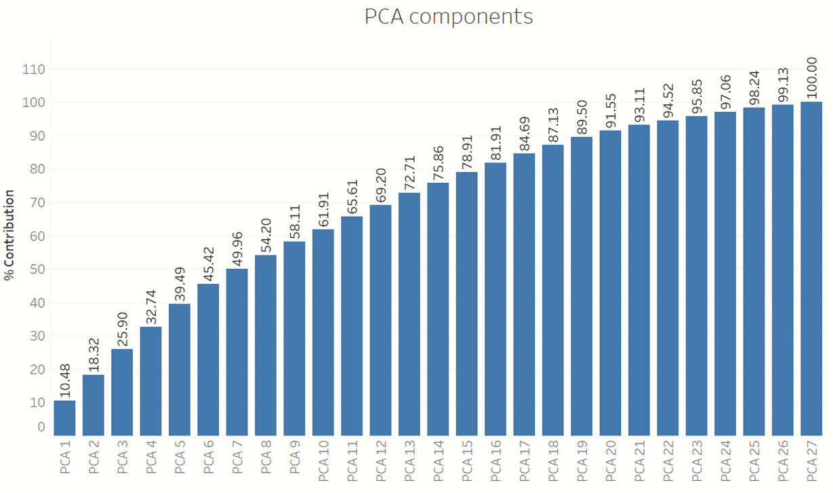
PCA Evaluation : Discard
16PCA components =81.91 %

Slide 5
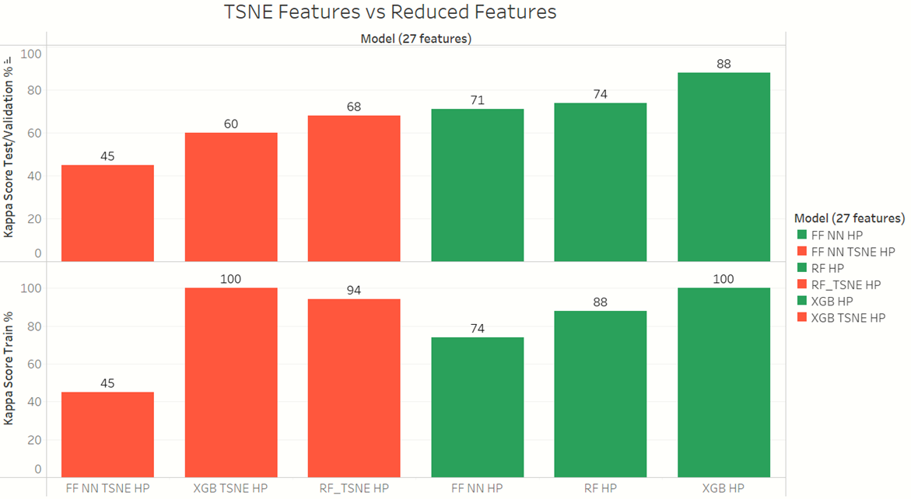
TSNE Evaluation : Discard
TSNE models underperformed:

Slide 6
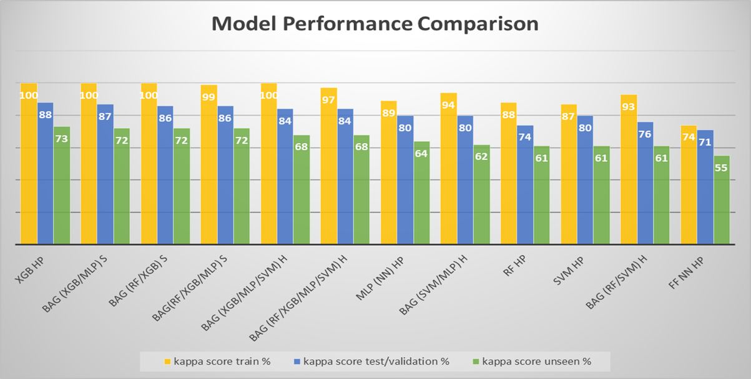
Model comparison(27 feat.)- winner: XGB HP
Best performing models:

Slide 7
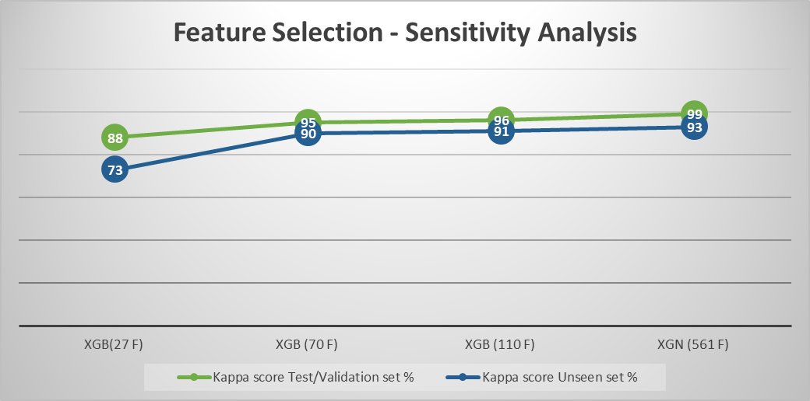
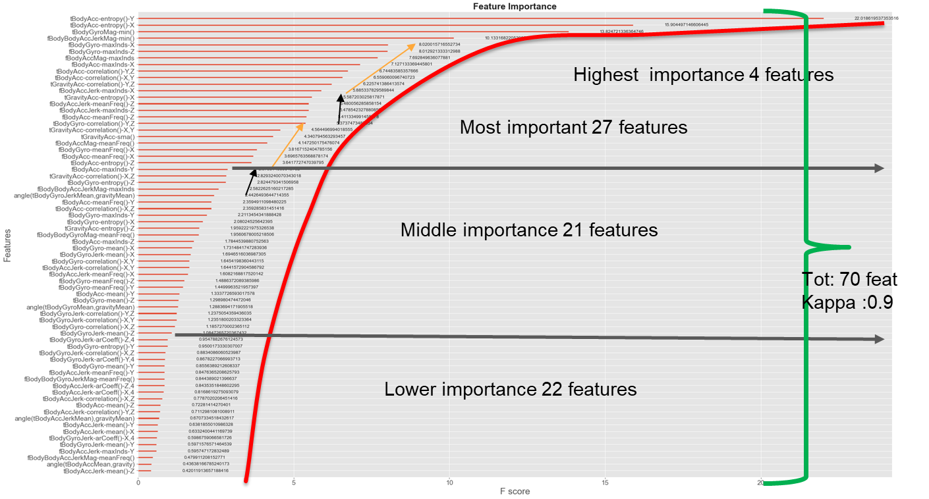
Feature Selection optimization
XGB (70 F) 23.3 % performance improvement
90 % Kappa Score on unseen data
Using 12 % of features

Slide 8
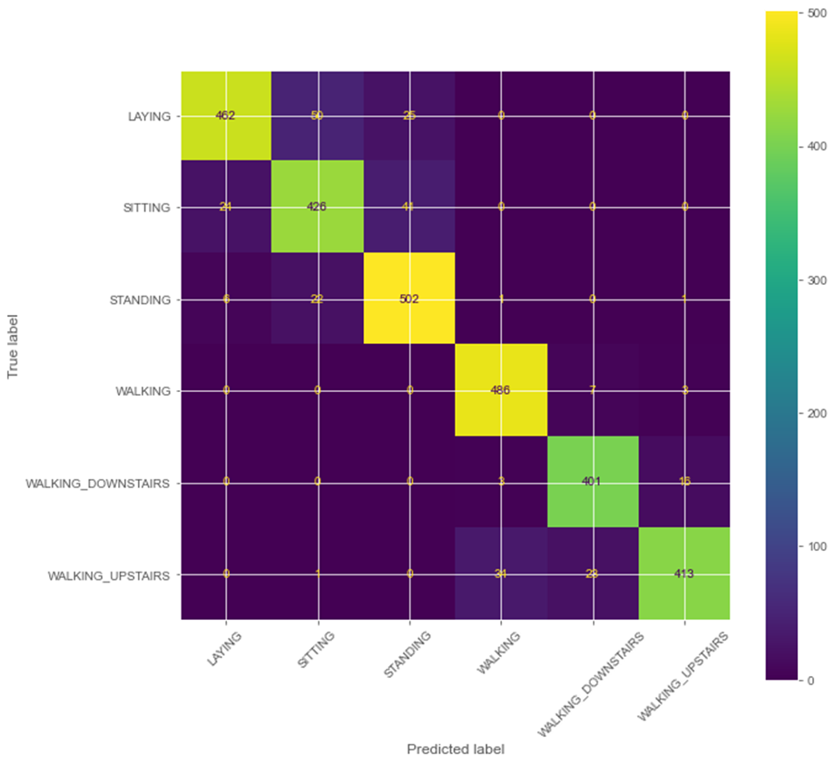
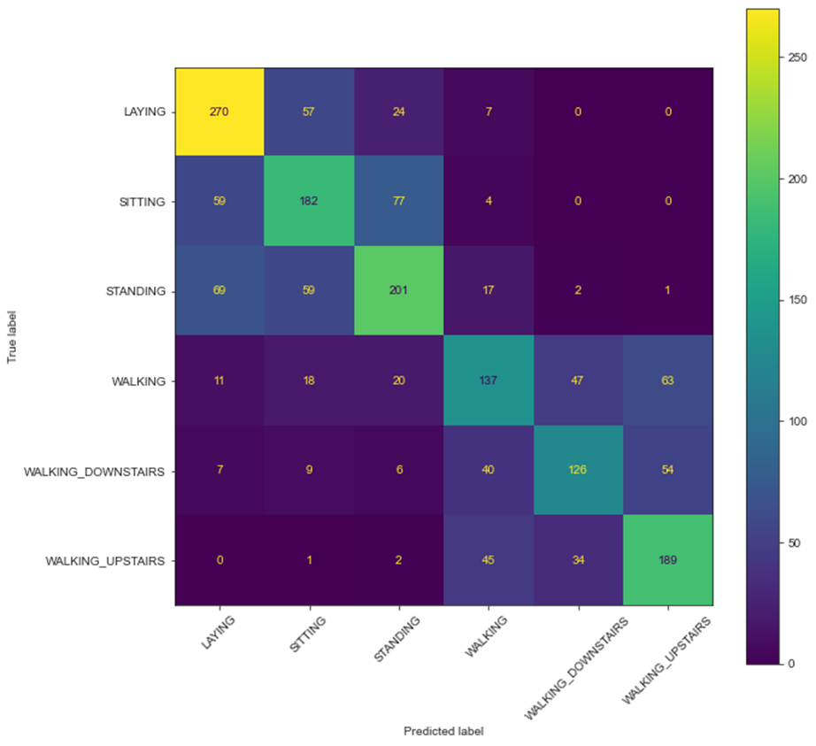
After: XGB HP 70. feature
Before

Slide 9

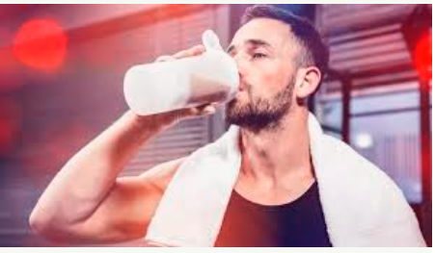

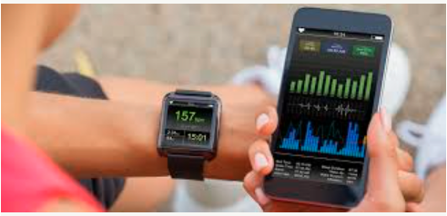
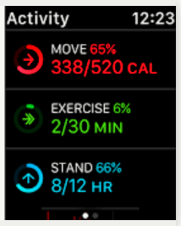
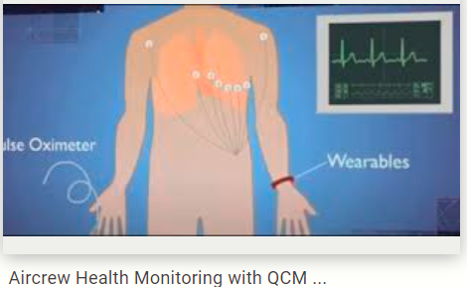
Use Cases
Leisure > music recommenders ….
Health & Wellness : exercise recommendation & diet apps
Medical : prediction of medical conditions & insurance
Behavior pattern recognition : targeted advertisement

Slide 10

Questions
Amr Elarabi

Slide 11
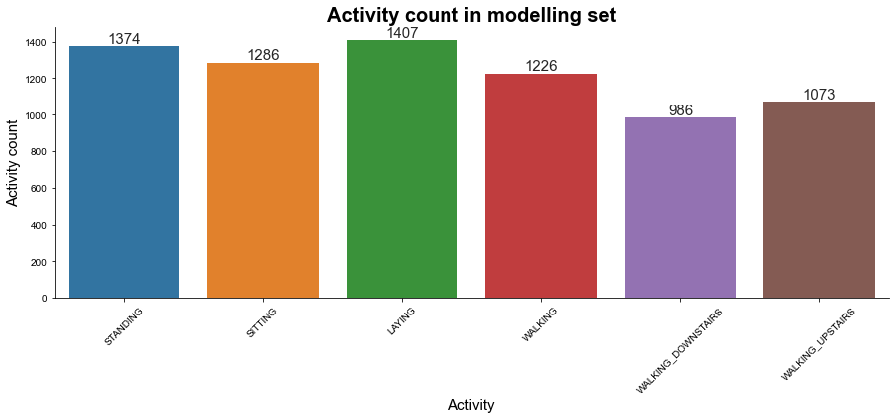
Amr Elarabi

Slide 12
Amr Elarabi
Notes:
The sensor signals (accelerometer and gyroscope) were pre-processed by applying noise filters and then sampled in fixed-width sliding windows of 2.56 sec and 50% overlap (128 readings/window). The sensor acceleration signal, which has gravitational and body motion components, was separated using a Butterworth low-pass filter into body acceleration and gravity. The gravitational force is assumed to have only low frequency components, therefore a filter with 0.3 Hz cutoff frequency was used. From each window, a vector of features was obtained by calculating variables from the time and frequency domain.

