Slide 1

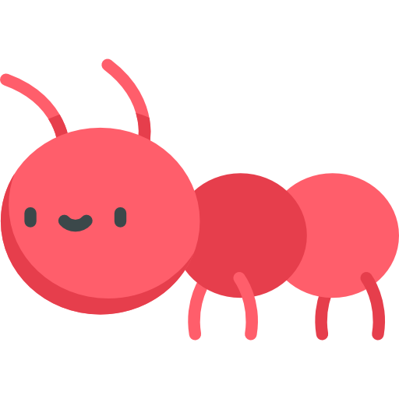


Slide 2

Web Development
Python: Level 3 - Ants

Slide 3
Our friends during the journey
Hi, it’s Andy
Hello, I’m Samy

Slide 4

Story Time
The Meadow
Adventures

Slide 5
What is a Website?
How do we build one?

Slide 6
What is a Website?
"A website is like a house on the internet. It’s a place to share information, pictures, and even messages for anyone to see!"

Slide 7

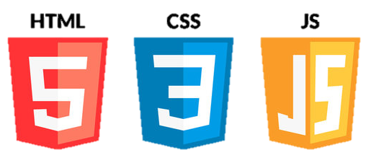


Frontend
Backend

Slide 8
So,
The frontend is what visitors see, and the backend is how we make it work behind the scenes. Together, they create the whole website!
Frontend
Backend
Nice drawing by the way!!

Slide 9

What are your favorite websites?
Awesome!
Let’s talk about HTML

Slide 10


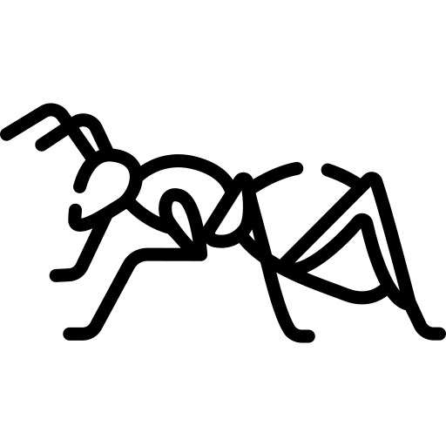
HTML

Slide 11
HTML
Hyper
Text
Markup
Language

Slide 12

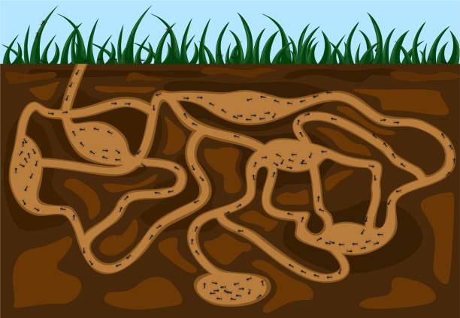
HTML
Hyper
Text
Markup
Language
It means that websites are linked together through hyperlink text (Like tunnels in the ant colony)
It tells the computer what to display on the screen

Slide 13
How do we write HTML?

Slide 14
HTML
Elements
like headings, paragraphs, or images.
Tags
It marks the start and the end of an element

Slide 15
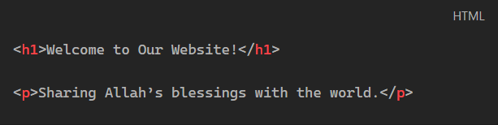
HTML
Elements
Can you Guess
The elements and the tags?
Tags

Slide 16
HTML
Tags
Element
Elements
Element
Starting Tag
Closing/ending Tag
Tags
Do you notice any common things between tags?

Slide 17

< Tag name >
/
If it’s the closing Tag:
< Tag name >
Mmm, I will remember this

Slide 18
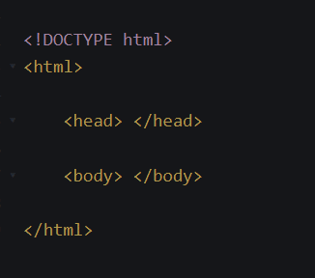
Tells the computer that this file is an HTML document to make it understand it.
Did you know that HTML
has a head and a body ?!
Like us?
Does it have six legs too?! ^^

Slide 19
is the root element that holds all the codes of our website in it. It has two parts
head
body

Slide 20
head
is where we put important information, like the title of the page.
body

Slide 21
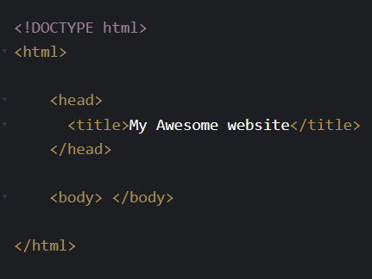
head
is where we put important information, like the title of the page.
but like thoughts in our head are not visible, most of what's inside the <head> tag is not really visible on our website page.
body

Slide 22
head
is where we put important information, like the title of the page.
but like thoughts in our head are not visible, most of what's inside the <head> tag is not really visible on our website page.
body
where we put all the visible content of the website, like headings, paragraphs, and pictures. It’s like the inside of the house.

Slide 23
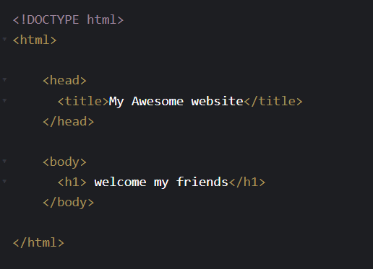
head
is where we put important information, like the title of the page.
but like thoughts in our head are not visible, most of what's inside the <head> tag is not really visible on our website page.
body
where we put all the visible content of the website, like headings, paragraphs, and pictures. It’s like the inside of the house.
Like this h1

Slide 24

So, what is This <h1> element?
Very good question

Slide 25
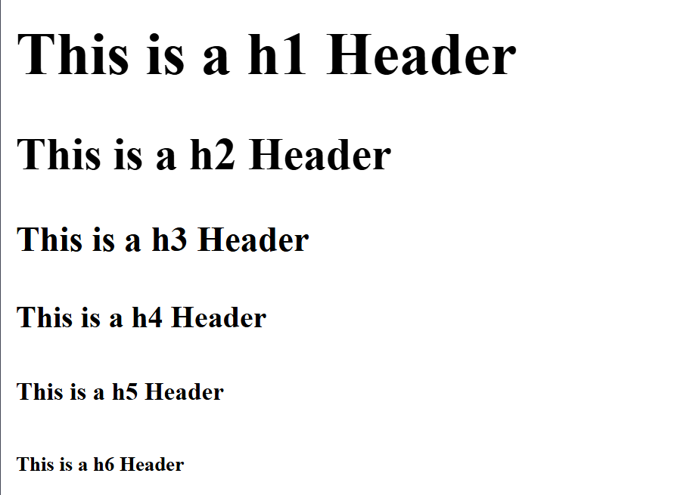
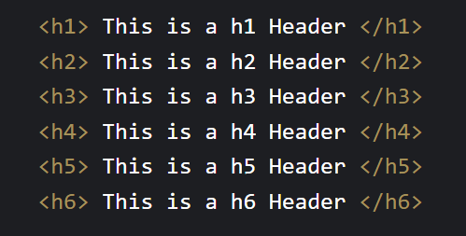
Header Element
Used to add text headers to our website
It has six different sizes from 1 to 6

Slide 26
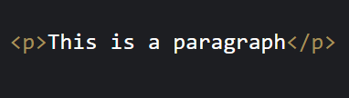
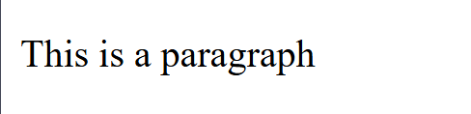
Paragraph Element
Used to add small text paragraphs to our website
We can use them on our site. Let me try.

Slide 27
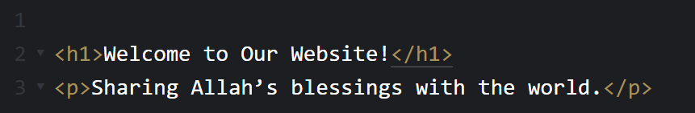
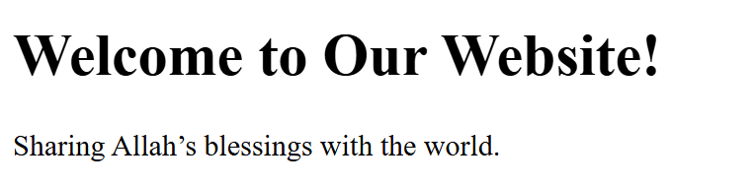
What if I want to add a list of the blessings?
Very good!

Slide 28
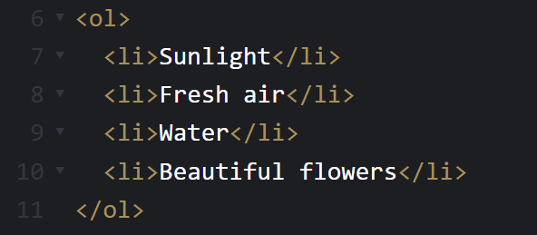
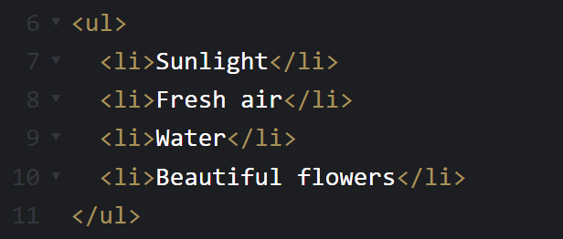
List Element
Used to add list of items to our website
It has two different types :
<ol> | <ul>
For ordered list | For unordered list

Slide 29
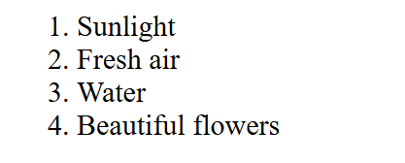
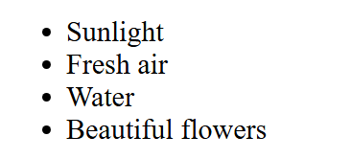
List Element
<ol> | <ul>
For ordered list | For unordered list

Slide 30

Image Element
Used to add images to our website
The src is the image's file path and address.
The alt is a picture description. This helps people who can’t see the image understand what it’s about.
The width and height.
Where is the closing tag?
This is called an attribute
Used to add more information to the element
Can we add images too? That would be fun
What are these things added after the tag name?

Slide 31
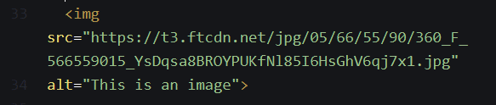

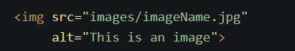
Example:
Online Link
File path (local)

Slide 32
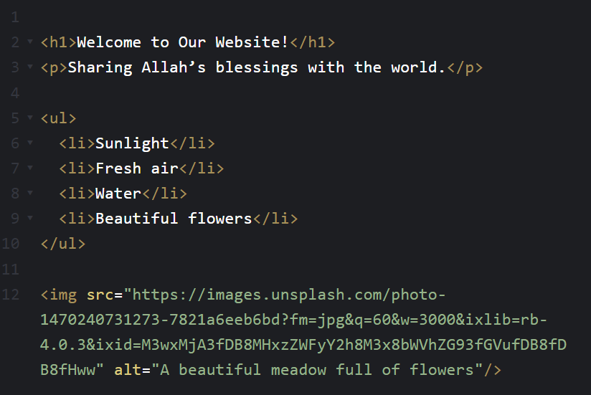
Now I understand how to build a website!
SubhanAllah, HTML is easy and amazing!
Let me try ^^

Slide 33


Link Element
Used to add links to other websites
The href attribute Specifies the link’s destination to which you will go when you click on it.
So if we want to add a link to Google for example:
What if I want to add a link to another site?
This href is also an attribute, right?

Slide 34
SubhanAllah, HTML is simple yet amazing!
With these simple tags, we can share our gratitude and inspire others to reflect on Allah’s blessings.

Slide 35
See you in the next chapter of the journey

