Slide 1

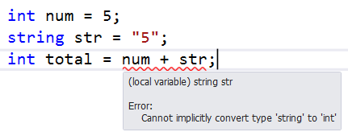
Type-safe reusable web components

Slide 2
Agenda
Define type-safe
TypeScript and Decorators
What is Web Components?
Web Components Specification
What do Web Components Solve?
Demo
Web Components Code using TypeScript
Web Components using custom-elements-ts library
Use ar-input custom-element in angular, vue, and react

Slide 3



Arjay Elbore
@VirtualOverride
https://github.com/aelbore
Open Source Project
https://github.com/aelbore/ngx-devtools
https://github.com/geocine/custom-elements-ts

Slide 4
What is Type safe?
The compiler will validate types while compiling, and throw an error if you try to assign the wrong type to a variable.
https://stackoverflow.com/questions/260626/what-is-type-safe

Slide 5
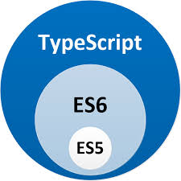
TypeScript
It is a strict syntactical superset of JavaScript, and adds optional static typing to the language.

Slide 6
Decorators
A Decorator is a special kind of declaration that can be attached to a class declaration, method, accessor, property, or parameter
https://www.typescriptlang.org/docs/handbook/decorators.html
A decorator is simply a way of wrapping one piece of code with another — literally “decorating” it.
https://www.sitepoint.com/javascript-decorators-what-they-are/

Slide 7
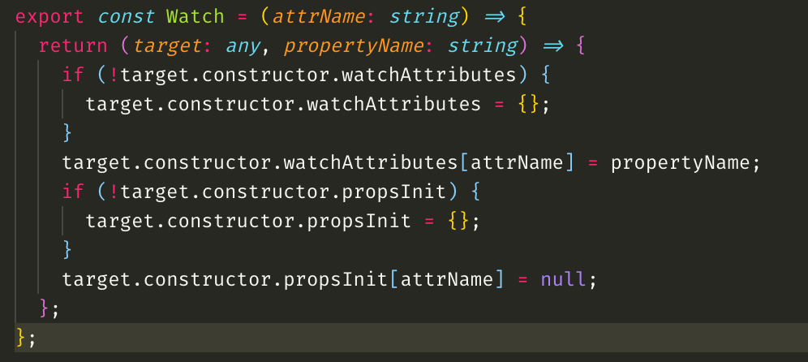
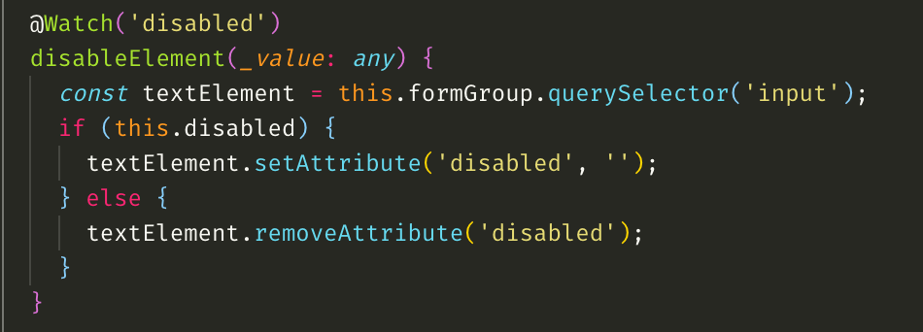

Slide 8
What is Web Components?
are a set of web platform APIs that allow you to create new custom, reusable, encapsulated HTML tags to use in web pages and web apps. Custom components and widgets build on the Web Component standards, will work across modern browsers, and can be used with any JavaScript library or framework that works with HTML.
https://www.webcomponents.org/introduction

Slide 9





Web Components Specification
HTML Template
Custom Elements
Shadow Dom

Slide 10
Custom Elements - the Custom Elements specification lays the foundation for designing and using new types of DOM elements.
Shadow DOM - the shadow DOM specification defines how to use encapsulated style and markup in web components.
ES Modules - the ES Modules specification defines the inclusion and reuse of JS documents in a standards based, modular, performant way.
HTML Template - the HTML template element specification defines how to declare fragments of markup that go unused at page load, but can be instantiated later on at runtime.
https://www.webcomponents.org/introduction

Slide 11
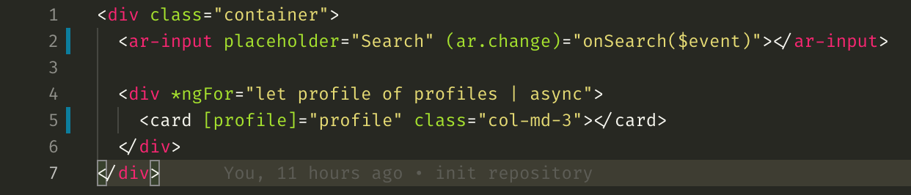
Custom Element

Slide 12
What do Web Components Solve?
Composability
We want legos
Encapsulation
Markup, style, and behavior don’t leak into the rest of the page
Reusability
Stop reinventing the wheel

Slide 13
Demo
Custom Elements using TypeScript
Refactor it using custom-element-ts library

Slide 14
Demo
Use custom element input in Angular, React and Vue.

