Slide 1
ARCHETYPE
Security Engineering
Attack, Defense, and Analysis

Slide 2
Table of Contents
Network Topology
Exploits
Detection Avoidance
Alert Implementation
Hardening
Questions

Slide 3
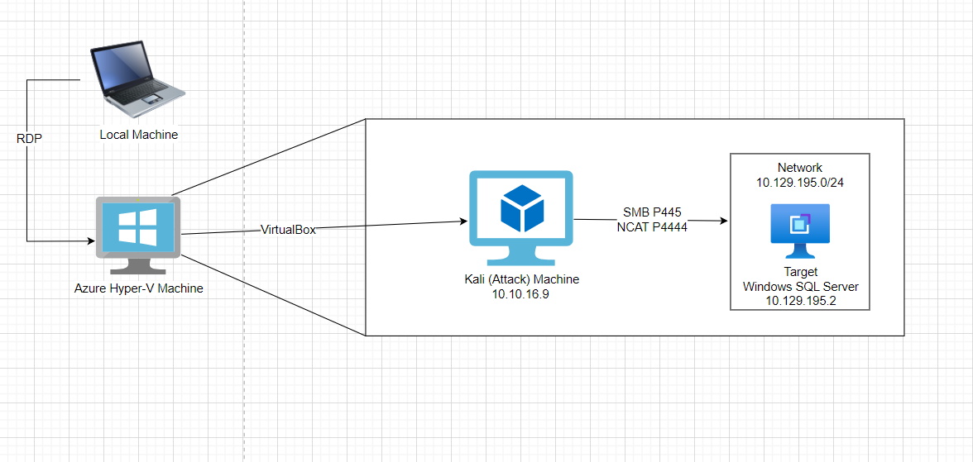
Network Topology

Slide 4
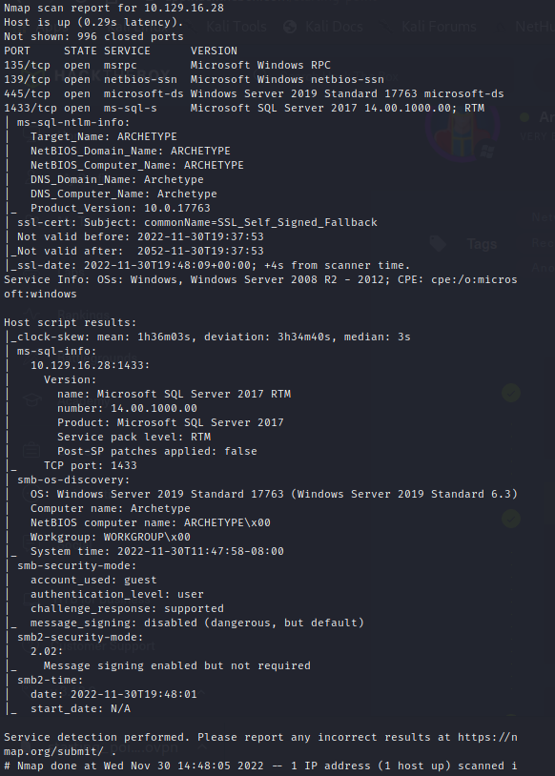
Exploit: Enumeration (Nmap)
Nmap scan fingerprint & services
Collect IP, OS, version, and port information
Ports 22, 135, 139, 445, and 1433 exposed
TCP port hosting database is 1433
SMB client exploitation to move laterally

Slide 5
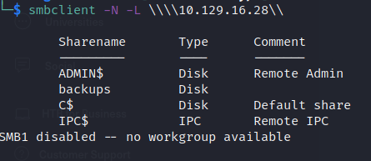
Exploit: SMB Shares
SMB Client to view shares
Administrative shares marked with “$”
Administrative shares include:
ADMIN$
C$
IPC$
Non-administrative share
Backups

Slide 6
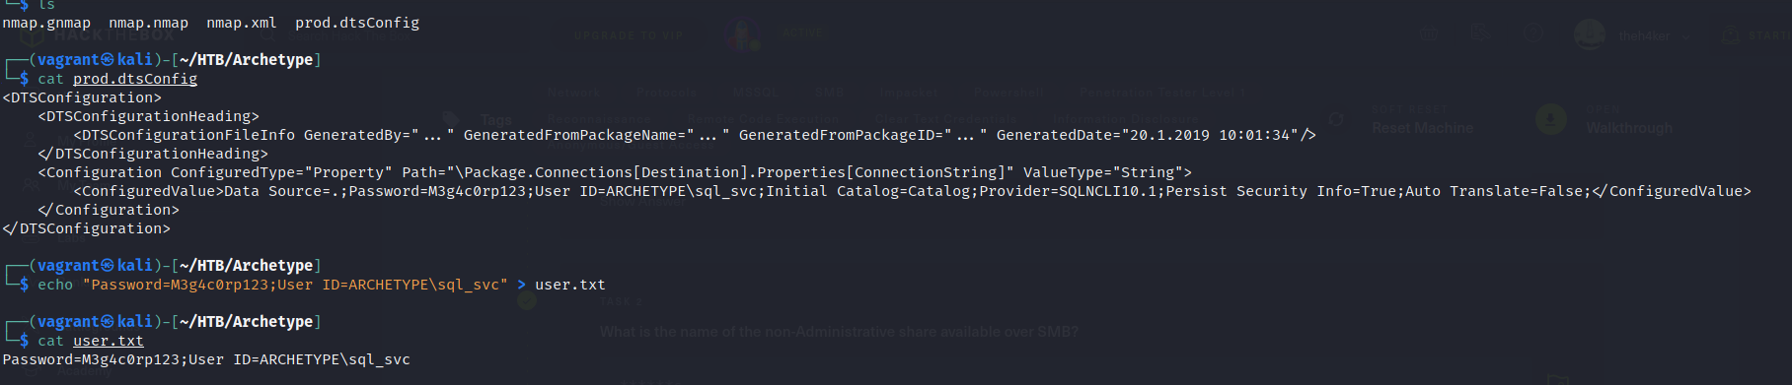
Exploit: Accessing SMB Share “backups”
Access “backups”
Acquire credentials for SQL
Echo credentials to Kali Machine for easy access

Slide 7
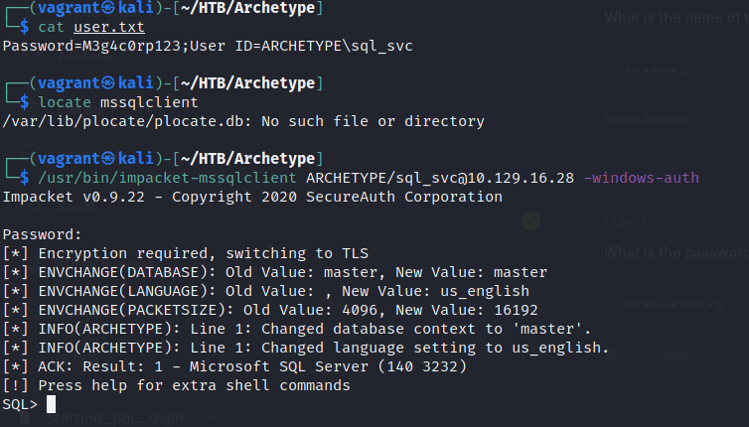
Exploit: Accessing SQL Database (lmpacket)
Access Microsoft SQL client with impacket
Utilize xp command shell
Feature of SQL that spawns a Windows command shell

Slide 8
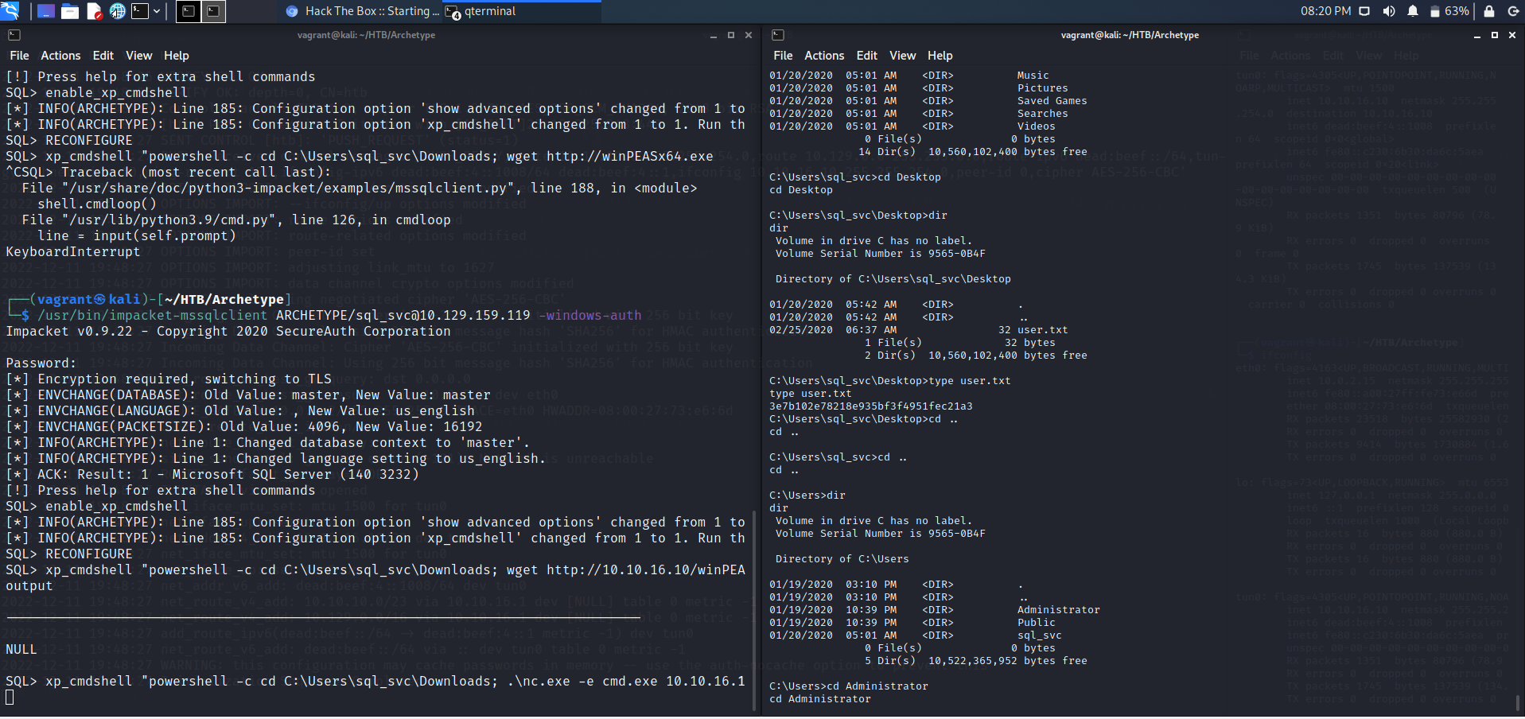
Exploit: XP Command Shell
Enable and reconfigure shell
Upload Netcat to target

Slide 9
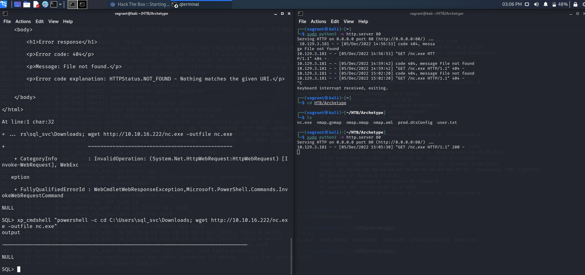
Exploit: Netcat
Install Netcat on target
Establish direct command line access
Navigate to Admin account
Unable to access administrator account due to privileges

Slide 10
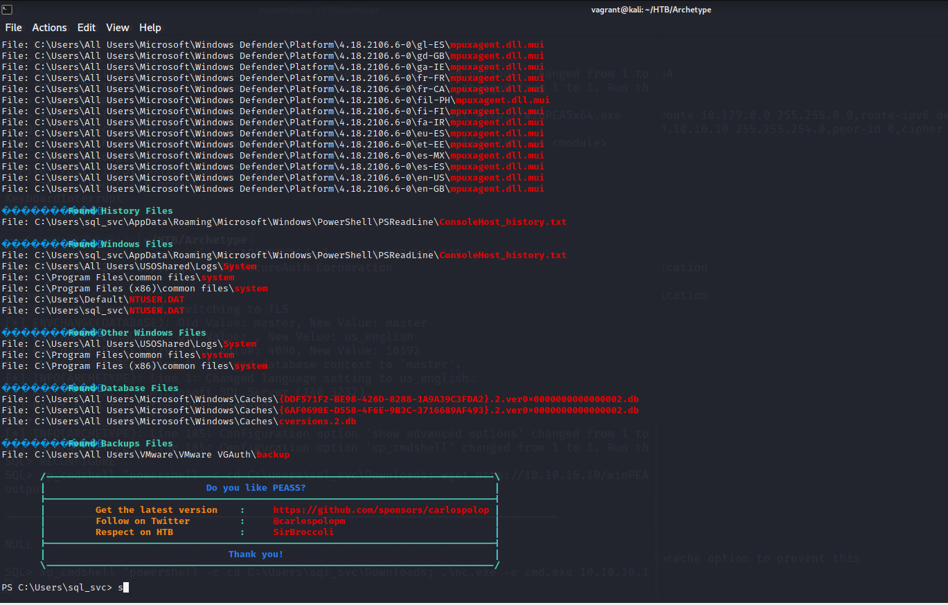
Exploit: Privilege Escalation with winPEAS
Upload winPEAS on target utilizing same method w/ NCAT
Utilize winPEAS to locate possible paths of privilege escalation to access admin account
Locate and acquire administrative credentials from winPEAS

Slide 11
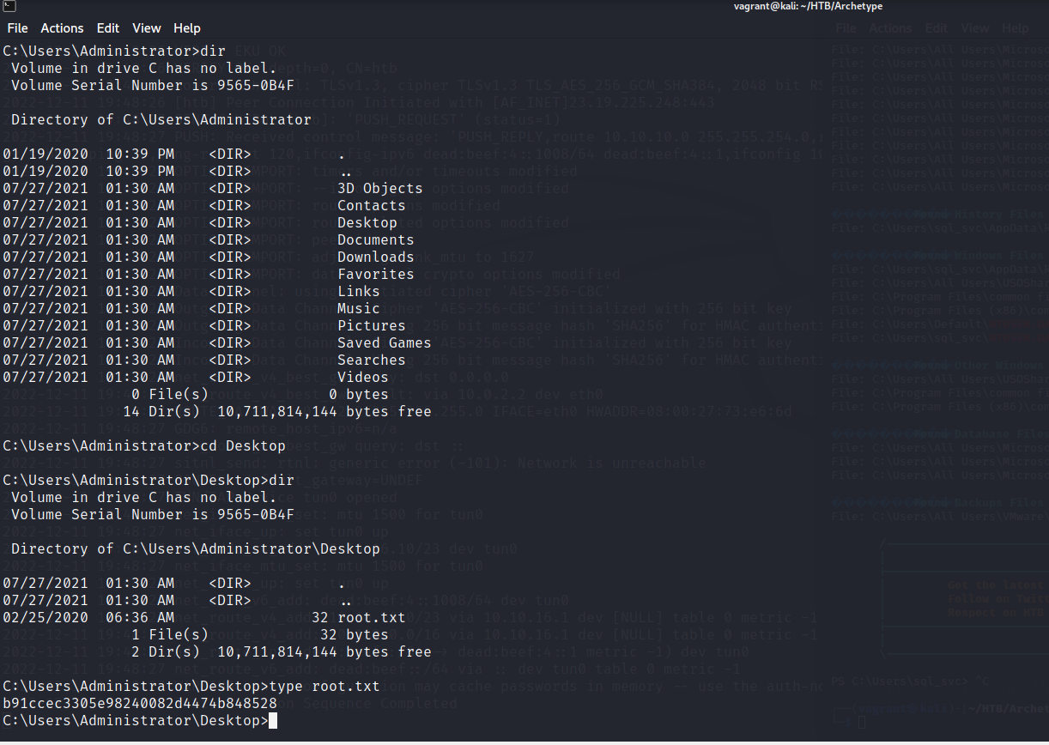
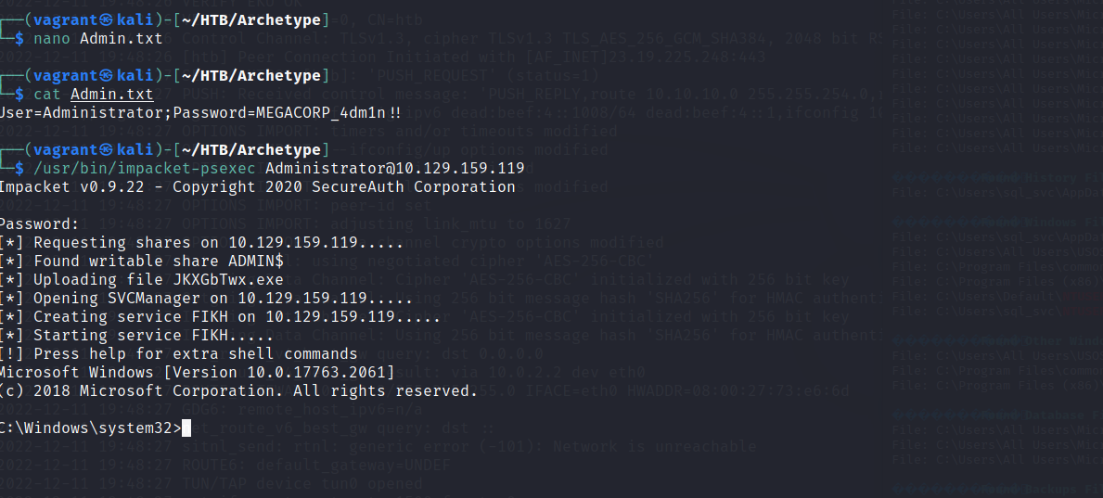
Exploit: Accessing Administrative Account & Rooting
Login with discovered credentials
Root target
Mission accomplished

Slide 12
Avoiding Detection
Stealth scans
Enumerating is noisy
SYN scan & decoy scan
Move laterally with SMB & Impackets
Port 445 – SMB
Avoid using intrusive tools (can be detected by security tools)
False positives
Stagger attempts
Fileless malware & refactoring

Slide 13
Implementing Alerts
CPU Usage Alert
Set alerts for ports 1433, 443, 445, and 80
Set WAF rules (inbound & outbound traffic)
Properly configure and implement tools (SIEM, SOAR, IDS, IPS, EDR, Firewalls, AV, etc.)
Utilize threat hunting, intelligence, research, security testing, incident response, OSINT, and additional tools and methods to create custom detections and alerts
Tailor alerts to environment
Less detections that are highly effective

Slide 14
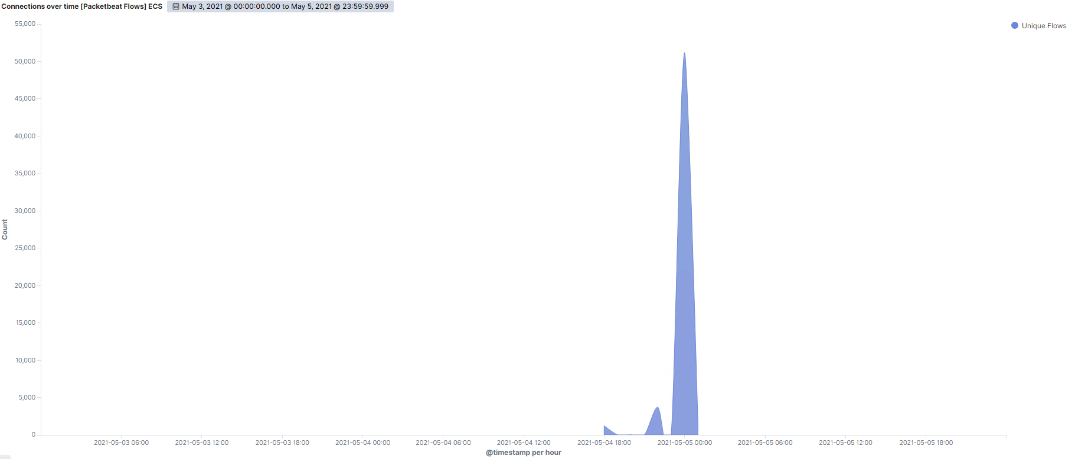
Hardening – Port Scans
Properly configure firewalls
Detect and block unauthorized scans
Assessments, audits, and threat hunting

Slide 15
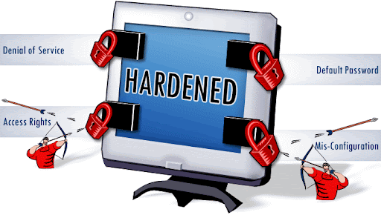
Hardening - SSH
Enable public and private key encryption
Security enhanced Linux module
Disable root privileges for users
Local IP tables
Defense in depth

Slide 16
Hardening – Malicious Payloads & Malware
Filter ports
Filter IP addresses
Implement proper controls, techniques, and procedures
Require passwords with administrative (sudo) commands
Monitoring & alerts
Application
Network
Infrastructure
Security analytics

Slide 17
Hardening – SQL & LAN Manager Server Hardening
Update SQL
Disable features not in use
XP Command
Protect against SQL injection
Implement Web Application Firewall (WAF)
Input validation
Query parameterization
Data sanitization
Monitor and protect port 445, SMB, and LAN Manager

Slide 18
Thank You!

