Slide 2
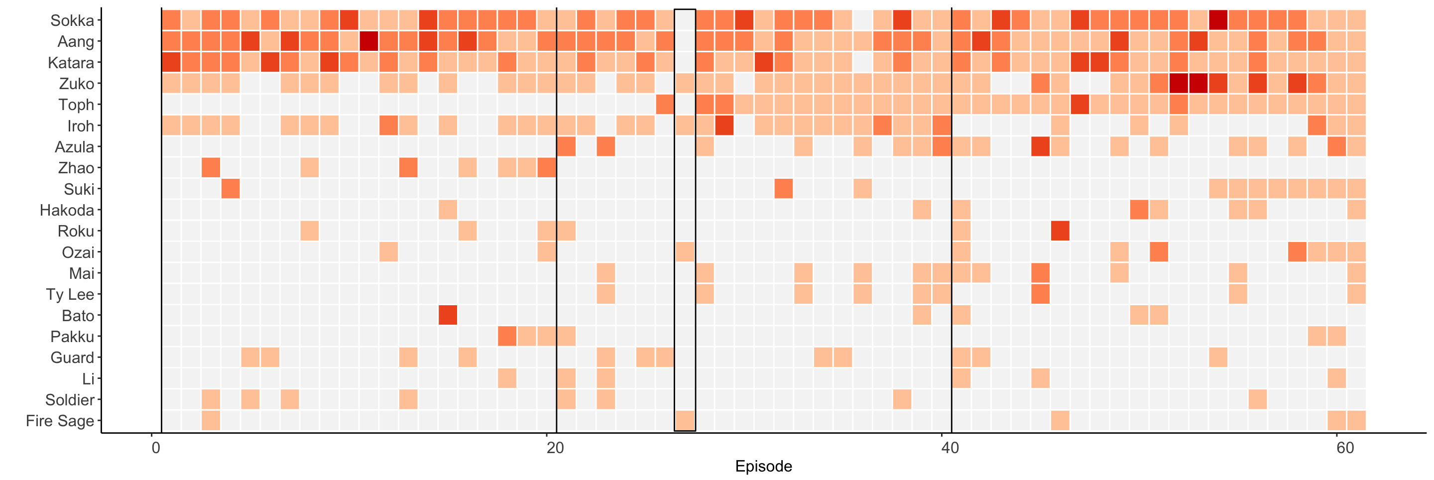
Which Character Appeared and Spoke the Most in Avatar: The Last Air Bender?
Avatar: The Last Airbender is driven by the development of its characters throughout the series – primarily among Aang, Sokka, Katara, and later Toph, and Zuko. Among the characters who appeared the most in ATLAB, Sokka spoke the most at +18k words by the end of Book Three. Aang said +17k words, and Katara spoke just under 15k.
“Zuko Alone” is the only episode to not feature Team Avatar at all.
Book One
Book Two
Book Three
Visualization by Alex Elfering
Source: Appa R Package

