Slide 1
Bank Customer Churn Analysis epsilon ai mid-project By amira el-garem

Slide 2
Project objective
Identify the patterns that contribute to customer churn.
Build an interactive dashboard for exploration and insights.
Generate actionable recommendations to improve retention.

Slide 3
Dataset overview
Contains 10,000 records, 14 columns
Features include:
Demographics: Age, Gender, Geography
Financials: Balance, Credit Score, Estimated Salary
Engagement: Tenure, Number of Products, Credit Card status
Target: Exited (1 = churned, 0 = stayed)

Slide 4
Eda & FEATURE ENG.
Data Exploration
Wrong data types for binary columns and “NumOfProducts” column
Verified no missing values and inconsistent values
Outliers detected in Balance Column
Feature Engineering
TenureGroup: New, Mid-term, Long-term
BalanceSalaryRatio: Balance / (Estimated Salary + 1)
AgeGroup: Young (<30), Adult (30–50), Senior (>50)

Slide 5
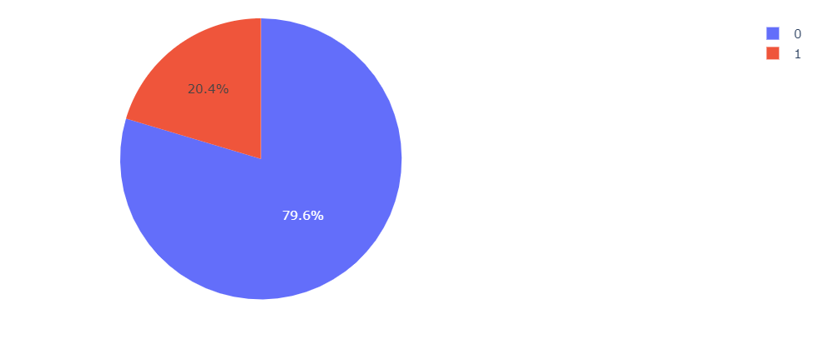
Analysis Questions
What is the distribution of churned vs non-churned customers?
With a 20% churn rate, the situation is manageable but warrants proactive strategies to retain at-risk customers.

Slide 6
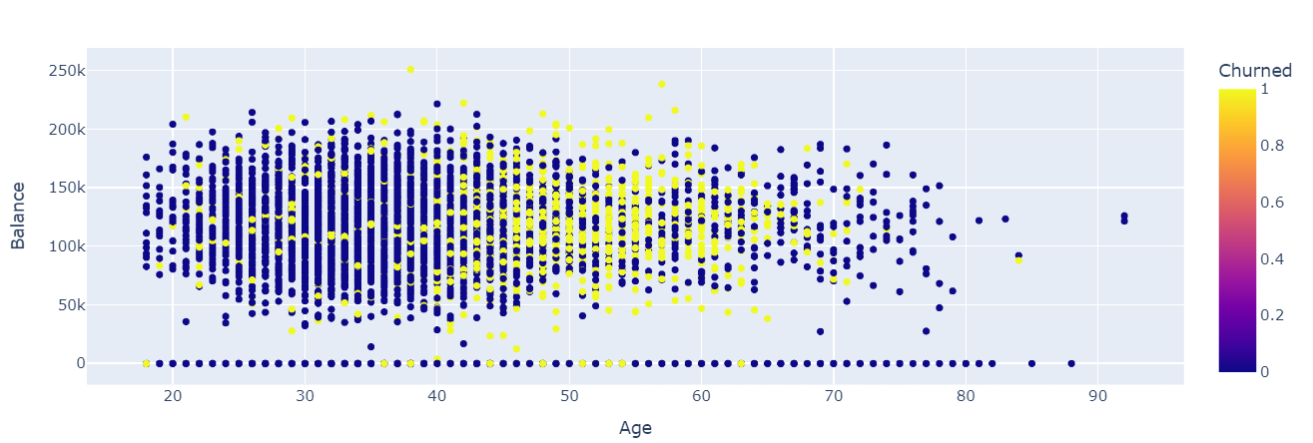
Analysis Questions
2. What is the relationship between Age and Balance for churned customers?
While there is no clear relationship between age and balance, churn rates are significantly higher for customers aged 40 to 70.

Slide 7
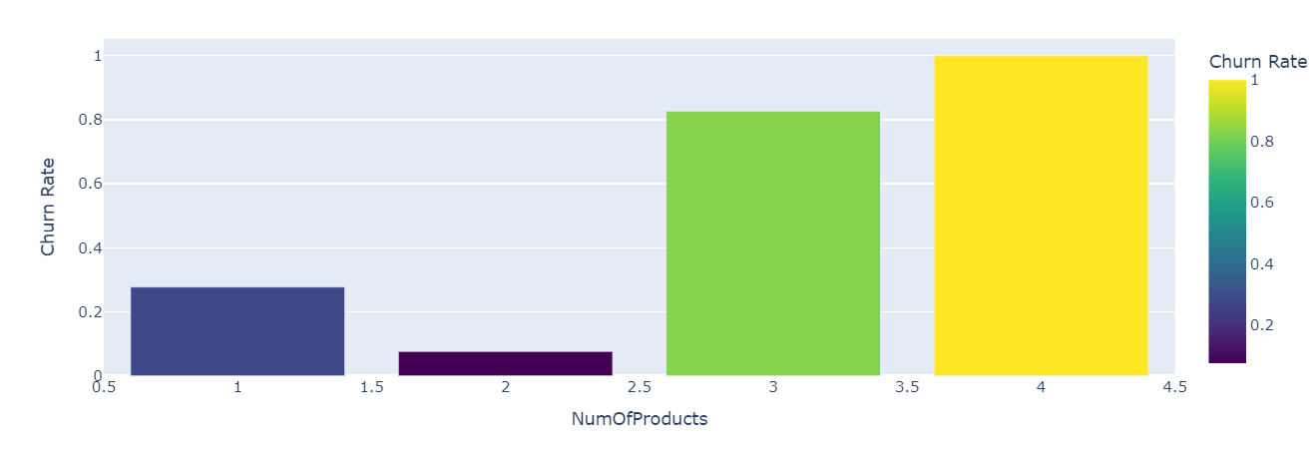
Analysis Questions
3. How does customer churn rate vary across different number of products?
Churn is high among customers with only one product. It also rises when customers hold more than two products.

Slide 8
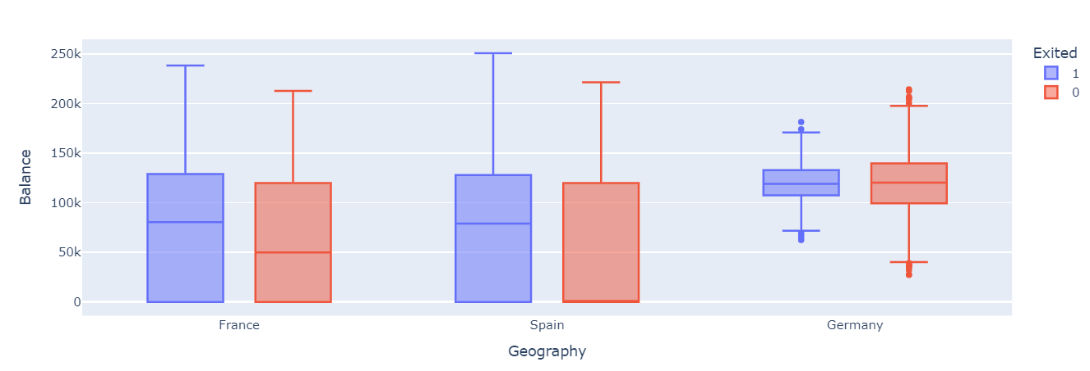
Analysis Questions
4. How Does Customer Balance Vary Across Regions and Churn Status?
German customers have the highest balances, but balance does not influence churn.

Slide 9
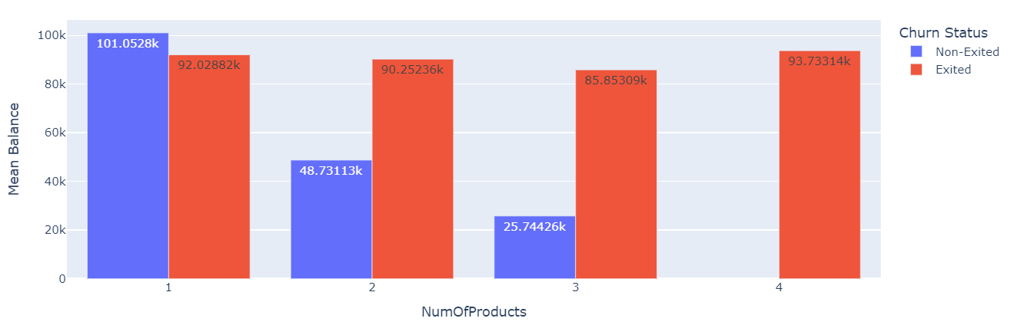
Analysis Questions
5. How Does the Number of Products Relate to Mean Customer Balance and Churn?
Among non-churned customers, average balance decreases as the number of products increases. For churned customers, mean balance remains consistent across all product counts.

Slide 10
Data Preprocessing
If this project were to continue into machine learning, I prepared the data accordingly:
I split the dataset into training and testing sets.
Applied RobustScaler to numerical features.
Encoded categorical features using OneHotEncoding.
And to address class imbalance, I used SMOTE, which generates synthetic data for the minority class.

Slide 11
Recommendations
Target At-Risk Age Groups: Implement personalized retention campaigns for customers aged 40–70.
Boost Engagement for Single-Product Holders: Proactively offer cross-sell opportunities or value bundles to customers with only one product.
Simplify communication around product benefits to reduce churn among customers holding more than two products.
Don’t Rely on Credit Score or Balance to Predict Churn Since financial indicators like credit score and balance show no strong correlation with churn, use behavioral or engagement metrics instead.

Slide 12
Thank you
🔗 Access
🌐 Streamlit App: https://bank-churn-analysis-kx6urd5sufmajswcx6mdvo.streamlit.app/
📁 GitHub Repository: https://github.com/aelgarem1/Bank-Churn-Analysis

