Slide 1
Bank Customer Churn Analysis epsilon ai mid-project By amira el-garem

Slide 2
Project objective
Identify the patterns that contribute to customer churn.
Build an interactive dashboard for exploration and insights.
Generate actionable recommendations to improve retention.

Slide 3
Dataset overview
Contains 10,000 records, 14 columns
Features include:
Demographics: Age, Gender, Geography
Financials: Balance, Credit Score, Estimated Salary
Engagement: Tenure, Number of Products, Credit Card status
Target: Exited (1 = churned, 0 = stayed)

Slide 4
Eda & FEATURE ENG.
Data Exploration
Wrong data types for binary columns and “NumOfProducts” column
Verified no missing values and inconsistent values
Outliers detected in Balance Column
Feature Engineering
TenureGroup: New, Mid-term, Long-term
BalanceSalaryRatio: Balance / (Estimated Salary + 1)
AgeGroup: Young (<30), Adult (30–50), Senior (>50)

Slide 5
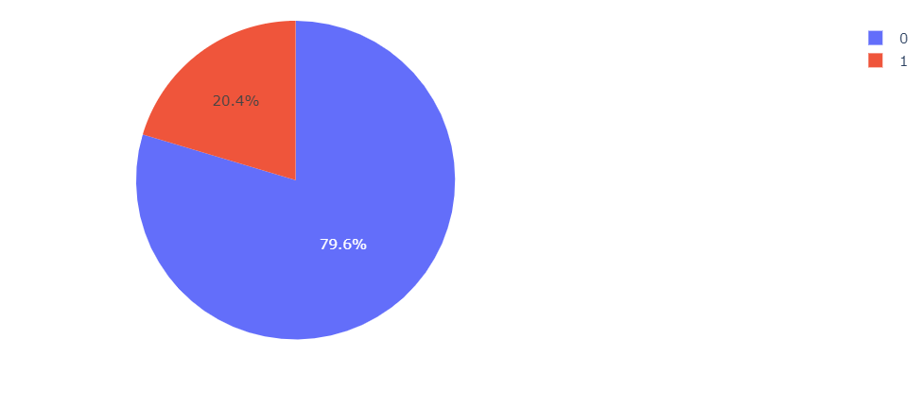
Analysis Questions
What is the distribution of churned vs non-churned customers?
With a 20% churn rate, the situation is manageable but warrants proactive strategies to retain at-risk customers.

Slide 6
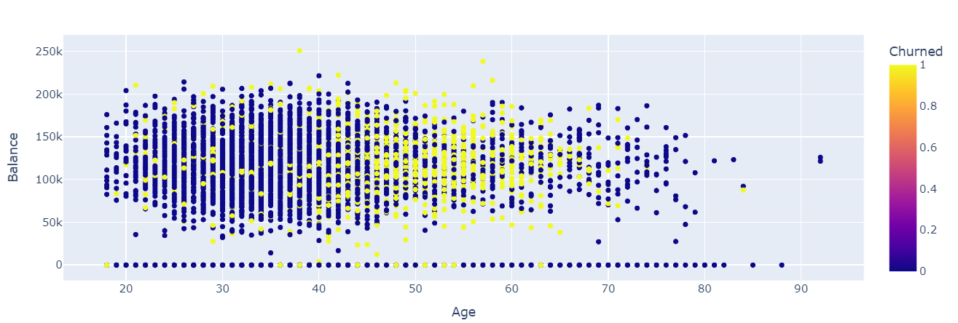
Analysis Questions
2. What is the relationship between Age and Balance for churned customers?
While there is no clear relationship between age and balance, churn rates are significantly higher for customers aged 40 to 70 making them critical focus segments for retention.

Slide 7
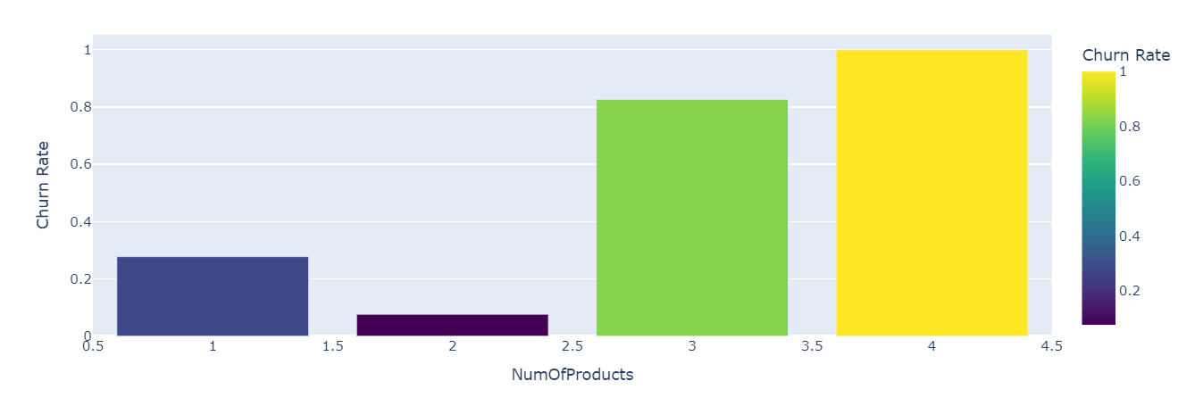
Analysis Questions
3. How does customer churn rate vary across different number of products?
Churn is high among customers with only one product suggesting low engagement/ dissatisfaction. It also rises when customers hold more than two products possibly due to complexity or lack of perceived value.

Slide 8
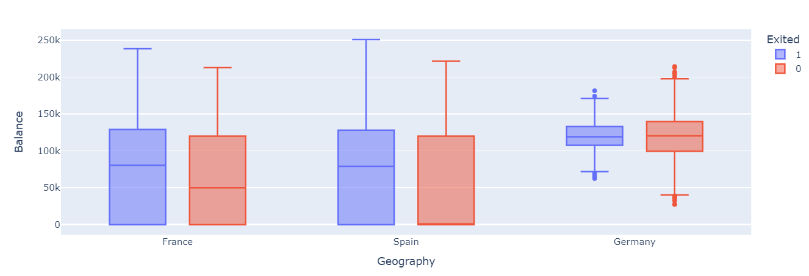
Analysis Questions
4. How Does Customer Balance Vary Across Regions and Churn Status?
German customers have the highest balances, but balance does not influence churn, suggesting retention strategies should not rely on financial metrics alone.

Slide 9
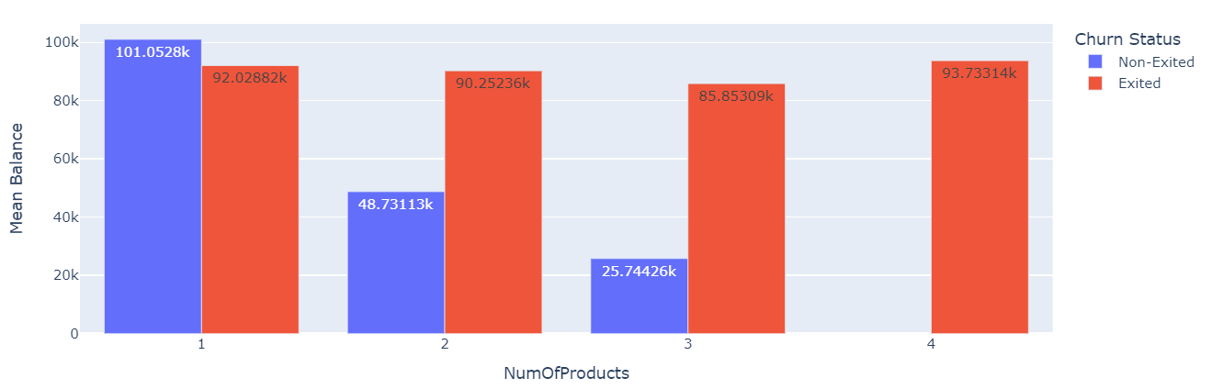
Analysis Questions
5. How Does the Number of Products Relate to Mean Customer Balance and Churn?
Non-churned customers, on the other hand, show a decrease in average balance as the number of products increases implying that Non-churned customers with more products are possibly more financially active, using bundled services that reduce their liquid balance (e.g., due to loan repayments or fund transfers).

Slide 10
Data Preprocessing
If this project were to continue into machine learning, I prepared the data accordingly:
I split the dataset into training and testing sets.
Applied RobustScaler to numerical features.
Encoded categorical features using OneHotEncoding.
And to address class imbalance, I used SMOTE, which generates synthetic data for the minority class.

Slide 11
Recommendations
Target At-Risk Age Groups: Implement personalized retention campaigns for customers aged 40–70.
Address dissatisfaction among customers with only 1 product or more than 2 products. Consider simplifying complex bundles and improving perceived value.
Boost Engagement for Single-Product Holders: Proactively offer cross-sell opportunities or value bundles to customers with only one product.
Use engagement indicators to identify and reward active users.
Target inactive customers with reactivation incentives.
Customers with multiple products who churn may not perceive value—use satisfaction metrics or exit feedback to refine offerings.

Slide 12
Thank you
🔗 Access
🌐 Streamlit App: https://bank-churn-analysis-kx6urd5sufmajswcx6mdvo.streamlit.app/
📁 GitHub Repository: https://github.com/aelgarem1/Bank-Churn-Analysis

