Slide 1
Portfolio Dashboard
Angular NodeJS MySQL
Aayush Goel

Slide 2
1
Overview
A brief introduction to the project

Slide 3
This project is a simple and clean dashboard template with robust log in and registration authentication.
The session is maintained using JSON Web Token(JWT)
A dashboard for any purpose requiring data and statistics can be built upon this template.
The front-end for this project is built using Angular and the backend is handled using NodeJS with many of its modules.
MySQL has been selected as the database option.

Slide 4
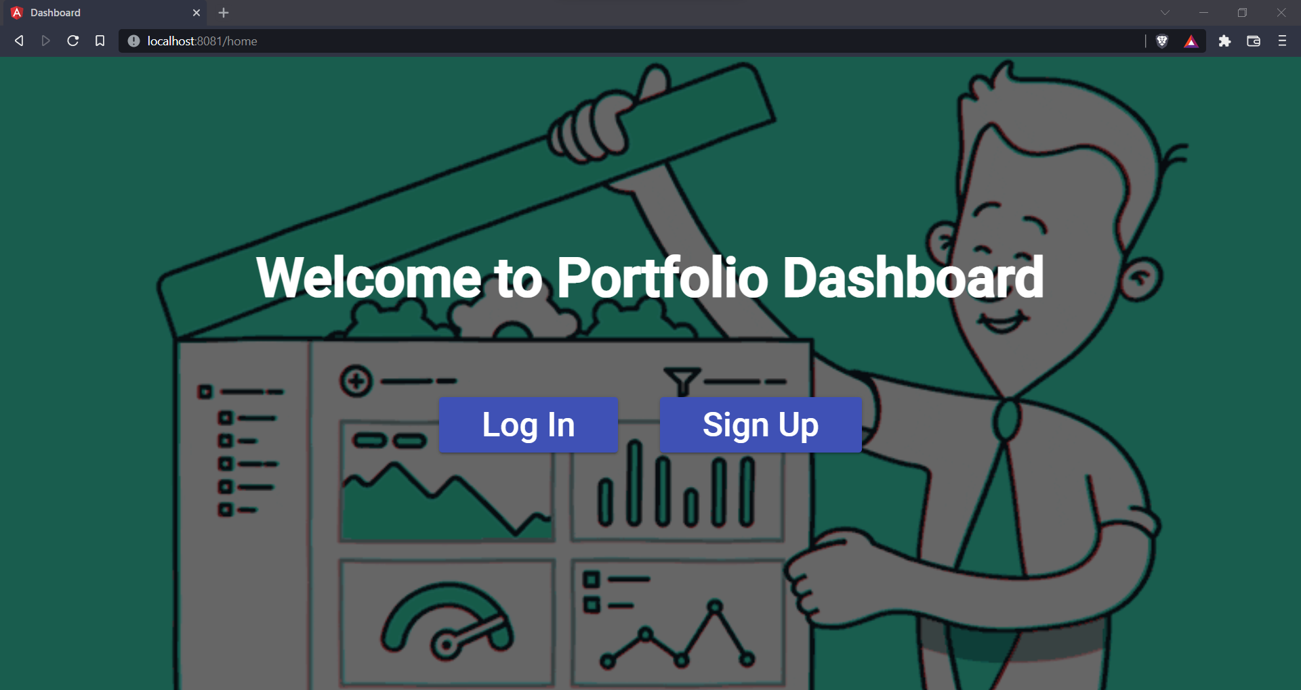
Home

Slide 5
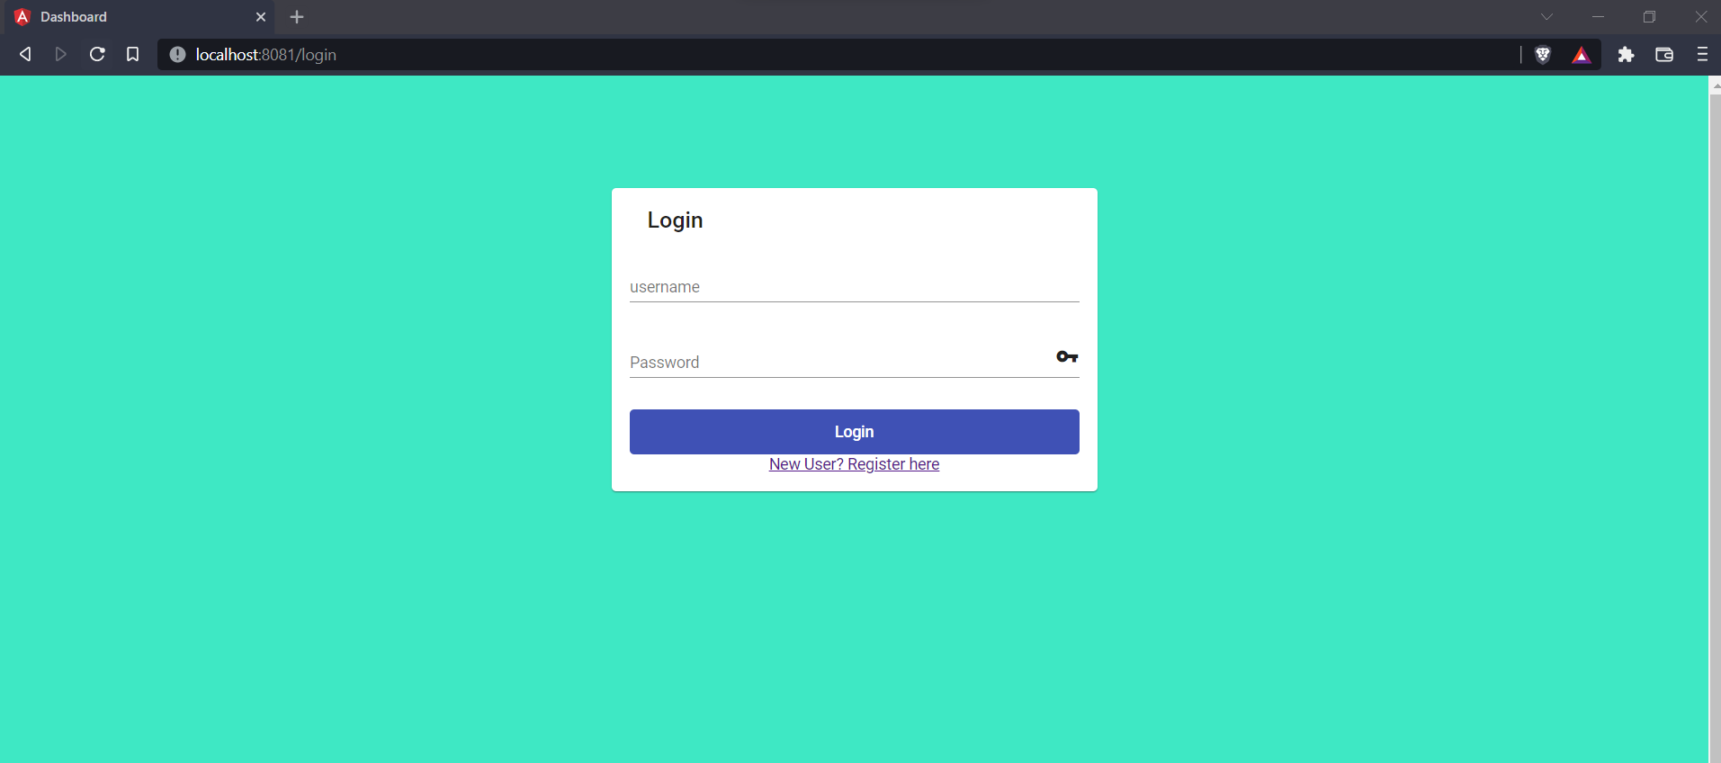
Login

Slide 6
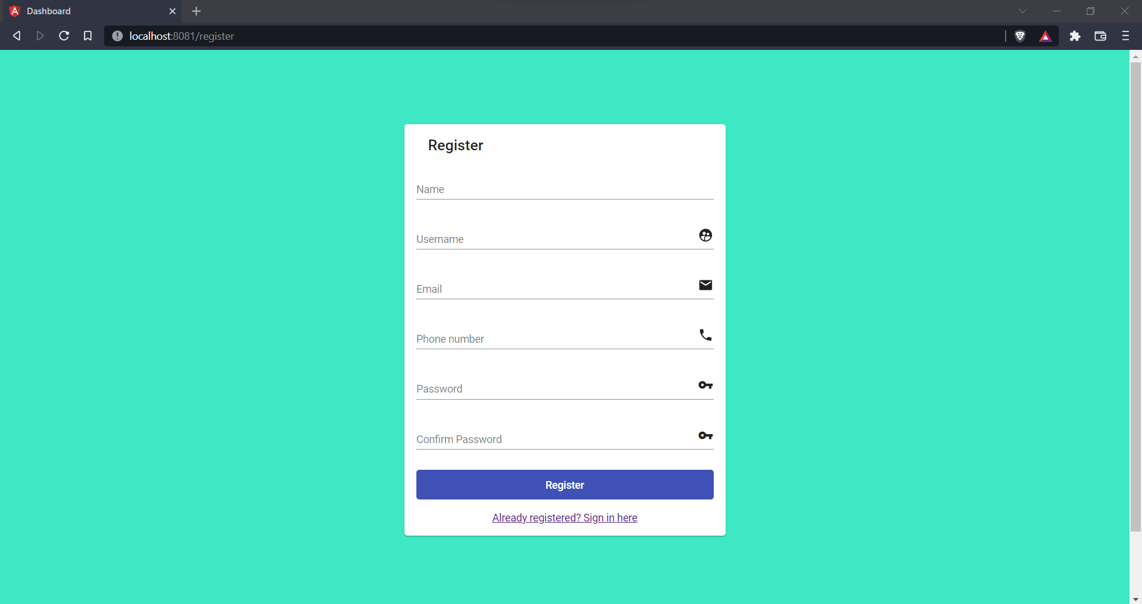
Register

Slide 7
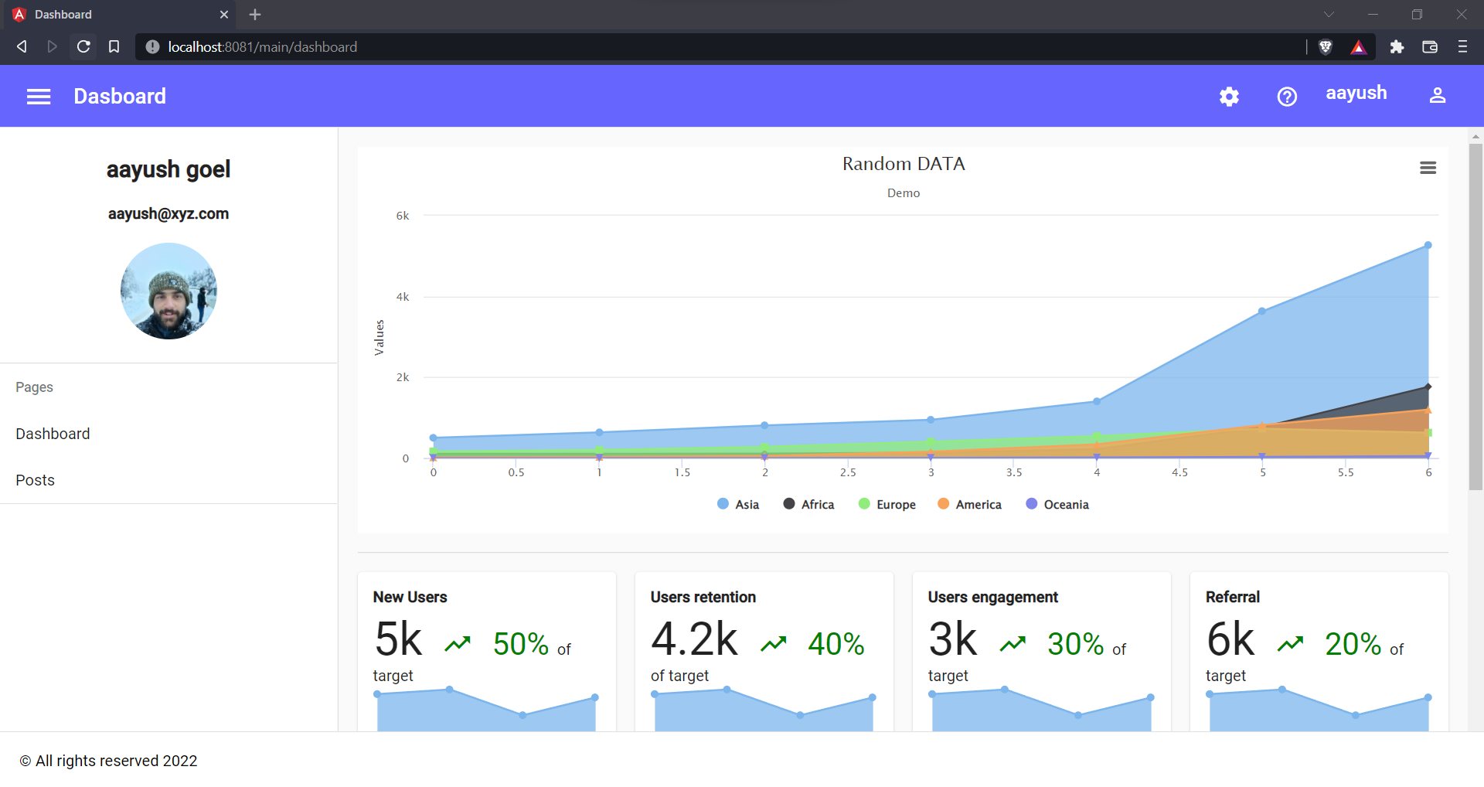
Dashboard

Slide 8
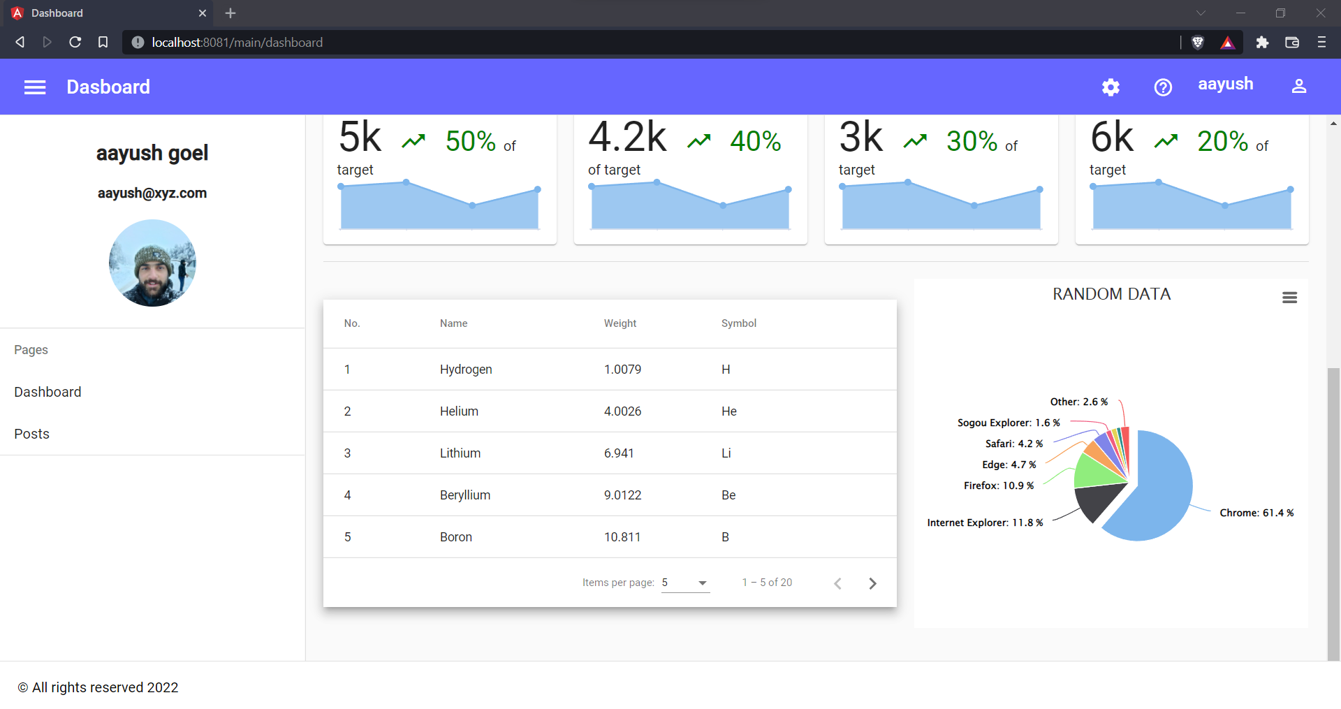
Dashboard

Slide 9
Technology
Stack
2
Technologies Used

Slide 10



Front-end Development
Angular 12
Back-end Development
NodeJS
Database System
MySQL

Slide 11
Angular 12 Modules
Angular Material
Angular Forms Module
Angular Reactive Forms
Angular HTTP Client Module
Highcharts Module
Flex-layout Module
Router Module
NodeJS Modules
ExpressJS
MySQL
Sequelize
Bcryptjs
Jsonwebtoken
CORS

Slide 12
3
Architecture
A visual representation of the Architecture

Slide 13
High Level Overview

Slide 14
Back-end Flow Diagram

Slide 15
Component Level Structure
4
A visual representation of the Components

Slide 16
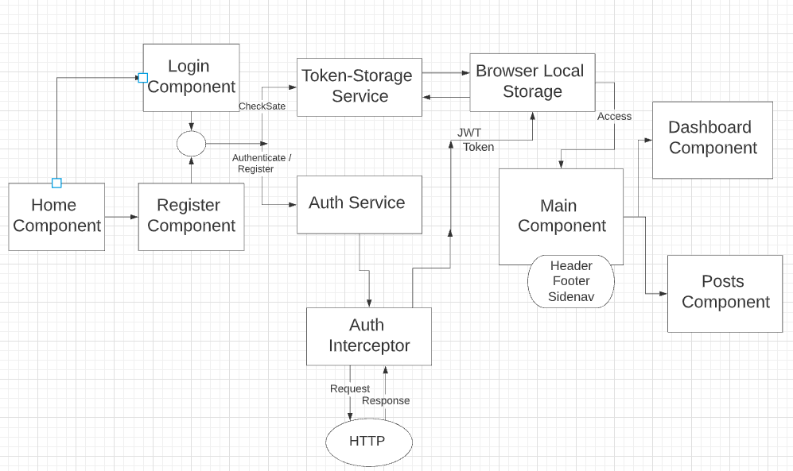
Flow Diagram

Slide 17
Thanks!
Any questions?
You can find me at: 13.june.aayush@gmail.com

