Slide 1
introduction to development for the internet

Slide 2

W e b 1.0
Static pages of hyperlinked information
Information revolution
HTML
created using HTML
<mark-up language>
HTML
HTML

Slide 3
Client/Server Request/Response
Web Browser The Internet
Web Server
at server.com
Disk Drive
at server.com
User requests
http://server.com
Look up address of:
server.com
Receive request for index page
Request server.com main page using IP
Fetch index.html from hard disk
Return the index page
Receive and display page

Slide 4
Moving Forward
Look and feel improved with style sheets
presentation and style could be
separated from the information structure and content
CSS
Cascading Style Sheet (CSS)
Mixed Media
HTML
Video
Audio
Image

Slide 5
BUT THEN

Slide 6
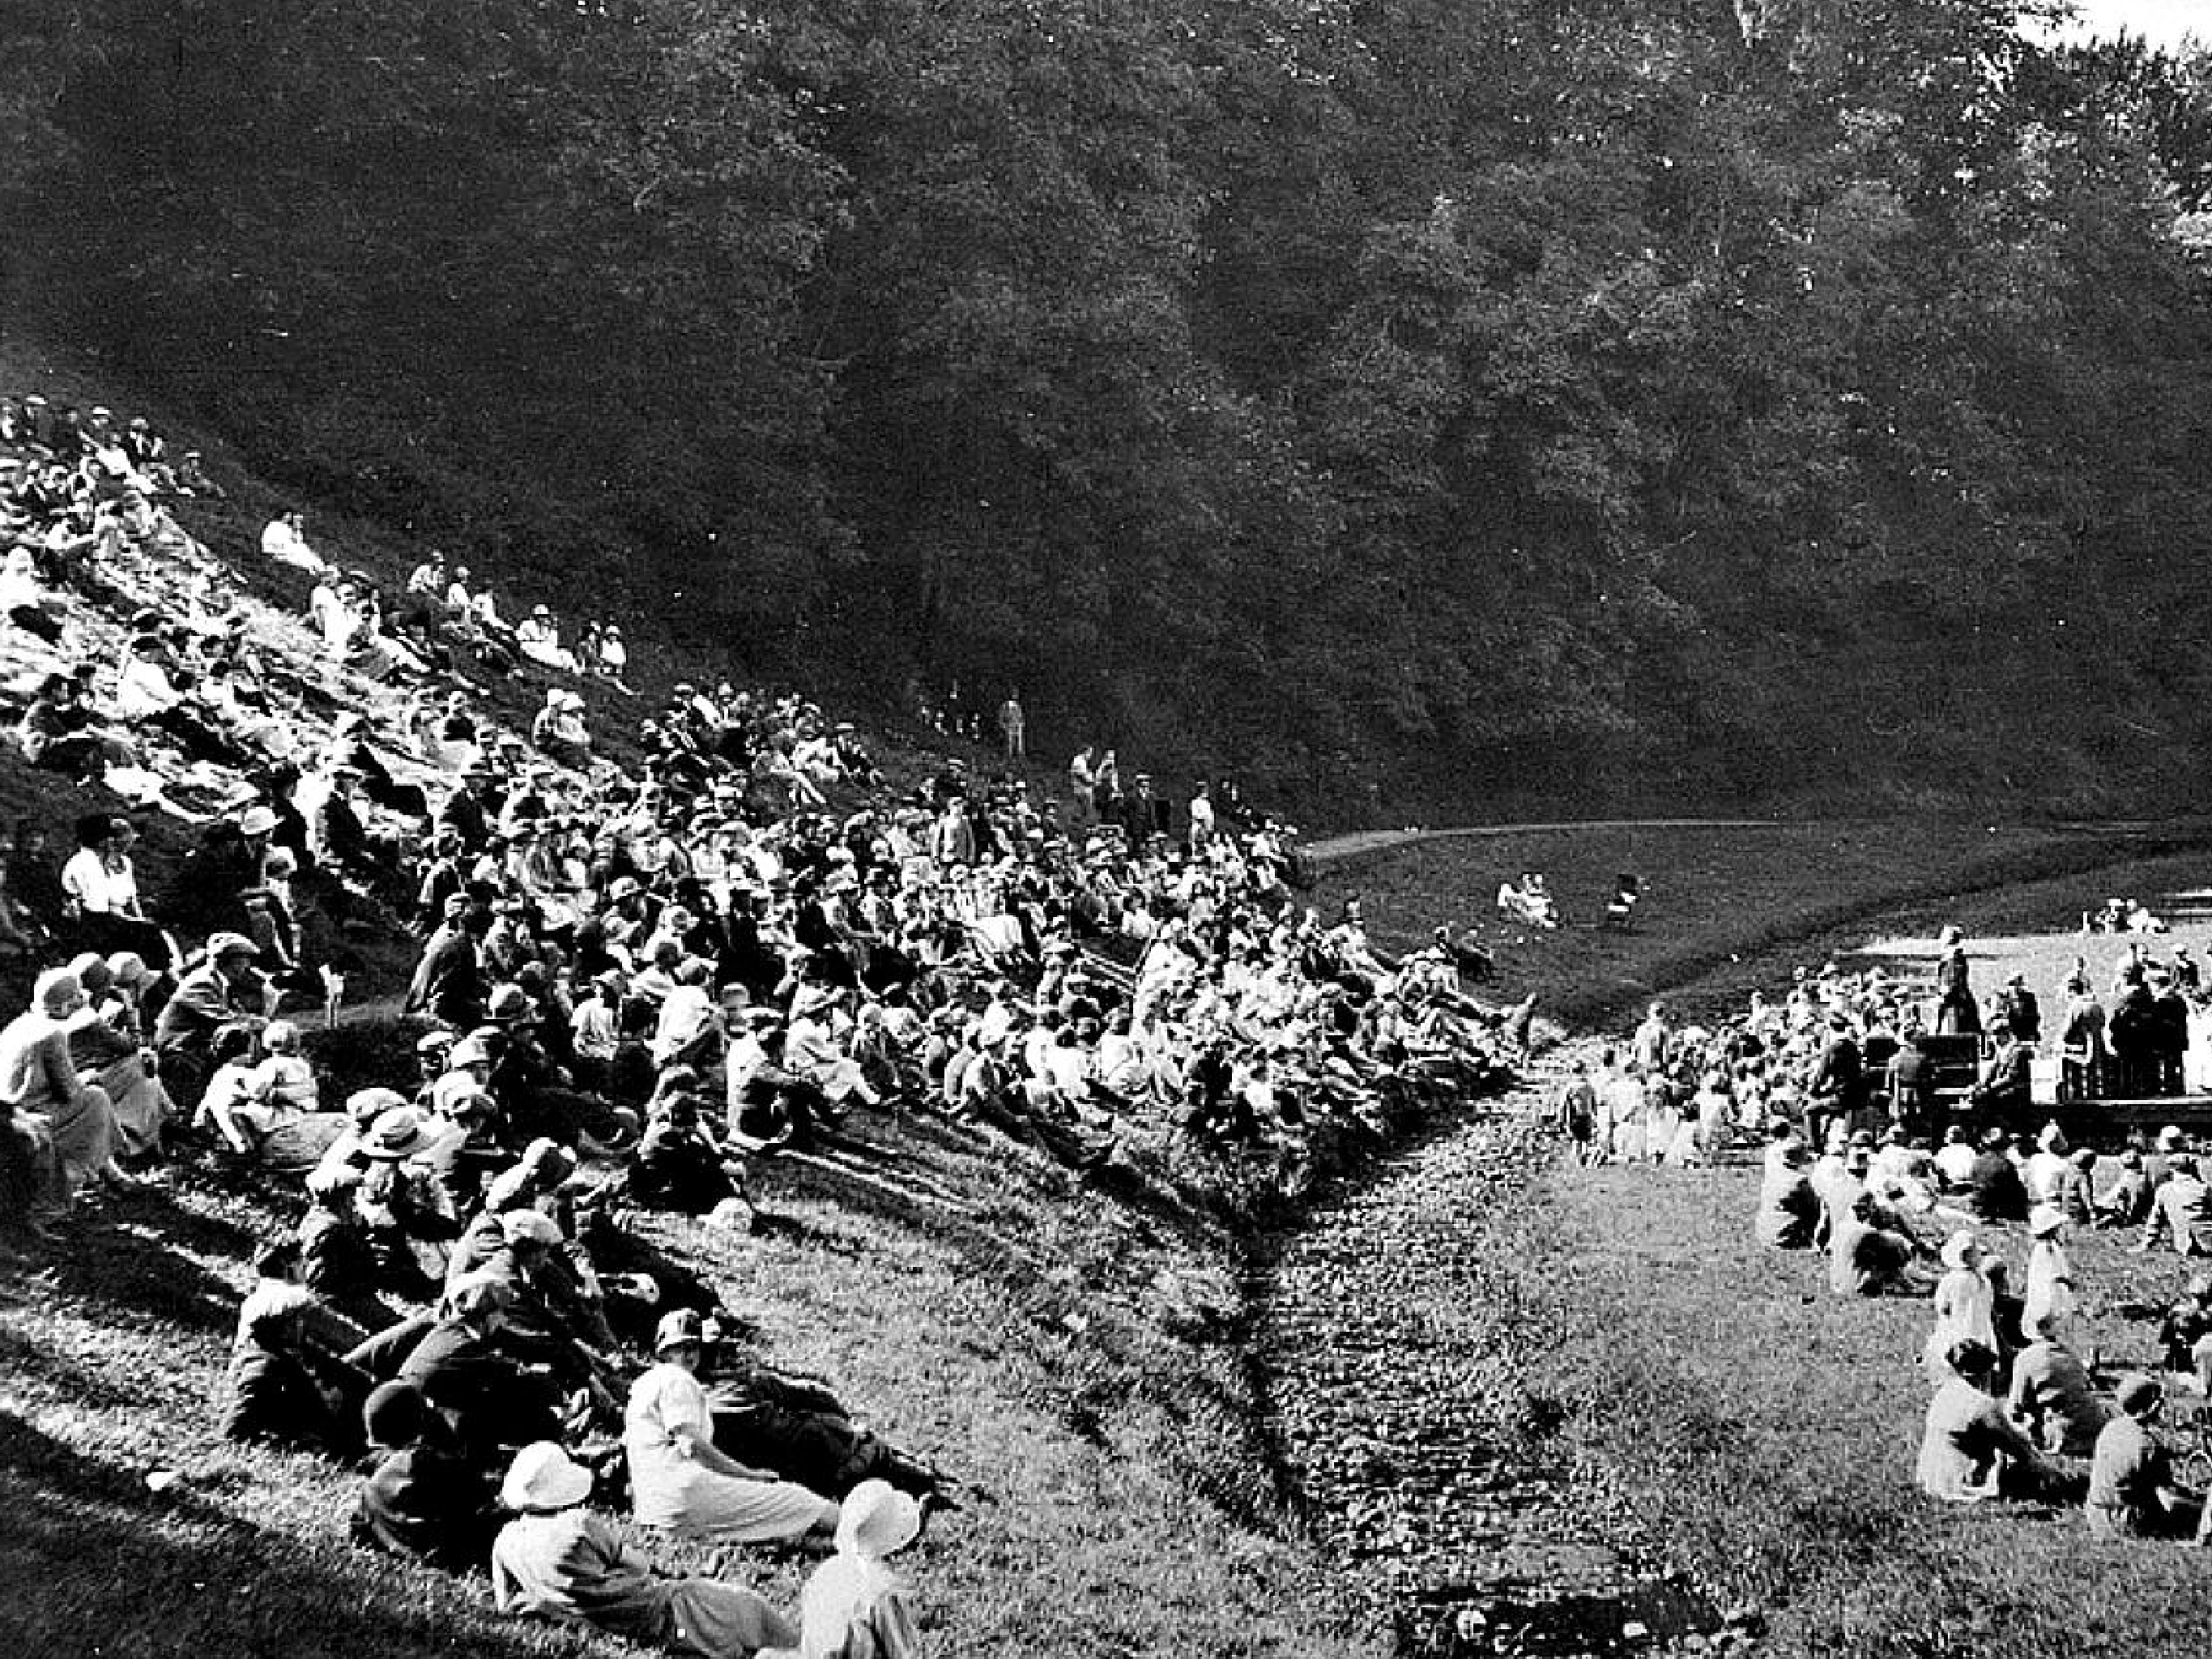


i’ve seen the future and it’s
Dynamic Content
p.s. - this is Kirriemuir…its awesome!

Slide 7


Dynamic Content
Server side dynamic content generation
Mature Web Server Stacks (e.g. LAMP)
Sites became web services (data not pages)
PHP Script
Database
Request Web Page
Web Server
Template Engine
HTML

Slide 8
Client/Server Request/Response
Web Browser
The Internet
PHP
Processor
Web Server
at server.com
Disk Drive
at
server.com
mySQL Database
User requests
http://server.com
Look up address of:
server.com
Request
Receive request
server.com main page using IP
for index page
Fetch index.html from hard disk
Contains PHP?
Process PHP
Execute SQL
Receive Data
Receive and display page
Return page

Slide 9
Dynamic Request/Response
Web Server Disk Drive
PHP Processor
mySQL Database
Receive Request
Fetch Page
Contains PHP?
Process PHP
Execute SQL
Receive Data
Return Page

Slide 10
Why are web apps important?
Nobody wants simple web pages anymore
Desktop software for common tasks may
be coming extinct
Oﬀsite storage as standard Collaboration easily added No software installation No software updates
•
•

Slide 11
Development Landscape
No single ‘one-size ﬁts all’ solution
No ‘correct’ way to do web development
Lots of diﬀerent web stacks available
this doesn't mean there isn’t a wrong way…there is!

Slide 12
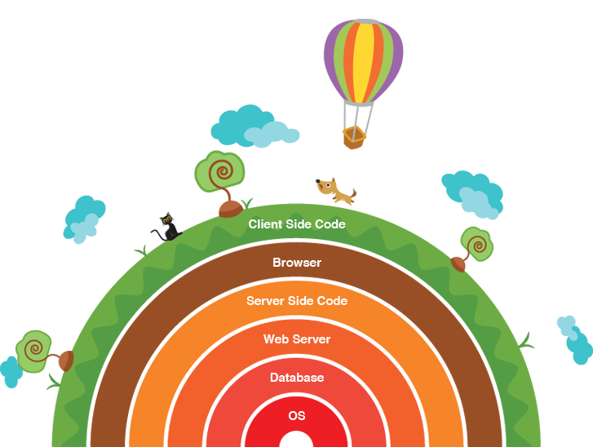
A software (or solution) stack: a set of components required to make a complete platform

Slide 13
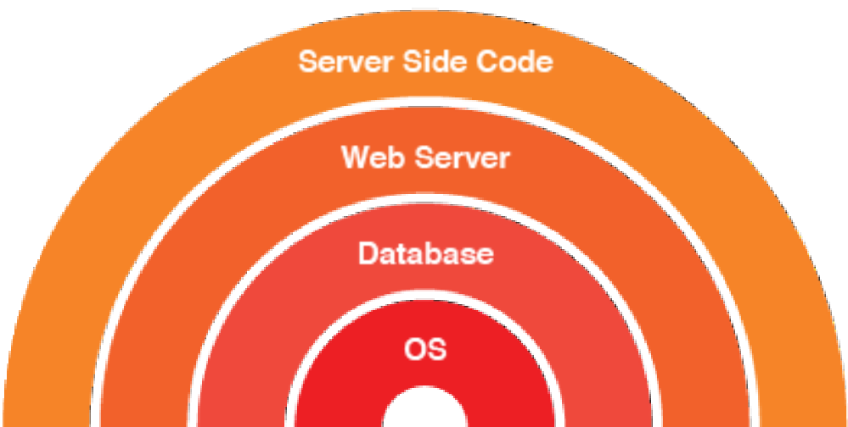
A software (or solution) stack: a set of components required to make a complete platform
Web stack: server side code utilises web server and database all running on an operating system

Slide 14
Common Web Stacks
LAMP | WAMP | MAMP
Linux | Windows | Mac
Apache | Apache | Apache
MySQL | MySQL | MySQL
PHP | PHP | PHP
LEMP | WIMP | WINS
Linux | Windows | Windows
EnginX | ISS | ISS
MySQL | MySQL | .Net
PHP | PHP | PHP

Slide 15
Linux Apache MySQL PHP

Slide 16
PHP
Apache MySQL
Linux
Notes:
<number>

Slide 17
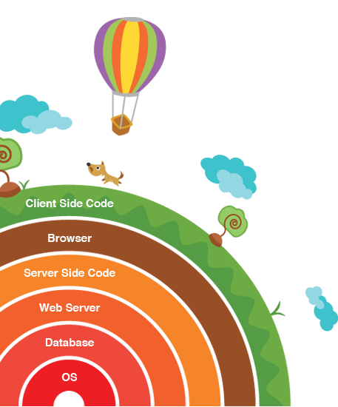

















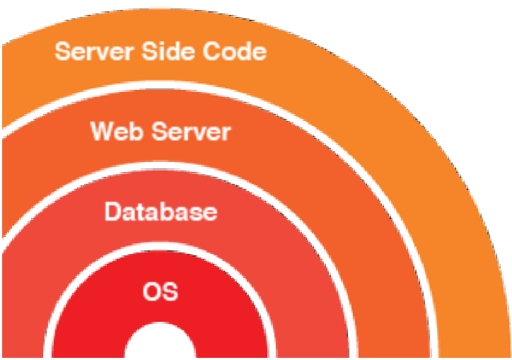

Alternatives Exist…

Slide 18
Database
Application Code

Slide 19
XAMP
MEAN
no need to mention, node is cross platform
OS
no need to mention, node is cross platform
Database
mySQL
mongoDB
node is its own server, Express makes it easier
nodeJS applications, may link to angular clientside
HTTP Server
apache
Serverside Code
PHP

Slide 20
html css php mySQL
How to structure a webpage
How to style a webpage
How to make a web page interactive
How to load and save information from a web page

Slide 21

Can be created and viewed on your own machine quite easily
html
css
How to structure a webpage
How to style a webpage
php
mySQL
How to make a web page interactive
How to load and save information from a web page
Needs specialised server in order to work

Slide 22
next is putting it into practice…

