Slide 1
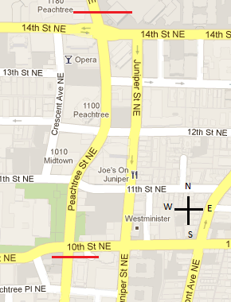
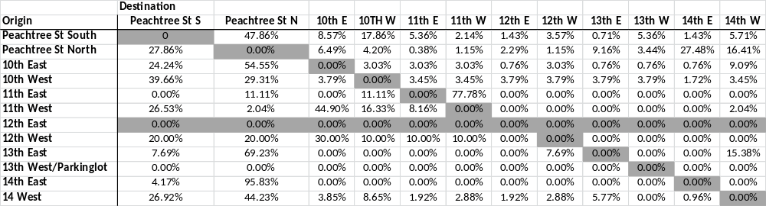
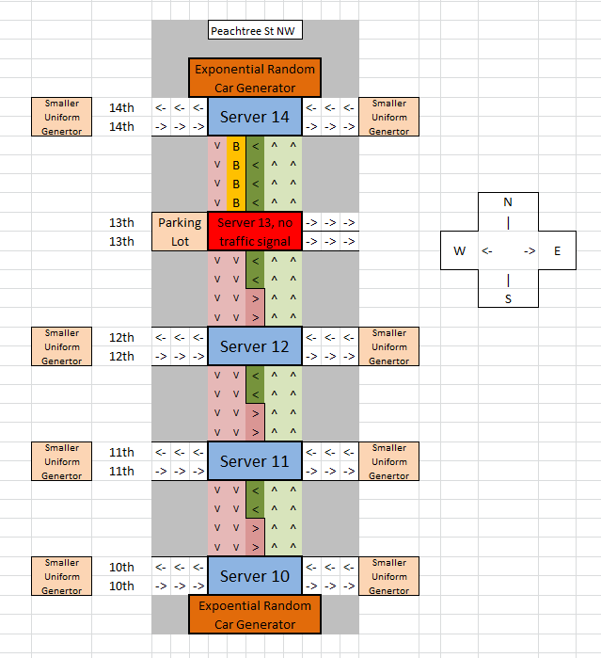
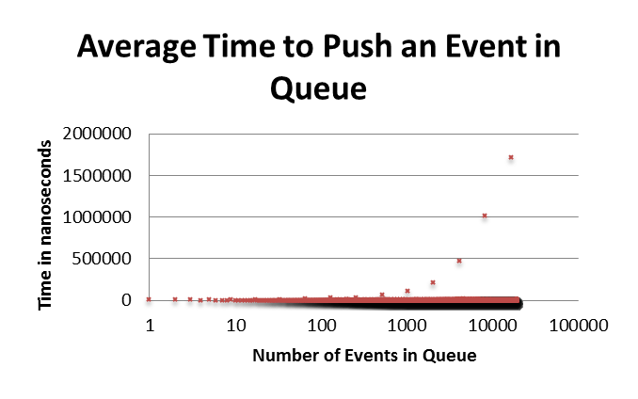
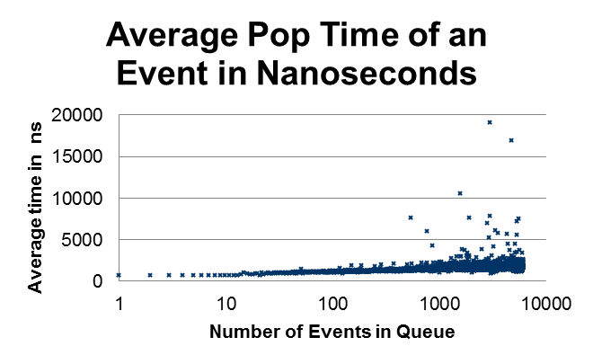
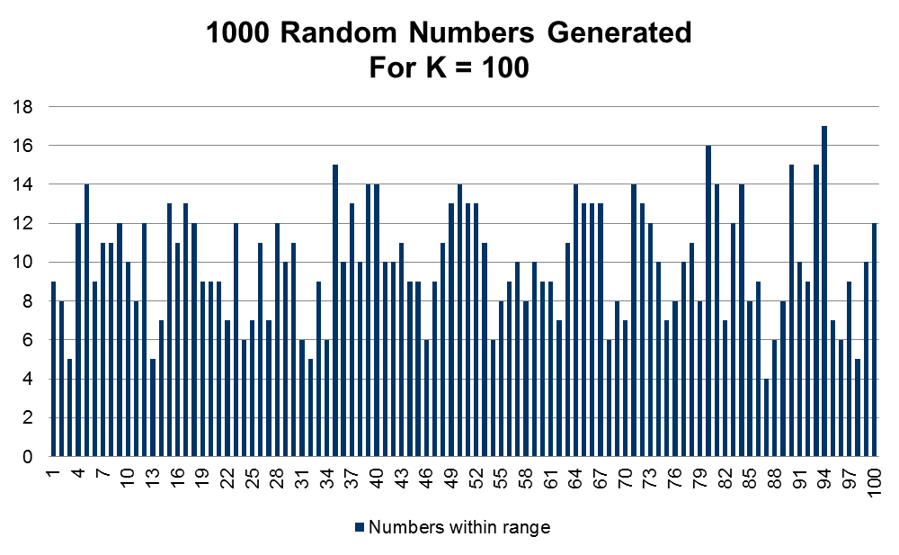
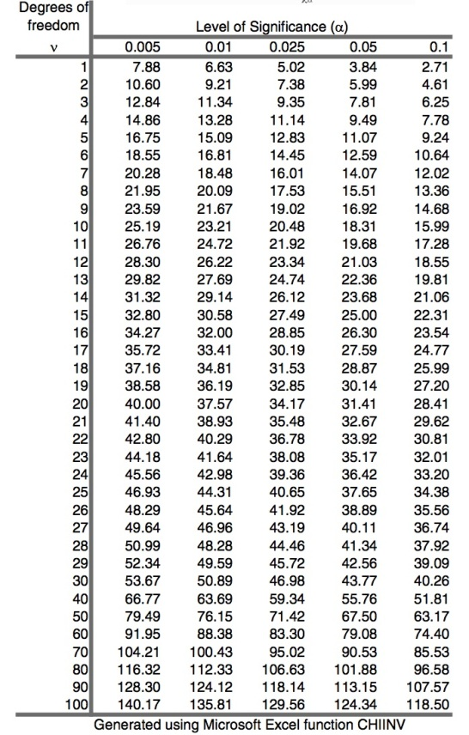
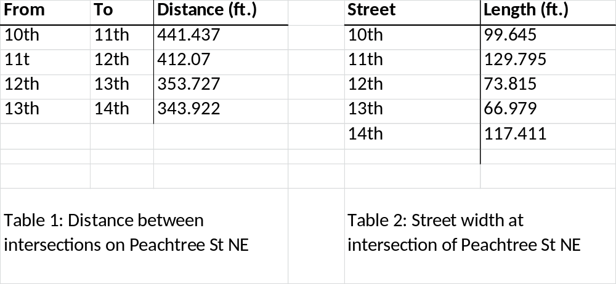
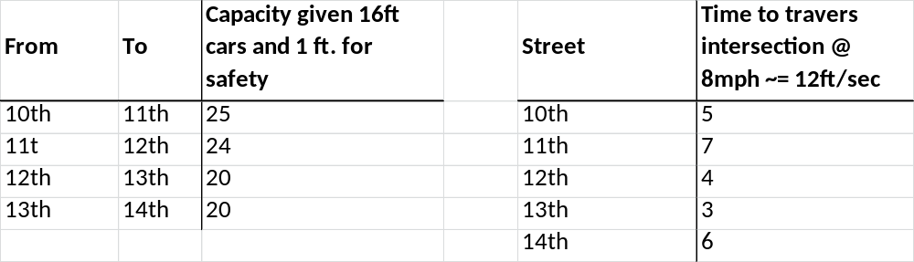
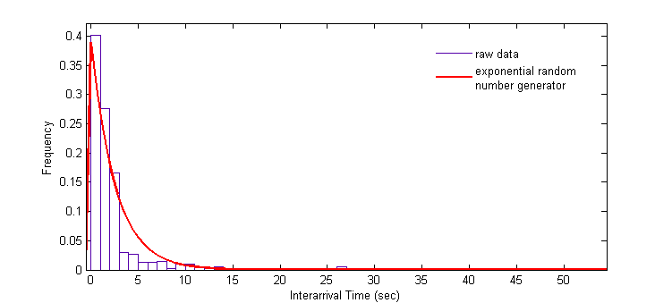
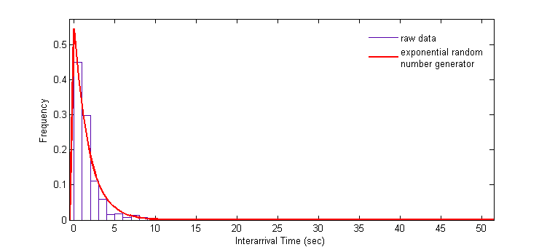
Peachtree St Simulation Presentation
Aemen Lodhi, Aderinola Gbade-Alabi, Shray Bansal, Shuozhi Xu
ECE 6730, CSE 6730, CS 4335
Project Description
Conceptual Model
Simulation Model
Simulation Program
The goal of this project is to model and capture the distribution of vehicle travel times during rush-hour(4 pm – 6pm) period as they traverse the stretch of Peachtree Street NE from 10th street to 14th street.
We decided on a few simplifications on the SUI. We are not including pedestrians in our conceptual model as we can safely make the assumption any pedestrian can cross during the stop times of the intersection. We will not model emergency vehicles attending an emergency during our simulation. We choose not to model emergency vehicles as they are not part of regular daily traffic. We will not include yellow light in our conceptual model as the goal of the project is not to capture vehicles slowing times, but to capture each car’s entrance and exit times in a simplified but reflective nature.
We also make the simplification that cars move at a constant speed/unit time or are simply static. Intersection blocking is illegal in Georgia, so we will not model intersection blocking in our model. We model two types of vehicles: cars and trucks.
Our model is coded in C++. The future event list is implemented with a binary heap priority queue. The roads are modeled with a simple FIFO linked list queue. The traffic signal changes, vehicle arrivals into a queue, and vehicle departures from the road queues are all modeled as events.
We implemented a Lehmer algorithm with overflow protection based random generator. We then used this generator to fuel the exponential generator for the inter-arrival times of vehicles.
The simulation must be seeded to begin. The simulation starts by pushing all the traffic signals events in the FEL. It then creates all the vehicle arrival events for the simulation times of 3 hours. The destination vehicle distribution is modeled after the data provided for the project, and is shown below.
Priority Queue Performance
Below are the average push and pop times for the FEL. Three runs were performed to find the average push and pop times. As seen below the priority queue exhibits time is Olog(n).
The SUI has 5 Intersections on Peachtree St NE: 10th, 11th, 12th, 13th, and 14th. 10th, 11th, 12th, and 14th street are all 4 way intersections with a 4 way stop light. 13th street is a 3 way intersection without a stop light or stop sign. 13th street also has a parking lot located at the west-end start of 13th St and Peachtree St NE. All intersections in the SUI have pedestrian cross walks.
Peachtree Street NE is a bi-directional street with 2 lanes for each direction (north and south) and one lane that serves as a turning left lane for both directions up from the 10th street intersection to the 13th street intersection.
From 13th Street to 14th street, the north heading direction of Peachtree street retains 3 lanes ( 1 lane in solely left turning), while the south direction retains 2 lanes, but one of the lanes can be used for turning left (see Figure 2 below). It is also important to note that 13th street does not have a stop light or a stop sign. Therefore cars turning left must make a turn essentially “when they can”.
Vehicle Origin Destination Distribution
Random Number Simulation Chi – Square Test
Output Analysis
The Chi-square test was performed on the Lehmer algorithm with overflow uniform random number generator. N = 1000 samples were generated and k= 100 sized intervals were used. X² = 82 and α< .05 .
The output validation was done on the average time it takes for a car to traverse the Peachtree road corridor from the intersections from 10th to 14th and vice-versa. We ran the experiment 40 times with different seeds for our random number generator.
The table below summarizes our observations. We found that the confidence Interval(CI) of the average traversal time lies between 22.196 and 22.756 seconds with 95% confidence level. The confidence interval half length = 1.495% is less than r given as 10%. So, this confidence interval was accepted.
Traffic for the SUI will be generated with two types of random car generators. An exponential random number generator for both ends of Peachtree St NE and a uniform random number generator for 10th, 11th, 12th, 13th., and 14th. These generators will also help to model the “burst-y” behavior of cars coming into intersections.
We will model the 13th parking lot as a smaller finite traffic generator. We will not model the overtaking of cars and changing on lanes; both do effect the overall driving time of a vehicle, but in our simplified model, we feel that this is negligible. The time unit in which we will model the SUI is in seconds.
Priority Queue Performance
Peachtree Street serves as one of the main roadways in Atlanta. There are several large corporate buildings, business, schools, etc. located on or around Peachtree Street.
In rush hour traffic, the average speed of a car will fall well below the speed limit of the actual roadway. Cars will drive closer together in packs and follow closer than they would in normal driving conditions. Cars entering the system will also exhibit burst-y behavior.
Vehicles, in their haste, may block an intersection because the road ahead does not have sufficient room to accommodate the vehicle. There may also to be accidents due to traffic, which in turn creates more traffic. Changing lanes can become difficult and even impede traffic, due to other vehicles unwillingness to let other overtake them. There is also the spill back phenomenon; when too vehicles try to turn left, but there is not enough room in the turning lane.
The histogram comes from the raw data, referring to the inter-arrival time of cars arriving at 10 & Peachtree, and 14 & Peachtree. The red curve is plotted by the output of exponential distributed random number generator. The exponential probability density function is: f(x) = λ * exp(-x* λ). The maximum likelihood estimation method says the estimation of lambda is the mean of 1/x. So λ = 0.3933 for 10th & Peachtree and 0.55157 for 14th & Peachtree..
In terms of code, we use queues to model the roads of Peachtree Street, servers to model the intersections on Peachtree Street, and a priority heap queue for the future event list. We have two types of severs and traffic generators. We use two different kinds of server because the intersection of 13th Street and Peachtree Street does not have a traffic light. We do not model the 10th, 11th, 12th, 13th, and 14th street as queues but as random car generators.
Inter-arrival time of 10th St
Inter-arrival time of 14th St

