Slide 1
Simulation of Biological Systems Spring 2011 Effects of network topology on epidemic dynamics
Aemen Lodhi

Slide 2
Outline
Introduction
Epidemiological models
Network models
Experimental & Simulation approach
Visualization of epidemic on Regular network
Statistical results

Slide 3
Introduction
Mathematical models for disease transmission
Transmissibility of the pathogen
Mutation
Immune response of host
Quality of health-care provision
Behavior of the population

Slide 4
Introduction
Networks as a tool to study population interaction
Individuals presented as nodes, interactions presented as links
Strength of the link & disease characteristics
Time scale of interest
The nature of interactions affects the spread of the epidemic

Slide 5
Introduction
Objective of the study:
What is the rate at which epidemic is spreading?
How long will the epidemic persist?
What kind of networks are most robust?
Who is affected the most?
Who should be isolated/inoculated first?

Slide 6
Epidemiological models
SIR – Susceptible, Infected, Removed
p = probability of disease
acquisition
S
I
t = duration of
infection
R

Slide 7
Epidemiological models
SIS – Susceptible, Infected, Susceptible
p = probability of disease
acquisition
S
I
t = duration of
infection

Slide 8
Epidemiological models
SIRS – Susceptible, Infected, Removed, Susceptible
p = probability of disease
acquisition
S
I
t = duration of
infection
R
t’ = duration of
immunity

Slide 9
Network Models
Regular: Lattice, Cube, Star
Random: Randomly interconnected with mean degree
Scale Free Networks: Skewed degree distribution (follows power law)
Small World Networks: “most nodes are not neighbors of one another, but most nodes can be reached from every other by a small number of hops or steps”

Slide 10
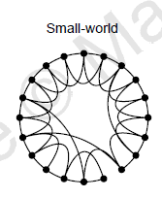
Network models
“Collective Dynamics of small-world networks”, Duncan Watts, Steven Strogatz

Slide 11
Approach
Visualization for regular network
Core simulator for statistics and properties
Regular network

Slide 12
Parameters
N: 10,000 nodes
Infection time: 5
Immune time: 9
Simulation time: 6000 time units

Slide 13
Results: Peak infected population

Slide 14
Results: Persistence

Slide 15
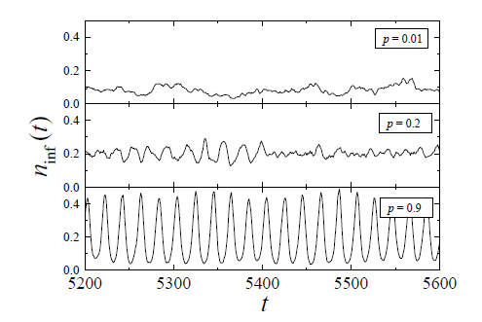
Results: Synchronization in small world networks
“Small world effect in an epidemiological model”, Guillermo Abramson, Marcelo Kuperman

Slide 16
Results: Synchronization in Small World networks

Slide 17
Results: Synchronization in small world networks

Slide 18
Results: Synchronization

Slide 19
Countermeasure seeding strategies
Random
Hub: seed the node with the largest degree
Center: seed the node with smallest avg. distance from all other nodes
Closest: seed the node with the most paths running through it (highest betweenness centrality)

Slide 20
Results: Countermeasures

Slide 21
Results: Countermeasures

Slide 22
References
L. Adamic. Collective dynamics of 'small-world' networks. Lecture Notes in Computer Science, (166):443452, 1999.
A. L. Barabási and R. Albert. Emergence of scaling in random networks. Science, 286(5439):509512,1999.
Marc Barthélemy, Alain Barrat, Romualdo Pastor-Satorras, and Alessandro Vespignani. Dynamical
patterns of epidemic outbreaks in complex heterogeneous networks. Journal of Theoretical Biology, 235:275288, 2005.
Ken T. Eames and Jonathan M. Read. Bio-inspired computing and communication. chapter Networks in Epidemiology, pages 7990. Springer-Verlag, Berlin, Heidelberg, 2008.
S Eubank, H Guclu, V S Anil Kumar, M V Marathe, A Srinivasan, Z Toroczkai, and N Wang. Modelling disease outbreaks in realistic urban social networks. Nature, 429(6988):180184, 2004.
Romualdo Pastor-Satorras and Alessandro Vespignani. Epidemic spreading in scale-free networks. PHYS.REV.LETT., 86:3200, 2001.

