Slide 1
CS 7641 Project Maximizing the Spread of Influence in a Social Network*
Aemen Lodhi
Sabyasachi Deyati
*David Kempe, Jon Kleinberg, and Éva Tardos. Maximizing the spread of influence through a social network. In Proceedings of the 9th ACM SIGKDD international conference on Knowledge discovery
and data mining, KDD '03

Slide 2
Outline
Introduction
Problem statement
Key ideas of the paper
Model
Results
Analysis

Slide 3

Introduction
Product to market
Social network

Slide 4
Introduction
Marketing has a cost
Directed instead of mass marketing
Want marketed individuals to influence others
Which individuals to market to?
Seed
Active
set

Slide 5
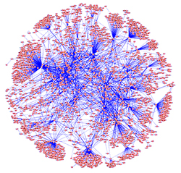
Problem Statement
Choose a set of k seed nodes initially to maximize the number of nodes N in the active set. k << N
NP hard

Slide 6
Key ideas of the paper
Proposed a greedy hill-climbing strategy to choose k nodes
Showed analytically that their algorithm achieves 63% of the theoretical optimal performance
Their algorithm outperforms existing heuristics
Random selection
High degree
High centrality

Slide 7
Model - Algorithms
Greedy
Let S be a set of size k obtained by selecting elements one at a time, each time choosing an element that provides the largest marginal increase in the function value
Random: Randomly choose k nodes
High Degree: Choose k nodes with highest degree
Centrality: Choose k nodes with highest betweenness centrality

Slide 8
Model – Diffusion processes
Diffusion: How do nodes influence their neighbors?
Node threshold denotes affinity for the idea/product
Edge weight denotes influence a node has on its neighbor
0.5
0.3
0
0.3

Slide 9
Model – Diffusion processes
Linear threshold: If the weighted sum of the active neighbors of a node increases beyond a threshold then activate the node
0.5
0.3
0
0.3

Slide 10
Model – Diffusion processes
Independent Cascade: Active nodes probabilistically influence their neighbors individually
Weighted Cascade
0.3
0
0.7

Slide 11
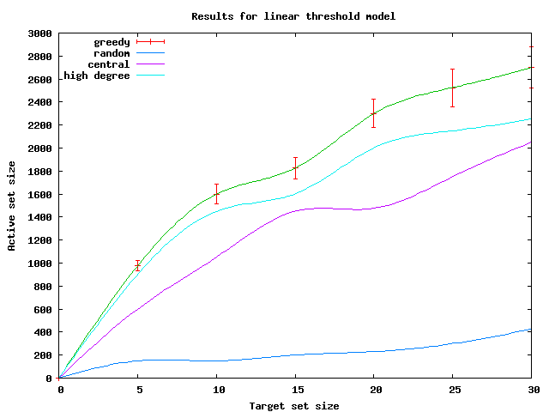
Results
4 algorithms x 3 diffusion processes

Slide 12
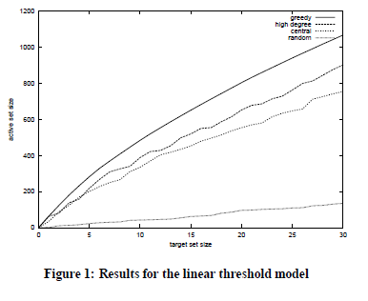
Results – Linear Threshold

Slide 13
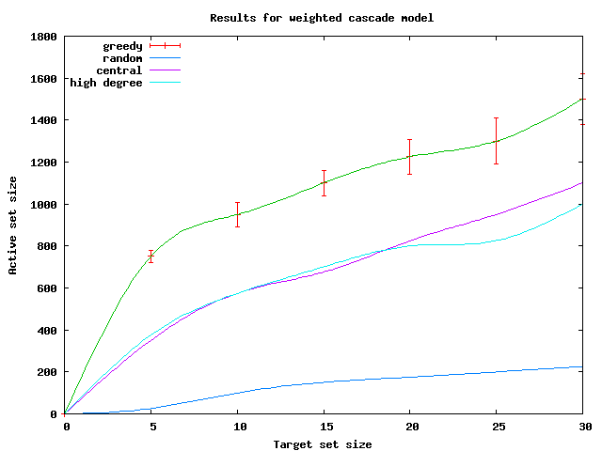
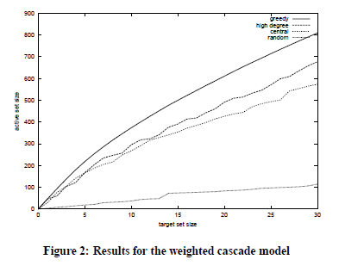
Results – Weighted Cascade

Slide 14
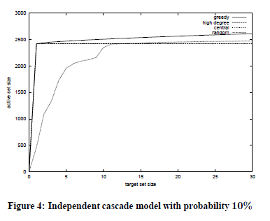
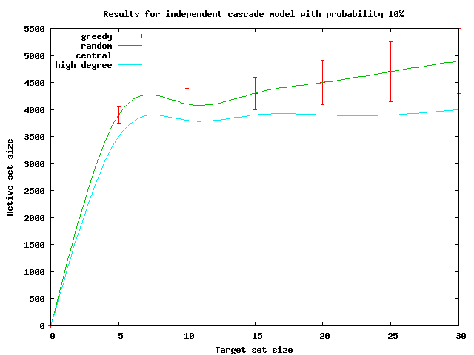
Results – Independent Cascade

Slide 15
Analysis
Our results qualitatively support the paper’s results
Algorithmic complexity still high
2 days of simulation time for 15000 nodes
Our proposition- Add sampling to the greedy algorithm
Additional experiments with different dataset also support paper’s results

Slide 16
Thank you

