Slide 1
Formation of the first low-mass stars from cosmological initial conditions
C. Safranek-Shrader, M. Milosavljevic, V. Bromm
2014

Slide 2
Modern Star Formation
Molecular clouds with supersonic turbulence
  SF dominated by shock compression → Jeans unstable
Fragmentation governed by:
  Turbulence, rotational, magnetic field support
  Complex rel. between heating and cooling
Star Formation peaks at ~ 0.1 – 0.5 Msun

Slide 3
Early Star Formation is Different
Pop III stars:
  Formed from pristine (Z ~ 0) gas
  H2 Cooling essential (and inefficient)
  CMB temperature sets cooling floor
Typical star more massive (maybe ~ 100Msun)
Produced the first metals that affect future SF

Slide 4
How did Pop III → Pop I
Dust and metals change the game completely
Not clear which is dominant effect....
Possible observables:
  1) Nature of reionization
  2) Still alive today in metal poor regions
  3) Observed directly at high z with JWST

Slide 5
Simulating the first metal stars
Perform a cut-out simulation of previous work
  Cosmological simulation
  Large (million solar mass halo)
  Initially pristine, populated with metals
  Evolved to “star” formation
  Resolution limited
Want to resolve fragmentation at all scales

Slide 6
All of the fancy physics
FLASH – grid based, AMR hydro code
High resolution (n ~ 10⁷ - 10¹³ cm⁻³)
Sink particle formation for stars
Include:
  Non-eq primordial chemical network (12 species)
  Populate metal chemistry (C,C+, Si, Si+, O,O+)
  Coupling between dust and gas (cooling and heating)

Slide 7
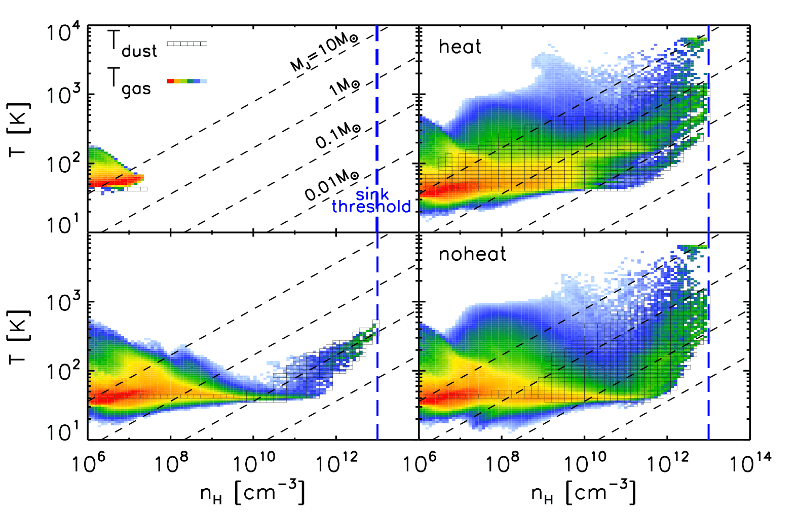
Gas and Dust Phases
Simulation Start
Simulation End
Start of Star Formation
Simulation End

Slide 8
Gas and Dust Phases
Simulation Start
Simulation End
Start of Star Formation
Simulation End
TCMB

Slide 9
Gas and Dust Phases
Simulation Start
Simulation End
Start of Star Formation
Simulation End
Optically thick to line cooling

Slide 10
Gas and Dust Phases
Simulation Start
Simulation End
Start of Star Formation
Simulation End
Coupling between dust and gas causes cooling

Slide 11
Gas and Dust Phases
Simulation Start
Simulation End
Start of Star Formation
Simulation End
Adiabatic Evolution of Gas

Slide 12
Filamentary Star Formation
Sink particle formation in filament
  Supersonic, colliding flow of gas
Filament fragmentation
Discy structures →Sites of SF
With / without dust heating:
  37 vs 46 sink particles
  15 vs 16 total solar masses

Slide 13
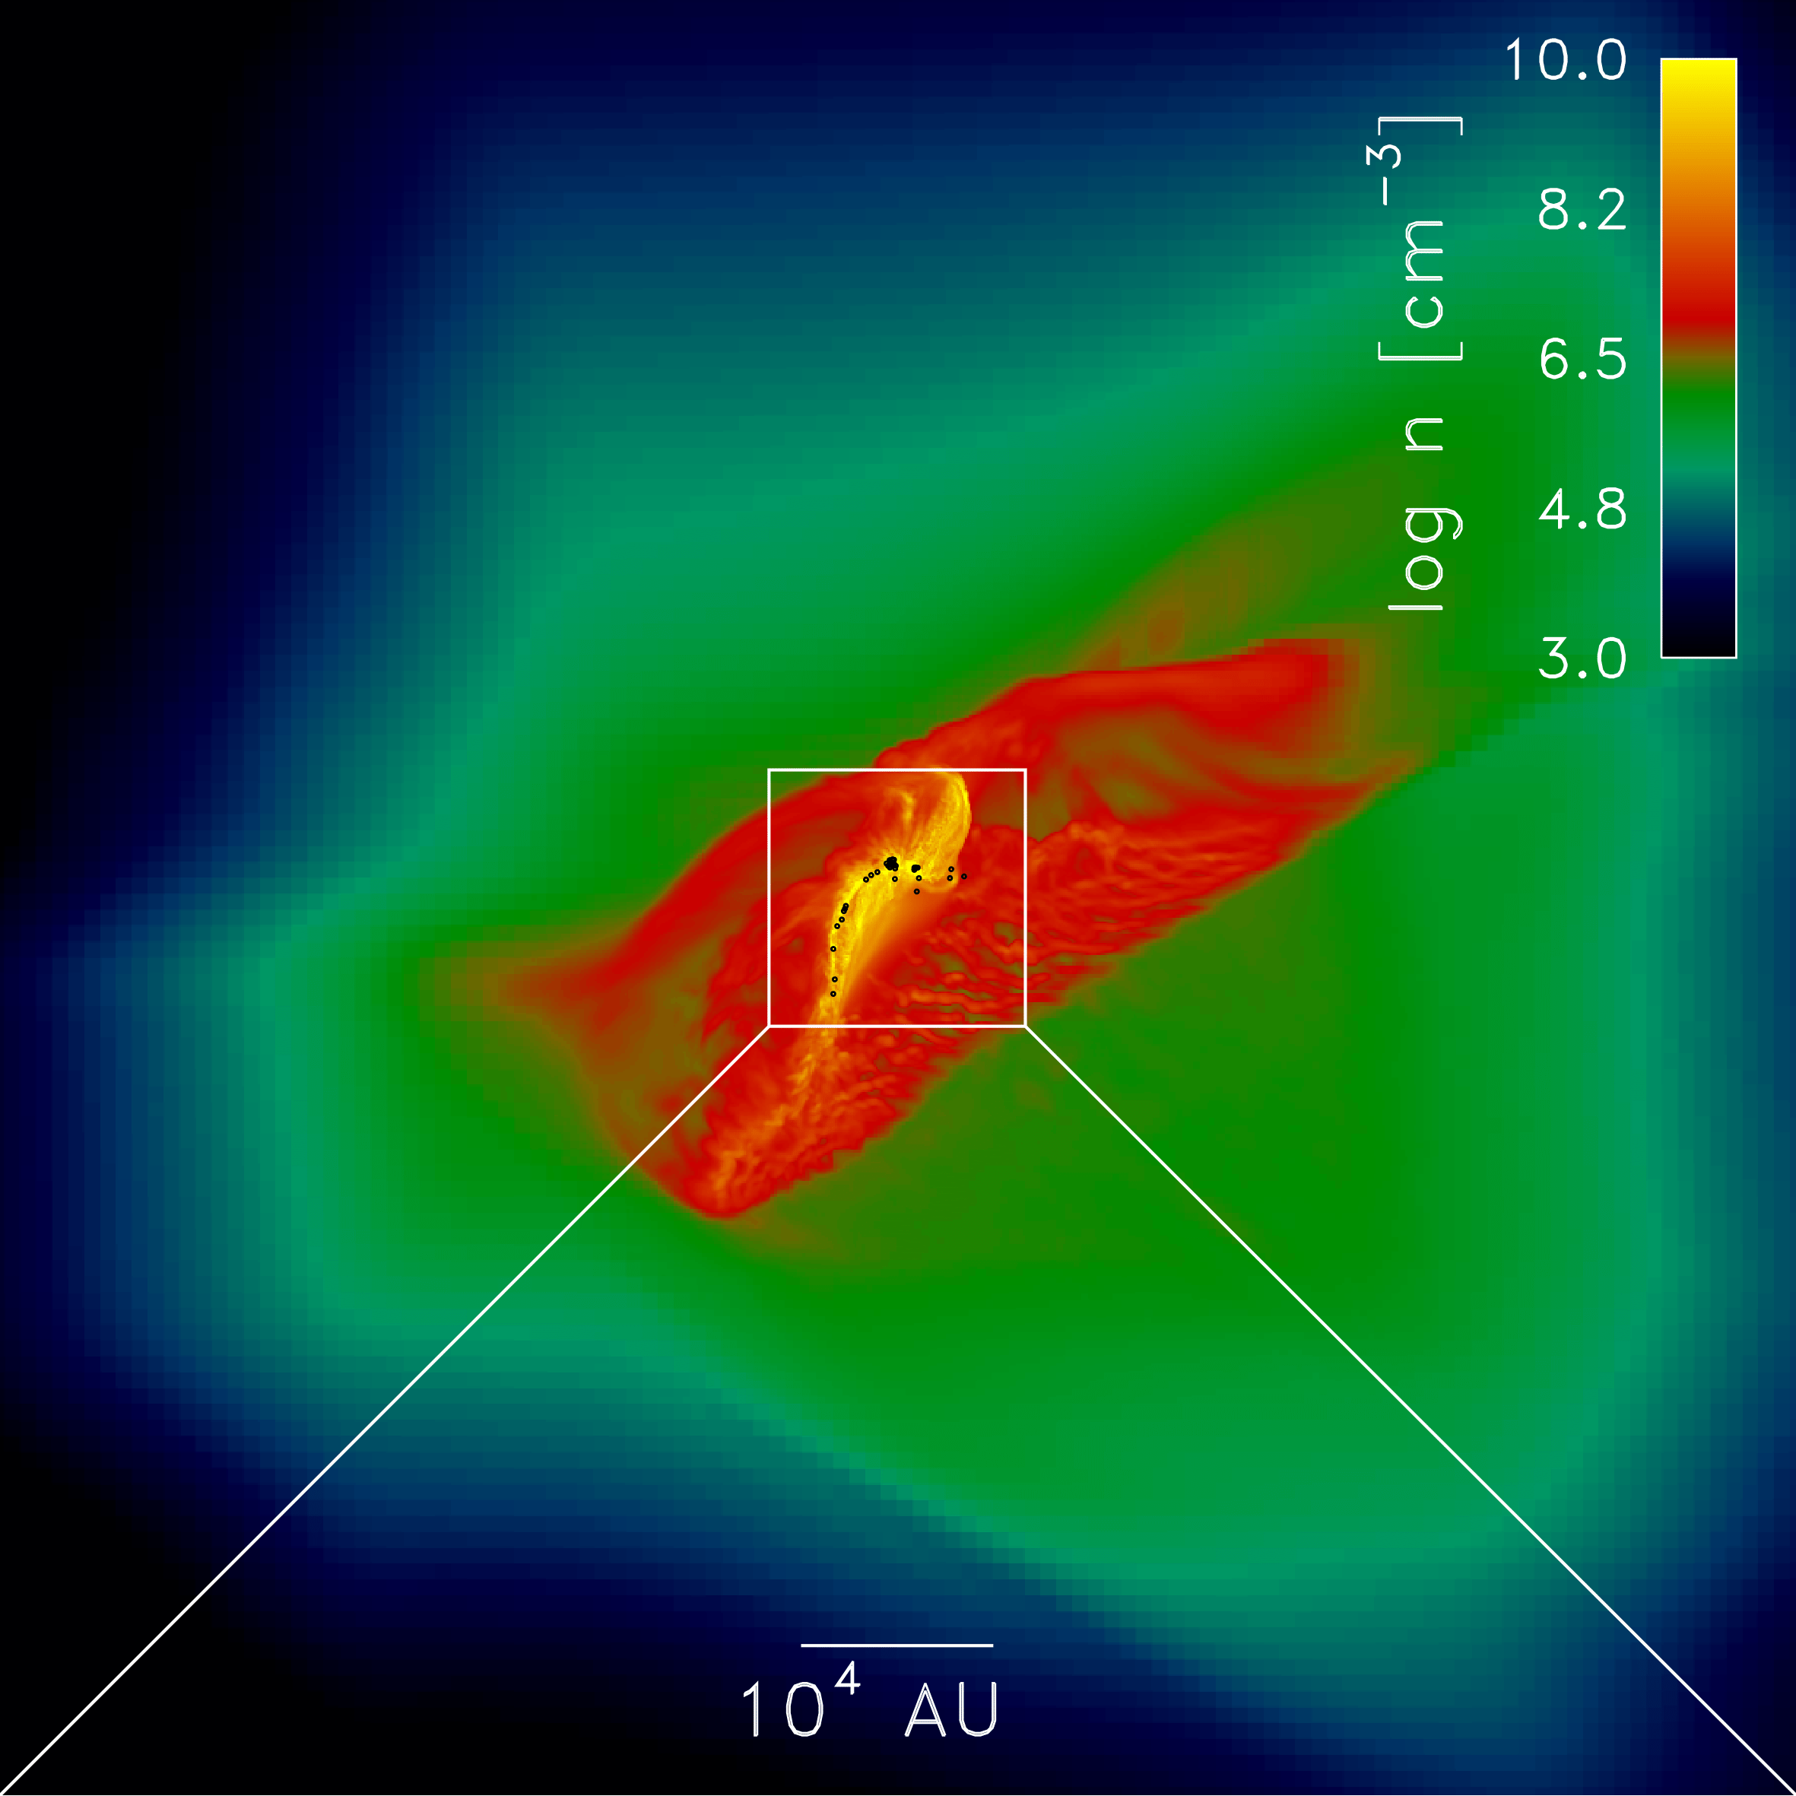
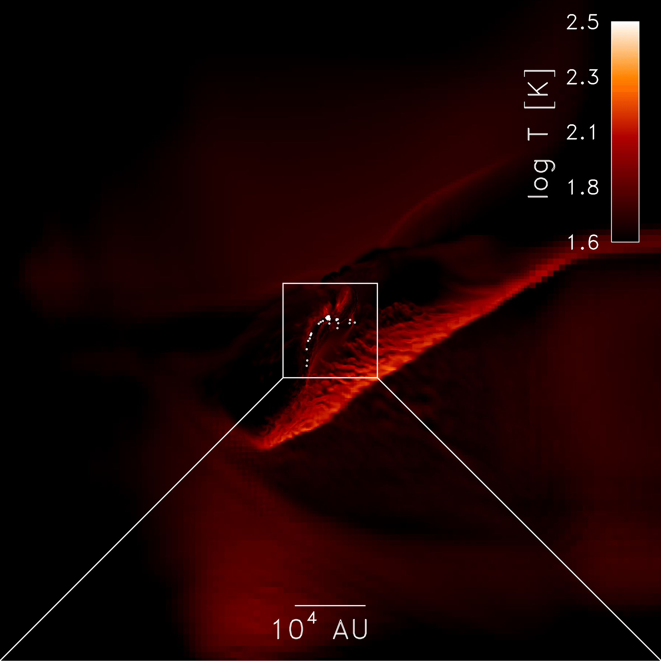
Collapse and Star Formation
Density Projection
Temperature Projection

Slide 14
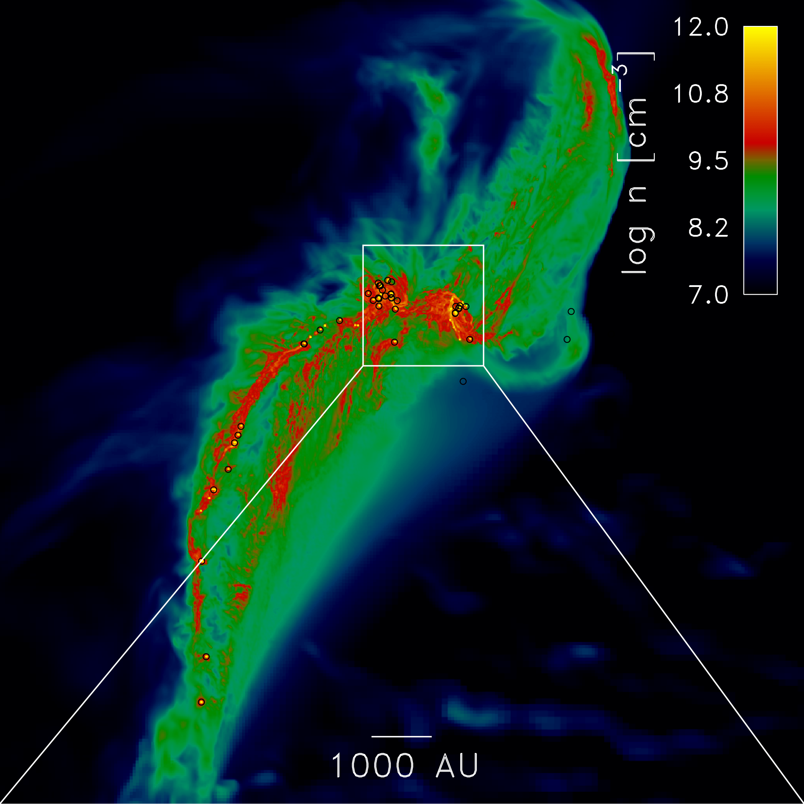
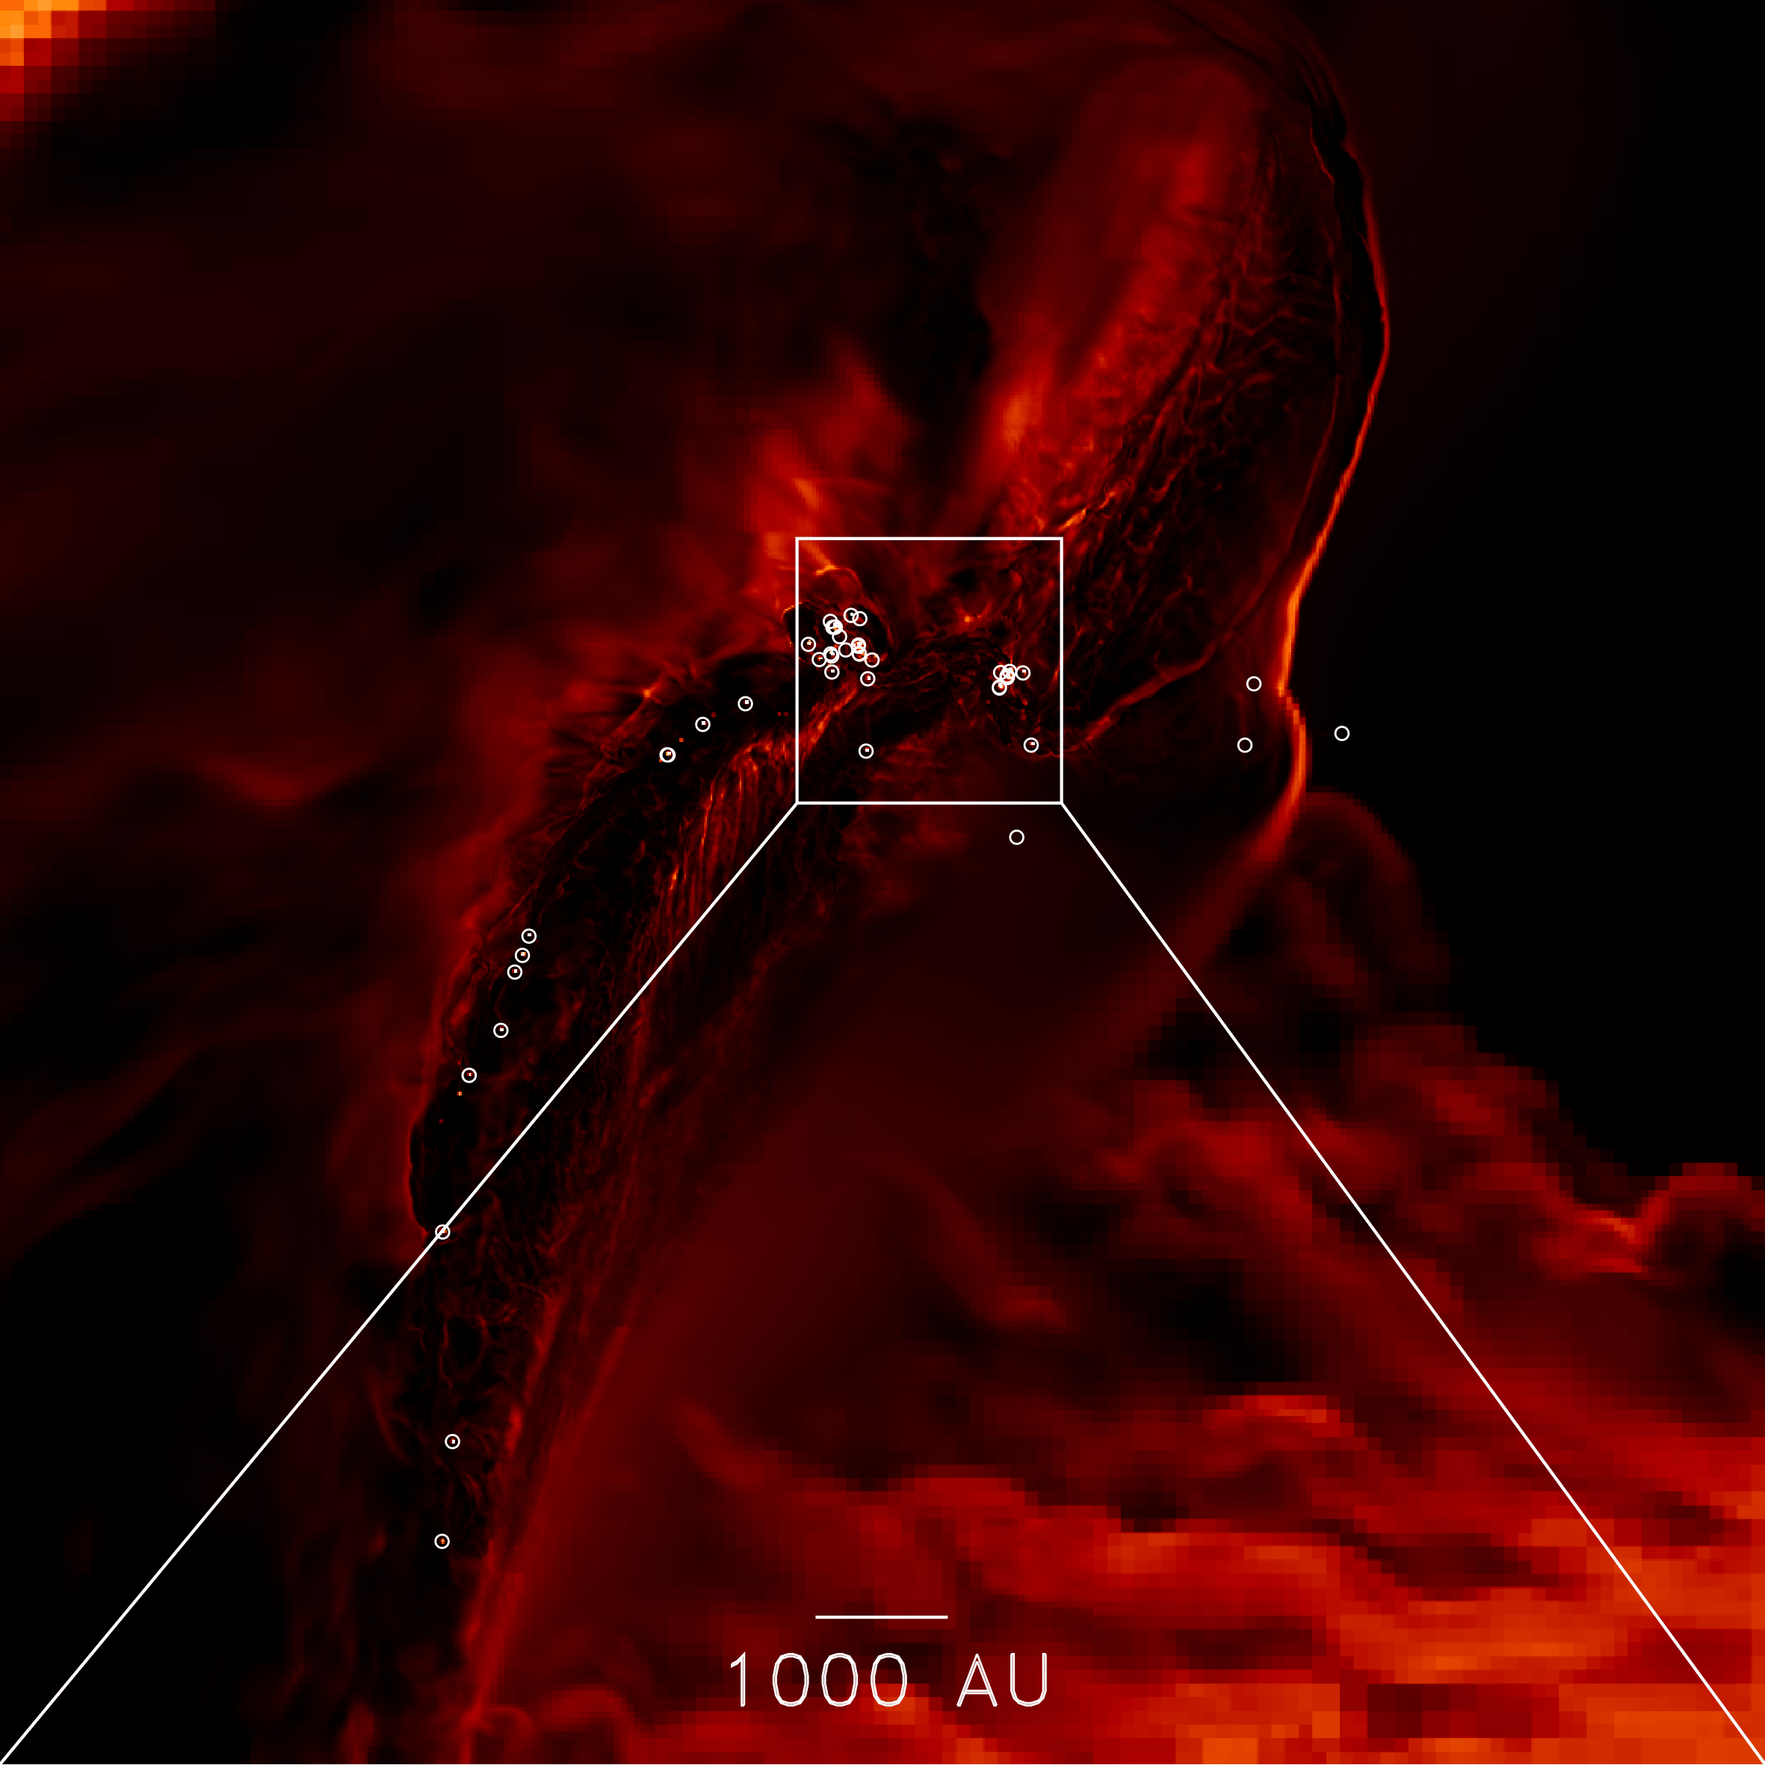
Forming in Filamentary Flows
Zooming in on the SF filament
Density Projection
Temperature Projection

Slide 15
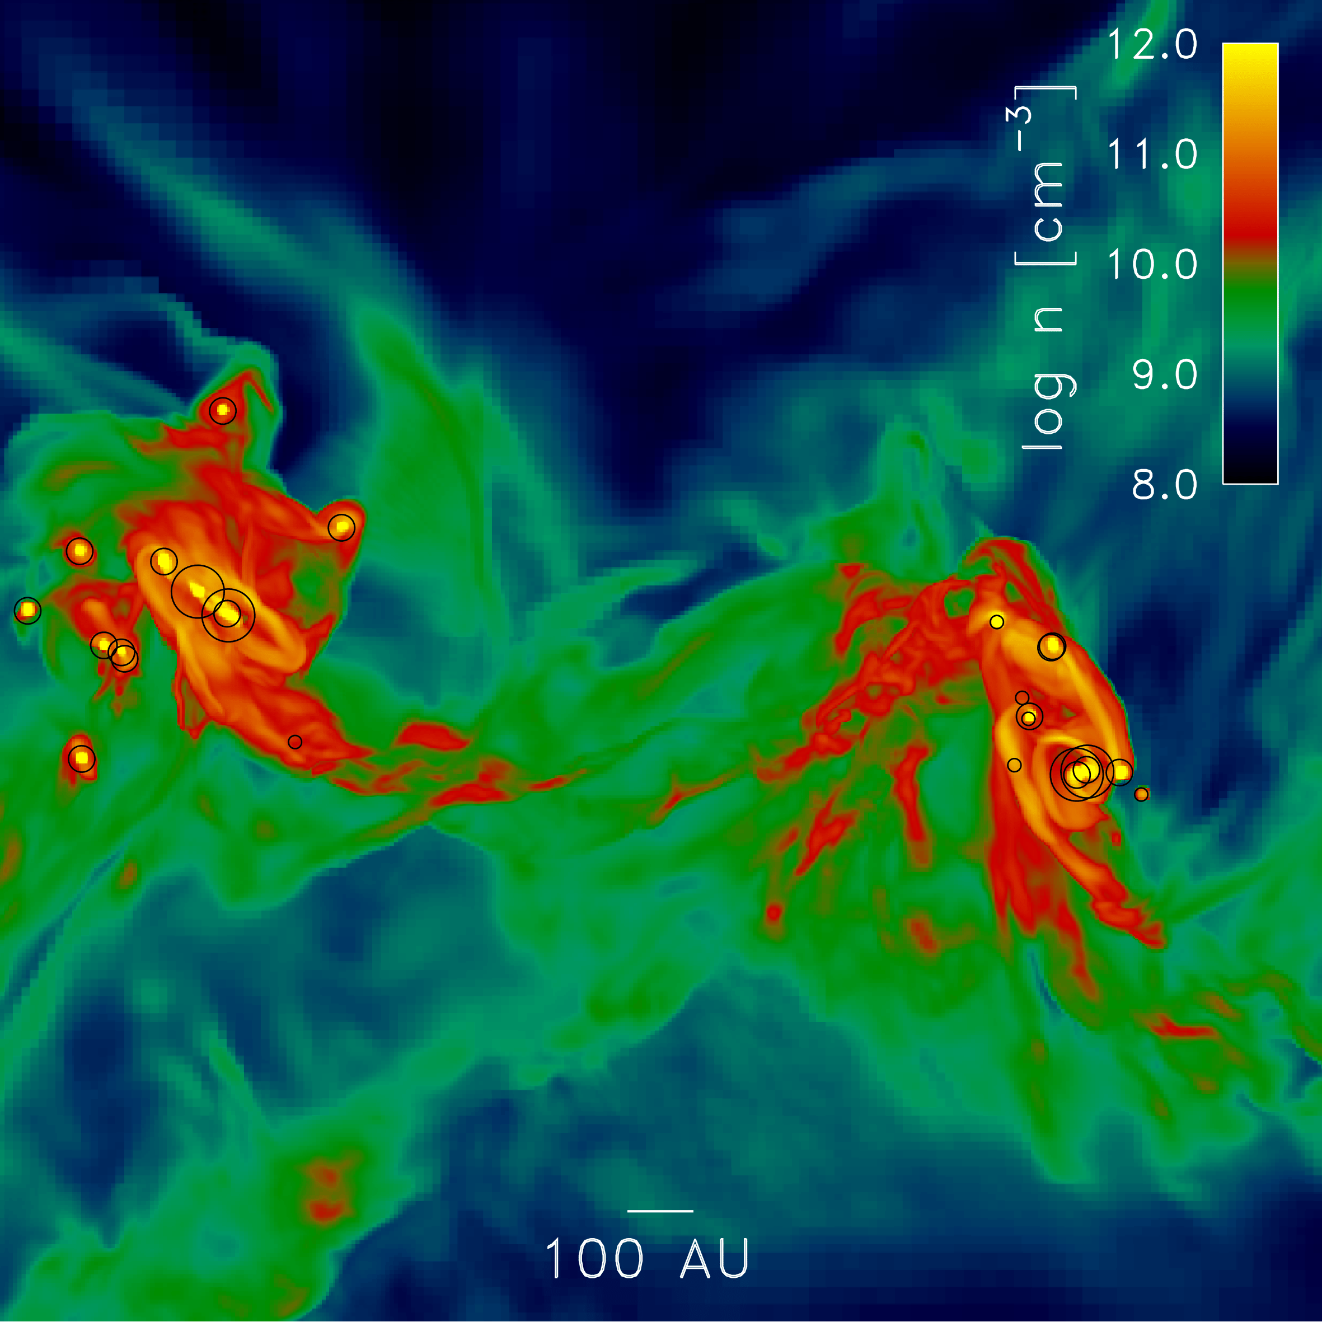
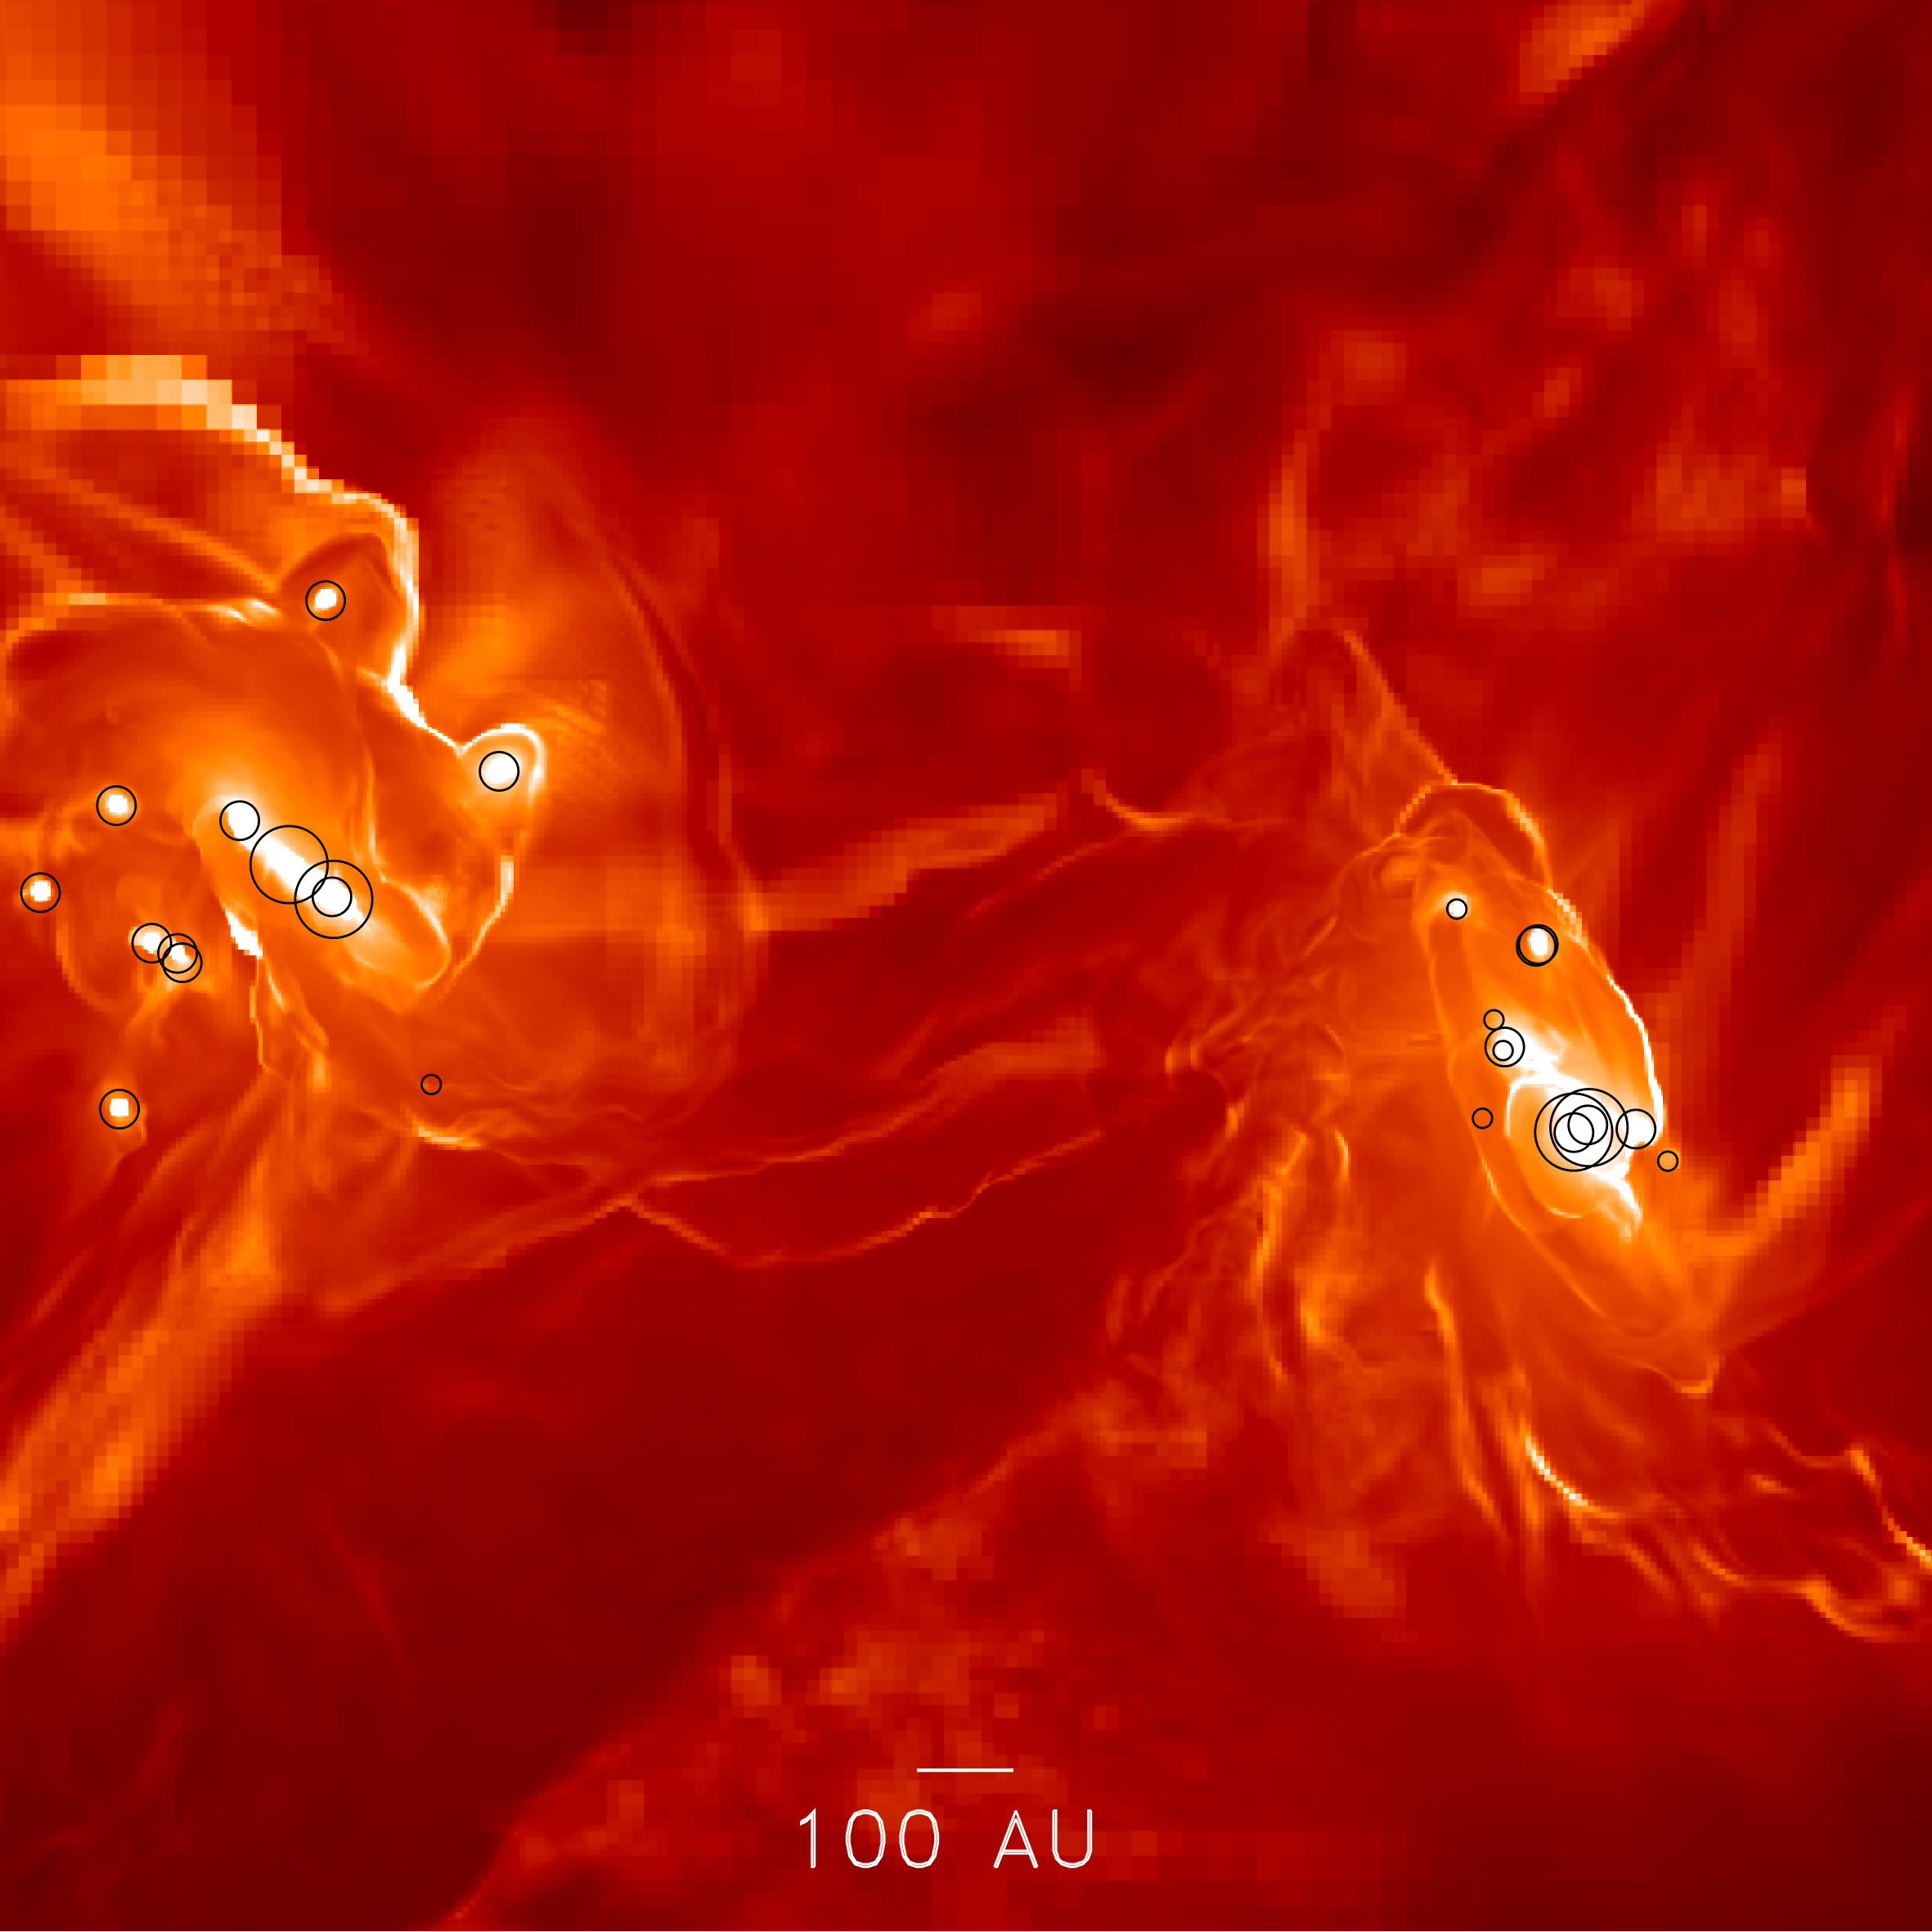
Formation in Discy Flows
Star forming discs at the core of the flow
Density Projection
Temperature Projection

Slide 16
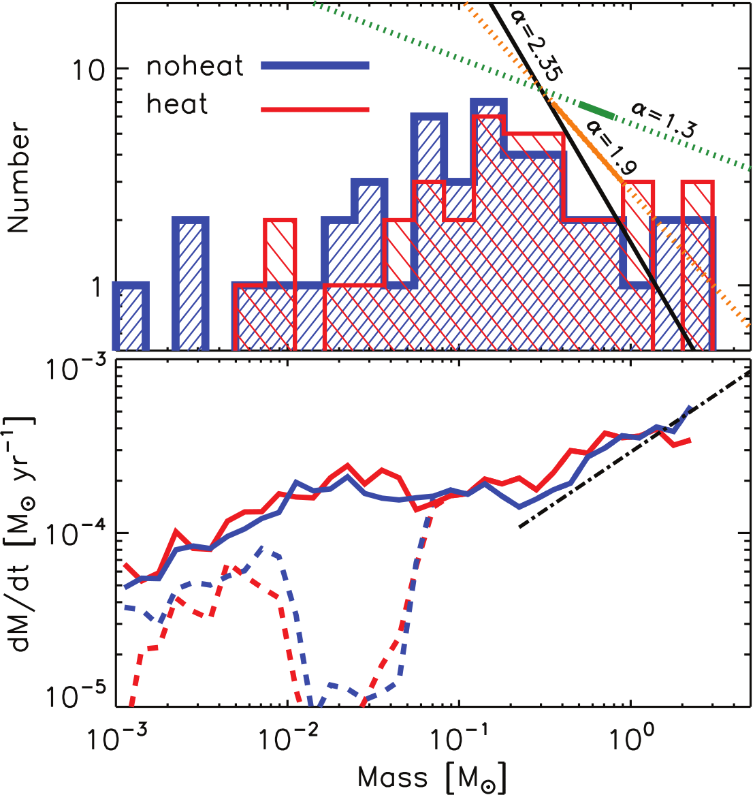
Sink Mass Function

Slide 17
Sink Accretion over Time

Slide 18
Summary
Explored to high resolution the first stages of star formation of the first metal stars
Sink IMF is tentatively consistent with UDF galaxies
Dust heating affects low mass fragmentation

Slide 19
What to do from here....
Characterization of role of turbulence
Inclusion of magnetic field support (MHD)
More realistic metal population model (explore inhomogeneities)

Slide 20
With much more computing power...
Higher resolution to resolve ALL fragmentation
Run simulation much longer
  Requires larger box (boundary conditions problems)
  higher resolution
  Would need to worry about SF feedback
Currently unfeasible:
  Full box simulation down to current res, not cut out

