Slide 1
The equations of Stellar Evolution

Slide 2
Local Thermodynamic Equilibrium
When mean free path < system dimensions
LTE (Local thermodynamic equilibrium)
i.e. different temperatures at different places
T=T(position)…a temperature distribution
When the time between collisions < t(change of system macroscopic properties)
→ Thermodynamic Equilibrium

Slide 3
Planck Distribution
Photon mean free path << R_{star}
→Blackbody radiation (Planck function)
TRUE In stellar interiors,
not true everywhere else!
Eg Solar Radiation at 5800 K passing through
Earth’s atmosphere
Trad = 5800K
Tgas = 300K (20X lower!)
**CRITICAL SIMPLIFICATION BECAUSE…

Slide 4
LTE CONTINUED
LTE→ CAN CALCULATE ALL THERMODYNAMIC PROPERTIES IN TERMS OF :
TEMPERATURE, DENSITY, COMPOSITION as f(r).
Thus STRUCTURE for a star of mass M is:
At given time t, specify ρ, T, X_{i} at each point.
Evolution : ρ(m,t), T(m,t), and X_{i}(m,t) at each point

Slide 5
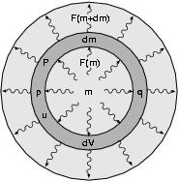
Spherical shell within a star and the heat flow into and out of it
The Energy Equation
1st Law (conservation of energy) →
delta (internal energy)= heat + work

Slide 6
definitions
U= internal energy/unit mass
P=pressure
δf=small change in quantity f during δt
Q=heat dQ>0 →heat absorbed
W=work dW>0 → work done on mass
δ(dm) = 0 conservation of mass
q= rate of nuclear energy release
F(m) = heat flowing through a surface

Slide 7
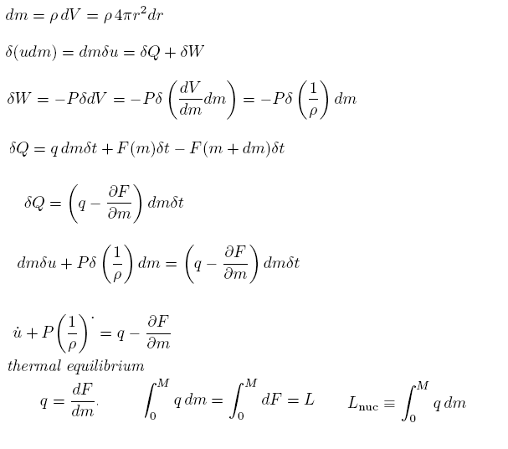
The Energy Equation
Typo!!
L star = Lnuc

Slide 8
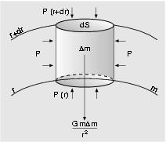
The Equations of Stellar Structure and Evolution
The equation of motion
Cylindrical mass element within a star

Slide 9
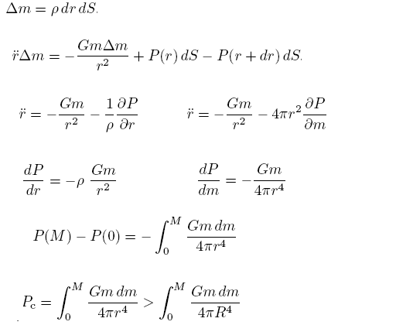
The equation of motion
> GM²/8πR⁴
> 450 MILLION ATMOSPHERES!

Slide 10
The Virial Theorem
Hydrostatic Equilibrium links
GRAVITATIONAL POTENTIAL ENERGY
TO
INTERNAL ENERGY
THESE ARE INTIMATELY CONNECTED

Slide 11
Hydrostatic Equilibrium
dP/dm = -Gm/4πr⁴ (hydrostatic equilibrium)
And multiply LHS by V
And RHS by (4/3)πr³
Then integrate over the whole star →

Slide 12
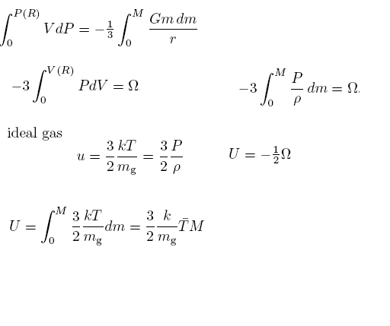
The virial theorem
=(1/3)Ω=Grav. Pot. Energy
Integrate by parts
Special Case: ideal gas
Internal Energy of a star =
-(1/2) Gravitational Potential Energy

Slide 13
Estimate the Temperature of the Sun
Ω=-αGM²/R gravitational potential energy
α~1, depends on density profile in the star
By the virial theorem U = (1/2) αGM²/R
But U = (3/2)(k/m)T_{av}M
Where Tav is average Temp integrated over the entire star
Thus T_{av}=(α/3)(m/k)(GM/R)
For α = 0.5, and pure hydrogen
T_{av(star)} =4 x 10⁶ (M/Mo)(Ro/R) Kelvin
All hydrogen + helium is ionized
Most other elements are mostly ionized
Tcenter > 4 x 10⁶ Kelvins

Slide 14
The Total energy of a Star
dE/dt = d/dt (U + K + Ω) = L_{nuc}-L
Thermal equilibrium → d/dt = 0
In hydrostatic equilibrium K =0
Internal Energy of a star = U
-(1/2) Gravitational Potential Energy =-1/2 Ω
Each of U and Ω is conserved SEPARATELY, not just their sum!
Hence
As stars lose energy they get hotter→
NEGATIVE SPECIFIC HEAT

Slide 15
Where did that come from??
E=U+Ω = Ω/2 = -U for a perfect gas
If dE/dt <0 → dU/dt >0
Since U = (3/2)(k/m)T_{av}M
hence dT/dt >0
ie a star LOSES ENERGY AND GETS HOTTER
Also T_{av}=(α/3)(m/k)(GM/R)
Hence, since M, m are constant →
R must decrease as T increases
→ Cores of stars inexorably get hotter and denser

Slide 16
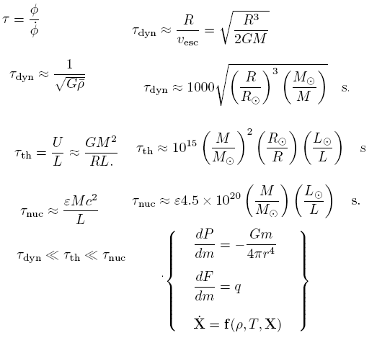
Stellar Timescales

Slide 17
Implications of Dynamical Timescales
Loss of HSE → Changes Observable in minutes to hours (eg Supernova)
t _{oscillation} → average density of a star
t_{Sun =} 15 minutes
So average density =1.4 gm/cm³
t _{White dwarf} = 1 second
So average density = 10⁶ gm/cm³
Stars evolve quasi-statically

Slide 18
Thermal Timescales
Tsun ~ 3 x 10⁷ years
= “Kelvin – Helmholtz time”
Due to the Sun’s heat reservoir

Slide 19
Nuclear Timescales
What is efficiency for nuclear reactions?
~ 10⁻³ ~ binding energy of nucleon/rest mass
~ Mev/Bev
Since this timescale is SO LONG, nuclear
Equilibrium throughout a star is NOT EXPECTED, EVER!

Slide 20
t_{dynamic} <<t _{thermal} <<t _{nuclear}

Slide 21
Prescription for Stellar Evolution
Must observe or assume an initial composition
HSE of any model occurs in hours
Thermal equilibrium occurs in 10⁷ yrs
Then follow the nuclear reactions and chemical changes to change the models will in quasi-HSE and TE.

