Slide 1
The Equation of State
P=P(ρ, T, X) is called the equation of state
We previously assumed a perfect gas,
i.e. free, non-interacting particles…but gases are ionized, hence free electrons and ions.
Is the Coulomb energy negligible relative to the thermal energy?

Slide 2
Coulomb/Thermal Energy Ratio
Mean interparticle distance = d
d= (Am_{H}/ρ_{av})^{1/3} = (4πAm_{H}/3M)^{1/3} R
Particle charge = Ze, then the Coulomb energy/particle is ε_{c}
ε_{c} ~ (1/4πε₀) Z²e²/d
The kinetic (thermal) energy ~ kT/particle so
Using T_{av}=(α/3)(m/k)(GM/R)
Then ε_{c}/kT ~ (1/4πε₀) Z²e²/(A^{4/3}m_{H}^{4/3}GM^{2/3})
~1% for Z=1 A=1 and M= Msun
Note for higher Z, A~ 2 Z and ε_{c}/kT ~Z^{2/3} <1 even
for iron.

Slide 3
Lower Mass objects
Again ε_{c}/kT ~ (1/4πε₀) Z²e²/(A^{4/3}m_{H}^{4/3}GM^{2/3})
Even for hydrogen,
ε_{c}/kT >1 for M < 10⁻³ Msun ~ M_{Jupiter}
THUS PLANETS DEMAND MORE COMPLICATED EQUATIONS OF STATE
AND
SMALLER PLANET → MORE “SOLID”

Slide 4
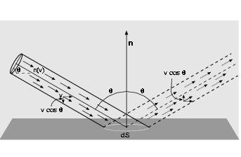
The Pressure Integral

Slide 5
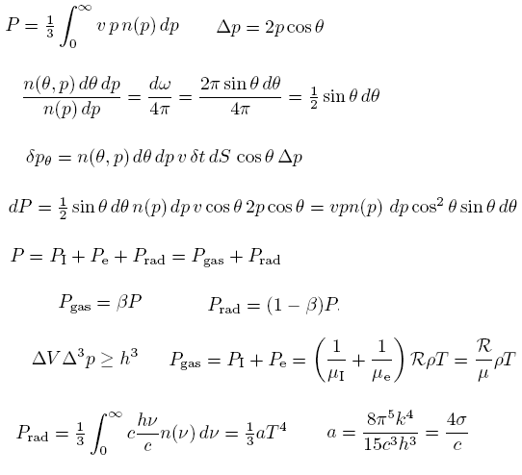
The pressure Integral
If n(p)dp is a
maxwellian
If n(ν)dν is a Planck
distribution

Slide 6
Other Assumptions?
Classical Mechanics:
Ignore Relativity
Ignore Quantum Mechanics
CANNOT BE NEGLECTED IN MOST STELLAR INTERIORS
→ DEGENERACY PRESSURE>> P(perfect gas)

Slide 7
Degenerate Electron Pressure section 3.3 and Appendix B - Prialnik
DVD³p >= h³ Heisenberg Uncertainty Principle
DV a r-1 Electrons Fiercely resist compression
P_{e,deg} = K ( r/m_{e})^{g} INDEPENDENT OF TEMPERATURE
When electron momentum exceeds gas ion momentum
g=5/3 nonrelativistic
g=4/3 relativistic
m_{e} = average number of nucleons per electron
= r/m_{H}n_{e}

Slide 8
Internal Energy of gas and radiation Adiabatic Exponents (Secs. 3.5 and 3.6)
Specific Energy of a classical ideal gas OR degenerate classical gas
u_{gas} = 3/2 (P_{gas}/r) (1)
For a relativistic degenerate gas u_{gas} = 3 (P_{gas}/r) (2)
For radiation it’s u_{rad} = 3 (P_{rad}/r) (3)
1st law of thermodynamics for adiabatic process (no heat exchange)
du + PdV = du + P d(1/r) = 0 (4)
From specific energy equations 1-3 above
u = f P/r (5)
Differentiating (5) and substituting (4) yields
P a r^{f+1/f} P= Krg where g is the adiabatic index

Slide 9
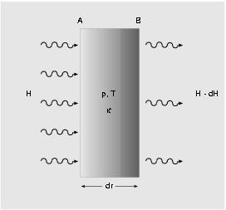
Radiative Transfer
Radiation flux passing through a slab

Slide 10
The Opacity κ
(κρ)⁻¹ ~ L = the absorption length = the mean free path of a photon
τ= optical depth; a measure of transparency
dτ = - κρ dr
An opaque medium has high opacity and/or high density and/or large physical depth
τ=1 defines a stellar photosphere, where T=T_{eff}
dP/dτ = g/κ is useful in stellar atmospheres
(from HSE and g=GM/r²)

Slide 11
Opacity Sources
κ=κ(ν,T,ρ)
Mostly due to electrons (m_{el} <<m_{ions})
(a)Electron Scattering
(Photon energy is unchanged)
(b)Free-Free Absorption
(Photon absorption by a free electron)
NOTE: Free-Free Emission =bremsstrahlung
(c)Bound-Free Absorption=photoionization
NOTE: Free-Bound emission=radiative recombination
(d)Bound-bound absorption

Slide 12
Opacity – Cont’d
In Stellar Interiors, photon energies~1 kev
Because Tcore/Tsurf ~ 1000 (eg Sun 5 Million/5000)
And visible photons have ~ 1 ev
Most atoms are ionized →No bound-free or bound-bound
→only free-free absorption and electron scattering contribute significantly to opacity
Remarkably, we find κ = κ₀ρªT^{b}
Electron Scattering a=b=0 κ = 0.4
Free-Free (Kramer’s Law) a=1 b=-7/2
◊ κ = κ₀ρT^{-7/2}

Slide 13
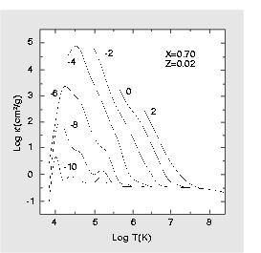
Opacity coefficients for a solar composition as a function of temperature for different density values
κ α T^{-7/2}
Floor of 0.4 set
By electron scattering

Slide 14
Opacity
In the interior on the main sequence and within the helium
core for later burning stages, electron opacity dominates.
In its simplest form:

Slide 15
There are correction terms that must be applied to κ_{es} especially at
high temperature and density
The relativistic electron-scattering cross section and Thomson cross section
differ at high energy. The actual cross section is smaller.
2) Degeneracy – at high density the phase space for the scattered electron
is less. This decreases the scattering cross section.
3) Incomplete ionization – Use the Saha equation 3.54 (Prialnik)
4) Electron positron pairs may increase κ at high temperature.

Slide 16
Electron conduction is not very important in massive stars but is
Critical in white dwarfs and therefore
the precursors to Type Ia supernovae;
IT CAN DOMINATE OVER RADIATIVE TRANSPORT

Slide 17
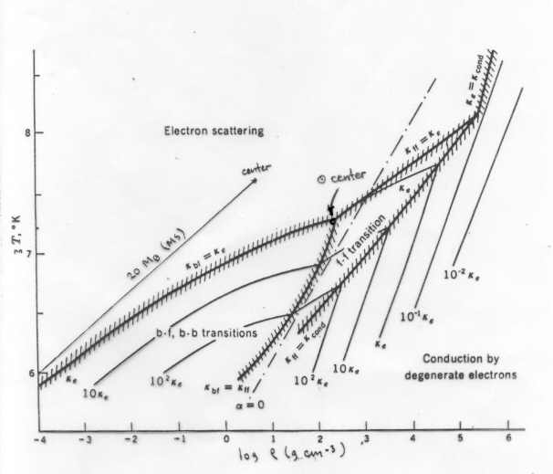
Which Process Dominates?

Slide 18
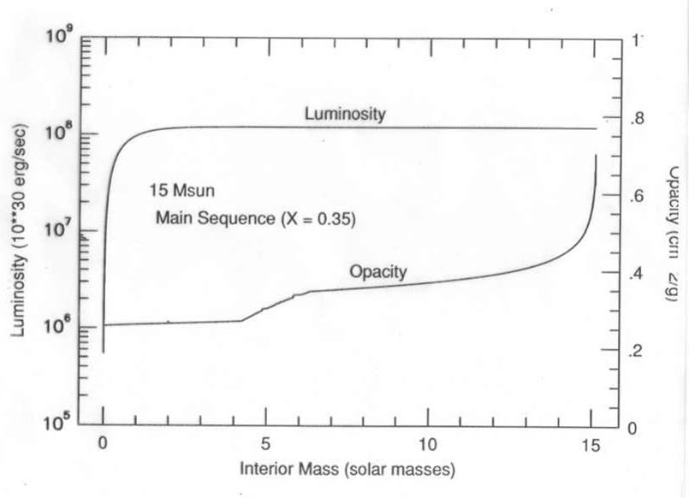

Slide 19
Opacity- Cont’d
Average opacity of solar material is ~ 1 cm² /gm
Average density in the Sun is ~ 1 gm/cm³
Hence mfp ~ (κρ)⁻¹ ~ L = the absorption length = the mean free path of a photon ~ 1 cm
Since dT/dr ~ 10⁷ Kelvin/10¹⁰ cm, thus
dT ~ 0.001 Kelvin over 1 mfp → Blackbody
This tiny deviation from isotropy →flux outwards

Slide 20
Radiation flux passing through a slab

Slide 21
Radiative Flux
The slab absorbs radiation, hence momentum per unit time = dp/dt = |dH|/c =-κHρdr
= Rate of momentum increase =
net force applied to slab (Newton’s 2nd law)
=P_{rad}(r) – P_{rad}(r+dr)= -(dP_{rad}/dr)dr
κHρ/c = - dP/dr but P = (1/3)aT⁴
H = -(4acT³/3κρ)dT/dr

Slide 22
Radiative Flux Equation
H = -(4acT³/3κρ)dT/dr
The total flux F crossing a spherical surface of radius r is 4πr²H, so
F = -4πr² (4acT³/3κρ)dT/dr
Solve for dT/dr = (3/4ac)(κρ/T³)(F/(4πr²)²) or
dT/dm = (3/4ac)(κ/T³)(F/(4πr²)²)
Which is the final equation of stellar structure

