Slide 1
Simultaneous ram pressure and tidal stripping; how dwarf spheroidals lost their gas
Lucio Mayer, Chiara Mastropietro, James Wadsley, Joachim Stadel, Ben Moore

Slide 2
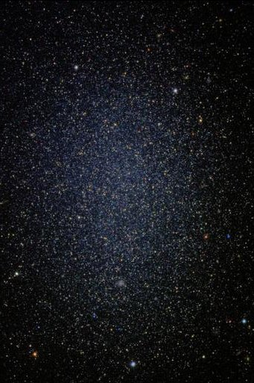
Dwarf Spheroidal
Extremely faint galaxies
No significant recent star formation
Gas poor to devoid of gas
Leo I dSph
250 kpc

Slide 3
Dwarf Spheroidal
Extremely faint galaxies (visual Mag < -14)
No significant recent star formation
Gas poor to devoid of gas
Leo I dSph
250 kpc

Slide 4
Dwarf Spheroidal
Extremely faint galaxies (visual Mag < -14)
No significant recent star formation
Gas poor to devoid of gas
Possible gas loss during via reionization
Leo I dSph
250 kpc

Slide 5
Dwarf Spheroidal
Extremely faint galaxies (visual Mag < -14)
No significant recent star formation
Gas poor to devoid of gas
Possible gas loss during via reionization
Leo I dSph
250 kpc
But what about density morphology relationship?

Slide 6
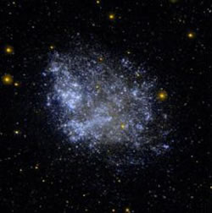
Dwarf Spheroidal
Dwarf Irregular
IC 1613
~730 kpc
Leo I dSph
250 kpc
Faint, like dSph... but:
Gas-rich with recent SF
Disc-like
Exponential surface brightness

Slide 7
Dwarf Spheroidal
Dwarf Irregular
Preferentially found in
low density regions
Significant stellar rotation
Found as satellites close to a host
Pressure supported

Slide 8
Dwarf Spheroidal
Dwarf Irregular
Is there an
evolutionary path
?

Slide 9
Dwarf Spheroidal
Dwarf Irregular
Is there an
evolutionary path
?
Supernova / Stellar Feedback

Slide 10
Dwarf Spheroidal
Dwarf Irregular
Is there an
evolutionary path
?
Ram Pressure Stripping
Tidal Stripping and Interactions
Supernova / Stellar Feedback

Slide 11
Dwarf Spheroidal
Dwarf Irregular
Is there an
evolutionary path
?
Ram Pressure Stripping
Tidal Stripping and Interactions
Supernova / Stellar Feedback
Possible Associated SF

Slide 12
Dwarf Spheroidal
Dwarf Irregular
Is there an
evolutionary path
?
Focus of Mayer et. al. 2006
Ram Pressure Stripping
Tidal Stripping and Interactions
Supernova / Stellar Feedback
Possible Associated SF

Slide 13
Simulation Design: Galaxy Model
Dwarf: Gas + stars in disc + live NFW halo
Host: Live NFW halo (no disk)
Hot Corona - 10⁶ K and 8 x 10⁻⁵ cm⁻³ at 50 kpc
3 Dwarfs: Peak rotation velocity = 28, 42, 62 km/s
Concentration = 4, 20, 4
Disc mass ~ 4% of total mass

Slide 14
Simulation Design: Galaxy Model
Dwarf: Gas + stars in disc + live NFW halo
Host: Live NFW halo (no disk)
Hot Corona - 10⁶ K and 8 x 10⁻⁵ cm⁻³ at 50 kpc
3 Dwarfs: Peak rotation velocity = 28, 42, 62 km/s
Concentration = 4, 20, 4
Disc mass ~ 4% of total mass
Resolution:
Dwarf: 3x10⁵ (DM) + 3x10⁴ (stars + gas)
Host : 5x10⁵ (DM) + 5x10⁵ (hot gas)

Slide 15
Dwarf Galaxy Orbits
Bound, eccentric orbits with rapo/rperi = 5
250 kpc / 50 kpc OR 150 kpc / 30 kpc
Orbital times ~ 3.2 OR 1.2 Gyr
Simulate 3 – 5 orbits
Disc begin at 60 degree incline to orbit

Slide 16
Simulation Code
GASOLINE – Tree+SPH code
Physics Varied in Simulations:
Radiative Cooling: On or Off (adiabatic cooling)
UV Background : On in some RC runs
Wind Tunnel : Some RPS only runs

Slide 17
Wind Tunnel Tests
0.05 Gyr
0.3 Gyr
NO RC
RC
RC, i = 90

Slide 18
Example of Complete RPS
0.05 Gyr
30 kpc
Peak Velocity = 28 km/s
c = 4
Radiative Cooling ON
0.3 Gyr
Stellar Disk
Trailing Gas Clumps
10 kpc

Slide 19
Tides Alone
v_peak -= 40 km/s

Slide 20
t = 0 Gyr:
- Adiabatic
- Peak Vel ~ 62 km/s
- Concen. c = 4
- Gas Mass = 450 Msun
1.7 Gyr after First Pericenter Passage
Stars
Gas
100 kpc
30 kpc

Slide 21
t = 1.7 Gyr
3.0 Gyr after First Pericenter Passage
Stars
Gas
50 kpc
50 kpc

Slide 22
t = 3.0 Gyr
6.0 Gyr after Second Pericenter Passage
Stars
Gas
Final Gas Mass:
60 Msun
(450 Msun Initial)
50 kpc
50 kpc

Slide 23
Complete RPS Dwarf + Tidal Effects
After 2nd
Pericenter
Stars
Gas
t = 1.7 Gyr
After 2nd
Pericenter
t = 6.0 Gyr
10 kpc
10 kpc

Slide 24
RC + Photoionization
RC – No UV
RC – UV Background
5 Gyr after 3rd pericenter passage

Slide 25
Results Summary
RPS + Tids → 50 – 100% gas mass loss
Greater loss with closer pericenters
UV ionizes gas (M_HI < 0.01 Mstar)
Vpeak < 30 km/s always stripped
Vpeak > 60 km/s always retains gas
  Potential dwarf elliptical progenitors

Slide 26
Fate of Stripped Gas
t = 1.5 Gyr
200 kpc
200 kpc
Density Map
Vpeak = 40 - RC
Vpeak = 40 – RC + UV

Slide 27
Fate of Stripped Gas: Clumps
t = 1.5 Gyr
40 kpc
Temperature
Zooming in on
the gas clumps
Vpeak = 40 - RC

Slide 28
Conclusions
RPS alone in some small dwarfs
Compressional heating enhances RPS w/o RC
Tides + RPS enhance total stripping
Tidal bar formation limits RPS
Realistic baryon content and M/L
Cloud fragments with RC realistic

