Slide 1
Exercises Session on Fault Detection
Federico Antonello
federico.antonello@polimi.it

Slide 2
In this Exercise Session
Exercise 1
Method: AAKR
Component: Gas Turbine
Homework 1
Method: PCA
Component: Gas Turbine
Homework 2
Method: you choose
Component: Wind Turbine

Slide 3
Exercise 1
Component: Gas Turbine

Slide 4
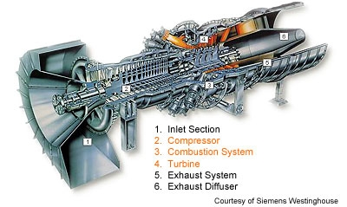
Gas Turbine

Slide 5
Measured Signals
Temperature location 1 (°C)
Temperature location 2 (°C)
Temperature location 3 (°C)
Temperature location 4 (°C)
Temperature location 5 (°C)
Temperature location 6 (°C)

Slide 6
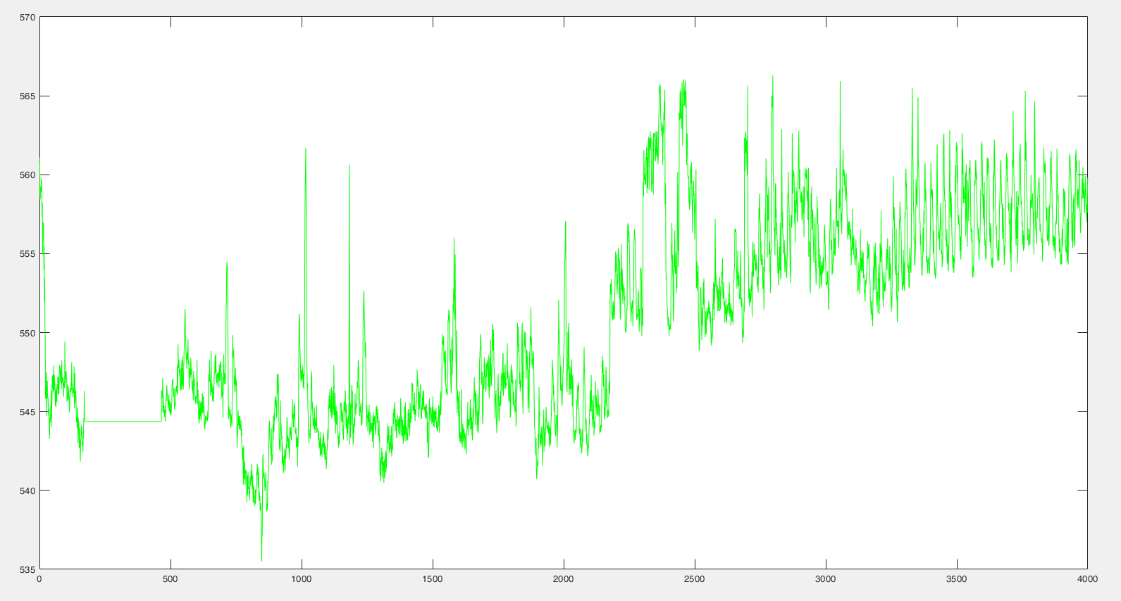
Available Data
Train.dat → Normal condition data [6 signals, 4000 data points, frequency: 5200 measuraments/year]
Temperature location 6 (°C)

Slide 7
Available Data
Validation.dat → Normal condition data [6 signals, 2500 data points, frequency: 5200 measuraments/year]
Temperature location 6 (°C)

Slide 8
Exercise 1
Method:AAKR

Slide 9






Fault Detection using AAKR for signal reconstruction
${\hat{x}}_{1}^{nc}$
SIGNAL RECONSTRUCTIONS
MEASURED SIGNALS
MODEL OF COMPONENT BEHAVIOR IN NORMAL CONDITIONS (AAKR)
t
$$x_{1}^{obs}$$
${\hat{x}}_{2}^{nc}$
t
t
$$x_{2}^{obs}$$
COMPARISON
(-)
t
${\hat{x}}_{1}^{nc}−x_{1}^{obs}$
${\hat{x}}_{2}^{nc}−x_{2}^{obs}$
…
…
RESIDUALS
t
t
DECISION
NORMAL
CONDITION:
No maintenance
ABNORMAL
CONDITION:
maintenance required

Slide 10
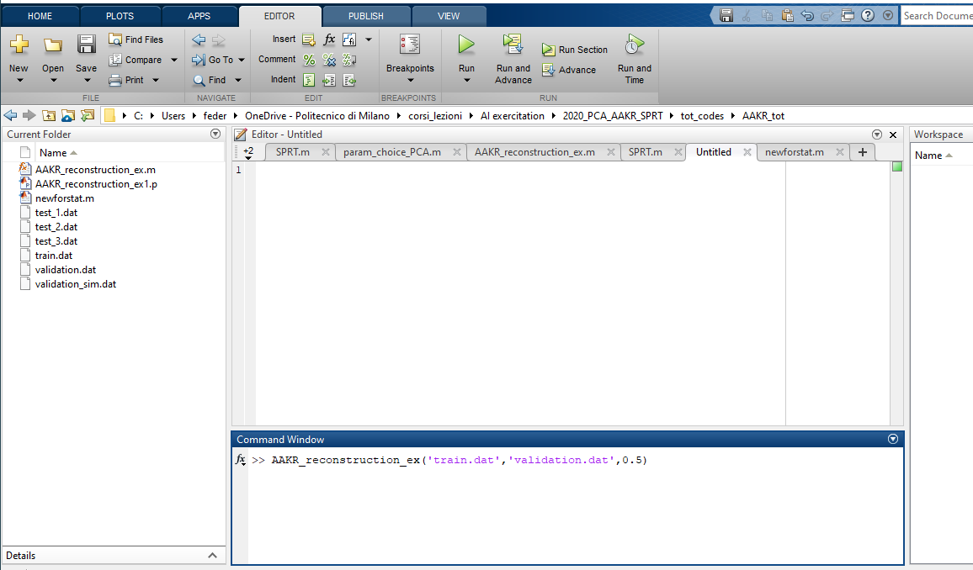
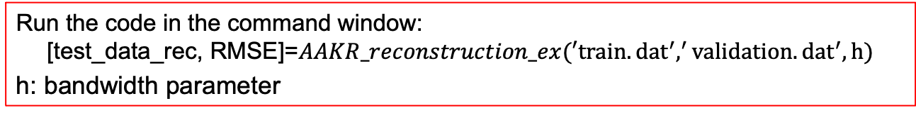
The AAKR code in Matlab: how to run the code?
Set as the current folder the folder ‘AAKR’
Run the code in the command window:
$$\text{[}\text{test}\text{_}\text{data}\text{_}\text{rec}\text{, }\text{RMSE}\text{]=}AAKR_reconstruction_ex(′train.{dat}^{′},^{′}validation.{dat}^{′},h)$$
h: bandwidth parameter

Slide 11
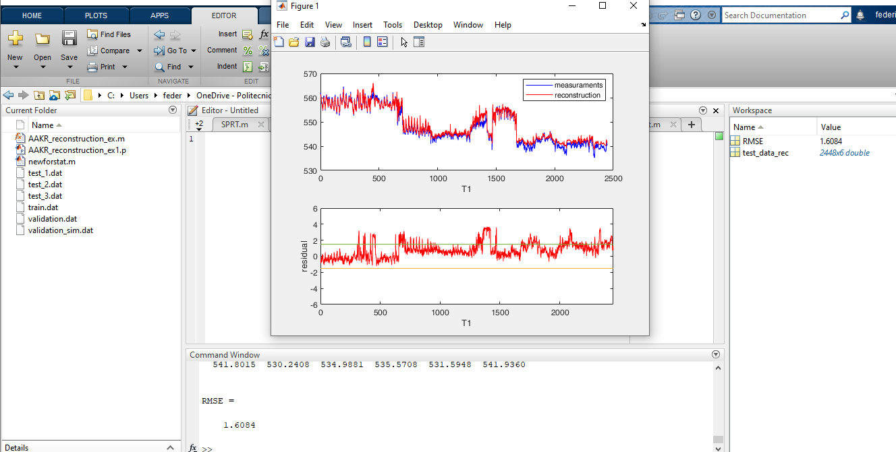
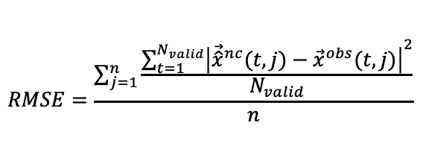
The AAKR code in Matlab: Output
The reconstruction obtained using the AAKR algorithm
The Root Mean Square Error:
6 figures (one for each signal) representing:
The original data and the reconstruction obtained using the AAKR algorithm
The residual for each data point
$$RMSE=\frac{\sum_{j=1}^{n}{\frac{\sum_{t=1}^{N_{valid}}{{\left|{\vec{\hat{x}}}^{nc}(t,j)−{\vec{x}}^{obs}(t,j)\right|}^{2}}}{N_{valid}}}}{n}$$

Slide 12
The AAKR code in Matlab: Example
5 minutes
Execute the code in the command window:
$$\text{[}\text{test}\text{_}\text{data}\text{_}\text{rec}\text{, }\text{RMSE}\text{]=}AAKR_reconstruction_ex(′train.{dat}^{′},^{′}validation.{dat}^{′},h)$$
Run the algorithm considering the bandwidth parameter h=0.1

Slide 13
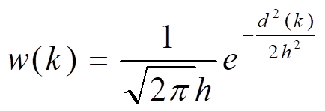
Exercise 1
Method: AAKR
Setting the model parameter:
h =bandwidth parameter
Objective: ACCURATE and ROBUST reconstruction model

Slide 14
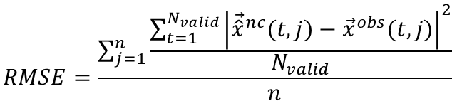
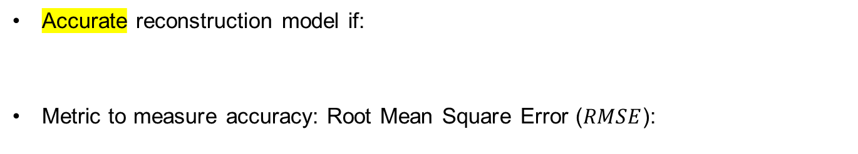

Accuracy
14
Signal
reconstructions
INPUT: NORMAL CONDITION DATA
M
O
D
E
L
t
t
t
t
Accurate reconstruction model if:
Metric to measure accuracy: Root Mean Square Error ($RMSE$):
$${\vec{\hat{x}}}^{nc}≅{ \vec{x}}^{obs}$$
$$RMSE=\frac{\sum_{j=1}^{n}{\frac{\sum_{t=1}^{N_{valid}}{{\left|{\vec{\hat{x}}}^{nc}(t,j)−{\vec{x}}^{obs}(t,j)\right|}^{2}}}{N_{valid}}}}{n}$$

Slide 15
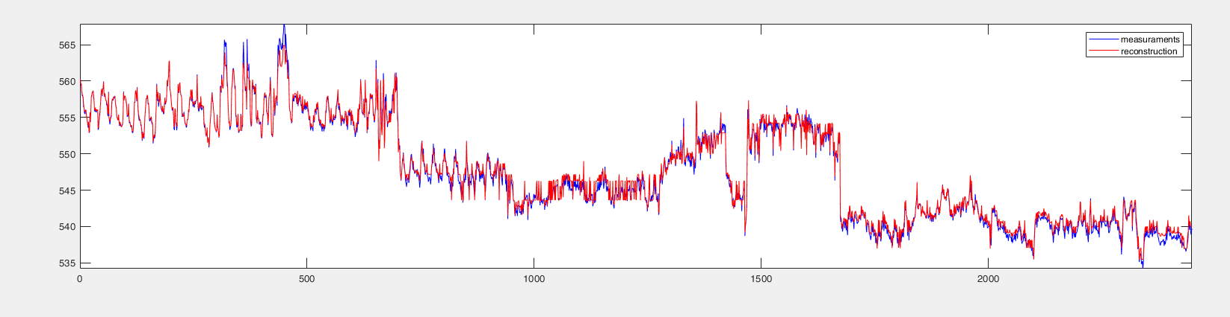
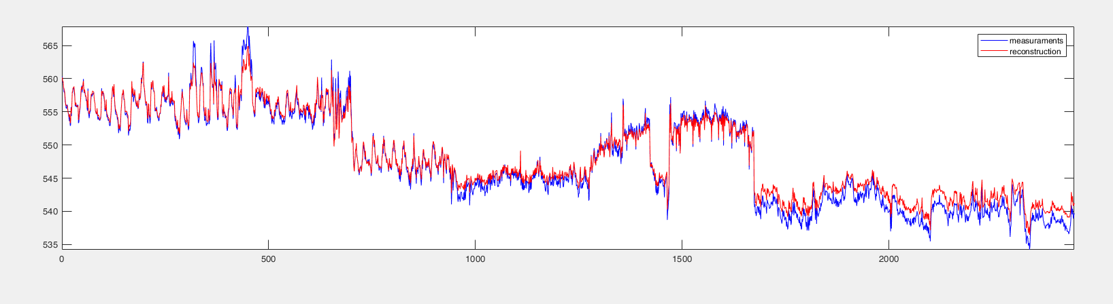
Accuracy – Results wit h=0.05 and h=0.4
Signal 6 normal condition
AAKR
h=0.05
h=0.4
h=0.05 results in a more accurate model

Slide 16

Robustness
16
INPUT: ABNORMAL CONDITION DATA (Typically simulated)
Signal
reconstructions
M
O
D
E
L
t
t
t
t
Robust reconstruction if:
$${\vec{\hat{x}}}^{nc}≅{\vec{x}}^{obs−nc}$$

Slide 17
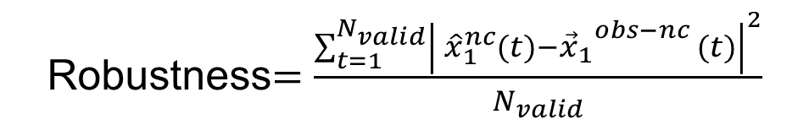
Robustness
17
INPUT: ABNORMAL CONDITION DATA (Typically simulated)
Signal
reconstructions
M
O
D
E
L
OK
t
t
t
t
Robust reconstruction if:
Metric to measure Robustness:
$${\vec{\hat{x}}}^{nc}≅{\vec{x}}^{obs−nc}$$
Reconstruction of the anomaly
Normal condition data (before anomaly simulation)
Robustness$=$ $\frac{\sum_{t=1}^{N_{valid}}{{\left| {\hat{x}}_{1}^{nc}(t)−{{\vec{x}}_{1}}^{obs−nc }(t)\right|}^{2}}}{N_{valid}}$

Slide 18
Verify Robustness in Practice
Signal 6 normal condition
Artificial simulated abnormal condition on signal 6
The other signals remain in normal condition
Signal 6 Abnormal condition
AAKR
-- Signal 6 normal condition
-- Signal 6 abnormal condition
-- AAKR signal reconstruction
The method is robust if AAKK reconstruction is equal to the signal in normal condition

Slide 19
Robustness – Results wit h=0.05 and h=0.4
Signal 6 normal condition
Signal 6 Abnormal condition
not robust but accurate
More robust but less accurate
AAKR
h=0.05
h=0.4
-- Signal 6 normal condition
-- Signal 6 abnormal condition
-- AAKR signal reconstruction
Optimal value of h is a trade off between accuracy and robustness

Slide 20
Code to measure the method robustness
val = load('validation.dat’);
[npat,nsig]=size(val);
anomaly=load('validation_sim.dat’);
[test_reconstruction,rmse]=AAKR_reconstruction('train.dat','validation_sim.dat',0.05);
robustness=sum(((test_reconstruction(:,6)-val(:,6)).^2)/npat)^0.5

Slide 21
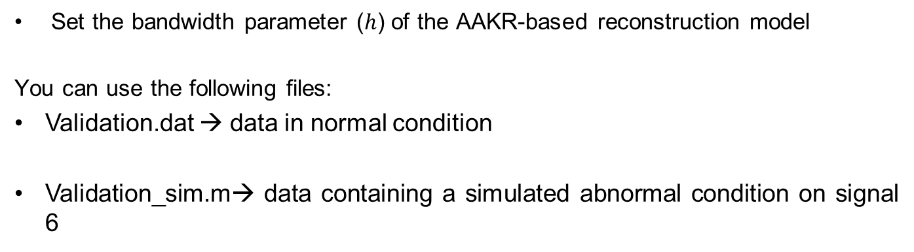
Exercise 1A: Assignment
Set the bandwidth parameter ($h$) of the AAKR-based reconstruction model
You can use the following files:
Validation.dat → data in normal condition
Validation_sim.m→ data containing a simulated abnormal condition on signal 6
30-40 minutes

Slide 22
Exercise 2
Perform the reconstruction of the signal measurements in the 4 files test_1.dat, test_2.dat, test_3.dat and test_4.dat.
In which files can you detect abnormal conditions? Do you have any hypothesis on the type of abnormal condition?
Draw your conclusions on the possibility of using the developed model for fault detection.
30 minutes

Slide 23
2. Analyze residuals with SPRT

Slide 24
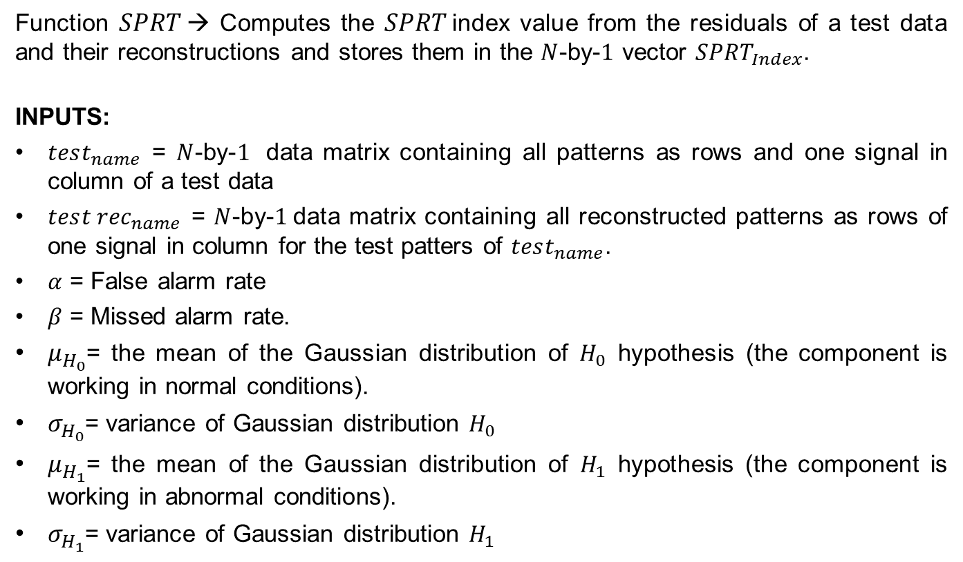
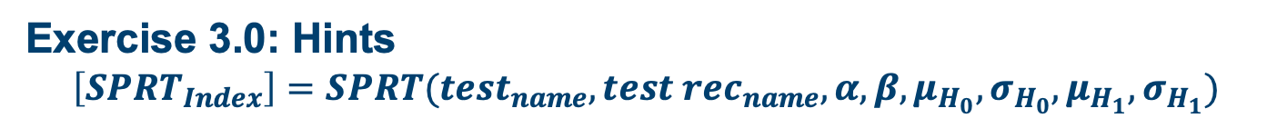
Exercise 3.0: Hints $$\left[SPRT_{Index}\right]=SPRT(test_{name},tes{t rec}_{name}, α,β,μ_{H_{0}},σ_{H_{0}},μ_{H_{1}},σ_{H_{1}})$$
Function $SPRT$→ Computes the $SPRT$index value from the residuals of a test data and their reconstructions and stores them in the $N$-by-$1$ vector $SPRT_{Index}$.
INPUTS:
$test_{name}$ = $N$-by-$1$ data matrix containing all patterns as rows and one signal in column of a test data
$tes{t rec}_{name}$ = $N$-by-$1$data matrix containing all reconstructed patterns as rows of one signal in column for the test patters of $test_{name}$.
$α$ = False alarm rate
$β$ = Missed alarm rate.
$μ_{H_{0}}$= the mean of the Gaussian distribution of $H_{0}$ hypothesis (the component is working in normal conditions).
$σ_{H_{0}}$= variance of Gaussian distribution $H_{0}$
$μ_{H_{1}}$= the mean of the Gaussian distribution of $H_{1}$ hypothesis (the component is working in abnormal conditions).
$σ_{H_{1}}$= variance of Gaussian distribution $H_{1}$

Slide 25
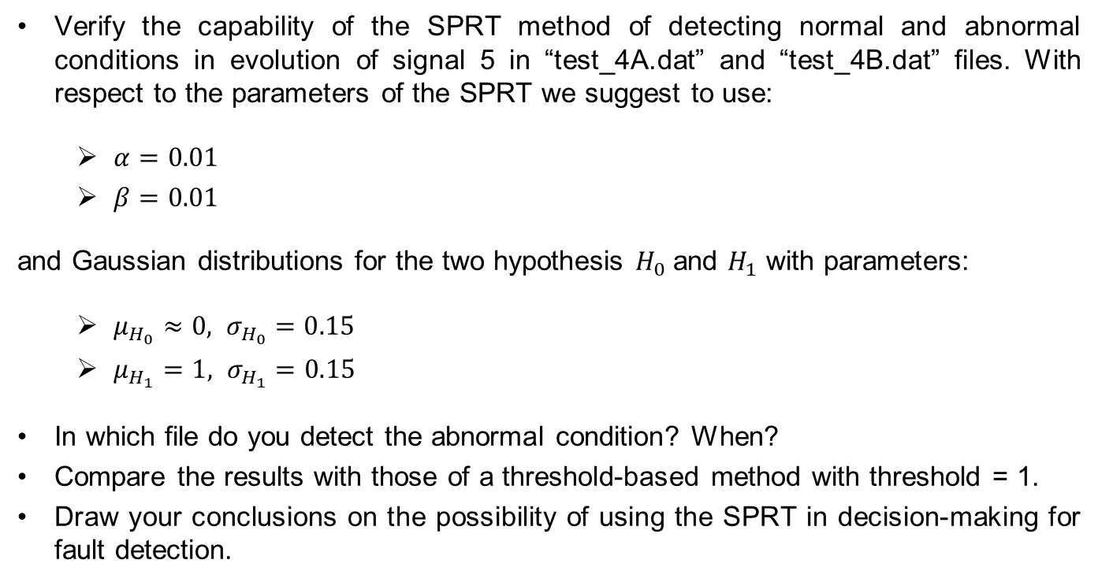
Exercise 3.1
Verify the capability of the SPRT method of detecting normal and abnormal conditions in evolution of signal 5 in “test_4A.dat” and “test_4B.dat” files. With respect to the parameters of the SPRT we suggest to use:
$α=0.01$
$β=0.01$
and Gaussian distributions for the two hypothesis $H_{0}$and $H_{1}$ with parameters:
$μ_{H_{0}}≈0, σ_{H_{0}}=0.15$
$μ_{H_{1}}=1, σ_{H_{1}}=0.15$
In which file do you detect the abnormal condition? When?
Compare the results with those of a threshold-based method with threshold = 1.
Draw your conclusions on the possibility of using the SPRT in decision-making for fault detection.

Slide 26
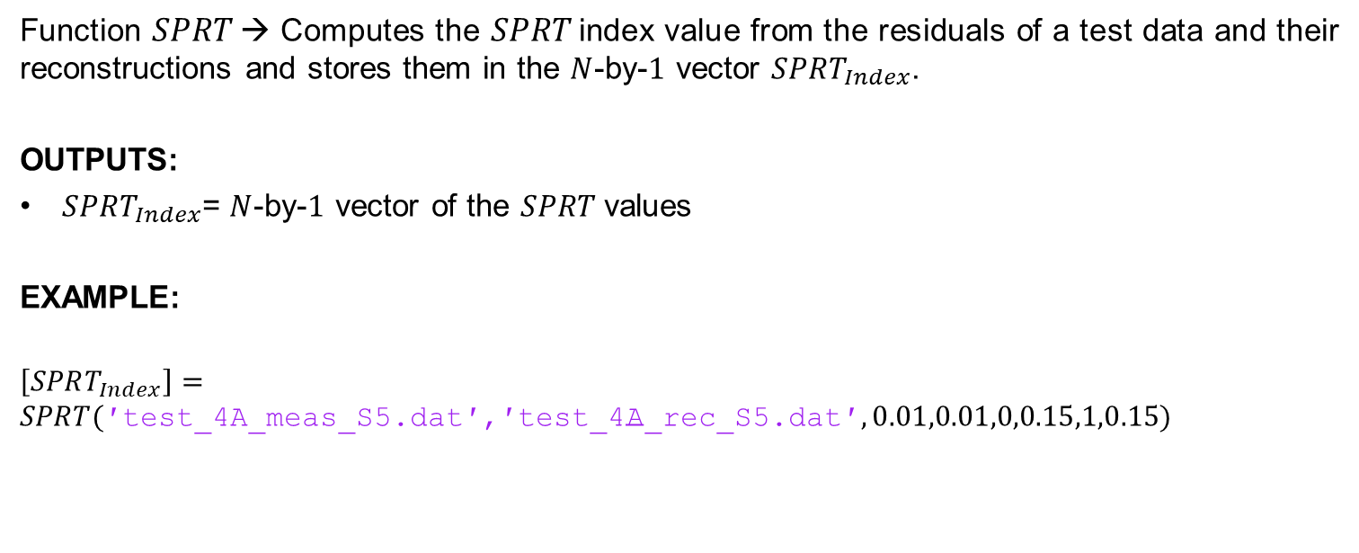
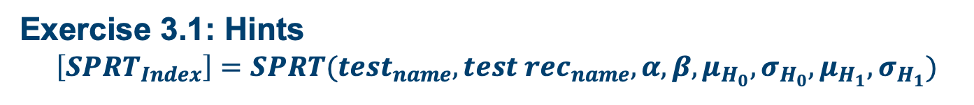
Exercise 3.1: Hints $$\left[SPRT_{Index}\right]=SPRT(test_{name},tes{t rec}_{name}, α,β,μ_{H_{0}},σ_{H_{0}},μ_{H_{1}},σ_{H_{1}})$$
Function $SPRT$→ Computes the $SPRT$index value from the residuals of a test data and their reconstructions and stores them in the $N$-by-$1$ vector $SPRT_{Index}$.
OUTPUTS:
$SPRT_{Index}$= $N$-by-$1$ vector of the $SPRT$values
EXAMPLE:
$$\left[SPRT_{Index}\right]=$$
$$SPRT(\text{′}\text{test}\text{_4}\text{A}\text{_}\text{meas}\text{_}\text{S}\text{5.}\text{dat}\text{′,′}\text{test}\text{_4}\text{A}\text{_}\text{rec}\text{_}\text{S}\text{5.}\text{dat}\text{′}, 0.01,0.01,0,0.15,1,0.15)$$

Slide 27
Second Part

Slide 28
Second Part
Homework 1
Fault detection with PCA considering turbine data
Optimize the PCA to achieve:
a. Accuracy
b. Robustness
2. Analise tests data with the PCA model
3. Compare AAKR and PCA results

Slide 29
Plant Component Monitoring
Component
S1
S2
S6
Signal
Reconstructions
=
Expected signal values in normal conditions
S5
S4
S3
Real
measurements
S1
S1
PCA
Reconstruction Model
S2
S2
S3
S3
S4
S4
S5
S5
S6
S6

Slide 30
PCA

Slide 31
Fault Detection using PCA for signal reconstruction
${\hat{x}}_{1}^{nc}$
SIGNAL RECONSTRUCTIONS
MEASURED SIGNALS
MODEL OF COMPONENT BEHAVIOR IN NORMAL CONDITIONS (PCA)
t
$$x_{1}^{obs}$$
${\hat{x}}_{2}^{nc}$
t
t
$$x_{2}^{obs}$$
COMPARISON
(-)
t
${\hat{x}}_{1}^{nc}−x_{1}^{obs}$
${\hat{x}}_{2}^{nc}−x_{2}^{obs}$
…
…
RESIDUALS
t
t
DECISION
NORMAL
CONDITION:
No maintenance
ABNORMAL
CONDITION:
maintenance required

Slide 32
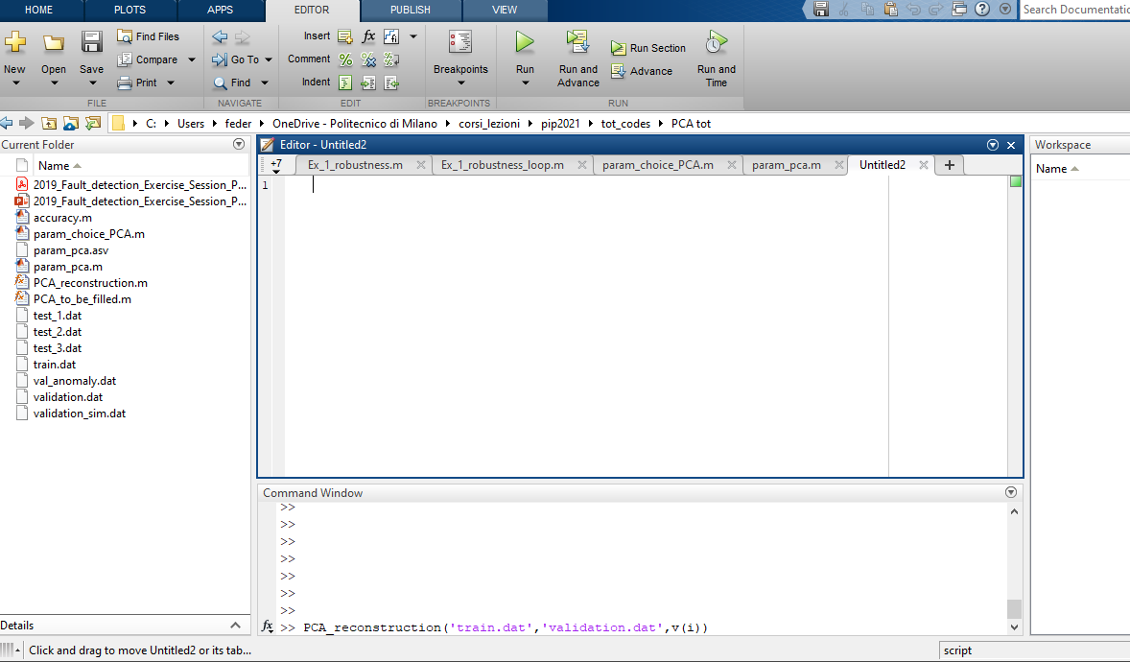
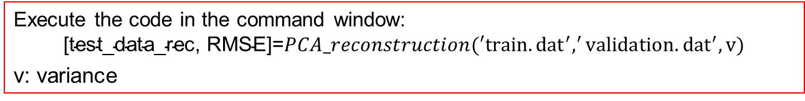
How to use PCA algorithm in Matlab (1): Algorithm execution
Set as the current folder the folder:
‘PCA’
Execute the code in the command window:
$$\text{[}\text{test}\text{_}\text{data}\text{_}\text{rec}\text{, }\text{RMSE}\text{]=}PCA_reconstruction(′train.{dat}^{′},^{′}validation.{dat}^{′},v)$$
v: variance

Slide 33
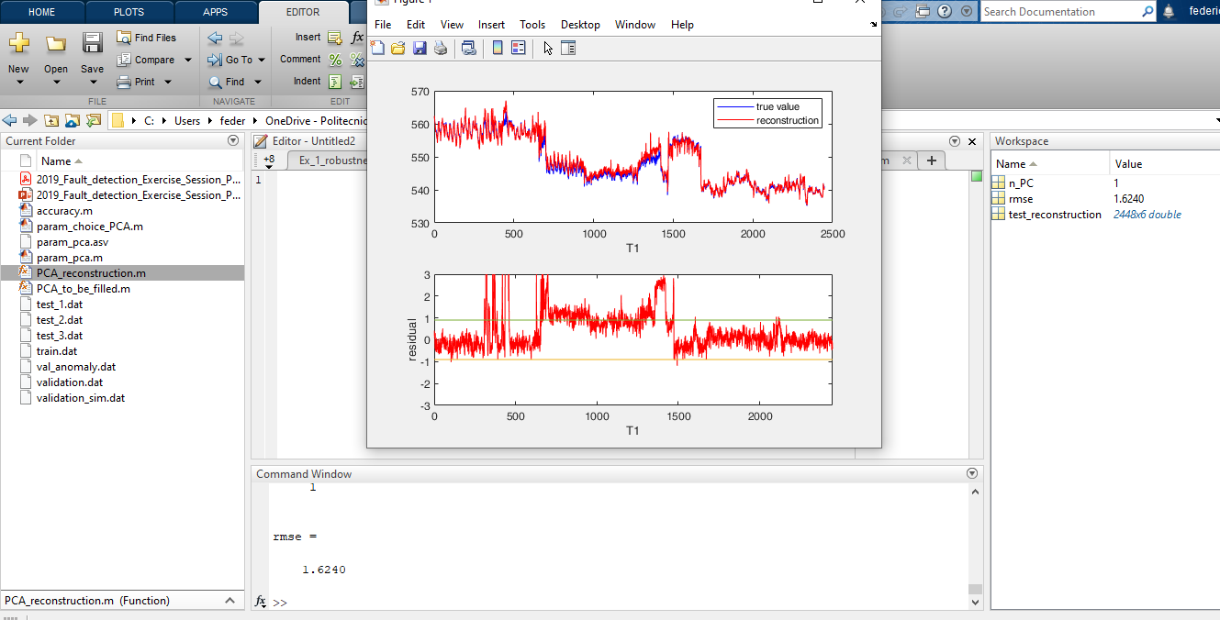
How to use PCA algorithm in Matlab (2) Execution output
The reconstruction obtained using the PCA algorithm
The number of principal components corresponding to the selected variance
The RMSE
6 figures (one for each signal) representing:
The original data and the reconstruction obtained using the PCA algorithm
The residual for each data point

Slide 34
Exercise 2:
Consider the patterns in file ‘train.dat’ to develop a PCA reconstruction model. The file contains data collected during normal conditions. They are 6 temperature signals, 5200 measuraments/year.
Develop the PCA reconstruction model
Perform the reconstruction of the file ‘validation.dat’. The file contains data collected during normal conditions
Hints:
Perform the computation considering different numbers of Principal Components
Consider the root mean square error as a performance measure. Two tests should be performed:
Input = normal condition signals
Input = simulated abnormal conditions
[test_reconstruction,n_PC, RMSE]=PCA_reconstruction(‘train.dat’,’validation.dat’,0.95)

Slide 35
Second Part
Homework 2
Fault detection with Method you choose
Component: Wind Turbine

Slide 36
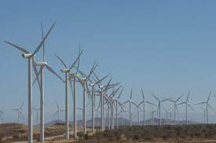
The Monitoring System
Wind turbine farm built in 2002.
Main Bearing+ Planetary Gear box + Gearbox + Generator

Slide 37
The Monitoring System
Monitoring system: 6 accelerometers and 1 sensor measuring the rotating speed
A10

Slide 38
Failures Modes
Crashing of the highspeed shaft of the gear box
Breaking of a teeth in the planetary stage
Misalignment between the generator and the gearbox shafts
Wearing of the rear bearing housing of the generator

Slide 39
Unplanned Maintenance
Gearbox-Generator Failure
Three months of turbine downtime
Intervention of expensive tools

Slide 40
Current Diagnostic Protocol
Data sent to the field operator and the diagnostic center
Filed operator & expert in vibration signal analysis isolate anomalies.
Expert knowledge required
e.g. considering thresholds on vibration levels at different rotating speeds of the highspeed shaft
Maintenance center assign a priority level (Green, Yellow, Red) for the intervention and plan the maintenance intervention

Slide 41
Example
Wearing of the rear bearing housing of the generator
Maintenance intervention
Vibration feature

Slide 42
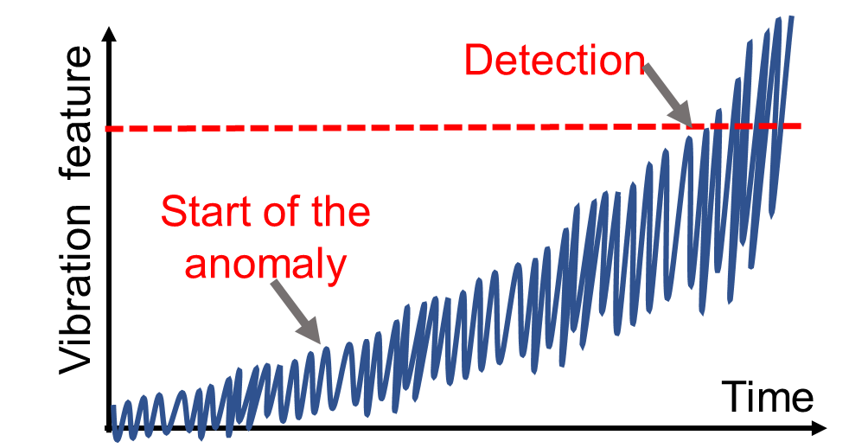
Limitation of the Current Approach
Detection and Diagnosis Delays
Human errors
Develop an “automatic” system for anomaly detection and diagnostic

Slide 43
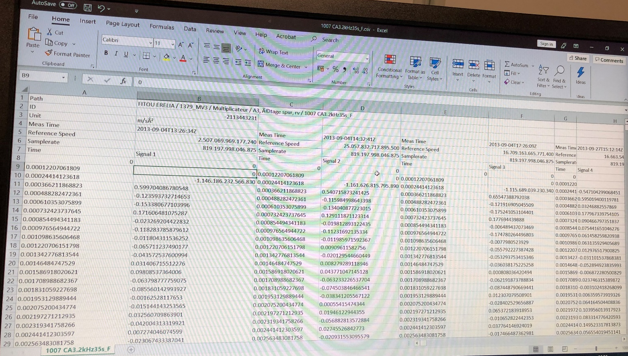
DESCRIPTION OF THE DATASET
A file contains 5 seconds of measurements of the accelerator at a frequency of 5.0kHz is collected each time at ‘Meas Time’ in the file.
Notes:
The raw dataset are stored in 1019 ZA5.0kHz5s.csv 5.60 GB for A6; 4.84GB for A5

Slide 44
Feature Extraction
High frequency sensor:
10 k observations
10 k observations
10 k observations
Window 1
Window 2
Window 3
…
Feature
Feature
Feature

Slide 45



Feature Extraction
Window 1
Window 2
Window 3
…
$${W_{1}=\left\{x_{i}\right\}}_{i=1}^{n_{w}}$$
$${W_{2}=\left\{x_{i}\right\}}_{i=n_{w}+1}^{{2n}_{w}}$$
$${W_{3}=\left\{x_{i}\right\}}_{i={2n}_{w}+1}^{{3n}_{w}}$$
Feature 1
Time t
Feature 2
Time t
…

Slide 46
Feature Extraction
Window 1
Window 2
Window 3
…
Feature 1
Time t
Feature 2
Time t
PART 2 Fault Detection
Normal
Abnormal

Slide 47
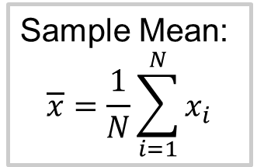
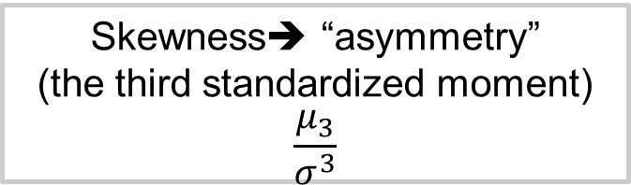
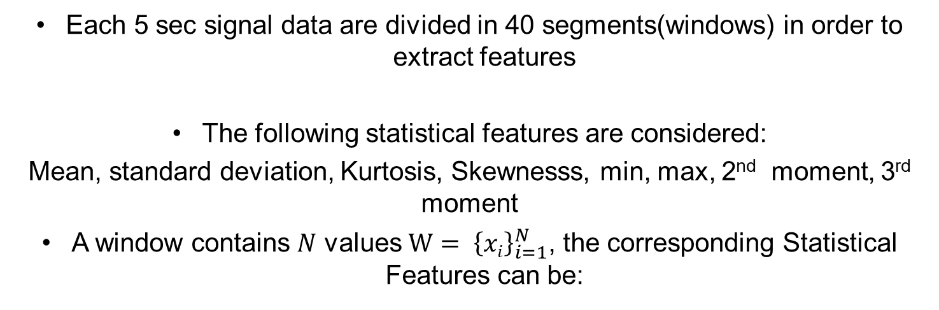
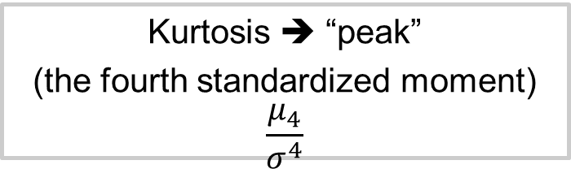
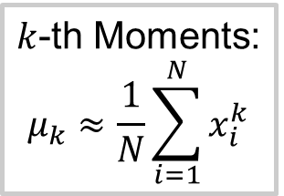
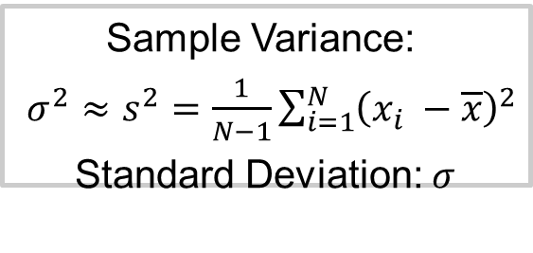
EXERCISE 1: FEATURE EXTRACTION
Each 5 sec signal data are divided in 40 segments(windows) in order to extract features
The following statistical features are considered:
Mean, standard deviation, Kurtosis, Skewnesss, min, max, 2nd moment, 3rd moment
A window contains $N$ values $W= {\left\{xi\right\}}_{i=1}^{N}$, the corresponding Statistical Features can be:
Sample Mean:
$$\overline{x}=\frac{1}{N}\sum_{i=1}^{N}{x_{i}}$$
Sample Variance:
$σ^{2}≈s^{2}=\frac{1}{N−1}\sum_{i=1}^{N}{{\left(x_{i} −\overline{x}\right)}^{2}}$
Standard Deviation: $σ$
$k$-th Moments:
$$μ_{k}≈\frac{1}{N}\sum_{i=1}^{N}{x_{i}^{k}}$$
Skewness➔ “asymmetry” (the third standardized moment)
$$\frac{μ_{3}}{σ^{3}}$$
Kurtosis ➔ “peak”
(the fourth standardized moment)
$$\frac{μ_{4}}{σ^{4}}$$

Slide 48
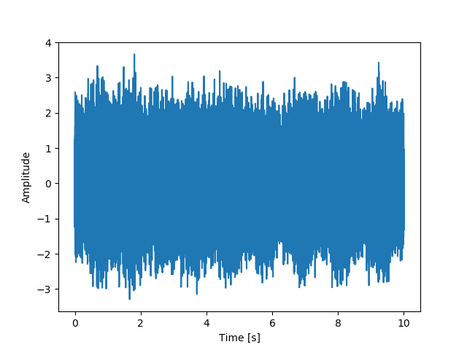
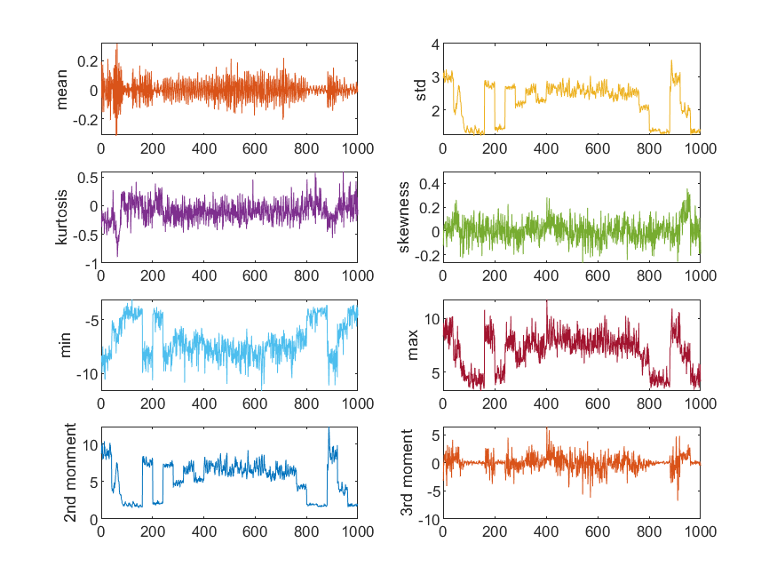
EXERCISE 1: FEATURE EXTRACTION
0
5

Slide 49
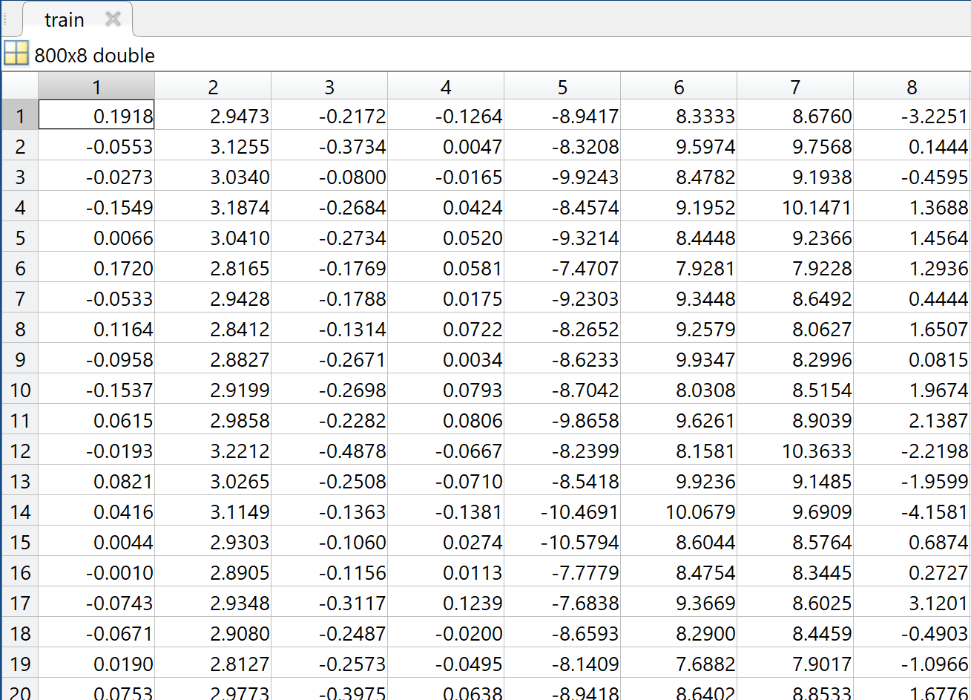
EXERCISE 1 DEVELOPMENT OF A FAULT DETECTION TOOL FOR A WIND TURBINE GENERATOR
Given:
The file ‘train.dat’ contains the features already extracted in norml condition
The file ‘validation.dat’ contains the features already extracted in normal condition
The file ‘validation_sim.dat’ contains the features in simulated abnormal condition
You are required to:
Develop a fault detection tool for the turbine generator;
Apply the developed tool to the data in the file “test.mat” Identify possible abnormal condition period.
Col 1 | Col 2 | Col 3 | Col 4 | Col 5 | Col 6 | Col 7 | Col 8
mean | std | kurtosiss | skewness | min | max | 2nd Moment | 3rd Moment

Slide 50
Homework 1
Fault detection with PCA
Optimize the PCA to achieve Accuracy and Robustness
Analyze test data
Use data and code in foldier ‘PCA’
Homework 2
Fault detection with AAKR on new data
Use data and code in foldier ‘second case study’

