Slide 1
Explaining the COVID-19 cases
in Montreal

Slide 2
Introduction
What are the most affected boroughs?
Why are they harder hit than the rest of the island?
Which borough is likely to be the least prepared for the next outbreak?

Slide 3
Data Acquisition
Santé Montréal website
https://santemontreal.qc.ca/en/public/coronavirus-covid-19/situation-of-the-coronavirus-covid-19-in-montreal
Ville de Montréal website
http://donnees.ville.montreal.qc.ca/dataset/polygones-arrondissements
Foursquare API
https://developer.foursquare.com/docs/build-with-foursquare/categories

Slide 4
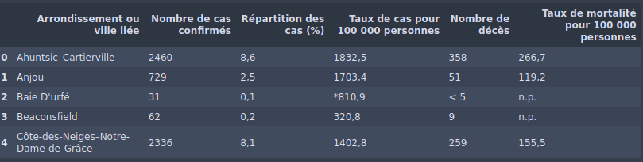
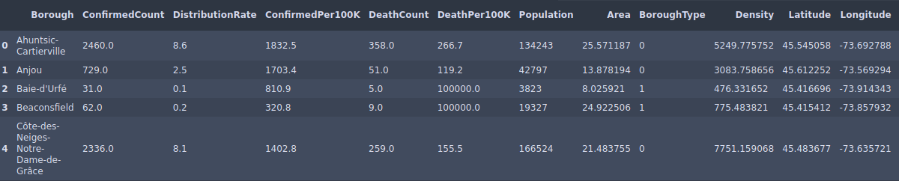
Data Cleaning / Wrangling

Slide 5
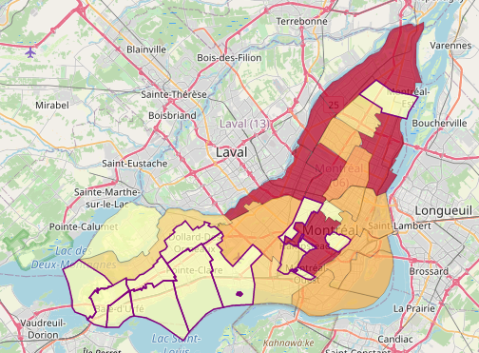
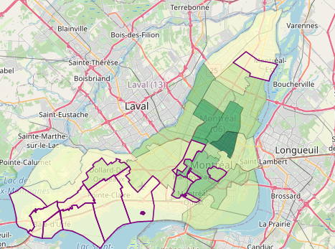
Exploratory Analysis
Confirmed cases
Population density

Slide 6
Exploratory Analysis
Are linked cities doing better?
Is it due to population density?
How many clinics does each borough have?

Slide 7
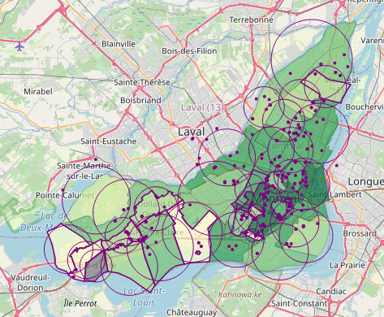
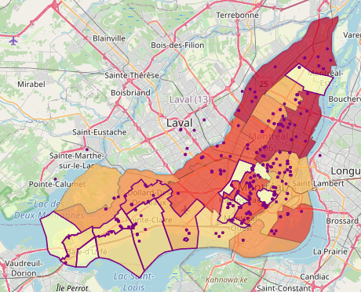
Exploratory Analysis
Clinics nearby
Patients per clinic

Slide 8
Results
Cluster 1: Boroughs to watch out for. These boroughs seem to be under control but exhibit a moderate-to-relatively-high patient per clinic ratio. This could become a bottleneck for testing and patient care if cases start going up all of the sudden.
Cluster 2: Very affected boroughs. High confirmed cases, likely due to population density and high patient per clinic ratio.
Cluster 3: Safe zones, low confirmed cases and deaths. Usually, high ratio of number of patients to clinic availability.

Slide 9
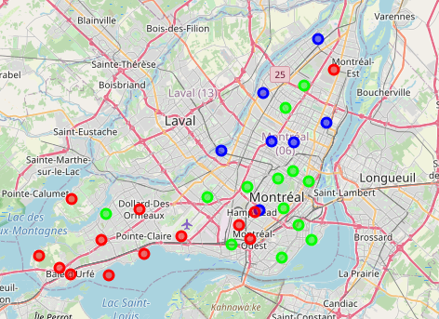
Results
Cluster 1: GREEN
Cluster 2: BLUE
Cluster 3: RED

Slide 10
Conclusion
Additional demographics data is required.
Linked cities (less densely populated areas) are managing it better.
More testing and intensive care clinics are needed in highly populated areas.

