Slide 1
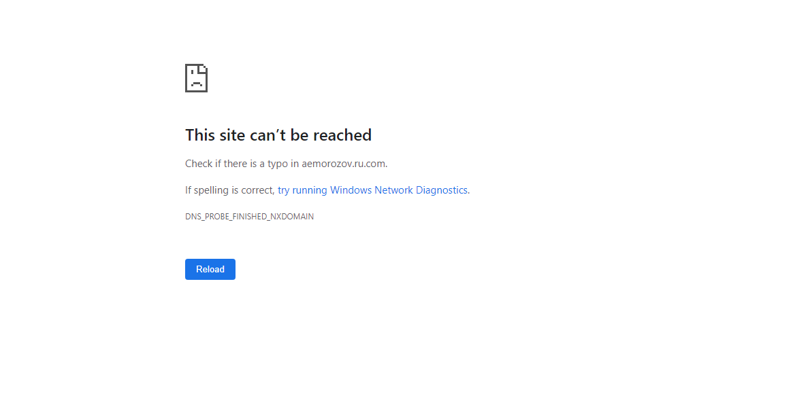

Slide 2
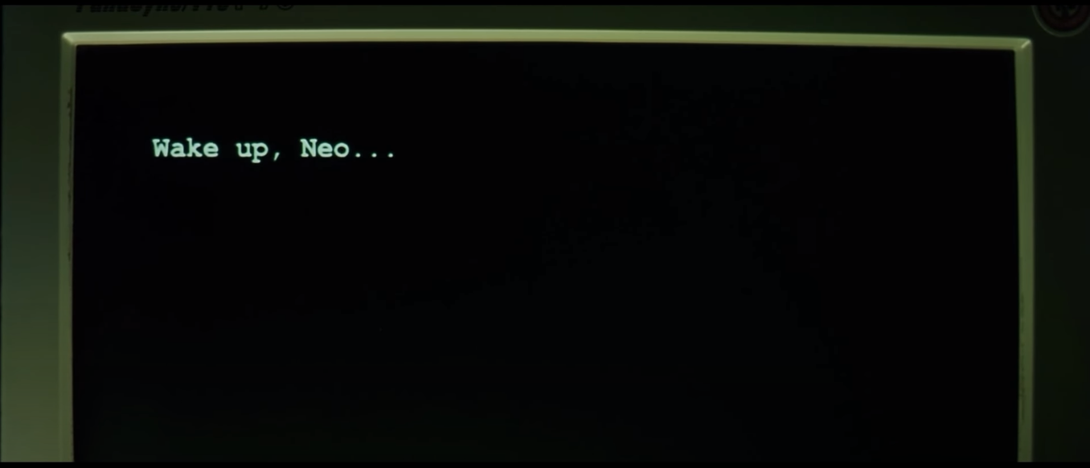
Wake up, Neo . . .
The Matrix has you . . .
Follow the white rabbit.

Slide 3
Knock, knock, Neo.
PS C:\Users\**взять данные пользователя**> Open

Slide 4
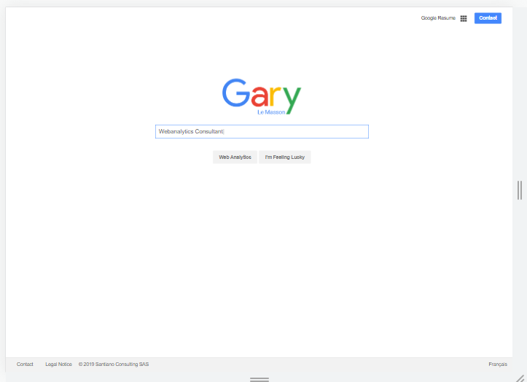

Slide 5


Slide 6
