Slide 1
Course Materials
DFT Compiler

Slide 2

Agenda
1
Understanding Scan Testing
2
DFTC User Interfaces
3
DFT for Clocks and Resets

Slide 3
Prerequisites
You should have experience in the following areas:
  Digital IC design
  Verilog or VHDL
  UNIX and X-Windows

Slide 4
Curriculum Flow
Physical Compiler 1
The Power of Tcl
The Power of Tcl
3 workshops
at 3 skill levels
The Power of Tcl
3 workshops
at 3 skill levels
Design Compiler 1
PrimeTime:
Advanced STA
Constraint Debugging
PrimeTime 1
You are here
PrimeTime:
Signal Integrity
DFT Compiler 1
ATPG with TetraMAX
Astro 1
Astro XTalk

Slide 5
Galaxy™ Design Platform
Synopsys Manufacturing Test Solution
Design Services
Test Synthesis
DFT Compiler™, SoCBIST
Unified DFT synthesis, verification and
test signoff
Significant test cost reduction
Design Compiler
Module
Compiler
Design-
Ware
Power
Compiler
DFT
Compiler
JupiterXT
Physical Compiler
Astro
Milkyway
ATPG
TetraMAX® ATPG, DSMTest, TenX
Leading-edge ATPG with comprehensive
support for delay related defects
PrimeTime SI
Star-RCXT
Hercules
Proteus
Notes:
Illustrated is an overview of the manufacturing test capabilities in the Galaxy Design Platform. It is a open integrated design platform with best in class tools centered around the Milkyway database. The consistent timing, common libraries and constraints from RTL to manufacturing ensures the highest QOR, rapid TTR and minimal risk to production.
All the test tools are benefited by this tight integration. DFT Compiler is the test synthesis product and SoCBIST is the logicBIST option to DFT Compiler. TetraMAX is Synopsys’ ATPG solution integrated into the Galaxy Test flow.
Design Compiler: logic synthesis
PrimeTime: static timing analysis
Physical Compiler: logic synthesis and placement combined
Astro: place and route
Star-RCXT: parasitic extraction
Hercules: layout versus netlist validation
Proteus: Design-for-Manufacturing (Optical Proximity Correction)

Slide 6

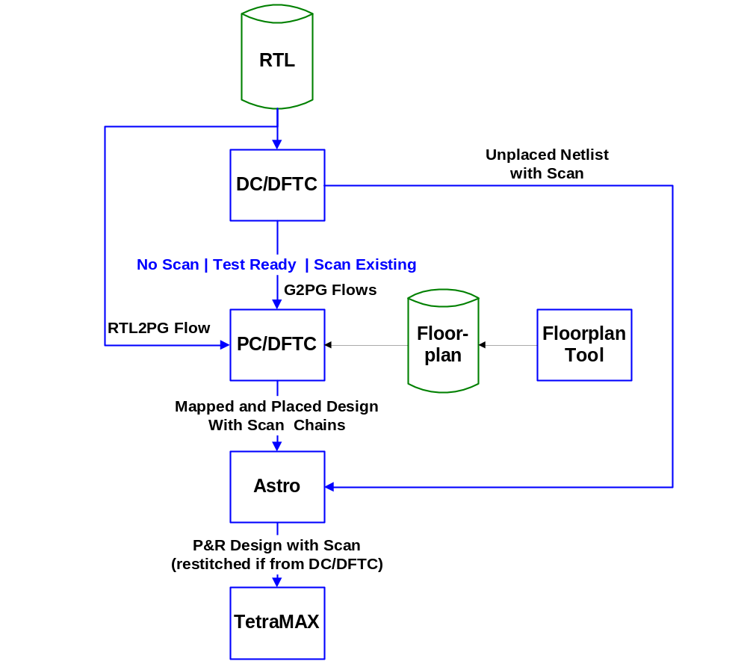
External DFT and ATPG Flows
Which flow(s) do you use now or plan to use in the future?

Slide 7
1-Pass Test Suite: Environment Overview
RTL Source
Design Compiler/Physical Compiler Environment
BSD Compiler
IEEE-1149.1
DFT Compiler
1-Pass Test Synthesis
Boundary Scan Netlist
BSDL
Test Vectors
Scan Design
(Gates)
Setup Info
STIL File
TetraMAX Environment
TetraMAX ATPG
Sequential Fault Simulator
Bridging Faults
IDDQ
Transition Delay
Path Delay

Slide 8

DFT Compiler TM 1-Pass Scan Synthesis
RTL Rule Checking: In-depth testability analysis
at RT Level:
  Helps designers write “test-friendly” RTL
AutoFix: Automatic correction of scan DRC violations:
  Removes unpredictability from back-end design process
    DFT synthesis
    Shadow LogicDFT synthesis
Scan Synthesis: Transparent scan implementation:
  Seamlessly optimize all design constraints — timing, area, power and test (logical and physical domain)
Hierarchical Scan Synthesis: Leverage existing flows and test models to gain multi-million gate capacity and improved performance (logical and physical domain)

Slide 9
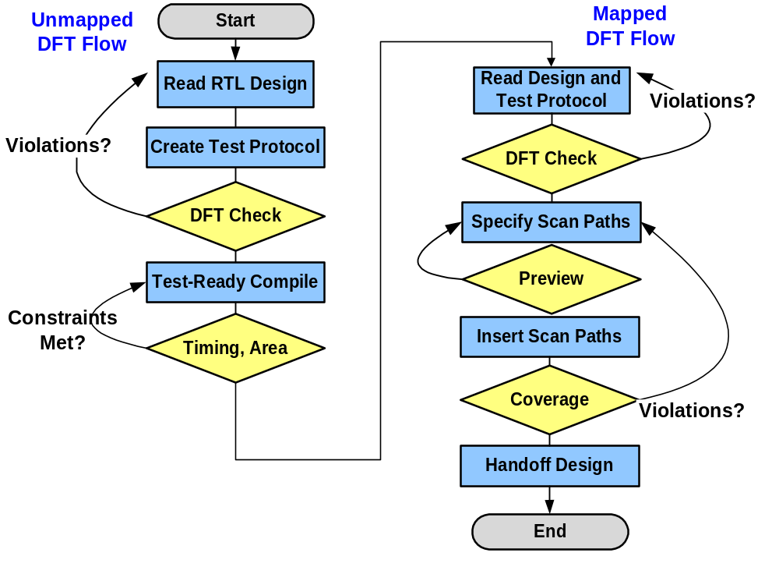
Top-Down Scan Insertion Flow
Notes:
Violations at RTL could be due to incomplete test protocol or test-unfriendly RTL or a combination of both.
If this RTL-level check is not done and the first DFT Check occurs at the gate-level on a mapped design or test-ready design, violations again could be due to incomplete protocol or test-unfriendly gates.
Violations after inserting scan paths means estimated test coverage is too low. This can be due to many factors such as not all flip-flops being on the scan paths, DFT violations reported earlier were ignored, or perhaps due to embedded memories or nonscan flip-flops sequential ATPG is required in TetraMAX.

Slide 10
DFT Compiler Test-Ready or Unmapped Flow
Test-Ready Flow
Start point is RTL (unmapped) design
IDEAL starting point
1-Pass Scan synthesis achieved by taking RTL directly to a scan synthesized design
RTL
Source
DFT Compiler
DFT synthesis, test drc, test coverage preview
Scan-inserted
Design
Testability
Reports

Slide 11
DFT Compiler Mapped Flow
Mapped Flow
Start point is gate-level (mapped) design with no scan circuitry yet
DFT Compiler performs scan cell replacement and scan chain synthesis
Gate-Level
Source
DFT Compiler
DFT synthesis, test drc, test coverage preview
Scan-inserted
Design
Testability
Reports

Slide 12
DFT Compiler Existing Scan Flow
Existing Scan Flow
Start point is gate-level design that already includes scan cells and chains
DFT Compiler performs scan chain extraction & test DRCs in preparation for TetraMAX ATPG
Gate-Level
Source
DFT Compiler
DFT synthesis, test drc, test coverage preview
Scan-inserted
Design
Testability
Reports
Notes:
If the existing scan design was created by DFTC, saved in .db format and no test attributes removed (3 important conditions), DFTC automatically recognized the chains it inserted earlier. If you were to bring in a Verilog or VHDL netlist with scan chains in it, however, there is nothing in the RTL to describe all the test attributes…so DFTC has to use your test protocol and defined test attributes to "extract" the scan chain from the netlist.

Slide 13
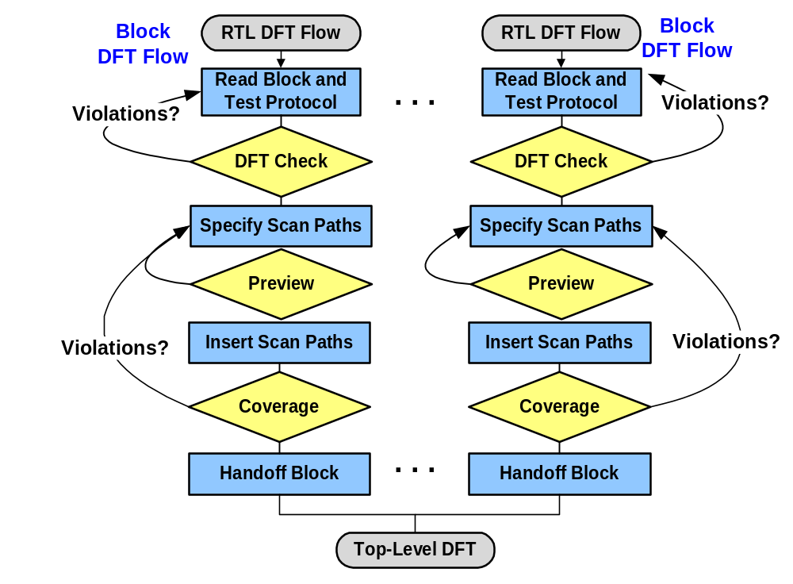
Bottom-Up Scan Insertion Flow
Notes:
Bottom-up scan insertion gives you greater manual control, but requires more effort.
Scan paths are inserted on a block-by-block basis, then integrated at the chip level.
Advantages:
Bottom-up insertion allows block designers to maintain ownership until block sign off.
You can ensure that your block still meets timing even after the scan paths are inserted.
Since insert_dft runs on individual blocks, overall run times are conveniently short.
Disadvantages:
Block level clock mixing and tristate disabling may need revision later at the chip level.
The bottom-up approach usually requires more planning and scripting by the design team.
Conclusion:
Use the approach that fits your SOC design flow—DFTC fully supports both techniques.
Mix top-down and bottom-up by inserting scan top-down into major subsystem blocks.

Slide 14
Scan Design
  Circuit is designed using pre-specified design rules.
  Test structure (hardware) is added to the verified design:
    Add a test control (TC) primary input.
    Replace flip-flops by scan flip-flops (SFF) and connect to form one or more shift registers in the test mode.
    Make input/output of each scan shift register controllable/observable from PI/PO.
  Use combinational ATPG to obtain tests for all testable faults in the combinational logic.
  Add shift register tests and convert ATPG tests into scan sequences for use in manufacturing test.

Slide 15
Scan Design Rules
Use only clocked D-type of flip-flops for all state variables.
At least one PI pin must be available for test; more pins, if available, can be used.
All clocks must be controlled from PIs.
Clocks must not feed data inputs of flip-flops.

Slide 16
Correcting a Rule Violation
All clocks must be controlled from PIs.
Comb.
logic
D1
Q
FF
Comb.
logic
D2
CK
Comb.
logic
Q
D1
D2
FF
Comb.
logic
CK

Slide 17
Scan Flip-Flop (SFF)
D
Master latch
Slave latch
TC
Logic
overhead
Q
MUX
SD
Q
CK
D flip-flop
CK
Master open
Slave open
t
TC
Normal mode, D selected
Scan mode, SD selected
t

Slide 18
Scan Based Test
ScanIn
ScanOut
Register
Register
Out
Combinational
Logic
A
Combinational
Logic
B
In

Slide 19
Circuit with Scan
Scan enable
MUX
FF
1
0
0
MUX
1
1
1
FF
Combinational logic
Combinational logic
Combinational logic
MUX
FF
MUX
FF
MUX
FF
MUX
FF
0
1
0
Scan Input
Clock
Scan Output

