Slide 1
word_{k}
word_{i}
word_{k}
word_{i}
word_{k}
word_{i}
word_{i}
word_{k}

Slide 2
word_{k}
word_{i}
word_{k}
word_{i}
Word vs. part-word test
Word vs. part-word test
vs.
vs.
word_{i}
word_{k}
word_{i}
Word vs. part-word test
Word vs. part-word test
word_{k}
vs.
vs.

Slide 3
word_{k}
word_{i}
word_{k}
word_{i}
Word vs. part-word test
Word vs. part-word test
vs.
vs.
1
2
word_{i}
word_{k}
word_{i}
Word vs. part-word test
Word vs. part-word test
word_{k}
vs.
vs.
3
4

Slide 4
s₁
word_{k}
s₂
s₃
word_{i}
word_{k}
s₃
s₁
s₂
s₃
s₃
word_{i}
Word vs. part-word test
s₂
s₁s₂s₃
Word vs. part-word test
s₂
s₃s₂
s₁
s₁
s₁
vs.
s₃
s₂
vs.
s₁
s₃
s₁s₂
1
2
s₁
s₂
s₃
s₁
word_{i}
word_{i}
s₂
s₃
word_{k}
s₁
s₁
s₁s₂s₃
s₂
Word vs. part-word test
word_{k}
Word vs. part-word test
s₁
s₂
s₃
s₃
s₃
s₁
s₁
s₂
vs.
vs.
s₂s₃
s₁
s₃
3
4

Slide 5
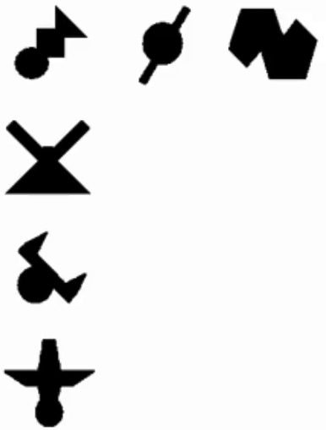

a
b

